Slide 2
Equivalent Fractions (1)
Diving
Label the fractions and identify the equivalents for a third.
One third is equivalent to two sixths.
= $\frac{\text{2}}{\text{6}}$
1
3
1
3
1
3
One third is equivalent to .
= $\frac{\text{2}}{\text{6}}$
1
3
1
3
1
3
1
6
1
6
1
6
1
6
1
6
1
6
1
3
1
3
2
6
One third is equivalent to .
= $\frac{\text{4}}{\text{12}}$
1
3
1
3
1
3
One third is equivalent to four twelfths.
= $\frac{\text{4}}{\text{12}}$
1
3
1
3
1
3
1
12
1
12
1
12
1
12
1
12
1
12
1
12
1
12
1
12
1
12
1
12
1
12
1
3
1
3
4
12

Slide 3
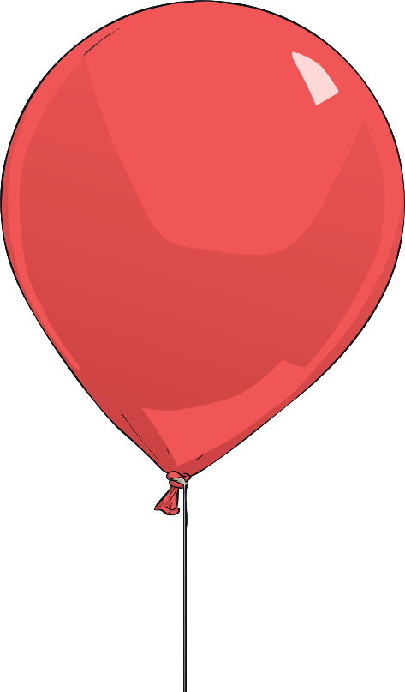
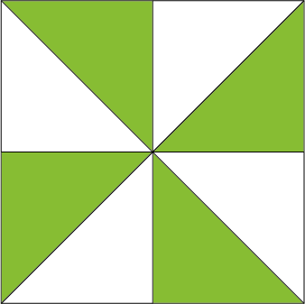
Equivalent Fractions (1)
Diving
Is the fraction equivalent to $?$
Complete the table.
1
2
Fraction | Is it equivalent to $\frac{\text{1}}{\text{2}}$ ? ✓ or ✗
1
2
✓ $\frac{\text{8}}{\text{16}}$ = $\frac{\text{1}}{\text{2}}$
8
16
1
2
✗
✓ $\frac{\text{8}}{\text{16}}$ = $\frac{\text{1}}{\text{2}}$
4
8
1
2

Slide 4
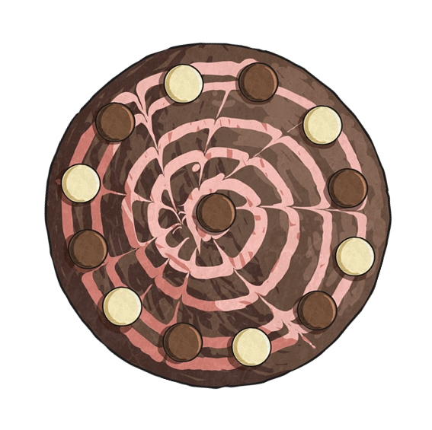
Equivalent Fractions (1)
Diving
Mrs Venn baked a cake.
Who ate the most?
Khem ate $\frac{\text{6}}{\text{12}}$ of the cake.
6
12
Carly ate $\frac{\text{1}}{\text{4}}$ .
Khem ate the most because $\frac{\text{6}}{\text{12}}$ is equivalent to $\frac{\text{1}}{\text{2}}$ or $\frac{\text{2}}{\text{4}}$ . Carly and Anya both ate the equivalent of $\frac{\text{1}}{\text{4}}$ each.
1
4
6
12
1
2
2
4
Anya ate $\frac{\text{3}}{\text{12}}$ of the cake.
3
12
1
4

Slide 5
Equivalent Fractions (1)
Deeper
Which one is the odd one out and why?
A
B
A shows $\frac{\text{3}}{\text{9}}$ , B shows $\frac{\text{1}}{\text{3}}$ and D shows $\frac{\text{6}}{\text{18}}$.
All of these fractions are equivalent to $\frac{\text{1}}{\text{3}}$ . C is the odd one out because it shows $\frac{\text{6}}{\text{12}}$ which is equivalent to $\frac{\text{1}}{\text{2}}$ and greater than the rest.
3
9
1
3
6
18
1
3
C
D
6
12
1
2

