Slide 1
Match the Fronted Adverbial
Match the fronted adverbials to the sentence they fit best with. Write them out on a piece of paper or print it out and join them with a line.
Almost unbelievably,
supermarkets do not stock products from particular brands.
Bravely,
Samurai warriors carried their swords into battle.
Sometimes,
the car screeched to a halt.
Immediately,
the team scored a goal in the final minute.
Below the sea,
a variety of previously unseen creatures are being discovered.

Slide 2
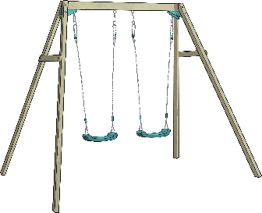
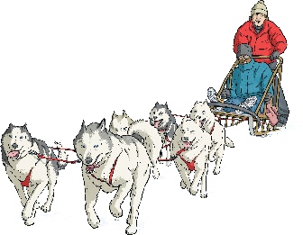
Add the Fronted Adverbial
Can you add appropriate fronted adverbials in these sentences? Write them on your paper.
, Kerry relaxed on the beach.
, the swings were empty.
, Jemima watered the flowers in her garden.
, Maya and Suki walked around the maze.
, the huskies pulled the sledge.

