Slide 1
Maths
Multiplication and Division
Year One
Maths | Year 2 | Multiplication and Division | Solve Multiplication and Division Facts | Lesson 2 of 5: Dividing by 2

Slide 3
Aim
To recall and use division facts for the 2 times table.
Success Criteria
I can count in 2s.
I can keep track of my count on my fingers.
I can recall division facts up to 24 ÷ 2.

Slide 4
Groups of 2
Count the objects and work out how many groups of 2 you can make each time.

Slide 5
Groups of 2
12 is 6 groups of 2.

Slide 6
Groups of 2
2 is 1 group of 2.

Slide 7
Groups of 2
6 is 3 groups of 2.

Slide 8
Groups of 2
20 is 10 groups of 2.

Slide 9
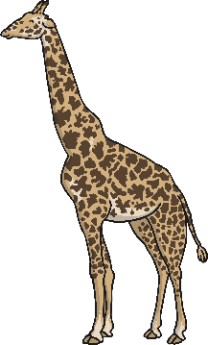
Groups of 2
4 is 2 groups of 2.

Slide 10
Groups of 2
0 is 0 groups of 2.

Slide 11
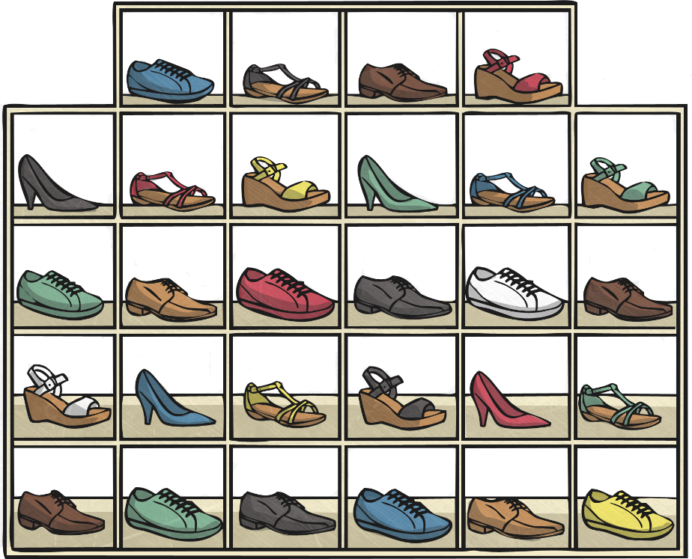
Shelby’s Shoes
Welcome to Shelby’s shoes. Can you see anything you like?

Slide 12
Shelby’s Shoes
?
?
This customer has bought 2 shoes.
I can put 2 shoes in each box.
How many boxes do I need?
?

Slide 13
Shelby’s Shoes
We could say:
There is 1 group of 2 in 2 2 is 1 group of 2
2 divided by 2 is 1 2 ÷ 2 = 1
On a number line, we jump in 2s until we reach 2!
This is one jump of 2:
2
0
1
2
3
4
5
6
7
8
9
10

Slide 14
Shelby’s Shoes
?
?
This customer has bought 4 shoes.
I can put 2 shoes in each box.
How many boxes do I need?
?

Slide 15
Shelby’s Shoes
We could say:
There are 2 groups of 2 in 4 4 is 2 groups of 2
4 divided by 2 is 2 4 ÷ 2 = 2
On a number line, we jump in 2s until we reach 4!
This is 2 jumps.
2
2
0
1
2
3
4
5
6
7
8
9
10

Slide 16
Shelby’s Shoes
?
?
This customer has bought 8 shoes.
I can put 2 shoes in each box.
How many boxes do I need?
?

Slide 17
Shelby’s Shoes
We could say:
There are 4 groups of 2 in 8 8 is 4 groups of 2
8 divided by 2 is 4 8 ÷ 2 = 4
On a number line, we jump in 2s until we reach 8!
This is 4 jumps.
2
2
2
2
0
1
2
3
4
5
6
7
8
9
10

Slide 18
Shelby’s Shoes
?
?
This customer has bought 12 shoes.
I can put 2 shoes in each box.
How many boxes do I need?
?

Slide 19
Dividing by 2
We could say:
There are 6 groups of 2 in 12 12 is 6 groups of 2
12 divided by 2 is 6 12 ÷ 2 = 6
On a number line, we jump in 2s until we reach 12!
This is 6 jumps.
2
2
2
2
2
2
0
1
2
3
4
5
6
7
8
9
10
11
12
13
14
15
16
17
18
19
20
21
22
23
24

Slide 20
Shelby’s Shoes
?
?
This customer has bought 16 shoes.
I can put 2 shoes in each box.
How many boxes do I need?
?

Slide 21
Dividing by 2
We could say:
There are 8 groups of 2 in 16 16 is 8 groups of 2
16 divided by 2 is 8 16 ÷ 2 = 8
On a number line, we jump in 2s until we reach 16!
This is 8 jumps.
2
2
2
2
2
2
2
2
0
1
2
3
4
5
6
7
8
9
10
11
12
13
14
15
16
17
18
19
20
21
22
23
24

Slide 22
Shelby’s Shoes
?
?
This customer has bought 20 shoes.
I can put 2 shoes in each box.
How many boxes do I need?
?

Slide 23
Dividing by 2
We could say:
There are 10 groups of 2 in 20 20 is 10 groups of 2
20 divided by 2 is 10 20 ÷ 2 = 10
On a number line, we jump in 2s until we reach 20!
This is 10 jumps.
2
2
2
2
2
2
2
2
2
2
0
1
2
3
4
5
6
7
8
9
10
11
12
13
14
15
16
17
18
19
20
21
22
23
24

Slide 24
Shelby’s Shoes
?
?
This customer has bought 24 shoes.
I can put 2 shoes in each box.
How many boxes do I need?
?

Slide 25
Dividing by 2
We could say:
There are 12 groups of 2 in 24 24 is 12 groups of 2
24 divided by 2 is 12 24 ÷ 2 = 12
On a number line, we jump in 2s until we reach 24!
This is 12 jumps.
2
2
2
2
2
2
2
2
2
2
2
2
0
1
2
3
4
5
6
7
8
9
10
11
12
13
14
15
16
17
18
19
20
21
22
23
24

Slide 26
Dividing by 2
2 divided by 2 is 1
14 divided by 2 is 7
4 divided by 2 is 2
16 divided by 2 is 8
6 divided by 2 is 3
18 divided by 2 is 9
8 divided by 2 is 4
20 divided by 2 is 10
10 divided by 2 is 5
22 divided by 2 is 11
12 divided by 2 is 6
24 divided by 2 is 12

Slide 27
Aim
To recall and use division facts for the 2 times table.
Success Criteria
I can count in 2s.
I can keep track of my count on my fingers.
I can recall division facts up to 24 ÷ 2.

