Slide 1
Maths
Multiplication and Division
Year One
Maths | Year 2 | Multiplication and Division | Solve Multiplication and Division Facts | Lesson 4 of 5: Super Sundaes

Slide 3
Aim
I can recall and use division facts for the 5 times table.
Success Criteria
I can count in 5s, stopping at a given point.
I can keep track of my count on my fingers.
I can recall division facts up to 60 ÷ 5.

Slide 4
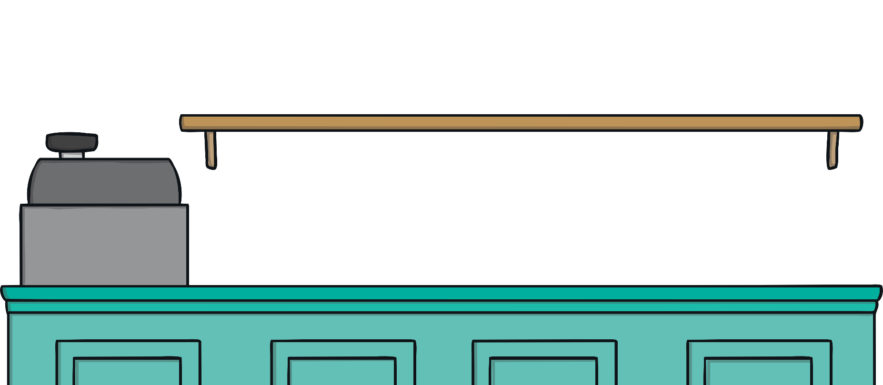
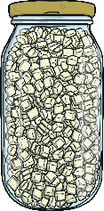
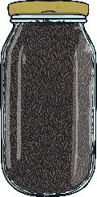
Toppings
Alice and her friends are at toppings café.
They are choosing toppings for their hot chocolates.
How many toppings do they choose?
All toppings 5p.

Slide 5
Alice’s Toppings
?
?
How much does Alice spend on toppings?
?
Alice spends 20p on toppings.
How many toppings can she buy for 20p?

Slide 6
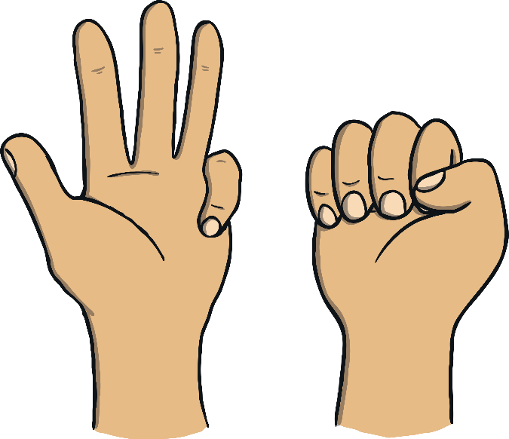
Alice’s Toppings
Let’s count to 20 in 5s. Keep track of your count on your fingers.
10
15
20
5
1
2
3
4
0
1
2
3
4
5
6
7
8
9
10
11
12
13
14
15
16
17
18
19
20
21
22
23
24
There are 4 5s in 20. 20 divided by 5 is 4. 20 ÷ 5 = 4

Slide 7
Aman’s Toppings
?
?
Aman spent 35p. How many toppings did he buy?
Can you explain how you worked it out?
?
All toppings 5p.

Slide 8
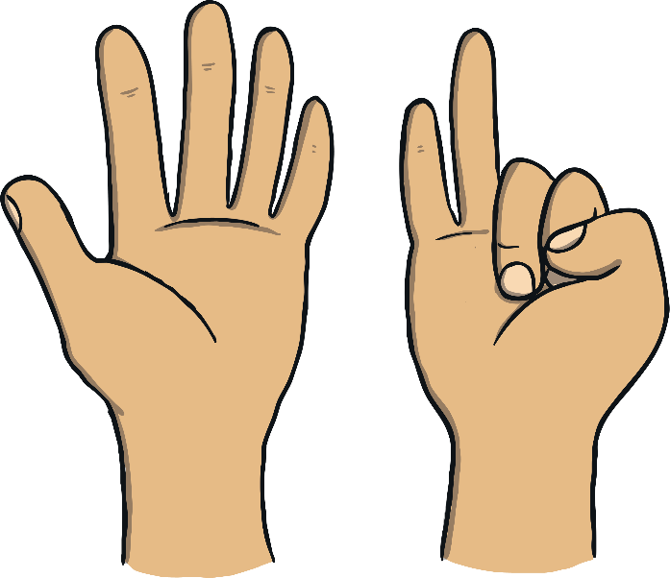
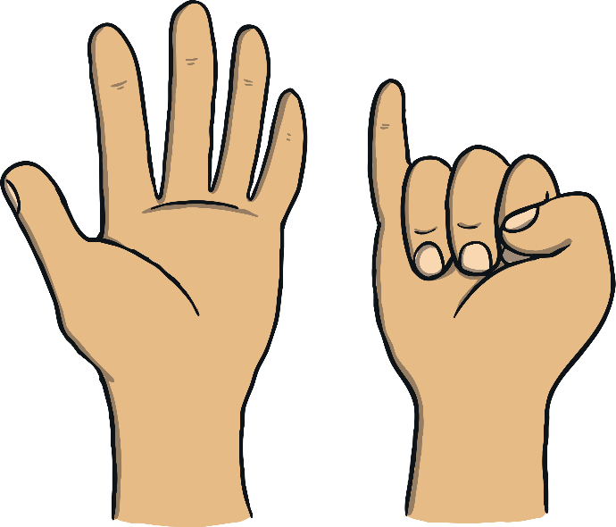
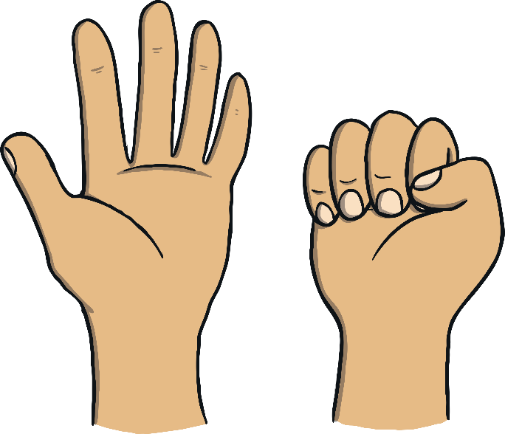
Aman’s Toppings
Let’s count to 35 in 5s. Keep track of your count on your fingers.
10
15
20
35
25
30
5
1
2
3
4
5
6
7
0
1
2
3
4
5
6
7
8
9
10
11
12
13
14
15
16
17
18
19
20
21
22
23
24
25
26
27
28
29
30
31
32
33
34
35
There are 7 lots of 5 in 35. 35 divided by 5 is 7. 35 ÷ 7 = 5

Slide 9
Jin’s Toppings
?
?
Jin spent 50p. How many toppings did he buy?
How did you work it out?
Can you write a division sentence for him?
?
All toppings 5p.

Slide 10
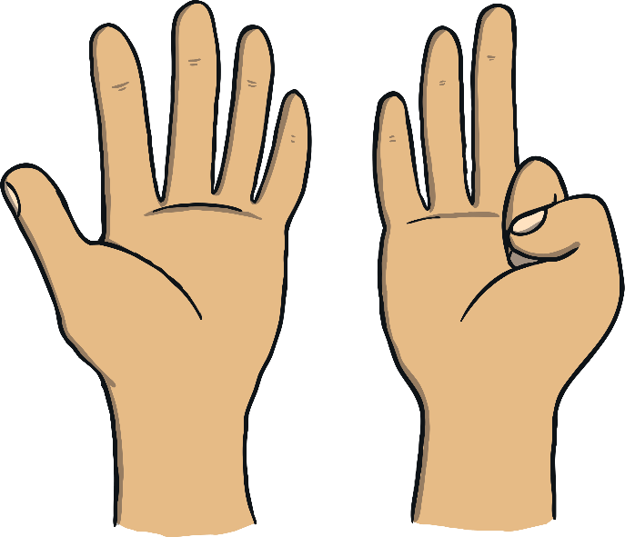
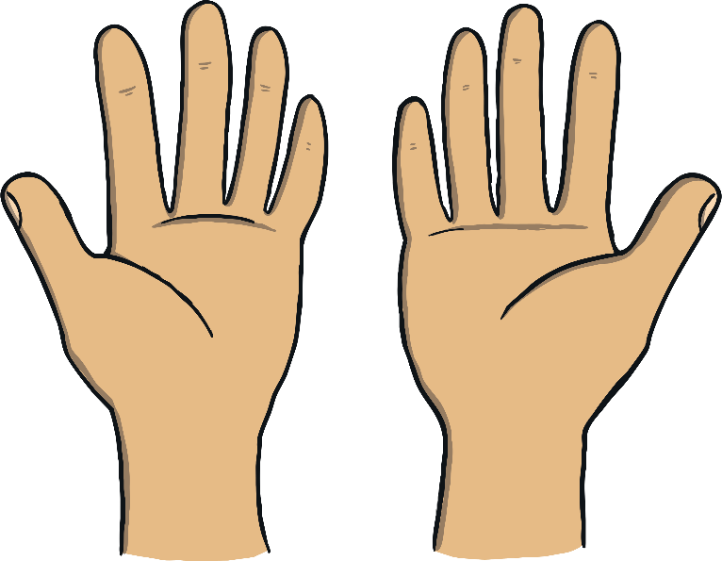
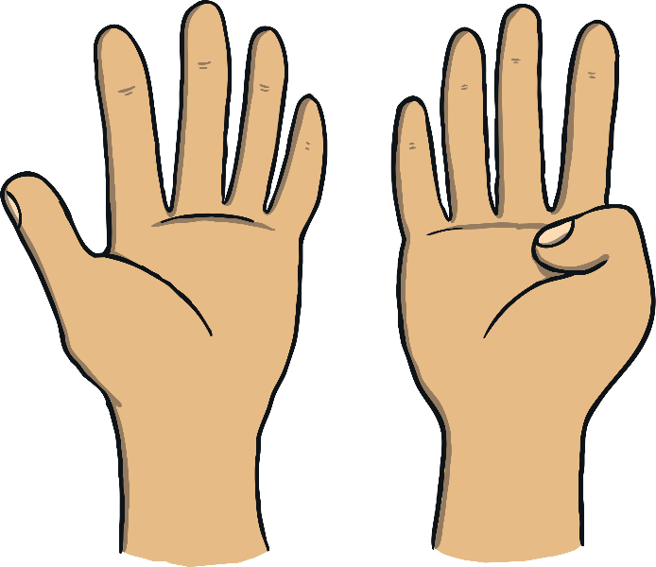
Aman’s Toppings
Let’s count to 50 in 5s. Keep track of your count on your fingers.
10
15
20
35
40
45
25
30
5
50
1
2
3
4
5
6
7
8
9
10
0
5
10
15
20
25
30
35
40
45
50
There are 10 lots of 5 in 50. 50 divided by 5 is 10. 50 ÷ 5 = 10

Slide 11
Write It Down!
Write 4 numbers between 1 and 12 on your whiteboard. If you have the answer to the division sentence that I choose, you can cross it off.
First to cross off all 4 numbers is the winner!
15 ÷ 5 =
3
60 ÷ 5 =
12
50 ÷ 5 =
10
5 ÷ 5 =
1
10 ÷ 5 =
2
25 ÷ 5 =
5
55 ÷ 5 =
11
40 ÷ 5 =
8
20 ÷ 5 =
4
30 ÷ 5 =
6
45 ÷ 5 =
9
35 ÷ 5 =
7

Slide 12
Aim
I can recall and use division facts for the 5 times table.
Success Criteria
I can count in 5s, stopping at a given point.
I can keep track of my count on my fingers.
I can recall division facts up to 60 ÷ 5.

