Slide 2
Can you name the shape?
Click here to reveal the answer
cone

Slide 3
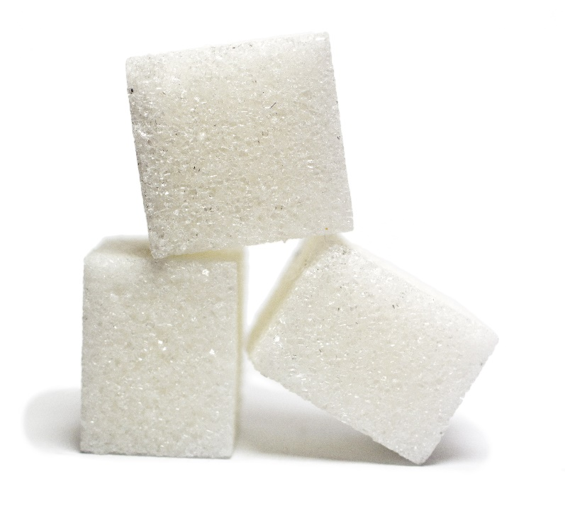
Can you name the shape?
Click here to reveal the answer
cube

Slide 4
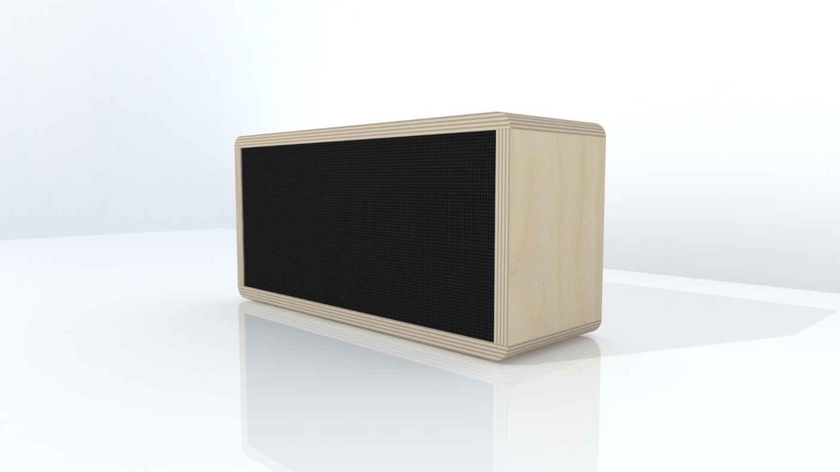
Can you name the shape?
Click here to reveal the answer
cuboid

Slide 5
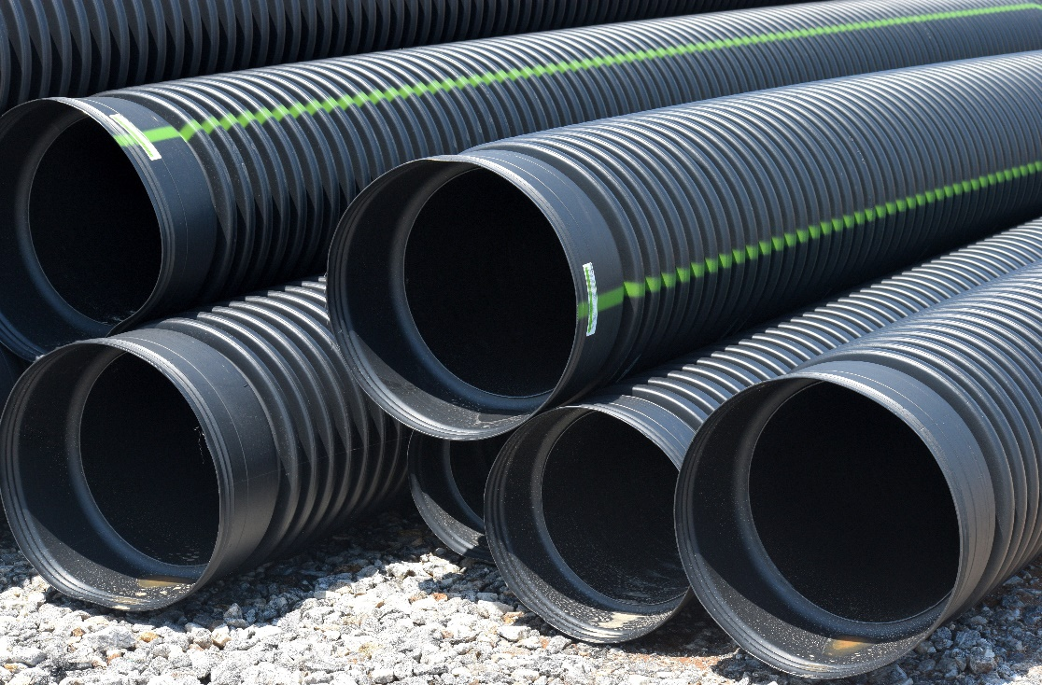
Can you name the shape?
Click here to reveal the answer
cylinder

Slide 6
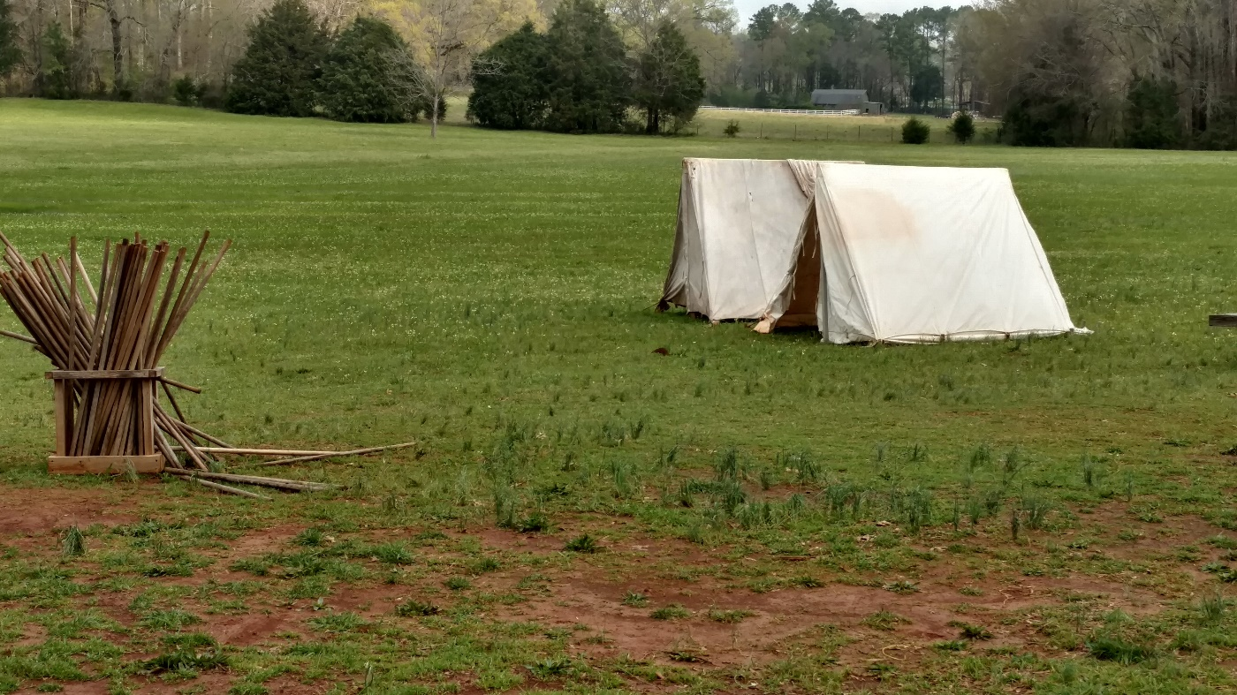
Can you name the shape?
Click here to reveal the answer
triangular prism

Slide 7
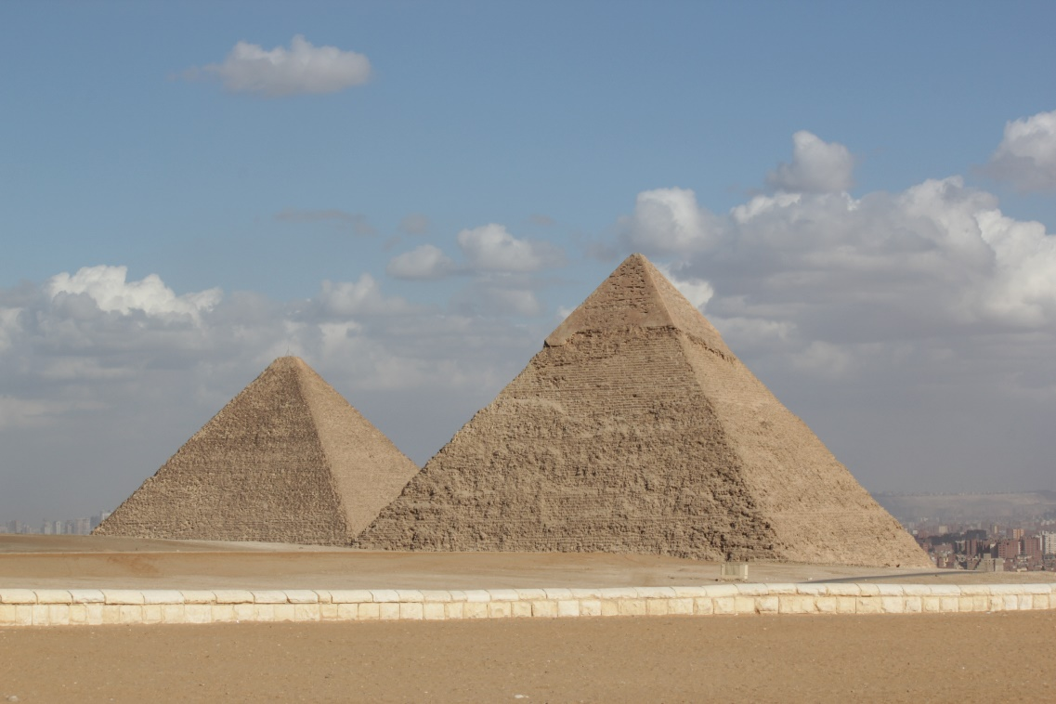
Can you name the shape?
Click here to reveal the answer
pyramid

Slide 8
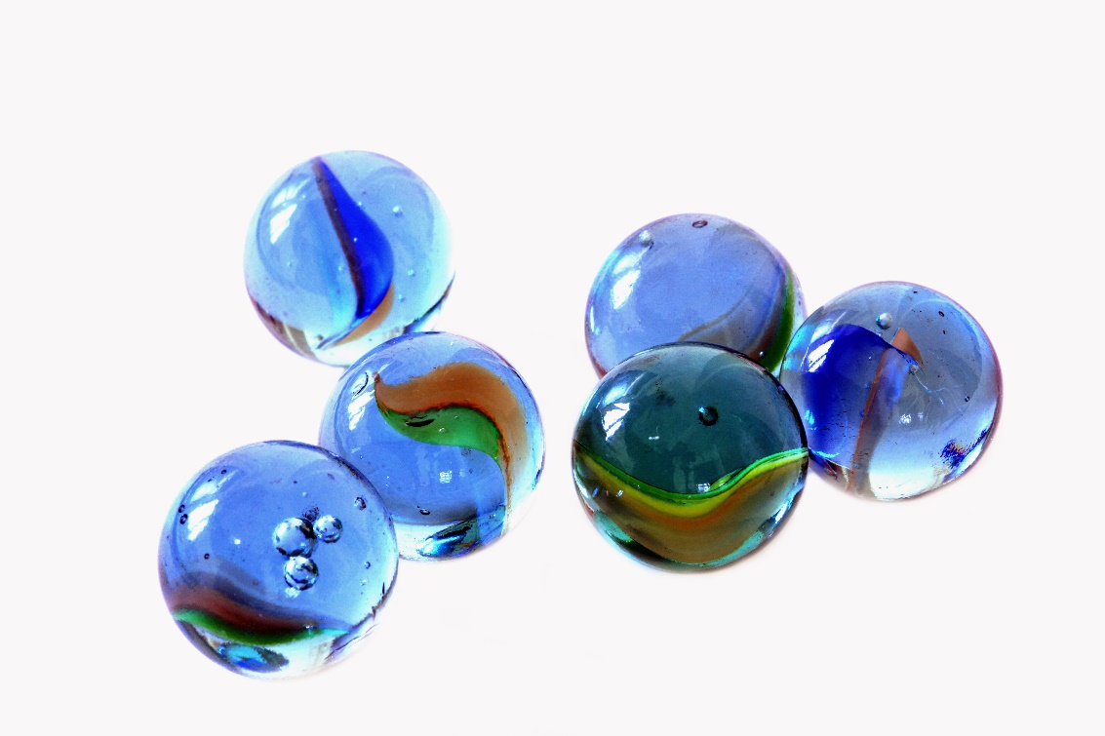
Can you name the shape?
Click here to reveal the answer
sphere

