Slide 1
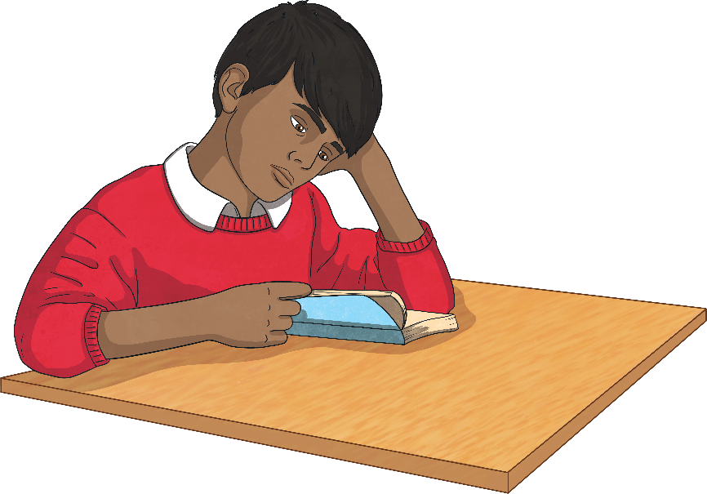
First Person
If writing a story in the first person, write as though you are a character inside the story.
Other pronouns used in the first person:
my
me
mine
we
our
ours
us
Describe how you feel and what you are doing or have done.
Use the pronoun ‘I’
For example:
Last year, I went to Spain with my family. I loved it!

Slide 2
Second Person
If writing in the second person, talk to the reader directly.
Other pronouns used in the second person:
your
yours
Use the pronoun ‘you’.
The second person is used a lot non-fiction as well as in fiction texts.
For example:
Before you begin, make sure that you have all of the tools listed above.

Slide 3
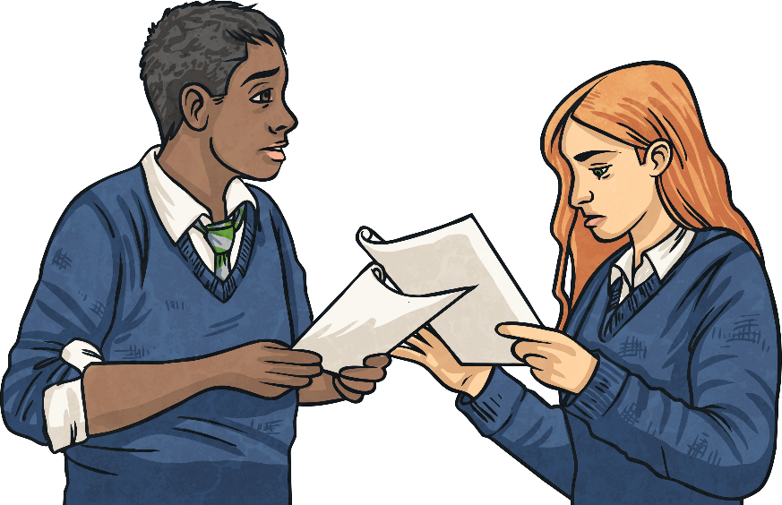
Third Person
If you are writing in the third person, you write about other people or characters.
Other pronouns used in the third person:
her/hers
his
theirs
You use the character’s name or pronouns such as ‘he’, ‘she’ and ‘they’.
For example:
Michelle sped off at top speed and was soon in first place. She couldn’t believe that she was going to win!

