Slide 1
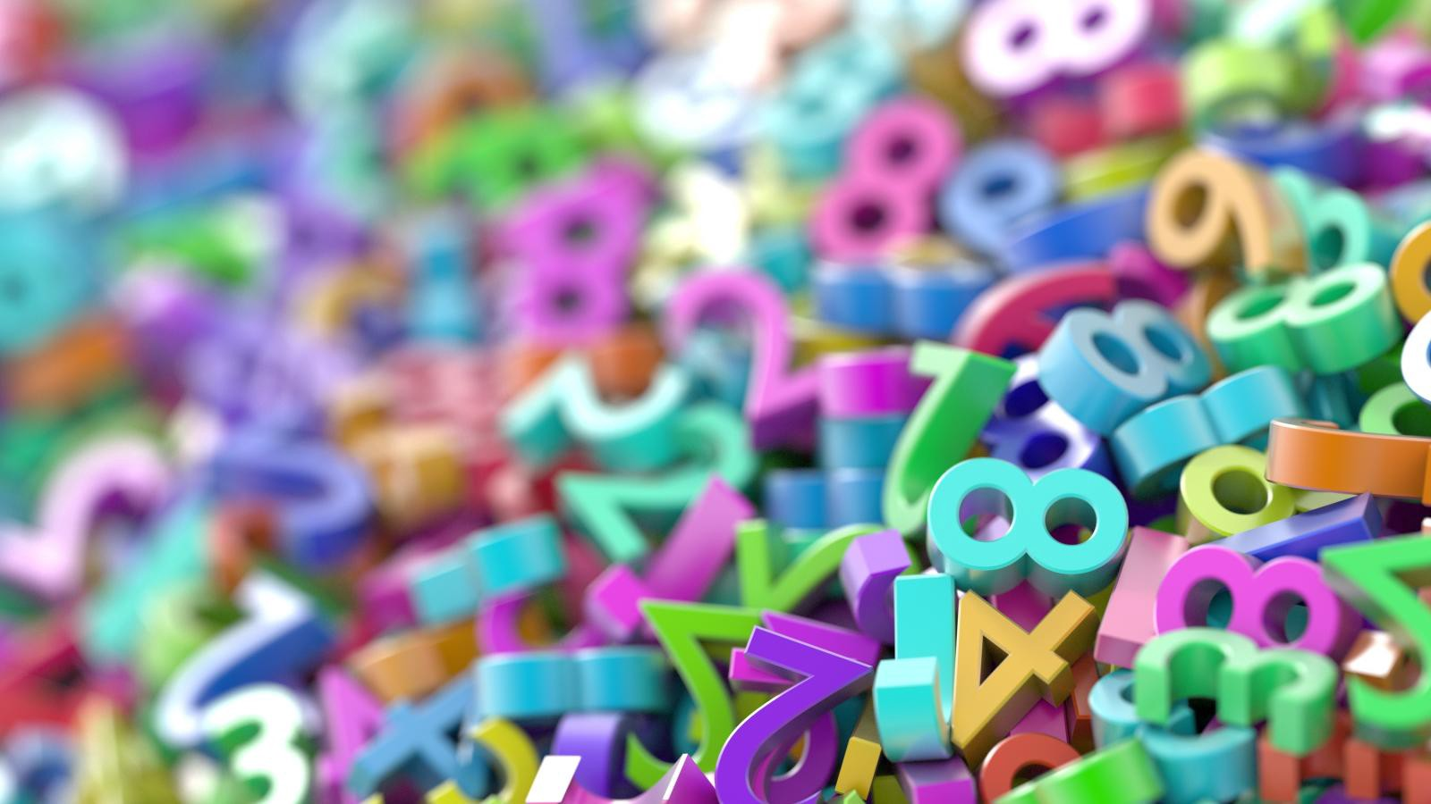
Divide a One-Digit Number by 10
(Make sure you play the slide show)

Slide 2
Draw a grid like this on your whiteboard/chalkboard/piece of scrap paper:
10s
1s
10ths
100ths

Slide 3
We’re going to do a bit of revision first...
(The questions ask you to draw counters but you could actually use real counters or coins if you’ve got them)

Slide 4
On the grid, draw counters to represent 2.1.
Click to reveal the answer.
10s
1s
10ths
100ths
2 1s in the 1s column
1
1 10th in the 10ths column
2

Slide 5
Draw counters to show the number 1.3
Click to reveal the answer
10s
1s
10ths
100ths
1 1 in the 1s column
3 10ths in the 10ths column
1
3

Slide 6
Last one! Draw counters to show the number 22.4
Click to reveal the answer.
10s
1s
10ths
100ths
4 10ths
2 10s
2 1s
2
2
4

Slide 7
Now we’re going to revise dividing by 10.

Slide 8
We did this with whole numbers in the Autumn term so cast your minds back…

Slide 9
If I told you to work out 200 ÷ 10 you would get 20. This is because you know that if your number ends in 0, you can take one zero away to divide it by 10.
Let’s look at why that works…

Slide 10
Let’s put the number 200 into this grid…
100s | 10s | 1s | 10ths | 100ths
2
0
0

Slide 11
Now when I divide it by 10, I’m not actually taking the zero away. All the digits in the number move one space to the right so the zero on the end gets pushed to the other side of the decimal point. Like this…
100s | 10s | 1s | 10ths | 100ths
2
0
0
And as you can see, the answer is 20

Slide 12
So what happens if my number does not end with a zero?
Let’s find out…

Slide 13
This time, we’re going to put the number 2 in the grid.
10s | 1s | 10ths | 100ths
2

Slide 14
Now we’re going to divide it by 10 by moving the digit one space to the right…
10s | 1s | 10ths | 100ths
2
0
That’s right! You can never have an empty ones column, so we have to fill it up with a zero!
Can you spot the mistake?
So the answer is 0.2
Let’s have another go…

Slide 15
We’re going to do the same thing again but with the number 3.
10s | 1s | 10ths | 100ths
3
Try to do it on your own whiteboard first before you check the answer on the next slide.

Slide 16
Now we’re going to divide it by 10 by moving the digit one space to the right…
10s | 1s | 10ths | 100ths
3
0
That’s right! You can never have an empty ones column, so we have to fill it up with a zero!
Can you spot the mistake?
So the answer is 0.3
Let’s have another go…

Slide 17
Now give these questions a go. Use your whiteboard to work them out if you need to and then write the answers in your maths book. Once you’ve done all of them, click to reveal the answers.
0.9
5) 9 ÷ 10 =
0.4
1) 4 ÷ 10 =
0.7
0.5
6) 7 ÷ 10 =
2) 5 ÷ 10 =
0.1
3) 1 ÷ 10 =
7) 8 ÷ 10 =
0.8
0.6
4) 6 ÷ 10 =

