Slide 2
Diving into Mastery Guidance for Educators
Each activity sheet is split into three sections, diving, deeper and deepest, which are represented by the following icons:
These carefully designed activities take your children through a learning journey, initially ensuring they are fluent with the key concept being taught; then applying this to a range of reasoning and problem-solving activities.
These sheets might not necessarily be used in a linear way. Some children might begin at the ‘Deeper’ section and in fact, others may ‘dive straight in’ to the ‘Deepest’ section if they have already mastered the skill and are applying this to show their depth of understanding.
Diving
Deeper
Deepest

Slide 3
Aim
Count up and down in hundredths; recognise that hundredths arise when dividing an object by one hundred and dividing tenths by ten.

Slide 4
Hundredths
Diving
Fill in the missing hundredths to complete the number lines.
Find the equivalents.
30
3
=
0
1
2
3
4
5
10
100
100
100
100
100
100
70
7
=
10
100
37
39
42
45
47
100
100
100
4
100
100
=
40
10
100

Slide 5
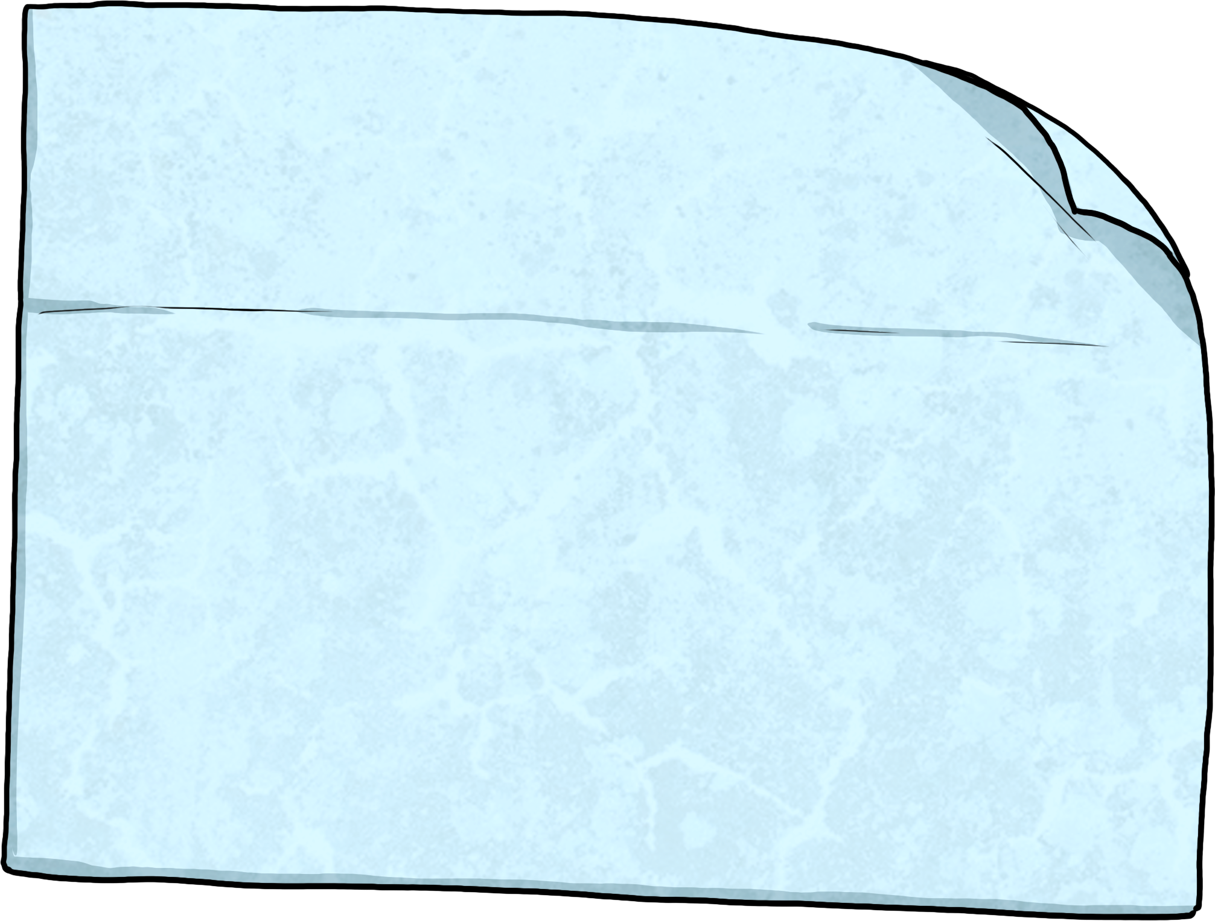
Hundredths
Diving
Fill in the missing tenths or hundredths to complete the sequence.
36
37
38
39
4
41
42
100
100
100
100
10
100
100
Which fractions do you think could be shown by the arrows on the number line?
30
6
32
Do you think would be a correct answer here? What about ? Why?
100
10
100
50
29
100
100

Slide 6
Hundredths
Deeper
Cara has been writing equivalents between tenths and hundredths. Tick or cross each statement. If there is a mistake, write the correct answer.
Equivalents
✓ or ×
Correction
8
80
=
✓
10
100
87
=
8
and
7
×
87
8
and
7
100
100
100
=
100
100
10
1
and
83
=
93
✓
10
100
100
79
=
7
and
9
79
7
and
9
×
=
100
100
100
10
100
10

Slide 7
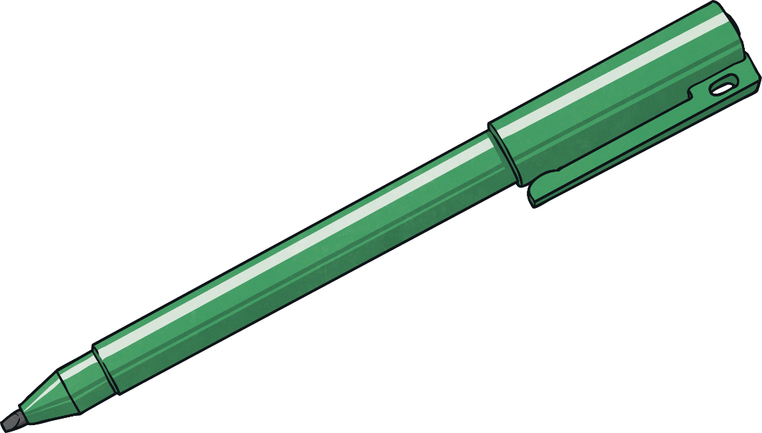
Hundredths
Deepest
Write a different digit in each box to complete the statement correctly.
20
2
<
40
4
>
38
=
=
100
10
100
10
100
There are lots of different ways to complete this correctly. Here is one example:

Slide 8
Hundredths
Deepest
Use these fractions to make comparing statements. One is done for you.
There are lots of possible answers. Here is one example:
40
50
 | =
 | >
 | <
 | =
100
100
60
4
and
2
100
10
10
37
92
100
100
9
and
10
38
4
100
10
79
79
and
2
39
100
100
10
10
40
and
4
8
7
100
10
10
10

Slide 9
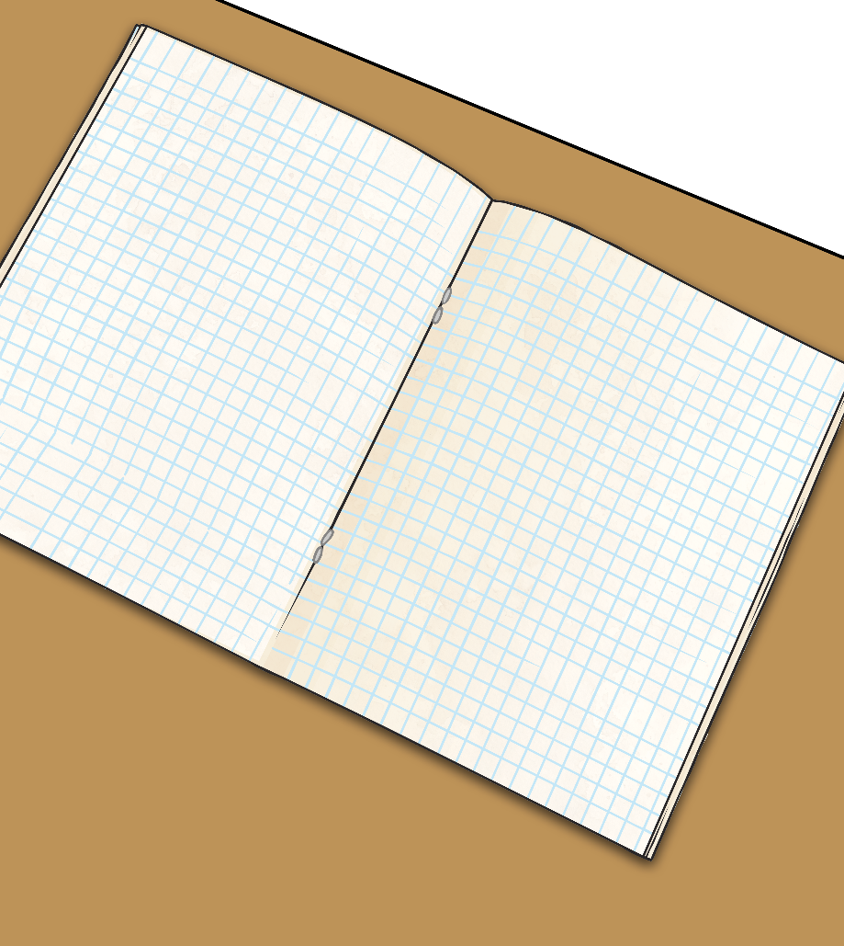
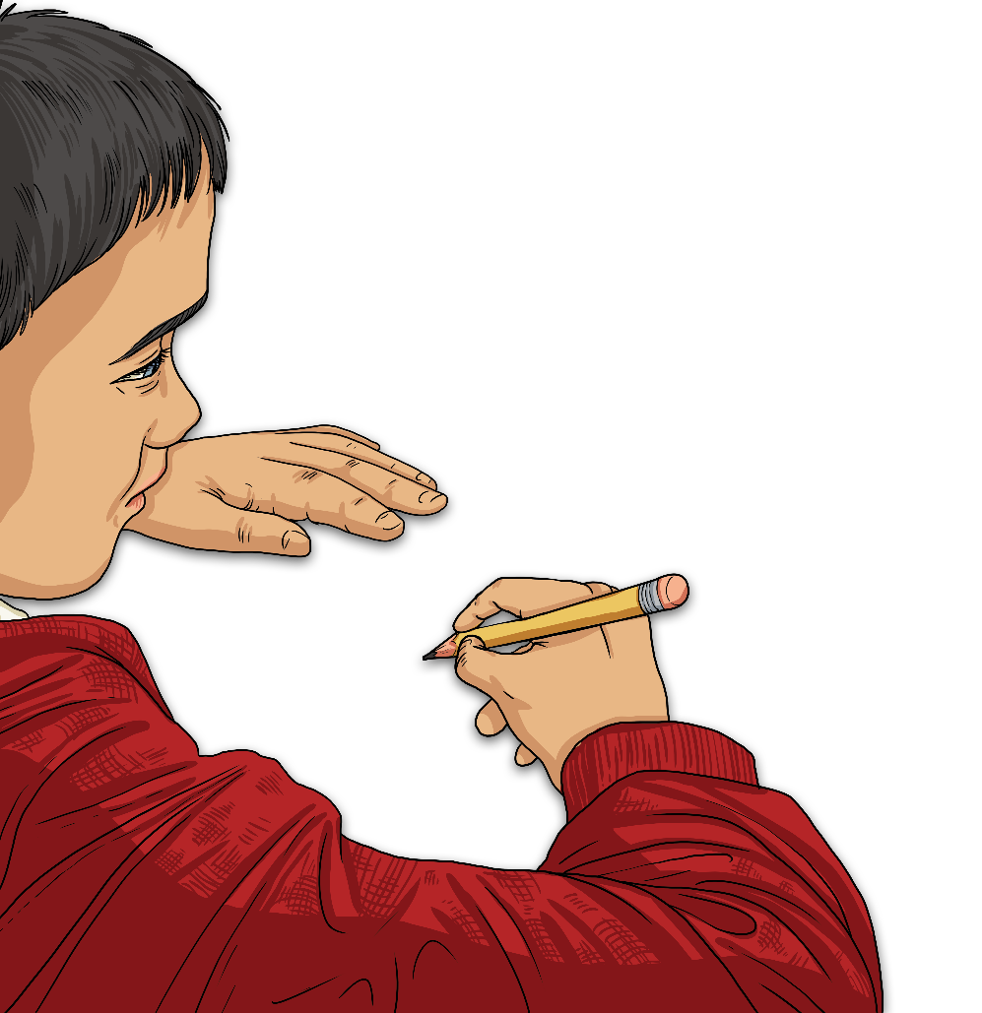
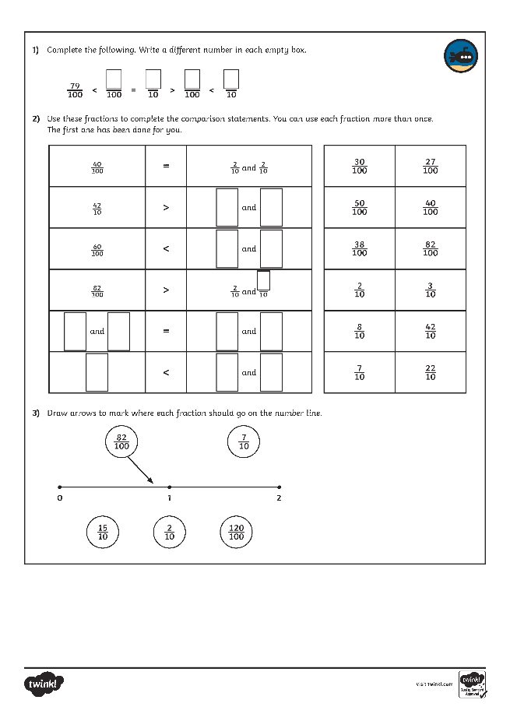
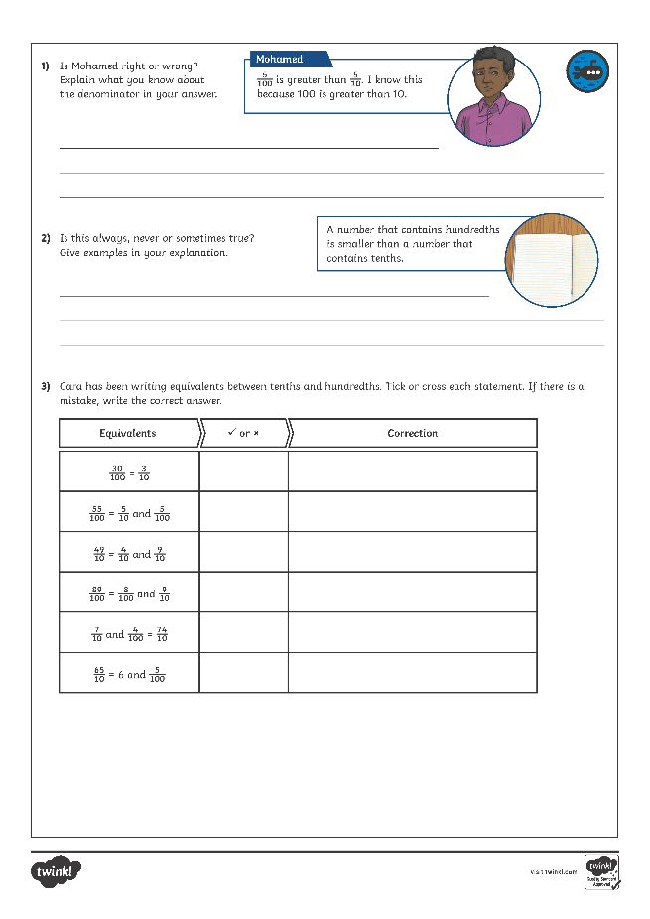
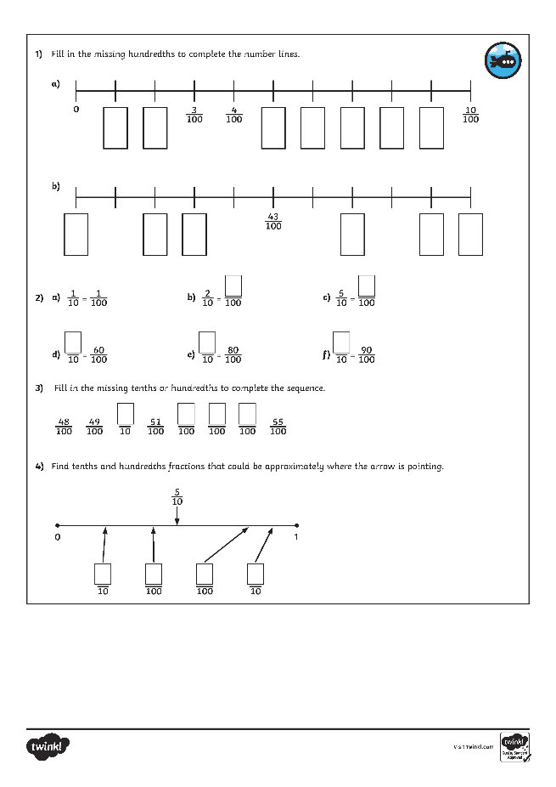
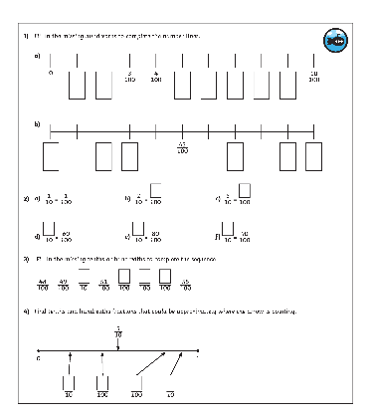
Hundredths
Dive in by completing your own activity!

Slide 10
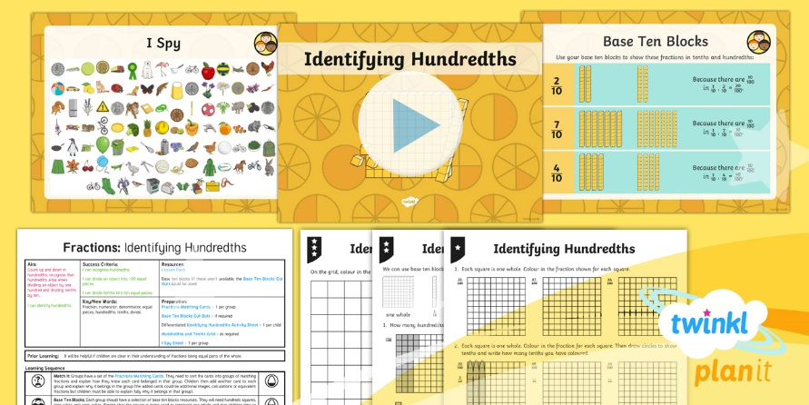
Need Planning to Complement this Resource?
National Curriculum Aim
Count up and down in hundredths; recognise that hundredths arise when dividing an object by one hundred and dividing tenths by ten.
For more planning resources to support this aim, click here.
Twinkl PlanIt is our award-winning scheme of work with over 4000 resources.

