Slide 1
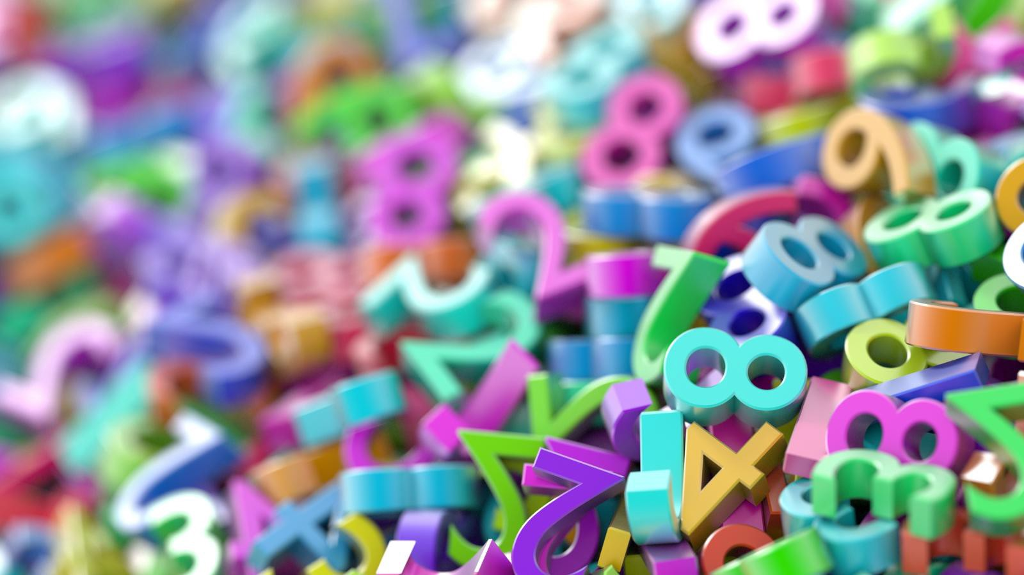
Hundredths as Decimals

Slide 2
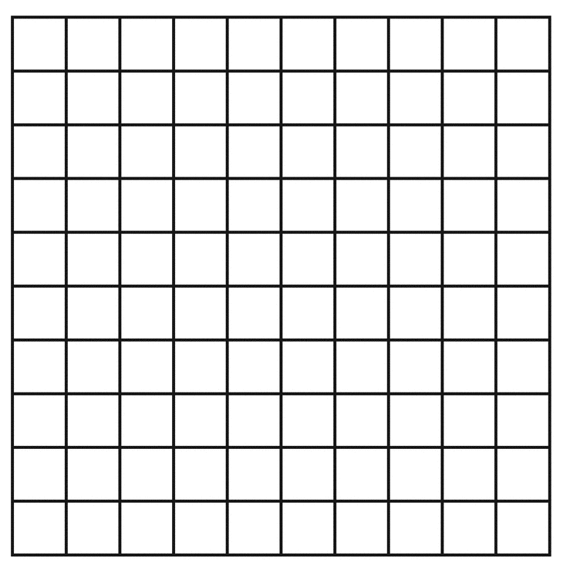
Here’s a hundred square…
What fraction is coloured in?
63
63 hundredths
100

Slide 3
Here’s another hundred square…
What fraction is coloured in?
39
39 hundredths
100

Slide 4
Here’s another hundred square…
What fraction is coloured in?
47
47 hundredths
100

Slide 5
So, in a hundred square, there are 100 pieces. This means that each square is worth…
1
100
One hundredth

Slide 6
Now I want to write this fraction as a decimal
1
One hundredth
100
This is the hundredths place so
since I’m writing one hundredth
I just put a one in here ☺
Here’s a place value grid.
1s | 10ths | 100ths
0
0
1
But I can’t leave these spaces empty otherwise my number would just look like 1. I have to fill them with zeros.

Slide 7
So, one hundredth as a decimal is 0.01
What would 2 hundredths be as a decimal?
1s | 10ths | 100ths
0
0
2
It’s 0.02 because this time there are 2 hundredths in the hundredths place

Slide 8
22
What if I wanted to write
As a decimal?
100
Well first, let’s colour it in on a hundred square.
22
Is 2 columns and 2 extra squares. If you think back to the
other day, a column is one tenth and a square is one hundredth
so if we write the number in the place value grid we’re
going to have 2 tenths in the tenths place and then 2
hundredths in the hundredths place.
100
It will look like this… The answer is 0.22
1s | 10ths | 100ths
0
2
2

Slide 9
86
What if I wanted to write
As a decimal?
100
Well first, let’s colour it in on a hundred square.
86
Is 8 columns and 6 extra squares.
So if we write the number in the place value grid we’re
going to have 8 tenths in the tenths place and then 6
hundredths in the hundredths place.
100
It will look like this… The answer is 0.86
1s | 10ths | 100ths
0
8
6

