Slide 1
Maths
Measurement
Year One
Maths | Year 2 | Measurement | Standard Units | Lesson 3 of 5: Capacity Concoctions

Slide 3
Aim
To understand the words volume and capacity.
Success Criteria
Know that volume and capacity can be measured in litres and millilitres.
Identify containers which hold more or less than a litre.
Record answers.

Slide 4
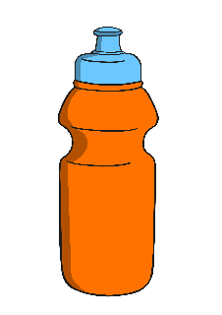
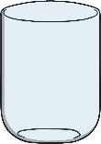
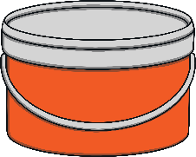
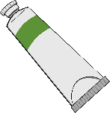
More or Less
Than a Litre?
We use millilitres or litres to measure volume and capacity.
Volume is how much liquid is in a container.
Capacity is how much liquid a container can hold.
Come back to the presentation
When you have written down your answers.
There are 1000 millilitres in 1 litre.
We can write l for litre.
We can write ml for millilitre.
Look around your home and garden and look at the labels to see which containers hold more or less than a litre.
Can you find any containers that hold exactly 1 litre?

Slide 5
Container Capacities
?
Can you estimate and match these containers to their capacities?
1l
200ml
10ml

Slide 6
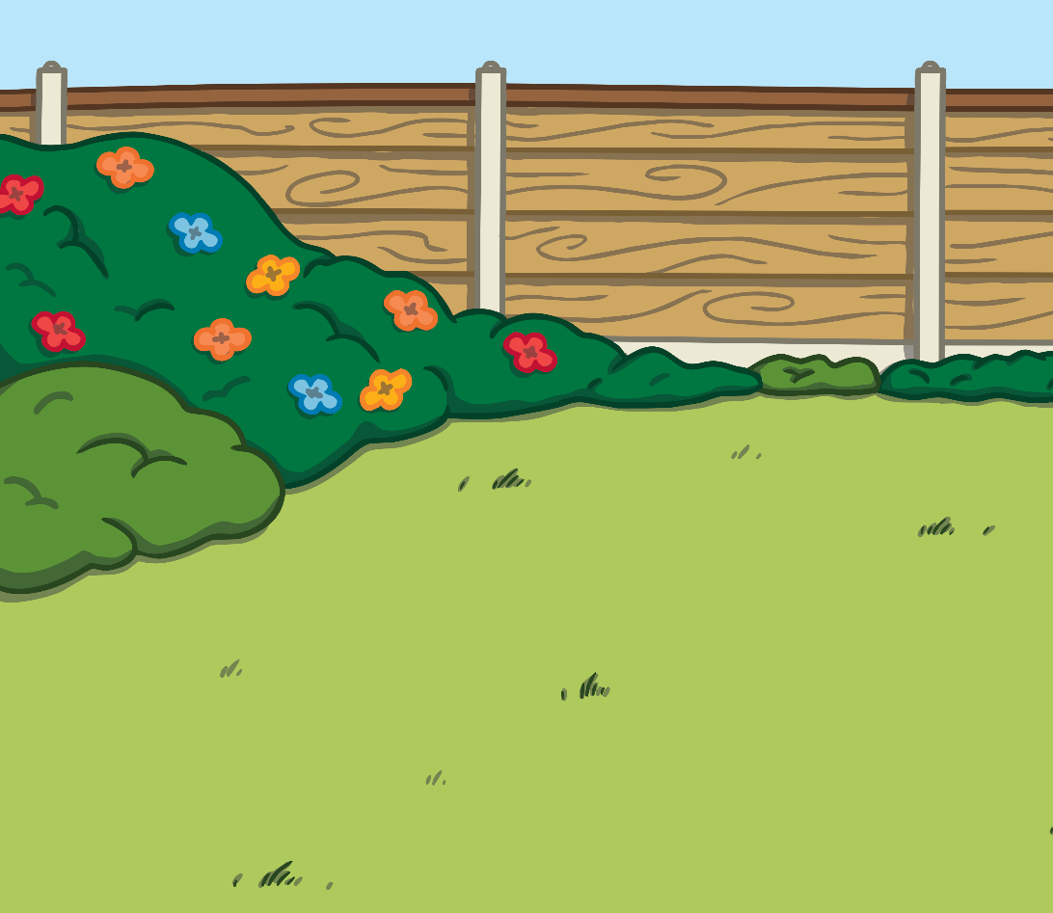
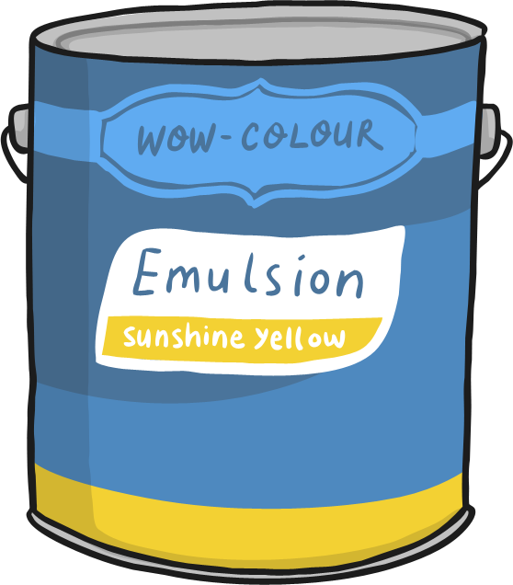
Container Capacities
?
Can you estimate and match these containers to their capacities?
100ml
10ml
2l

Slide 7
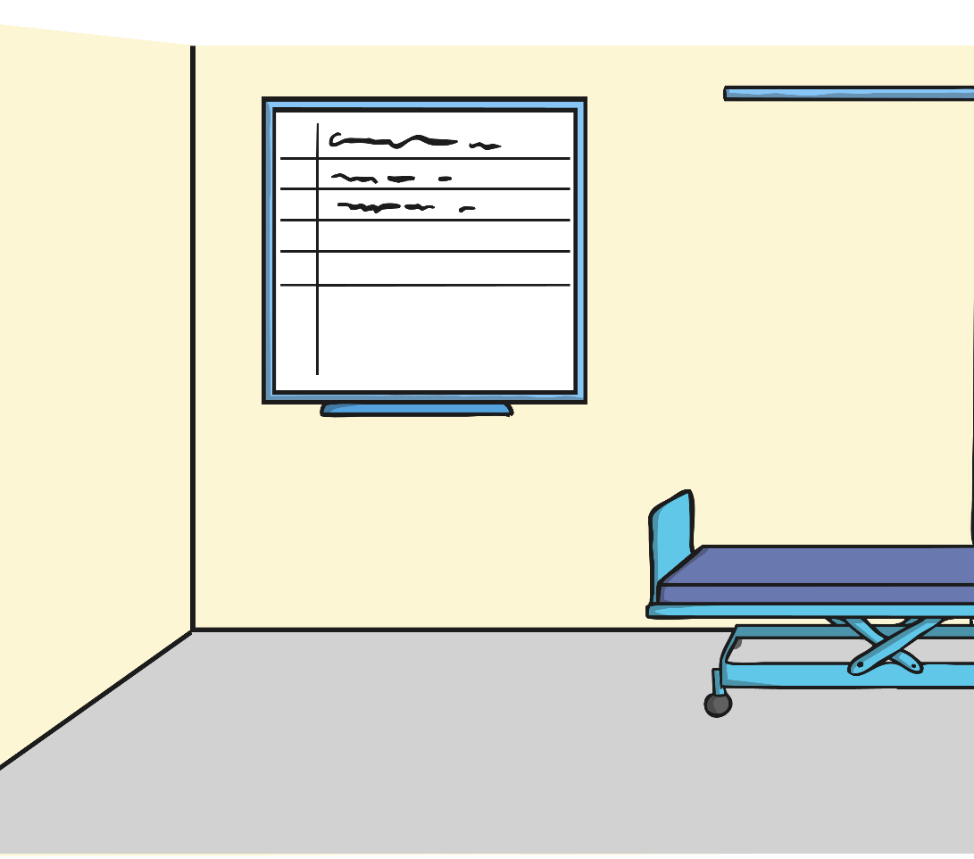
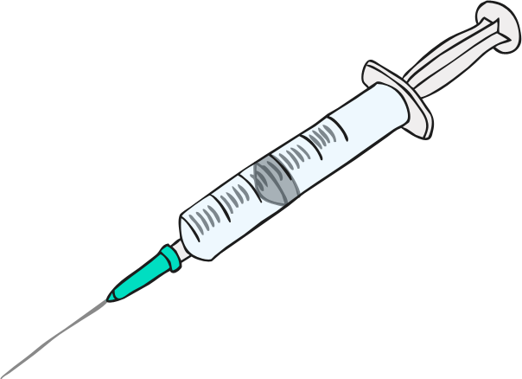
Container Capacities
?
Can you estimate and match these containers to their capacities?
10ml
3l
1l

Slide 8
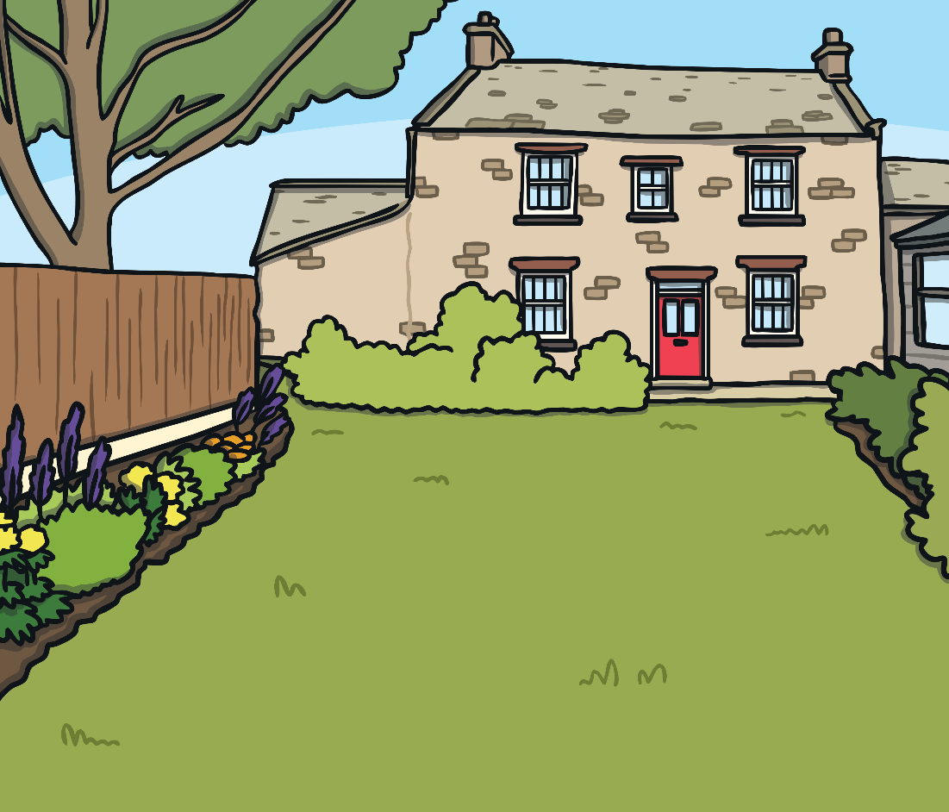
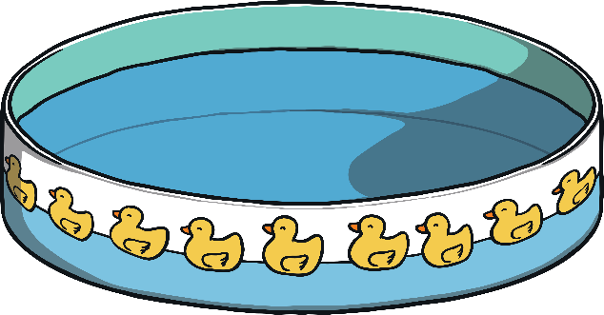
Container Capacities
?
Can you estimate and match these containers to their capacities?
200ml
700l
2l

Slide 9
Container Capacities
?
Can you estimate and match these containers to their capacities?
2l
10l
100ml

Slide 10
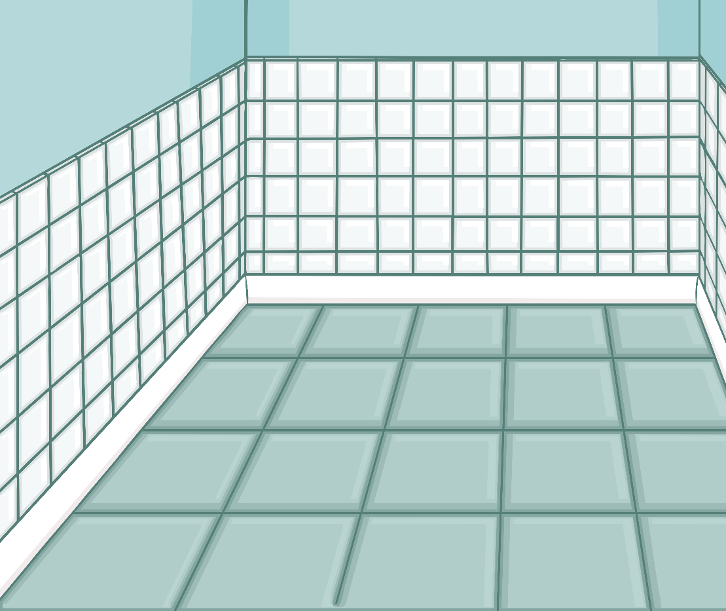
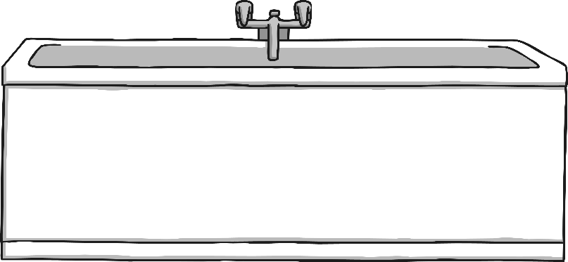
Container Capacities
?
Can you estimate and match these containers to their capacities?
800ml
8ml
80l

Slide 11
Aim
To estimate and measure volume/capacity in litres and millilitres.
Success Criteria
I can use language related to volume/capacity.
I can estimate volume/capacity.
I can measure the volume/capacity of liquid to the nearest litre/millilitre.

