Slide 1
History
Romans
Year One
History | LKS2 | Romans | Roman Roads | Lesson 2

Slide 3
Aim
I can understand why the Romans built new roads in Britain, know where some of the main roads ran to and from and know how the roads were made.
Success Criteria
I can label a map to show some Roman roads.
I can create a model to show a cross-section of a Roman road.

Slide 4
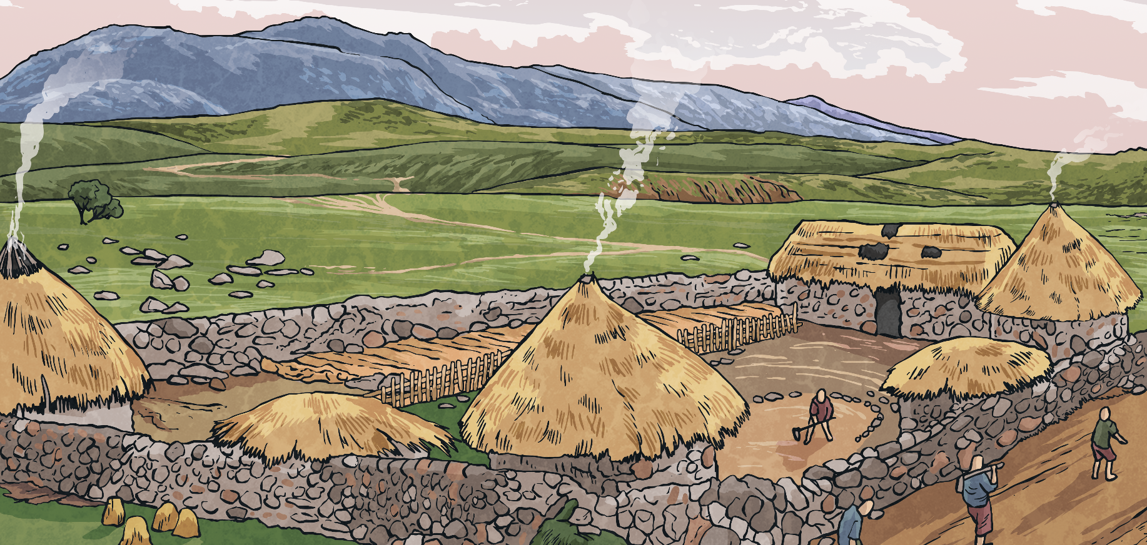
Before the Roman Roads
Before the Romans arrived, Britain had no proper roads. The Celts rode horses, walked and travelled in carts pulled by oxen along paths and tracks. These paths and tracks connected local farms and hamlets, and there were some longer routes for trade. These tracks were often in very poor condition.
Why do you think the Romans wanted to build new roads?
Can you think of three possible reasons?

Slide 5
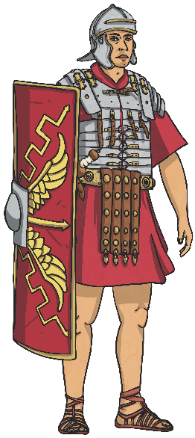
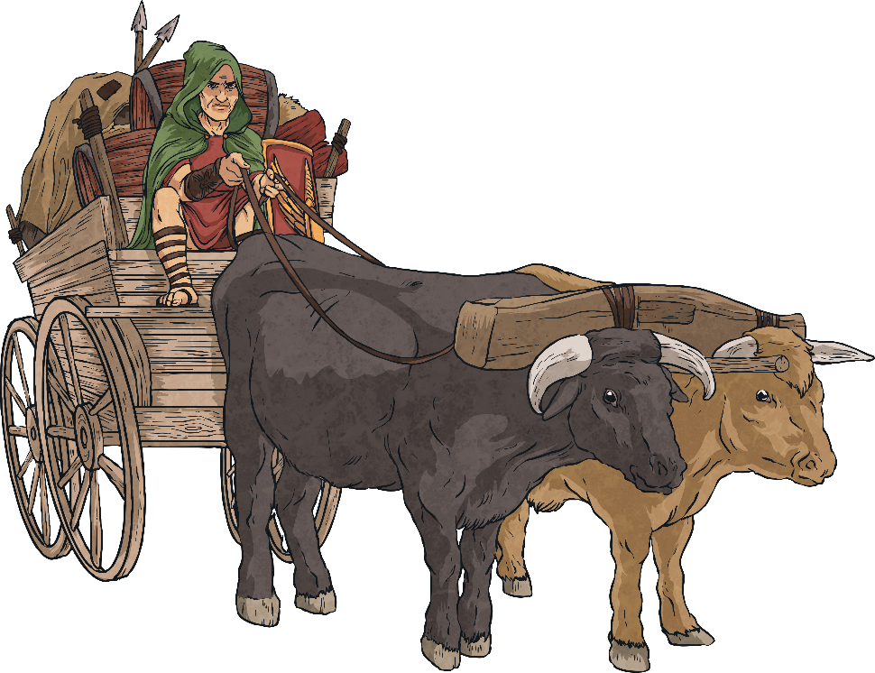
Roman Roads
Why did the Romans want better roads?
Did you think of any of these reasons?
Troops could be quickly moved from one place to another.
Supplies could be sent to different areas of the country.
The Emperor had more control if messages could be sent quickly.
Better links between places was good for trading.

Slide 6
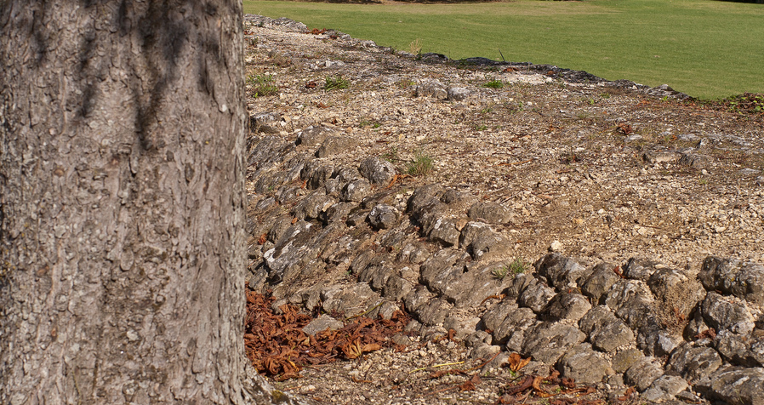
Roman Roads
The Romans were famous for their long, straight roads. You can still see some Roman roads today, two thousand years after they were built.
Photo courtesy of sybarite48 (@flickr.com) - granted under creative commons licence - attribution

Slide 7
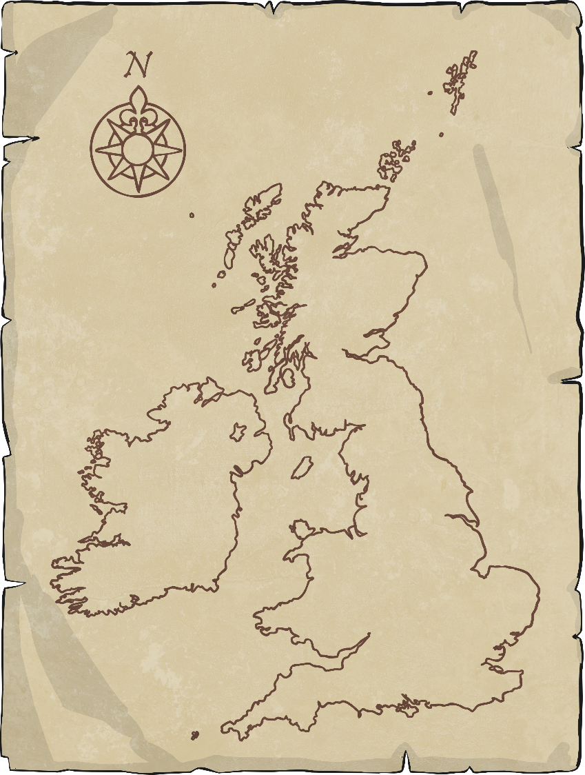
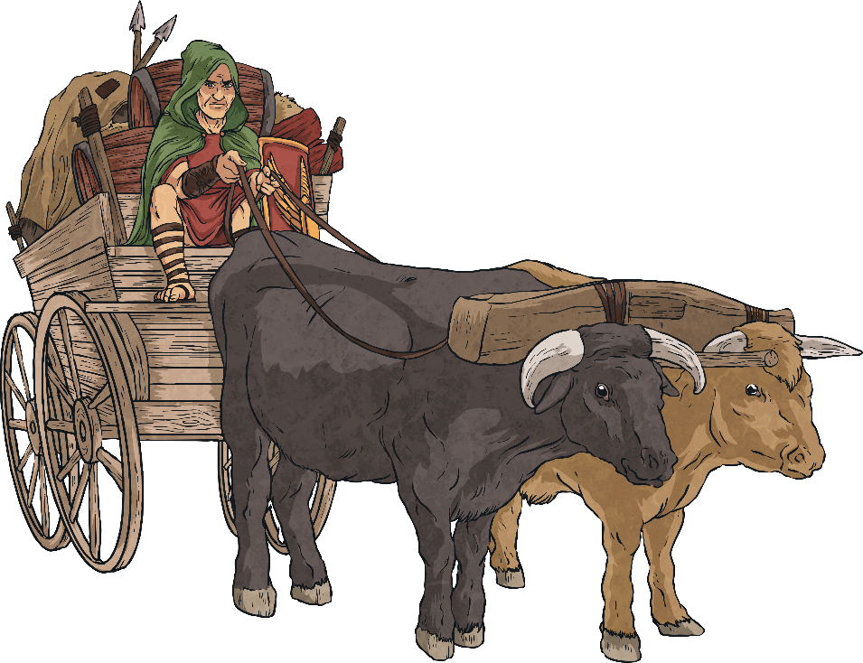
The First Roman Roads
Work with your partner. Use maps to locate the places.
Why was it important for the Romans to link the military centres to the ports?
Key
Military centre
Port
Colchester
London
Dover
Richborough
Lympne

Slide 8
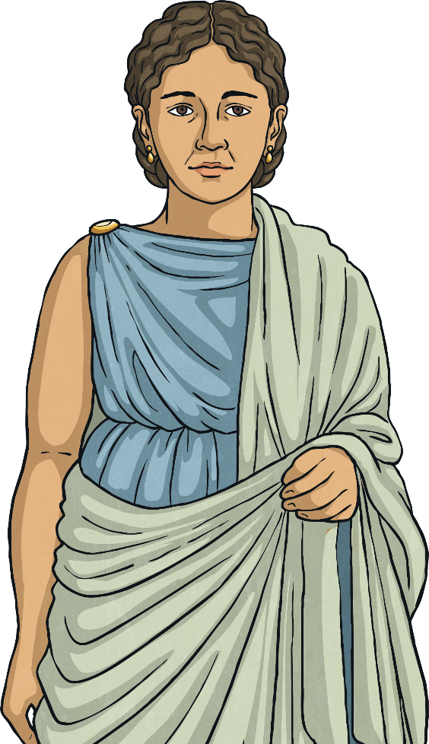
The First Roman Roads
The Fosse Way was one of the first great Roman roads in Britain. It ran from Exeter to Lincoln, passing through Bath, Gloucester and Leicester.
Key
Military centre
Can you find the Fosse Way on your map?
Port
Lincoln
Leicester
Gloucester
Colchester
Bath
Richborough
Dover
Exeter
Lympne
London

Slide 9
The First Roman Roads
Over the years, the Romans continued to build more roads, linking to many places throughout Britain.
Eventually, around 2000 miles of Roman roads had been built.
Key
Military centre
Port
Other Routes
Chester to York
London to Lincoln to York
Chester to Carlisle
Dover, Lympne and Richborough to London to Wroxeter
York
Lincoln
Carlisle
Chester
Leicester
Gloucester
Colchester
Bath
Richborough
Dover
Exeter
Lympne
London

Slide 10
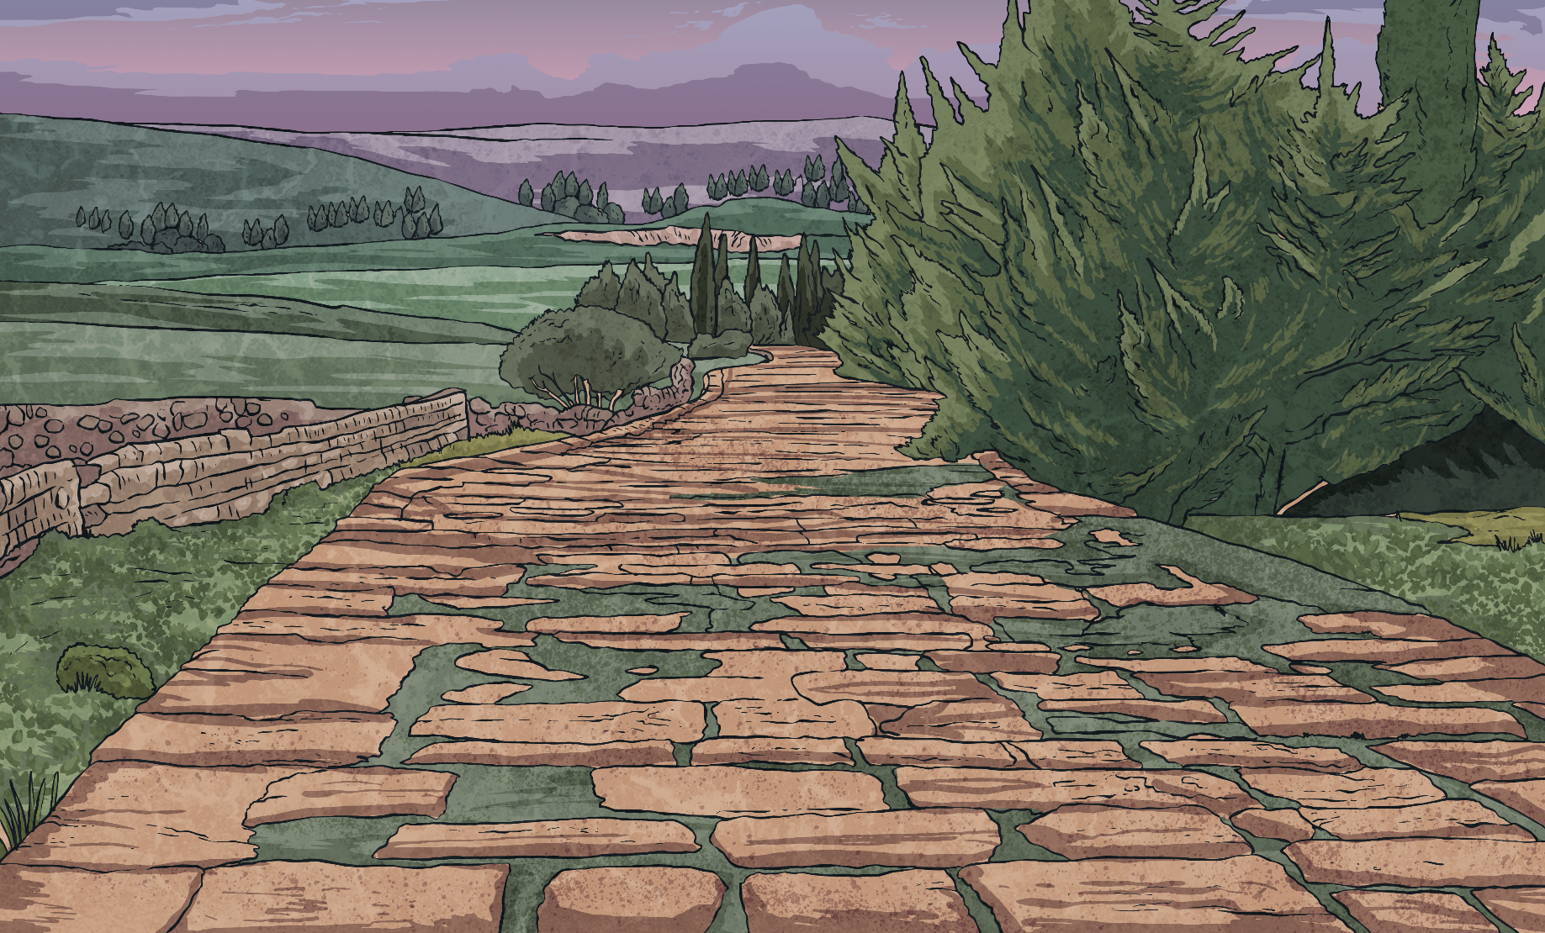
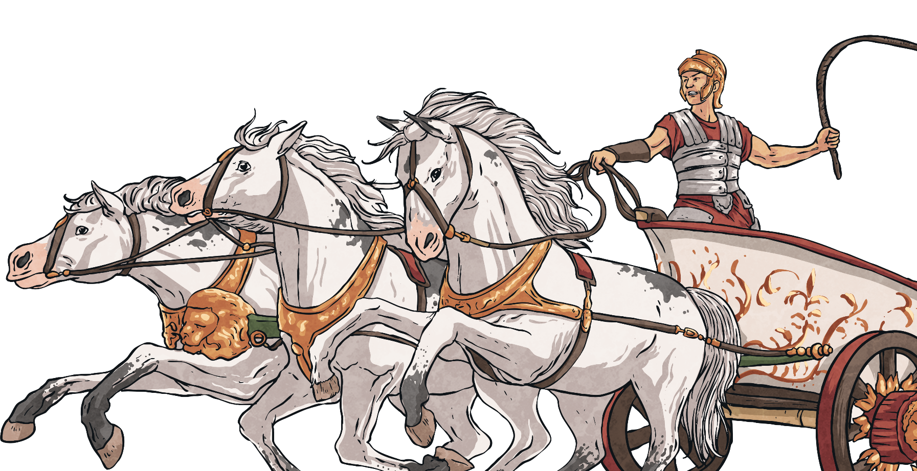
Mapping Roman Roads
Use an atlas to locate the start and finish points of the Romans roads on your sheet.
Mark and label the places on your map and then draw and label the road.
Use a different colour for each road.

Slide 11
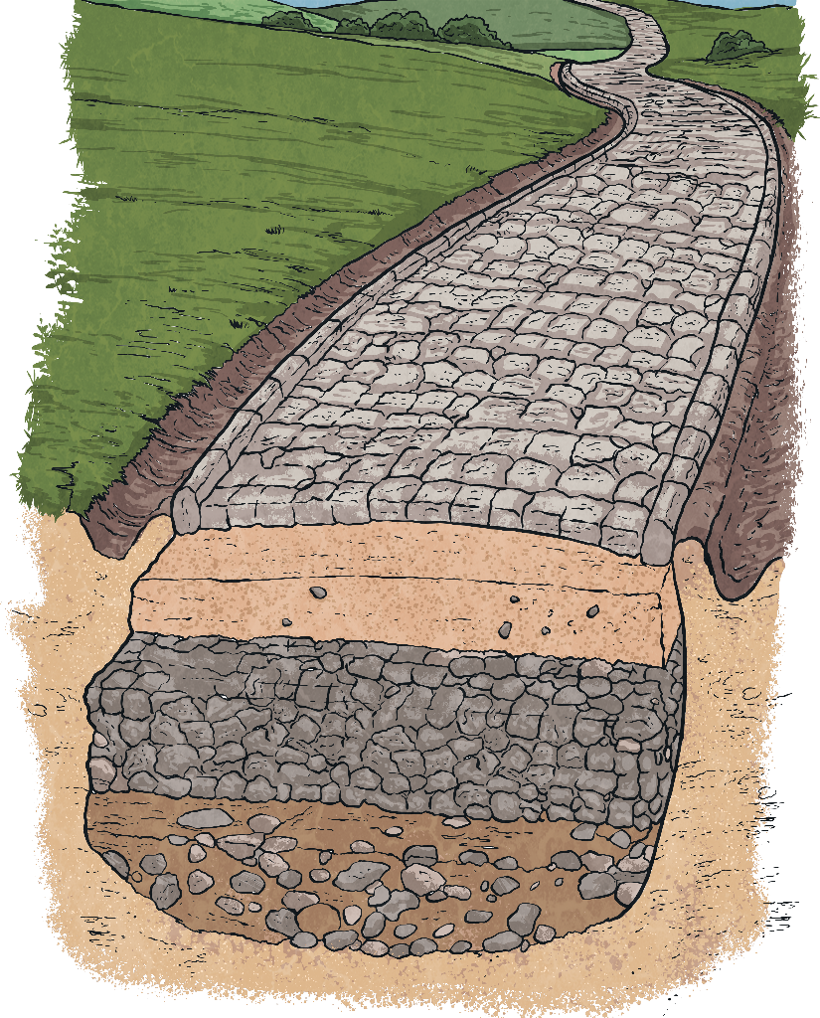
Building the Roads
To build a Roman road, we would need to:
Dig a large ditch the width of your road.
1
Fill your ditch with a layer of rubble and a layer of stones.
2
3
Dig two smaller ditches either side.
4
Cover the stones with a layer of sand or small pebbles and gravel, thicker in the middle to make a camber so that the rain will drain off into the two side ditches.
5
Set a layer of smooth paving stones into the sand or gravel to make a hard surface.

Slide 12
Building the Roads
Can you name the parts of this Roman road?
smooth paving stones
sand, pebbles and gravel
stones
rubble

