Slide 2
Diving into Mastery Guidance for Educators
Each activity sheet is split into three sections, diving, deeper and deepest, which are represented by the following icons:
These carefully designed activities take your children through a learning journey, initially ensuring they are fluent with the key concept being taught; then applying this to a range of reasoning and problem-solving activities.
These sheets might not necessarily be used in a linear way. Some children might begin at the ‘Deeper’ section and in fact, others may ‘dive straight in’ to the ‘Deepest’ section if they have already mastered the skill and are applying this to show their depth of understanding.
Diving
Deeper
Deepest

Slide 3
Aim
Recognise and write decimal equivalents of any number of tenths or hundredths.

Slide 4
Tenths as Decimals
Diving
Complete this table:
Representation
Decimal
Fraction
1.1
11 10
12 10
1.2
18 10
1.8
1.6
16 10

Slide 5
Tenths as Decimals
Diving
Write each of the following as a decimal and a fraction:
0.5
5 10
0
1
0.8
8 10
0.3
3 10

Slide 6
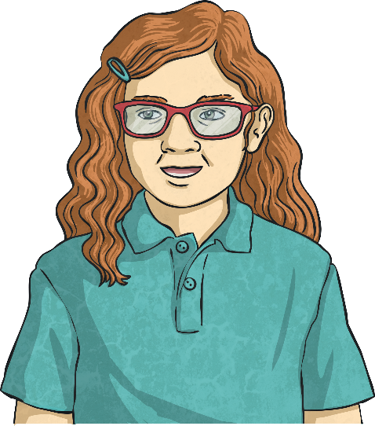
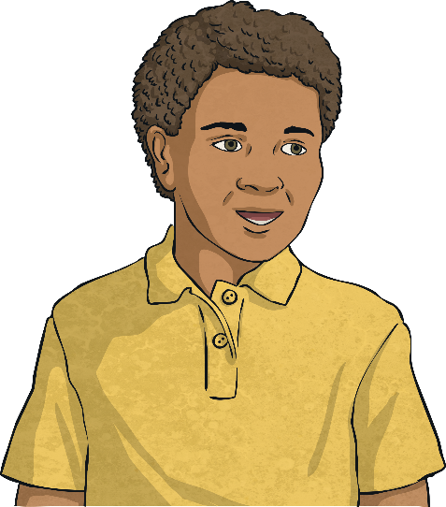
Tenths as Decimals
Deeper
Petra and Leo write this representation in the ways shown:
Are both children correct? If not, can you explain what mistake they have made and what they should have written.
4 10
Leo is correct as the representation shows one whole and three-tenths (which is equal to 1.3).
1.3
Petra is incorrect. She has counted the one whole as but it should have been .
1 10
Petra
Leo
10 10
10 10
3 10
13 10
So it would be and which is .

Slide 7
Tenths as Decimals
Deeper
Mandeep is converting decimals into fraction representations.
This is her first conversion.
1.4 =
What mistake did she make?
The 1 whole is correct but 0.4 has been represented incorrectly. Mandeep has represented 0.4 as a whole divided into 4 equal parts. Instead, as 0.4 is equal to , a whole should be divided into 10 equal parts with 4 parts shaded.
4
10
What should it look like?

Slide 8
Tenths as Decimals
Deepest
In a centimetre (cm), there are 10 millimetres (mm).
1mm = cm
Use this information to complete this table:
1 10
Centimetres and Millimetres | Millimetres | Fraction | Decimal
1cm 8mm | 18mm | 1 cm ( ) | 1.8cm
 | 13mm
 |  | cm
 |  |  | 1.1cm
8 10
18 10
3 10
13 10
1cm 3mm
1 cm ( )
1.3cm
0cm 6mm
6mm
6 10
0.6cm
1cm 1mm
11mm
1 10
11 10
1 cm ( )

Slide 9
Tenths as Decimals
Deepest
Which representations are equal to this representation?
Tick the correct representations:
1
0.9
ten-ninths
0
9 10

Slide 10
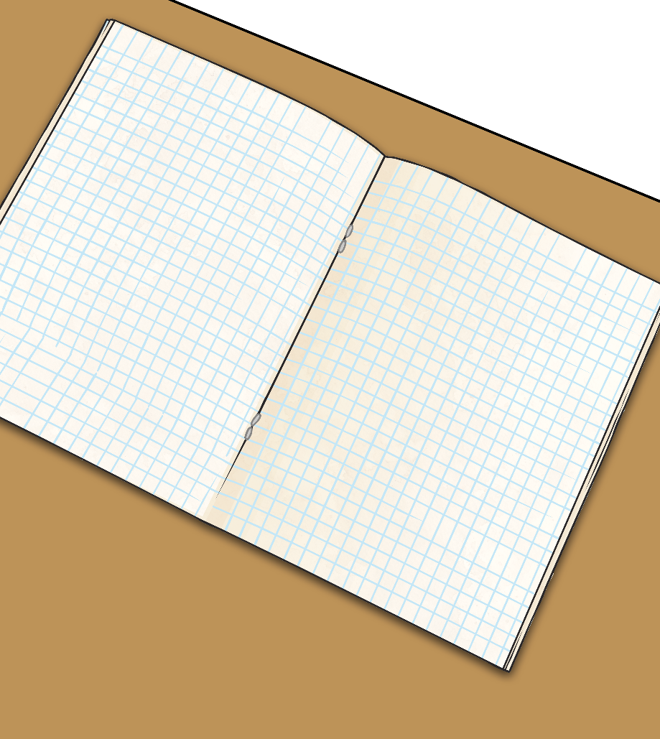
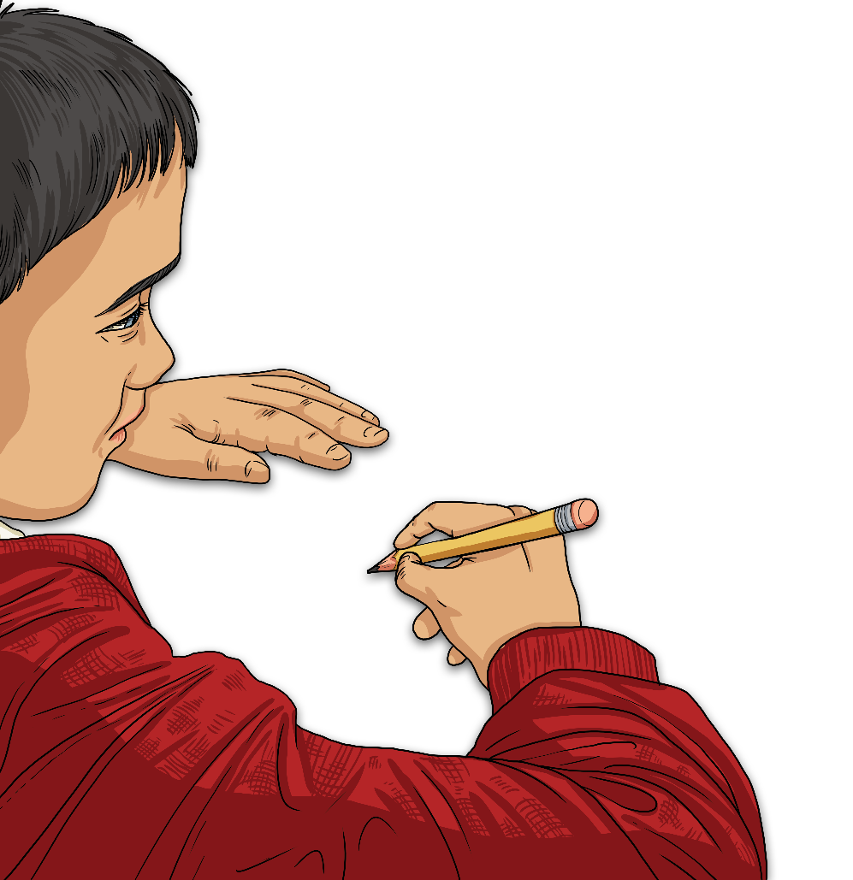
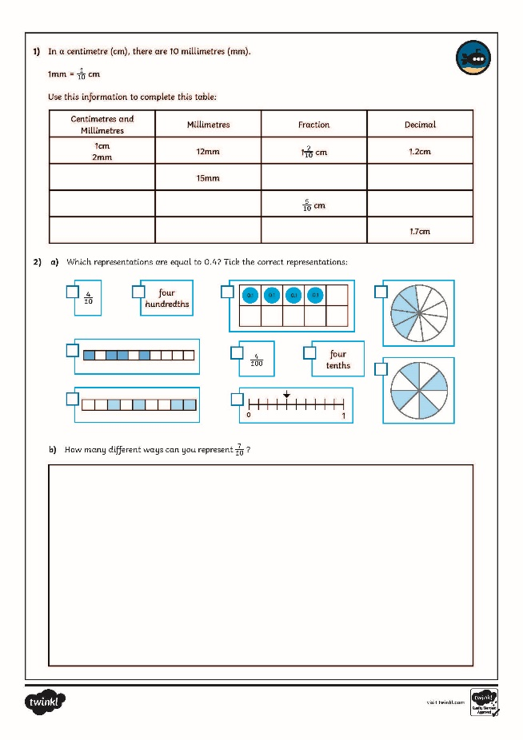
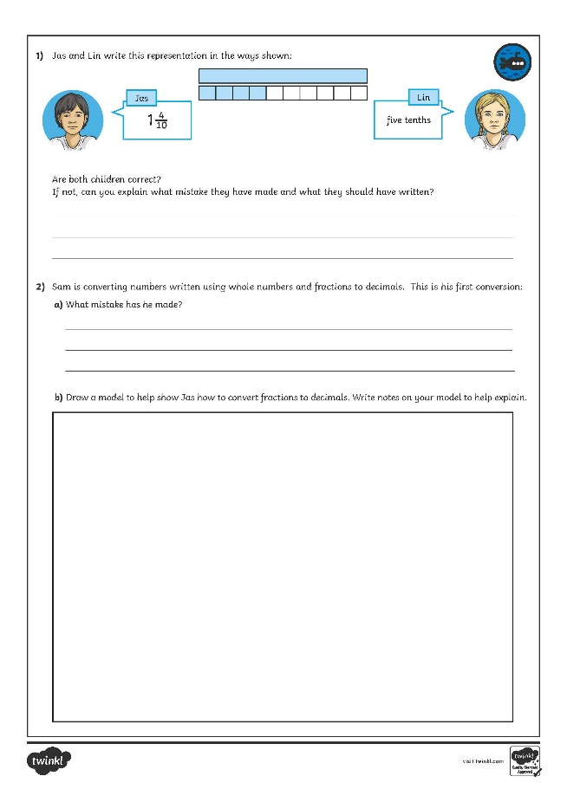
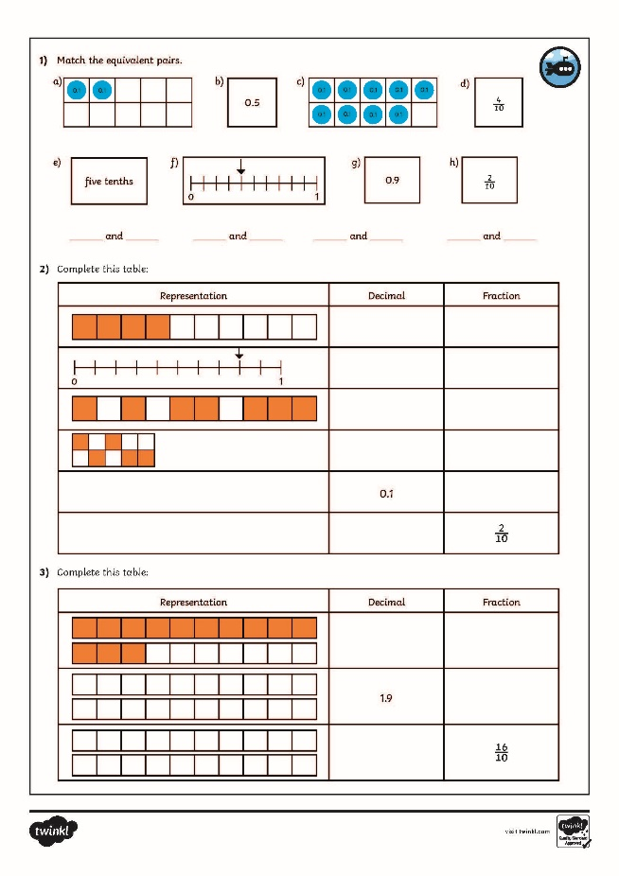
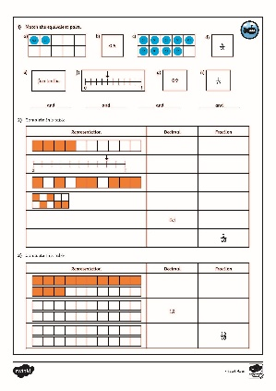
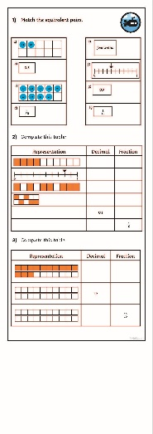
Tenths as Decimals
Dive in by completing your own activity!

Slide 11
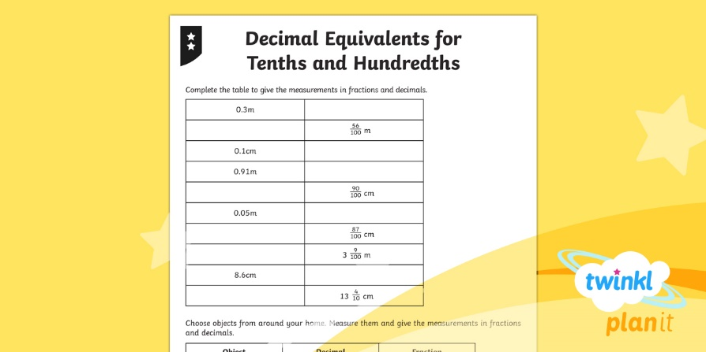
Need Planning to Complement this Resource?
National Curriculum Aim
Recognise and write decimal equivalents of any number of tenths or hundredths.
For more planning resources to support this aim, click here.
Twinkl PlanIt is our award-winning scheme of work with over 4000 resources.

