Slide 2
Tenths and Hundredths
Diving
Look at this grid. Complete the sentences to match the grid.
Each little square is 1 out of ____ and represents the fraction .
1
100
100
Each column is out of and represents the fraction .
1
10
1
10
The columns and rows can also be
represented as out of 100 or .
10
10
100

Slide 3
Tenths and Hundredths
Diving
Look at this grid. Complete the sentences to match the grid.
There are squares shaded out of 100.
40
40
This represents .
100
There are rows shaded out of 10.
4
4
This represents .
10

Slide 4
Tenths and Hundredths
Diving
Look at this grid. Complete the sentences to match the grid.
There are squares shaded out of 100.
26
26
This represents .
100

Slide 5
Tenths and Hundredths
Diving
Choose the correct fraction to match the statement.
How do you know you have chosen the correct one?
On my hundred square, 5 rows have been shaded plus 4 extra squares.
45
45
54
54
10
100
100
10
It has be this one as 5 rows of 10 is 50. If you add on the 4 extra, that gives you 54 out of 100.

Slide 6
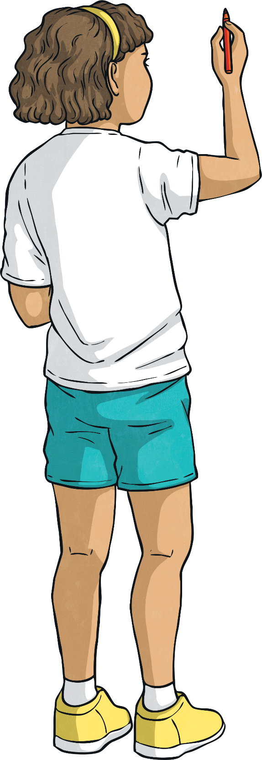
Tenths and Hundredths
Diving
Complete the part-whole model.
3
10
39
100
9
100

Slide 7
Tenths and Hundredths
Diving
Use the part–whole model to partition the fractions.
a) 60 hundredths
6
0
10
10
60
60
100
100
0
60
100
100
b) 41 hundredths
4
10
41
100
1
100

