Slide 2
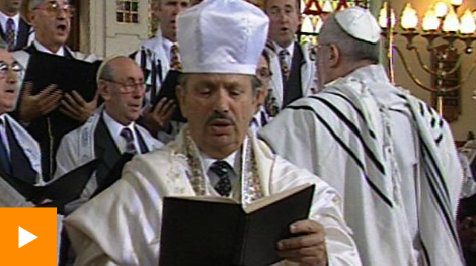
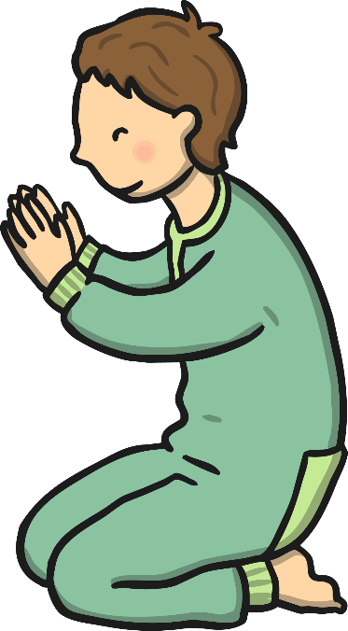
What is Yom Kippur?
Yom means "day" in Hebrew and Kippur comes from a root word which means "to atone". Atonement means making up for something you have done wrong by asking for forgiveness from God. Yom Kippur, also known as ‘Day of Atonement’, is the holiest day of the year for the Jewish people.
In the days leading up to Yom Kippur, Jews will apologise to people they might have upset or hurt, so that when the special day comes, God will forgive them for their wrongdoing.
In order to apologize
to God, one must:
Pray
Repent
Watch this video in which a Jewish teenager explains the meaning of Rosh Hashanah (the Jewish New Year) and Yom Kippur.
Give to charity

Slide 3
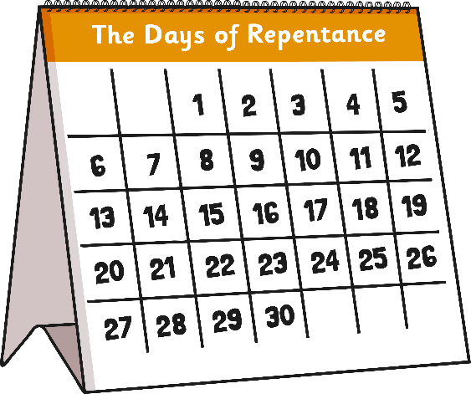
Getting Ready For Yom Kippur
According to Jewish tradition, God inscribes each person's fate for the coming year into a book, the Book of Life, on Rosh Hashanah, and waits until Yom Kippur to reveal this.
During Rosh Hashanah and Yom Kippur, everyone gets a chance to put things right with other people before asking God's forgiveness. This period is called The Days of Repentance or Days of Awe.
It's a time when Jews can make up for the wrongs of the past year and make a firm commitment to not do the same things again.
At the end of Yom Kippur, Jewish people hope that they have been forgiven by God.

Slide 4
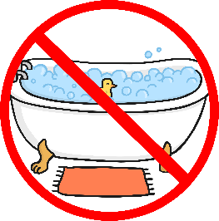
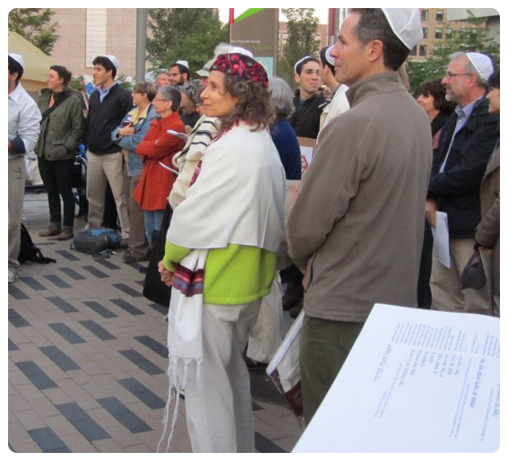
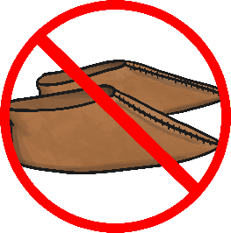
What Happens on Yom Kippur?
The special day of Yom Kippur is marked by Jewish people in a number of ways:
No eating
and drinking
By refraining from these activities, the body is uncomfortable but can still survive. Feeling pain enables us to feel when others are in pain.
No bathing
or washing
Jews may also
wear something
white to show
cleanliness.
No wearing of
leather shoes
No using
perfumes or lotions
Photo courtesy of leahbee5 (@flickr.com) - granted under creative commons licence - attribution

Slide 5
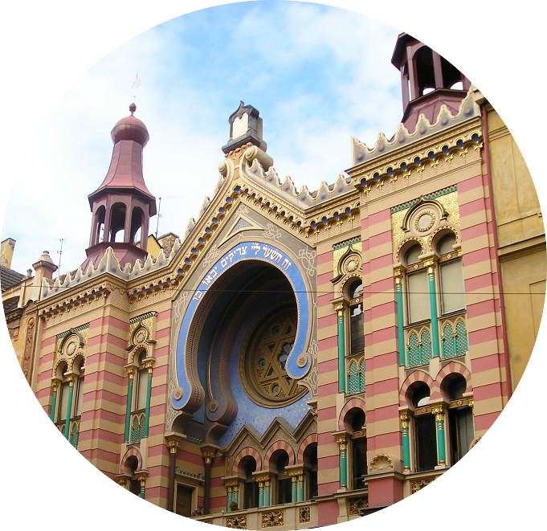
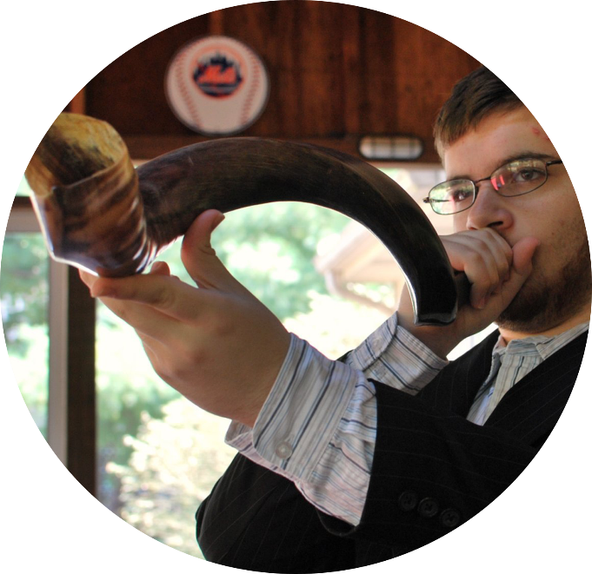
Prayer Service In the Synagogue
The most important part of Yom Kippur is the time spent in the synagogue. There are five services in the synagogue. The day is spent in continuous prayer for forgiveness. The sound of the shofar (ram's horn) marks the end of the holy day.
Jews go the synagogue to pray for forgiveness.
The priest sounds the shofar.
Photos courtesy of sambeckwith (@flickr.com) and slgckgc (@flickr.com) - granted under creative commons licence - attribution

Slide 6
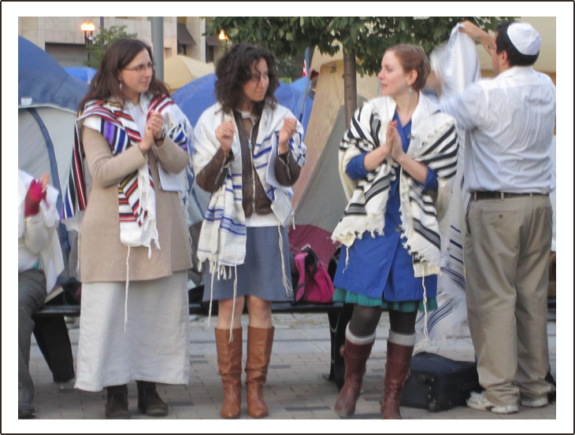
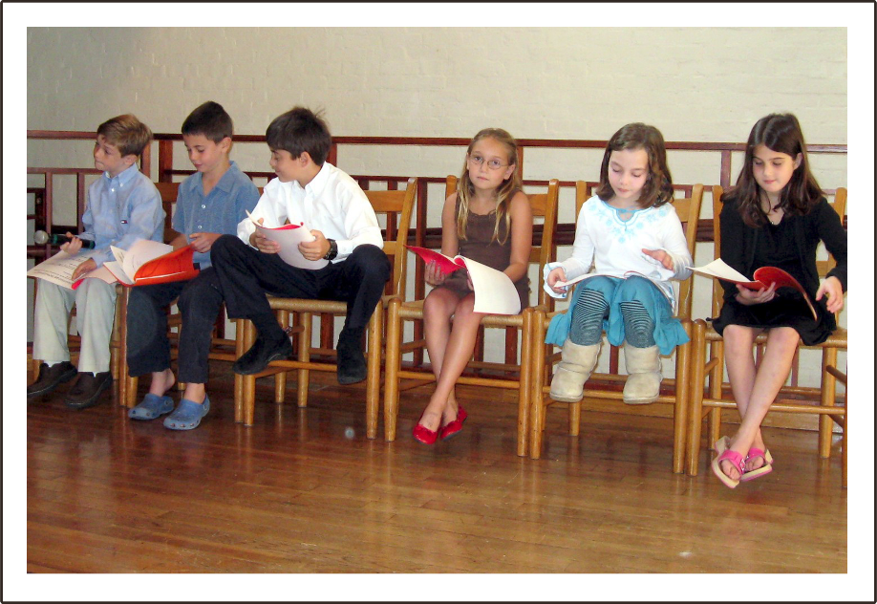
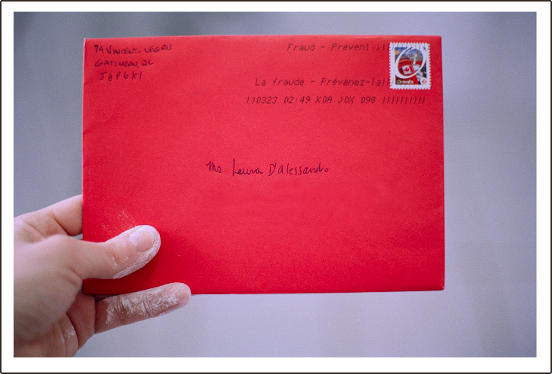
Celebrating Yom Kippur with family and friends
Jews like to celebrate Yom Kippur with their family and friends. They also enjoy sending them greeting cards to wish them a happy holiday.
Photos courtesy of runneralan2004 (@flickr.com), flossyflotsam (@flickr.com) and leahbee5 (@flickr.com) - granted under creative commons licence - attribution

