Slide 2
Missing Number Sequences
How could you work out the missing numbers?
Fill in the gaps.
12
?
20
24
?
?
36
16
28
32
8
24
48
?
16
?
32
40
?
56
64
600
700
1000
1100
?
800
900
?
?
400
350
?
?
?
?
100
300
250
200
150

Slide 3
Finding 10 or 100 More or Less Than a Given Number
37 is 10 more than
?
is 10 more than 615
27
?
625
371 is 100 more than
?
is 100 less than 898
271
?
798
199 is 10 less than
?
is 10 less than 940
209
?
930
508 is 100 less than
?
is 100 more than 899
608
?
999

Slide 4
Recognise the Place Value
of Each Digit in a Three-Digit Number
Write down the value of the red digit within each number.
78
70
101
0 (tens)
200
0
(ones)
380
300
591
1
732
30
111
10
902
2
555
640
600

Slide 5
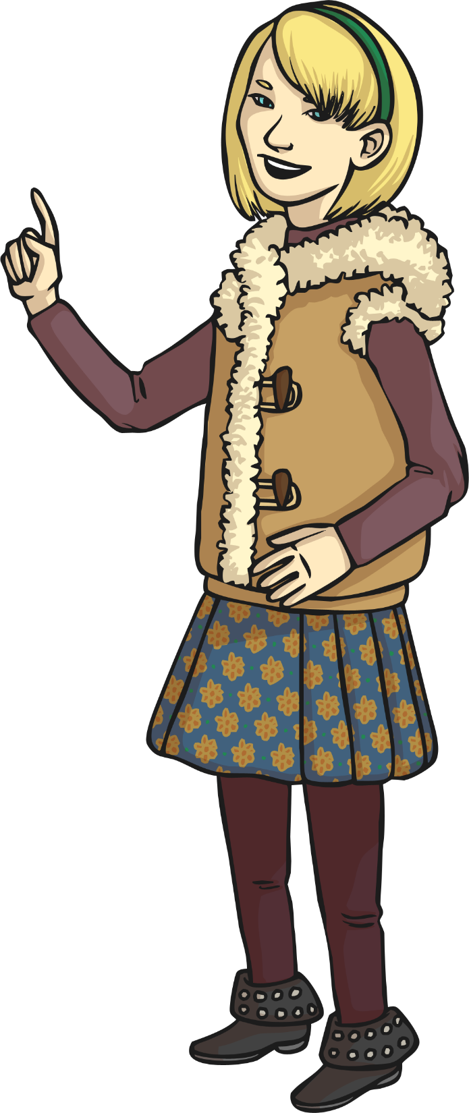
Recognise the Place Value of Each
Digit in a Three-Digit Number Reasoning Challenge
Which is greater - 908 or 809?
Convince me that your answer is correct.

Slide 6
Recognise the Place Value of
Each Digit in a Three-Digit Number
Partition these numbers into hundreds, tens and ones.
208
567
319
?
200
?
8
?
500
?
7
?
0
?
60
?
300
?
9
?
10

Slide 7
Recognise the Place Value of
Each Digit in a Three-Digit Number
Partition these numbers into hundreds, tens and ones.
782
999
814
?
700
?
2
?
900
?
9
?
80
?
90
?
800
?
4
?
10

Slide 8
Compare Numbers up to 1000
Look at this example. The symbol tells us that 77 is greater than 70.
77
>
70
Now write the correct sign (< >) to compare each set of numbers.
330
?
>
303
717
?
<
771
99
<
?
199
809
?
890
<
431
?
>
341
654
?
>
653

Slide 9
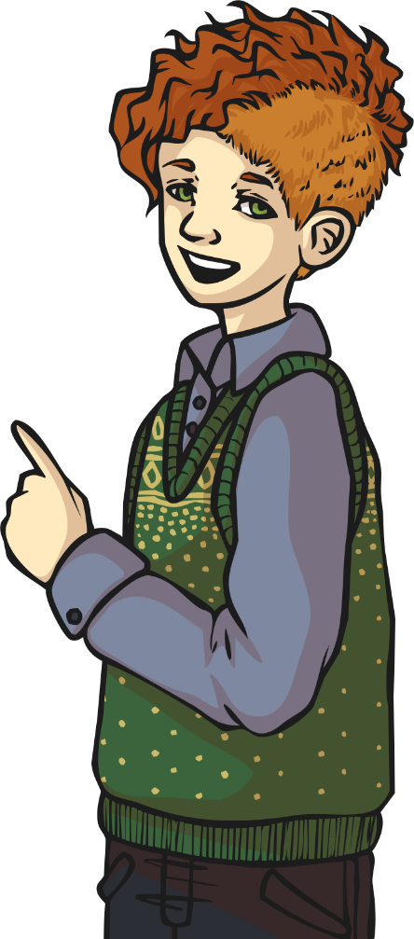
Compare Numbers up to 1000 Reasoning Challenge
Convince me that I’ve made a mistake.
187 > 781

Slide 10
Order Numbers up to 1000
Order these numbers from smallest to largest.
What is the best way to start ordering numbers?
654
650
605
506
546
605
641
650
654
546
506
641

Slide 11
Order Numbers up to 1000
Order these numbers from largest to smallest.
809
891
919
909
919
909
899
891
819
809
599
899
819
599

Slide 12
Order Numbers up to 1000
Reasoning Challenge
These numbers have been ordered from largest to smallest. Explain what is wrong and why, then correct the mistakes.
1000
1000
700
999
801
807
780
801
807
780
999
708
708
700

Slide 13

Estimating: Measures
Estimate the height of this chair in centimetres.
100cm
A good estimate would be 50cm.
0cm

Slide 14
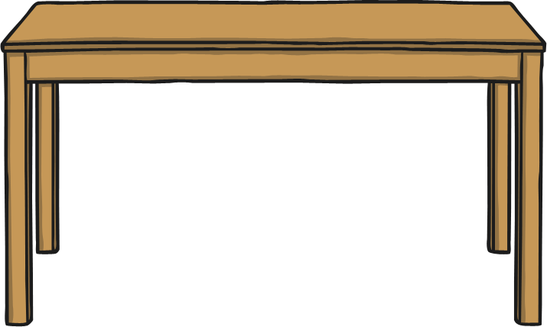
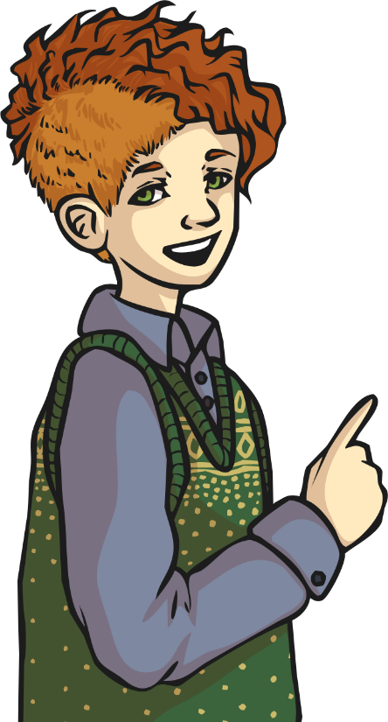
Estimating: Measures
Estimate the width of this table in centimetres.
0cm
100cm
A good estimate would be 105cm.

Slide 15
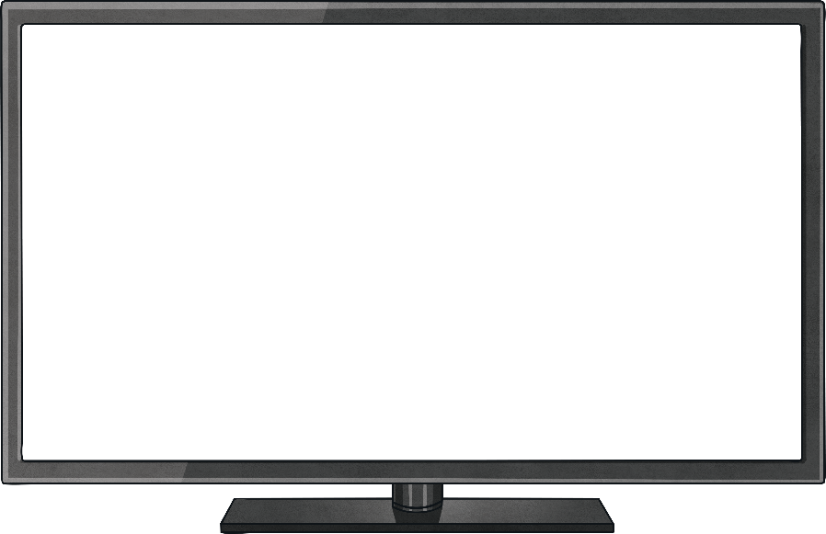
Estimating: Measures
Estimate the width of this television in centimetres.
0cm
100cm
A good estimate would be 75cm.

Slide 16
Read Numbers up to 1000 in
Numerals and Words
What is the correct written form for these numerals?
119
one hundred and ninety
one hundred and nineteen
one hundred and nine
one hundred and ninety-nine

Slide 17
Read Numbers up to 1000 in
Numerals and Words
What is the correct written form for these numerals?
567
five hundred and sixty-seven
five hundred and seventy-six
five hundred and sixteen
five hundred and seventeen

Slide 18
Read Numbers up to 1000 in
Numerals and Words
What is the correct written form for these numerals?
801
eight and one
eight hundred and eleven
eight hundred and one
eight hundred and ten

Slide 19
Read Numbers up to 1000 in
Numerals and Words
What are the correct numerals for this written form?
two hundred
and eighty-nine
278
289
298
280

Slide 20
Read Numbers up to 1000 in
Numerals and Words
What are the correct numerals for this written form?
five hundred
and seventy-three
570
753
357
573

Slide 21
Read Numbers up to 1000 in
Numerals and Words
What are the correct numerals for this written form?
seven hundred
and sixty-four
746
764
744
766

Slide 22
Read Numbers up to 1000 in
Numerals and Words
Match the written words with the correct numerals.
897
nine hundred and seventy-eight
789
eight hundred and ninety-seven
978
seven hundred and eighty-nine
987
nine hundred and eighty-seven
Click for answers!

Slide 23
Read Numbers up to 1000
Can you read these numbers?
123
234
345
456
567
678
898
987
101
202
303
404
505
606
707
808
909
1000
111
212
313
414
717
818
919
110
220
330
440
550
660
770
880
Choose one number from each column and write the number in words.

Slide 24
Solve Number Problems and Practical
Problems Involving These Ideas
Mrs Greggs sold 50 plums at the market. Estimate how many bananas were sold. Next, estimate how many oranges were sold.
50
plums
strawberries
oranges
bananas
Good estimation:
150 bananas
Good estimation:
25 oranges
How many bananas?
How many oranges?

Slide 25
Solve Number Problems and Practical
Problems Involving These Ideas
Samira worked eight hours a week for eight weeks.
How many hours is that altogether?
8 × 8 = 64 hours
On Monday, Jaden earned £196. On Tuesday, he earned £100 for clearing a garden. Altogether on Wednesday and Thursday, he earned £100 for cleaning cars. On Thursday, he spent £10 on equipment.
How much does he have now?
£196 + £100 + £100 = £396
£396 - £10 = £386 left

Slide 26
Solve Number Problems and Practical
Problems Involving These Ideas
If Sara earns 50p pocket money every week for nine weeks,
how much does she have altogether?
50p × 9 = £4.50
Tom had £286 in his savings account. His auntie sent £10 for his birthday, his friend gave him another £10 and his neighbour also gave him £10. He then spent £10 at the toy shop.
How much does he have now?
286 + £10 + £10 + £10 = £316
£316 - £10 = £306 left

Slide 27



Solve Number Problems and Practical
Problems Involving These Ideas
Jamie wins a prize. He can choose prize box 1, 2 or 3.
Which should he choose?
1
2
3
£336.68
£363.86
£336.86
Why is that one better than the other two boxes?

Slide 28
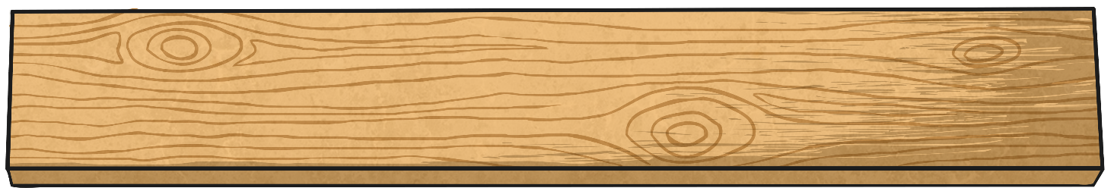
Solve Number Problems and Practical
Problems Involving These Ideas
Zain needs to cut a 44cm piece from this 2m length of wood, but he’s lost his tape measure to measure it out accurately.
Estimate where he will need to saw the wood.

Slide 29
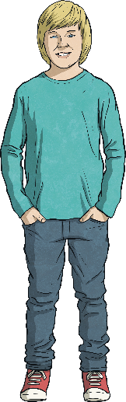
Solve Number Problems and Practical
Problems Involving These Ideas
Estimate Cody’s height in metres and centimetres.
2m
Good Estimate:
1m 10cm
0m

