Slide 1
Identifying Types of Angles
Recap

Slide 2
We’re going to have a quick look through some of the slides from yesterday. Before we start, can you remember the answer to any of these questions?
What is the unit of measure that angles are measured in?
How many degrees are in a right angle?
How can you tell that an angle is acute?
How can you tell that an angle is obtuse?
If after you get to the end of this powerpoint, you’re still not sure, it might be a good idea to have a look at yesterday’s powerpoint again before you attempt today’s work.

Slide 3
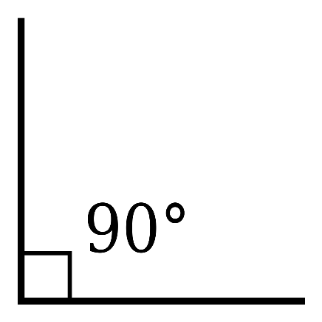
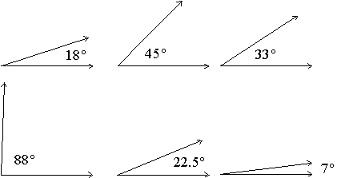
Let’s recap.
A quarter turn is called a right angle and it measures 90֯.
A half turn measures 180֯
Any angle that measures less than 90֯ is called an acute angle. They tend to look sharp and pointy ☺.
You can remember the name because they are small and ‘cute’.

Slide 4
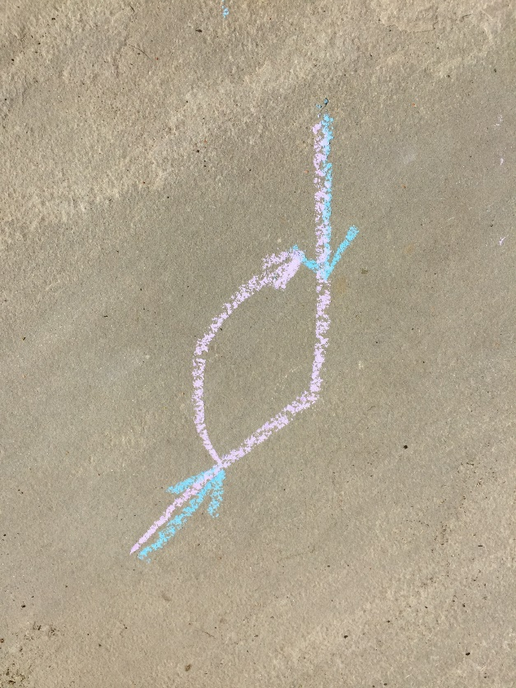
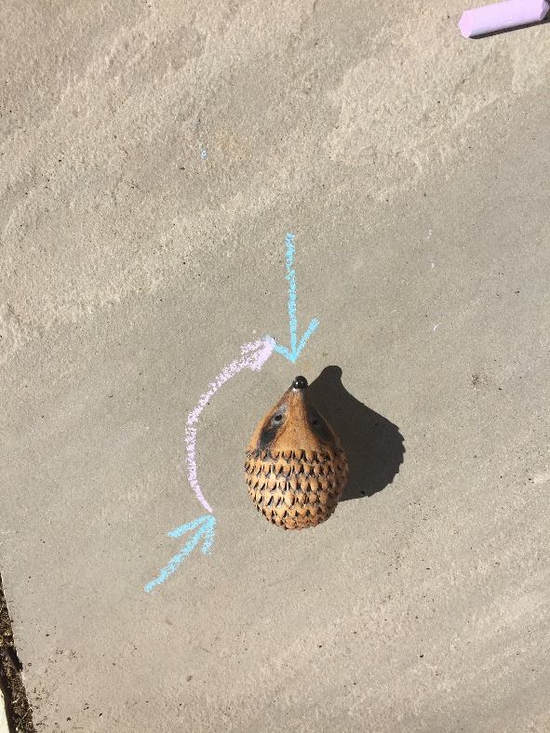
There is one more type of angle that we learn about in Year 4. Here’s Horace again…
He started off here.
Then he turned until he ended up here.
Here’s the angle without Horace.
Now this time, you can see that he turned more than a quarter turn BUT LESS than a half turn.
An angle that is more than 90֯ and less than 180֯ is called an obtuse angle.

Slide 5
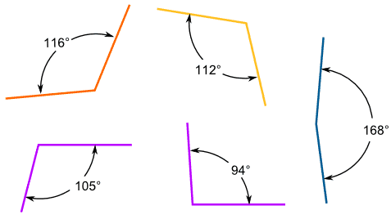
Here are some examples of obtuse angles. Have a good look at them.

Slide 6
If you’re struggling to see the difference between obtuse, acute and right angles it might help you to use the corner of a piece of paper.
The corner of a piece of paper is always a right angle so you can use it to check. Look at the next slide to see how…

Slide 7
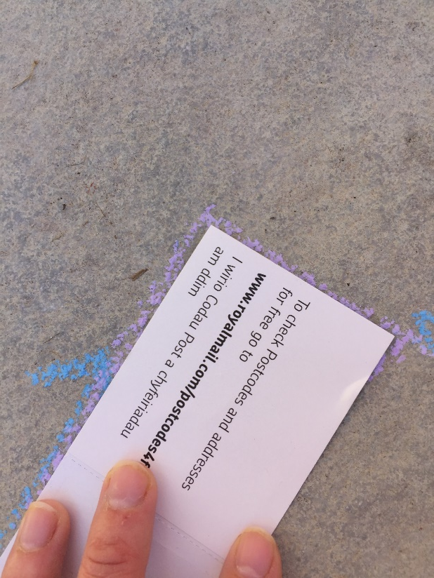
The paper fits exactly into the angle so this must be a right angle.

Slide 8
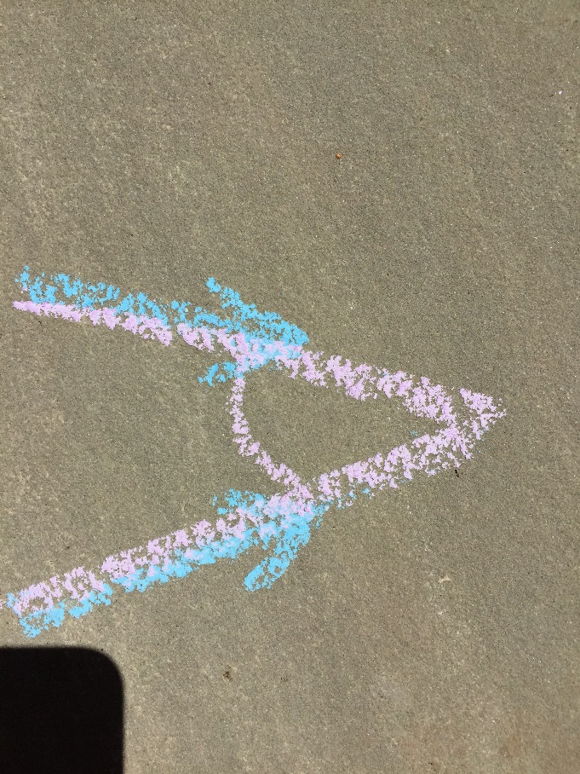
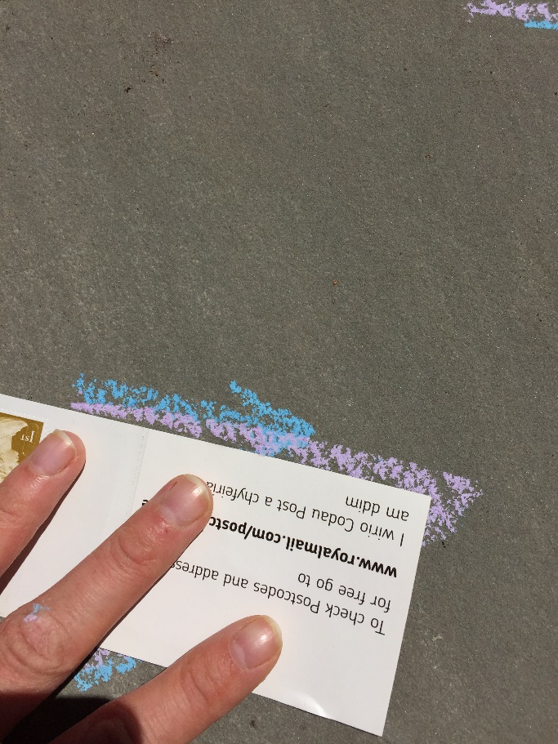
This time it doesn’t fit! The edge of my paper is overlapping the angle. The angle is smaller than a right angle.
This is an acute angle.

Slide 9
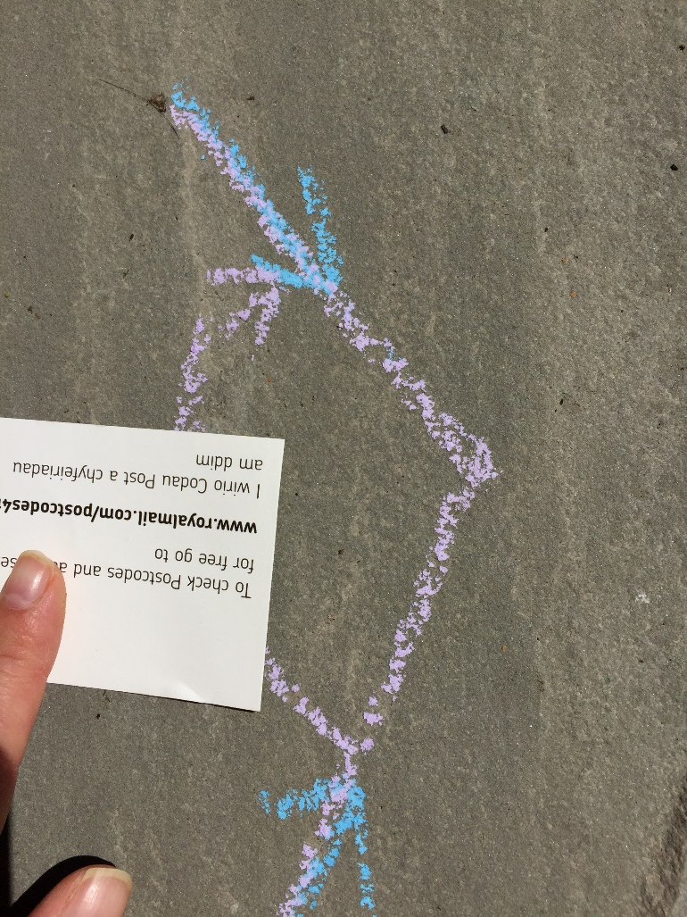
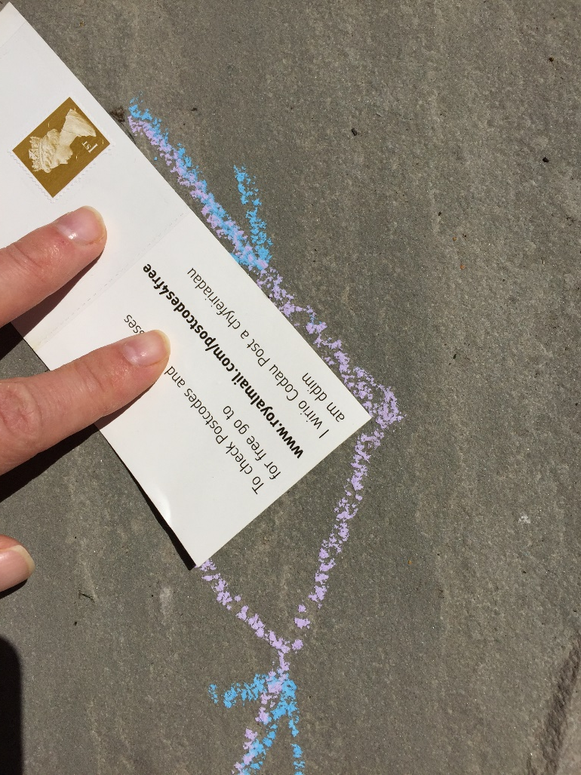
This time, you can see that the corner of the paper is smaller than the angle. The angle is bigger than a right angle.
This angle is obtuse.

Slide 10
Have a look at these and decide whether they are acute, obtuse or right angles.
Right angle
Obtuse
Acute
Obtuse
Acute

Slide 11
Have a go at the identifying angles sheet. The top half is just slightly trickier than yesterday but you’ll be fine if you think about it carefully. The second part is reasoning which you will need to do on a separate sheet or in your book as there isn’t room on the sheet.

