Slide 1
Maths
Properties of Shapes
Year One
Maths | Year 4 | Properties of Shapes | Angles | Lesson 2 of 2: Comparing Angles

Slide 2
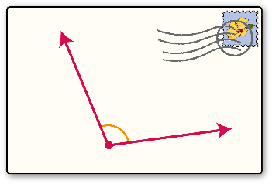
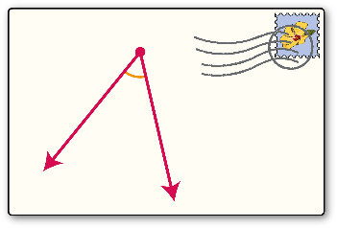
Comparing Angles

Slide 3
Aim
I can compare and order angles up to 180 degrees.
Success Criteria
I can identify acute and obtuse angles.
I can compare and order angles up to 180 degrees.

Slide 4
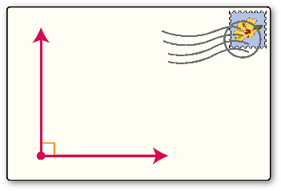
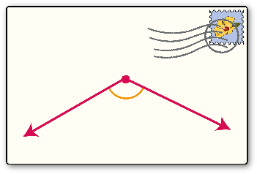
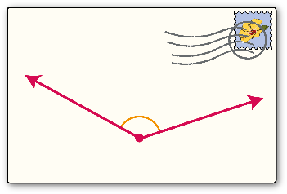
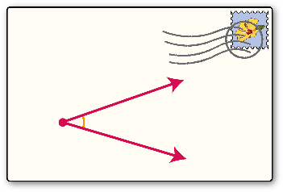
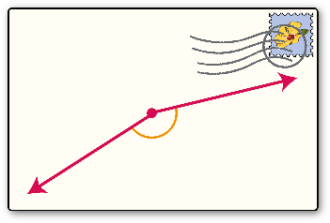
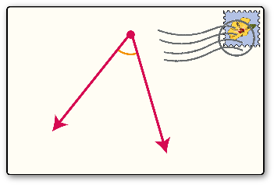
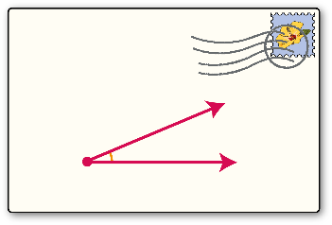
Angle Sort
Discuss where these angles should be sorted. Click an envelope to find out.
obtuse
acute
right angle

Slide 5
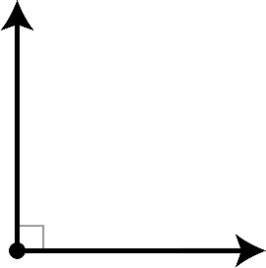
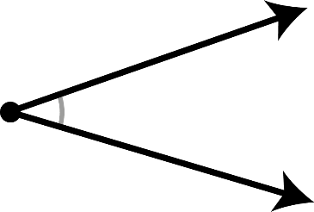
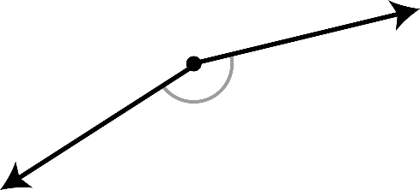
Angle Prove It!
Which of these angles are acute?
?
?

Slide 6
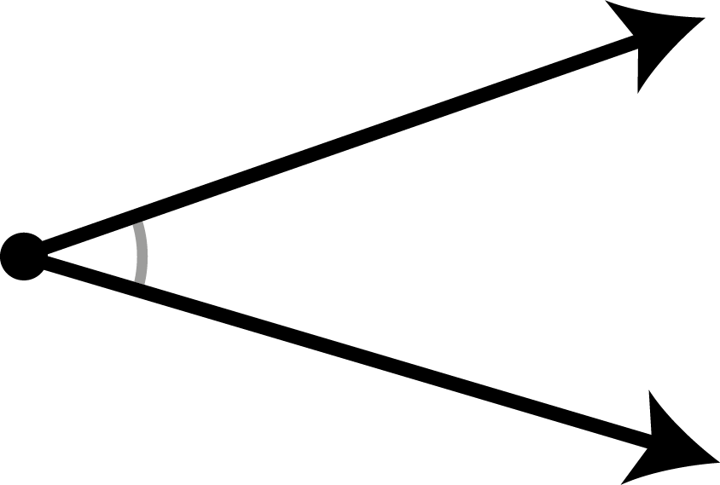
Ordering Angles
An acute angle measures less than 90°

Slide 7
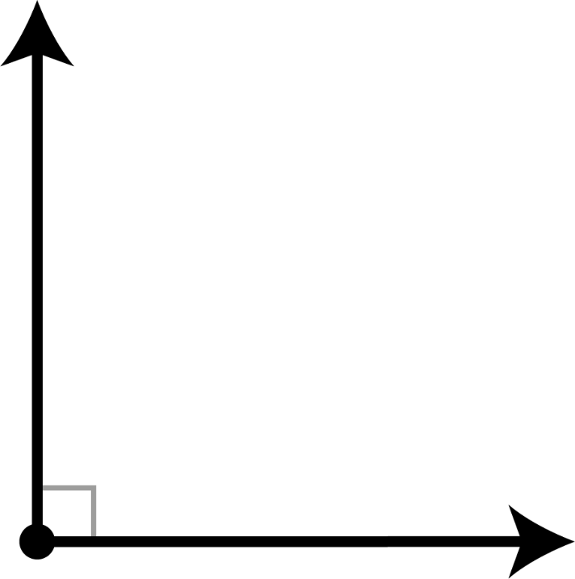
Ordering Angles
A right angle measures exactly 90°

Slide 8
Ordering Angles
An obtuse angle measures between 90° and 180°

Slide 9
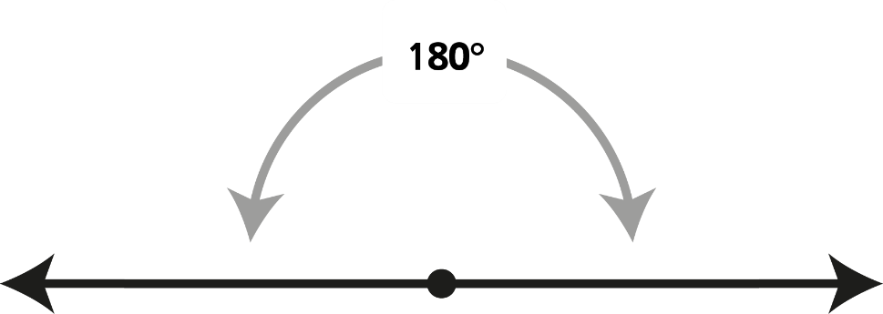
Ordering Angles
A straight angle measures exactly 180°

Slide 10
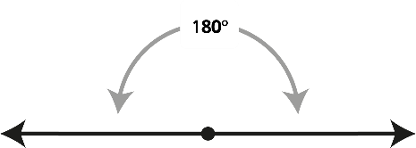
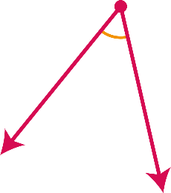
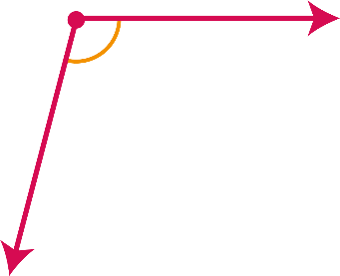
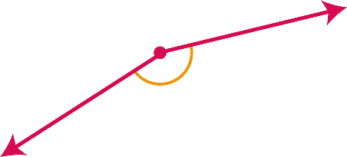
Ordering Angles
We can use these facts to help order a set of angles.
Smallest
Largest

Slide 11
Compare and Order Angles
Smallest
Largest
Can you order the angle cards from smallest to largest?

Slide 12
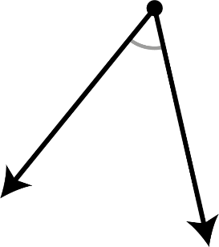
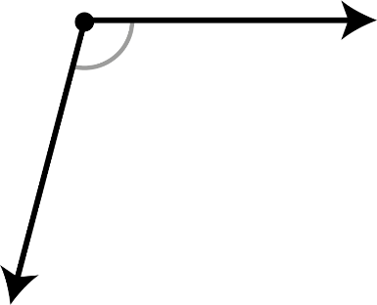
Comparing Signs
We can use the comparing signs <, = and > to write mathematical sentences that compare angles.
<
Angle 1 is smaller than angle 2.

Slide 13
Comparing Signs
We can use the comparing signs <, = and > to write mathematical sentences that compare angles.
>
Angle 1 is greater than angle 2.

Slide 14
Ordering Angles
We can use the comparing signs <, = and > to write mathematical sentences to compare angles.
1.
<
3.
2.
>
Angle 1 is smaller than angle 2.
Angle 2 is greater than angle 3.

Slide 15
Order the Angles Activity

Slide 16
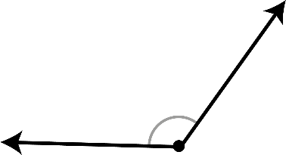
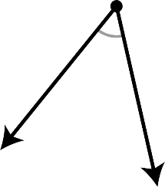
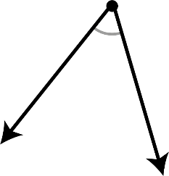
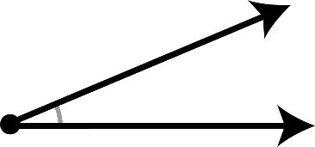
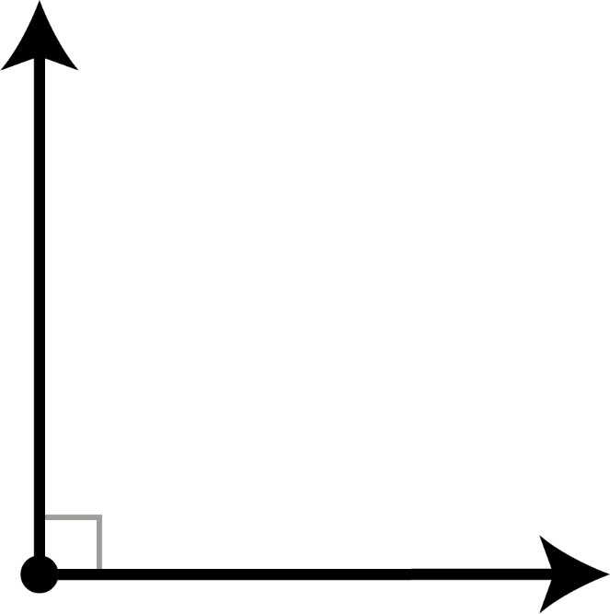
Odd Angle Out
Which angle is the odd one out in each set?

Slide 17
Aim
I can compare and order angles up to 180 degrees.
Success Criteria
I can identify acute and obtuse angles.
I can compare and order angles up to 180 degrees.

