Slide 1
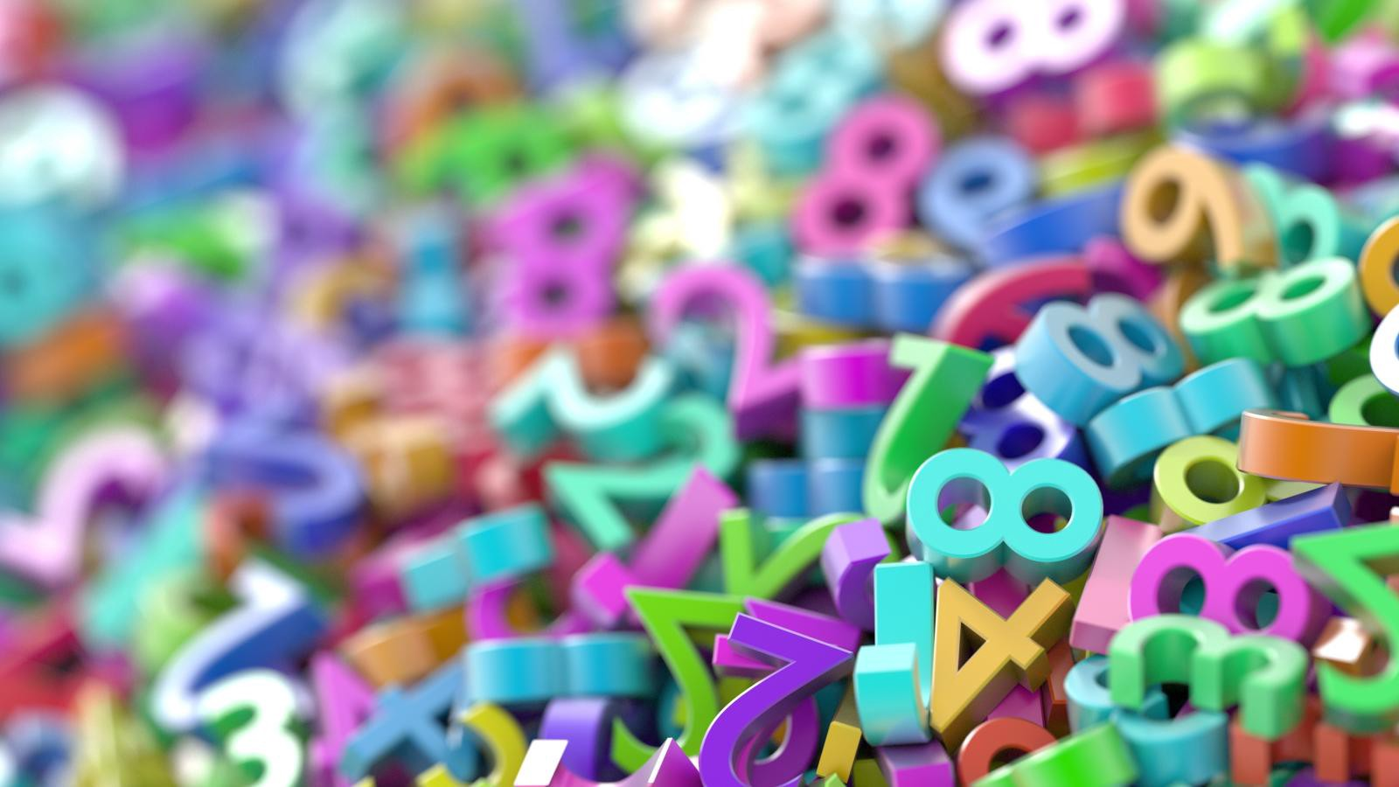
Divide a One or Two-Digit number by 100
(Make sure you play the slide show)

Slide 2
Draw a grid like this on your whiteboard/chalkboard/piece of scrap paper:
10s
1s
10ths
100ths

Slide 3
We’re going to do a bit of revision first...
Let’s revisit dividing numbers by 10 ☺

Slide 4
Draw the number 3 in your grid.
10s | 1s | 10ths | 100ths
3
Can you remember how to divide it by 10?

Slide 5
Now we’re going to divide it by 10 by moving the digit one space to the right…
10s | 1s | 10ths | 100ths
0
3
Don’t forget the 0 in the 1s column too ☺

Slide 6
We’re going to do the same thing again but with the number 13.
10s | 1s | 10ths | 100ths
1
3
Try to do it on your own whiteboard first before you check the answer on the next slide.

Slide 7
Now we’re going to divide it by 10 by moving the digit one space to the right…
10s | 1s | 10ths | 100ths
1
3
This time you don’t need a 0 because the 1s place has something in it.

Slide 8
Have a go at these three questions on a whiteboard/scrap paperjust to remind yourself…
0.7
1) 7 ÷ 10 =
1.5
2) 15 ÷ 10 =
3.6
3) 36÷ 10 =

Slide 9
Now we’re going to divide numbers by 100. Can you guess what we need to do?
Start by putting the number 5 in your grid…
10s | 1s | 10ths | 100ths
5
Try to work out the answer yourself before you go onto the next slide…

Slide 10
To divide by 100 you move each digit 2 spaces to the right. Did you guess correctly?
This is what happens…
10s | 1s | 10ths | 100ths
5
0
0
The 5 moves 2 spaces to the right but then we are left with 2 empty columns right next to the decimal point. You have to fill these in with 0s otherwise your number will just look like 5 instead of 0.05 which is the actual answer ☺

Slide 11
Now put the number 7 in your grid…
10s | 1s | 10ths | 100ths
7
Try to work out the answer yourself before you go onto the next slide…

Slide 12
To divide by 100 you move each digit 2 spaces to the right. This is what happens…
10s | 1s | 10ths | 100ths
7
0
0
The 5 moves 2 spaces to the right but then we are left with 2 empty columns right next to the decimal point. You have to fill these in with 0s otherwise your number will just look like 5 instead of 0.05 which is the actual answer ☺ This is what happens every time you divide a 1 digit number by 100.

Slide 13
Now what about if we want to divide a 2 digit number by 100 instead of a 1 digit number?
Try putting the number 22 into your grid.
10s | 1s | 10ths | 100ths
2
2
Try to work out the answer yourself before you go onto the next slide…

Slide 14
To divide by 100 you move each digit 2 spaces to the right. This is what happens…
It’s very similar to what you were doing before.
10s | 1s | 10ths | 100ths
2
0
2
Each digit moves 2 spaces to the right. This time though, there is only 1 empty space – the ones column. You just need to fill that with a 0. The answer is 0.22

Slide 15
Try putting the number 64 into your grid.
10s | 1s | 10ths | 100ths
6
4
Try to work out the answer yourself before you go onto the next slide…

Slide 16
To divide by 100 you move each digit 2 spaces to the right. This is what happens…
It’s very similar to what you were doing before.
10s | 1s | 10ths | 100ths
6
0
4
Each digit moves 2 spaces to the right. This time though, there is only 1 empty space – the ones column. You just need to fill that with a 0. The answer is 0.64

Slide 17
What about if your number is a multiple of 10?
10s | 1s | 10ths | 100ths
8
0
Try to work out the answer yourself before you go onto the next slide…

Slide 18
To divide by 100 you move each digit 2 spaces to the right. This is what happens…
It’s very similar to what you were doing before.
10s | 1s | 10ths | 100ths
8
0
0
This time, both the digits move two spaces to the right and you get the number 0.80
You can take the zero off the end and write 0.8 but we’re going to leave it on because it makes it a bit less confusing I think.

Slide 19
Complete these questions in your maths book. Use a place value grid on a whiteboard/scrap paper if it helps you work them out.
0.07
6) 94 ÷ 100 =
0.94
1) 7 ÷ 100 =
7) 72 ÷ 100 =
0.72
0.45
2) 45 ÷ 10 =
3) 36÷ 100 =
0.36
8) 40 ÷ 100 =
0.40 or 0.4
4) 6÷ 100 =
0.06
9) 55 ÷ 100 =
0.55
5) 12 ÷ 100 =
0.12
10) 20 ÷ 100 =
0.20 or 0.2

