Slide 2
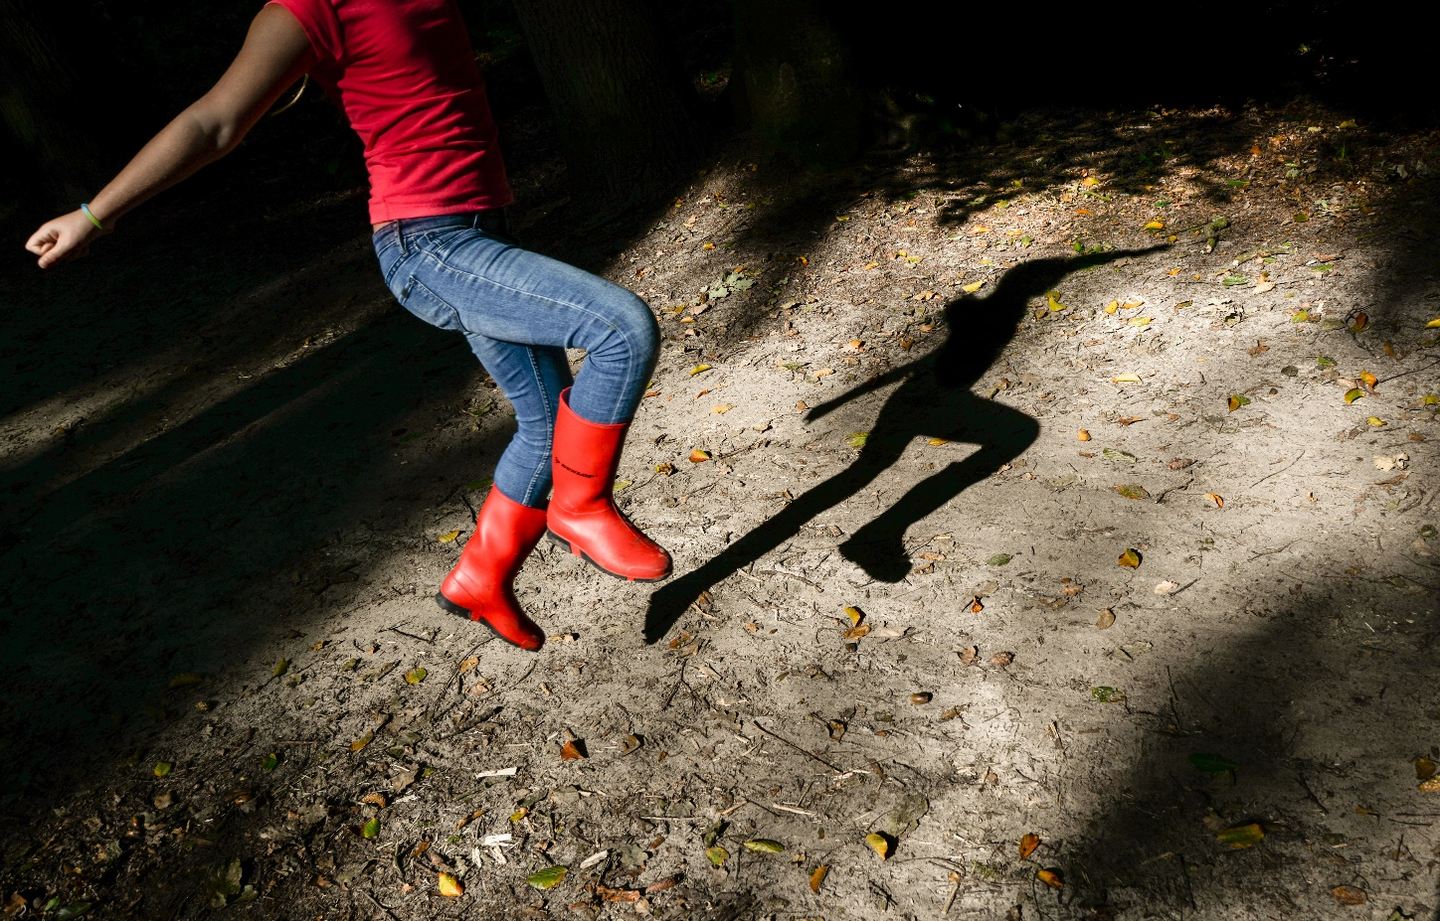
What Is a Shadow?
A shadow is formed when an object does not allow the light to pass through it.

Slide 3
What Direction Does Light Travel?
Light travels in straight lines.

Slide 4
How Are Shadows Made?
Shadows are made when there is an object blocking the light from hitting the surface.
The object needs to be a solid object. If it is clear then the sun will pass through it, whereas a solid object will block it.
This means that the shadow will always
be on the opposite side of an object to the
sun or light.

Slide 5
Which Direction Is the Sun?
Notes:
Click once to reveal the sun options, click again for answer to be revealed

Slide 6
Which Direction Is the Sun?

Slide 7
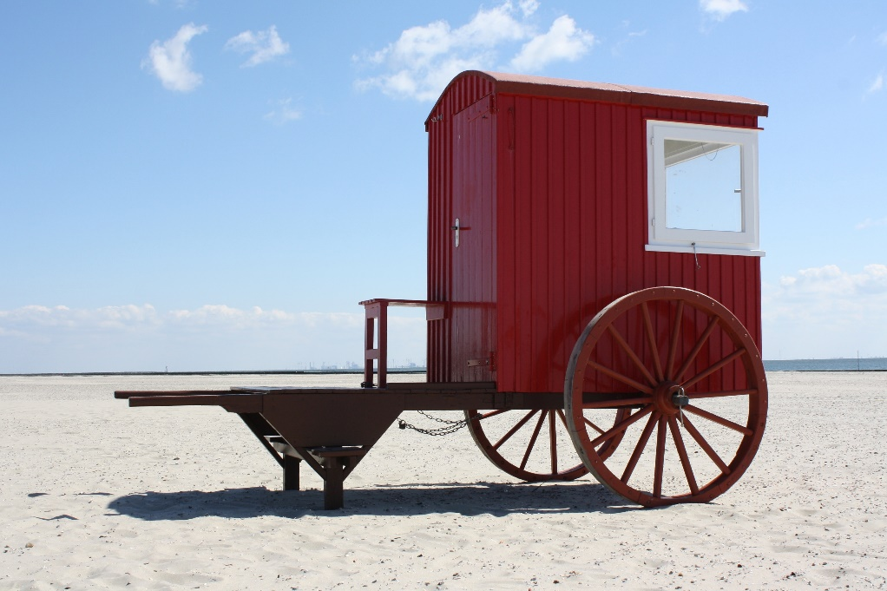
Which Direction Is the Sun?

Slide 8
Which Direction Is the Sun?

