Slide 1
Safari Park Fractions

Slide 2
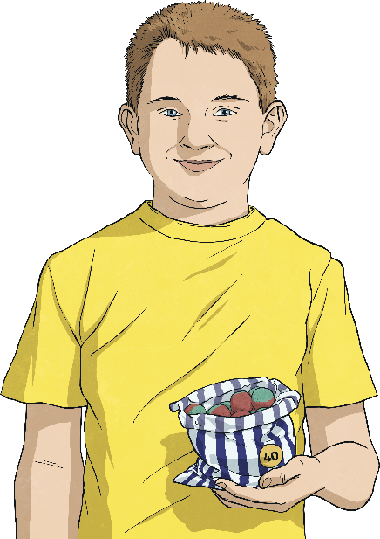
Fraction Bars
Joe had a bag of 28 sweets which he shared with 3 of his friends. How many sweets did each child get?
Draw a fraction bar to show ¼ of 28 sweets.
7 | 7 | 7 | 7
7 sweets | 7 sweets | 7 sweets | 7 sweets
¼ of 28 sweets = 7 sweets
How many sweets did Joe give away?
7 sweets | 7 sweets | 7 sweets | 7 sweets
7 | 7 | 7 | 7
¾ of 28 sweets = 21 sweets
What calculation have we done to work out what number goes in each section?
We don’t have to draw pictures or marks each time. We can just write the numbers in the fraction bar. The same number should be in each section so that they are equal sized groups.
28 ÷ 4 = 7
What do we have to do to the answer to get ¾ of 28?
7 × 3 = 21

Slide 3
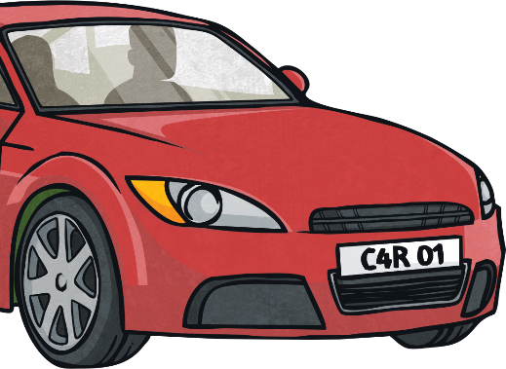
Fraction Bars
⅓ of the cars in a car park were red. There were 27 cars in the car park. How many red cars were there?
Draw a fraction bar to show ⅓ of 27 cars.
9 | 9 | 9
9 cars | 9 cars | 9 cars
⅓ of 27 cars = 9 cars
How many cars are not red?
9 | 9 | 9
9 cars | 9 cars | 9 cars
⅔ of 27 cars = 18 cars
What calculation have we done to work out what number goes in each section?
27 ÷ 3 = 9
What do we have to do to the answer to get ⅔ of 27?
9 × 2 = 18

Slide 4
Fraction Bars
Draw a fraction bar to help you to calculate the answer.
6 | 6 | 6 | 6 | 6
How many children do not wear glasses?
Draw a fraction bar to help you to calculate the answer.
6 | 6 | 6 | 6 | 6

Slide 5
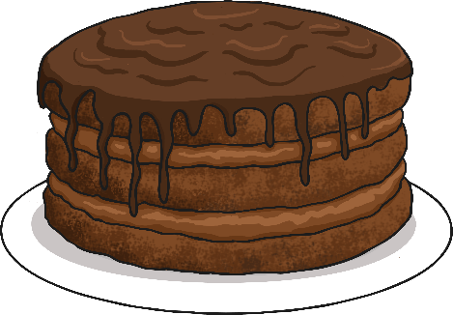
Cake Shop
100 ÷ 4 = 25
48 ÷ 6 = 8
35 ÷ 5 = 7
7 | 7 | 7 | 7 | 7
25 | 25 | 25 | 25
8 | 8 | 8 | 8 | 8 | 8
7 × 2 = 14
25 × 3 = 75
8 × 4 = 32
So ¾ of 100 = 75. 75 cakes had been sold by 2 o'clock.
2
So of 35 = 14. There were 14 cakes with pink icing.
−
5

