Slide 1
Story-reader
Problem-solver
Board-writer
Homework-setter
Playground-whistler
Register-taker
I don’t know – it’s beyond my ken!
An informative PowerPoint about identifying the features of kenning poems

Slide 2
LO: to recognise the features of kenning poems
Success Criteria:
I know that a kenning can consist of either noun-noun phrases or noun-verb phrases;
I understand that kennings do not name the theme of the poem;
I use the language in the poem to work out the theme;
I understand that kennings are understood best when they are read aloud.

Slide 3
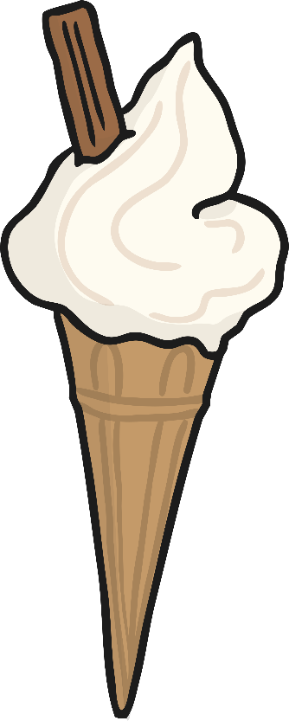
What is a kenning?
Kennings are like riddles.
They describe something without ever saying what it is.
Read these phrases out loud. What could they be describing?
lip-licking
sauce-swirling
chin-dripping
cone-filling
flake-holding
tongue-freezing

Slide 4
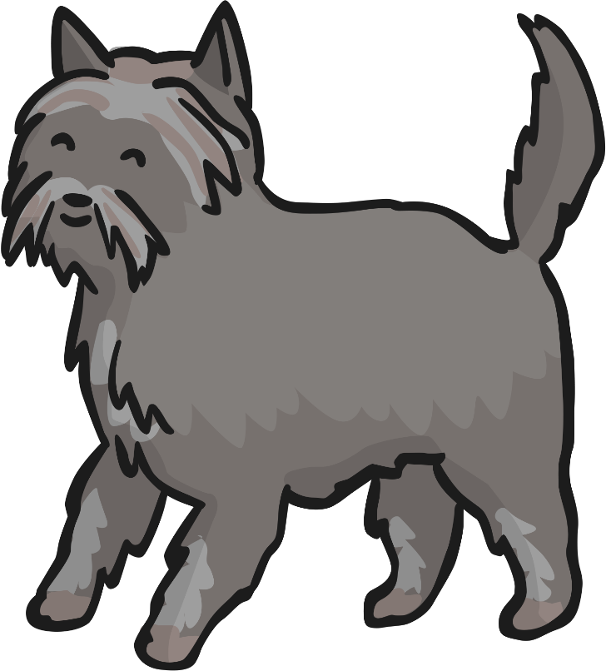
What is a kenning?
How about these?
tail-wagger
face-licker
ball-catcher
house-guardian
furry-friend
cat-chaser

Slide 5
What is a kenning?
What did you notice about the poems?
tail-wagger
lip-licking
face-licker
chin-dripping
ball-catcher
sauce-swirling
house-guardian
cone-filling
furry-friend
flake-holding
cat-chaser
tongue-freezing

Slide 6
What is a kenning?
What did you notice about the phrases in each poem?
Each line of the poem is made of a two-word phrase.
The words are joined by a hyphen.
house-guardian
lip-licking
furry-friend
chin-dripping
Here the phrases are made up of a noun + a noun.
Here the phrases are made up of a noun + a verb (the verb usually ends in -ing).

Slide 7
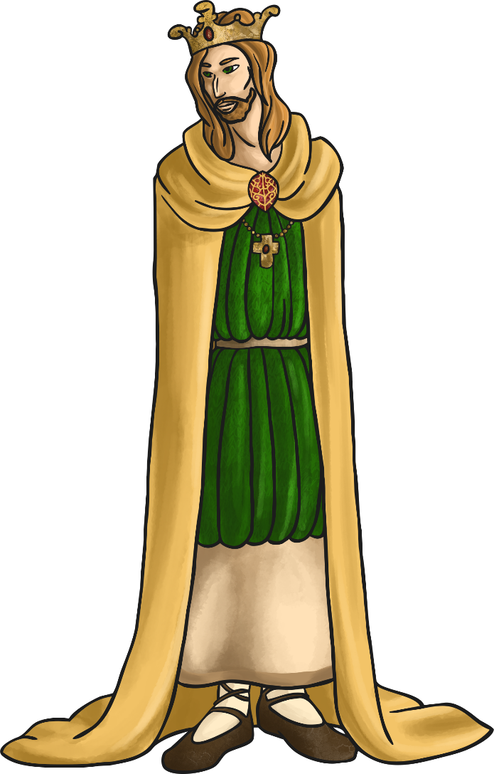
Did you know?
The two-word format for a kenning relates to the Old Norse tradition of naming things like weapons, e.g. Skull-Splitter or Blood-Taker.
Kennings came into our language via the Anglo-Saxon and Norse cultures. These people came from what is now Scandinavia and northern Germany.
The word ‘kenning’ derives from the Old Norse word ‘kenna eitt við’, which means ‘to express a thing in terms of another’.

Slide 8
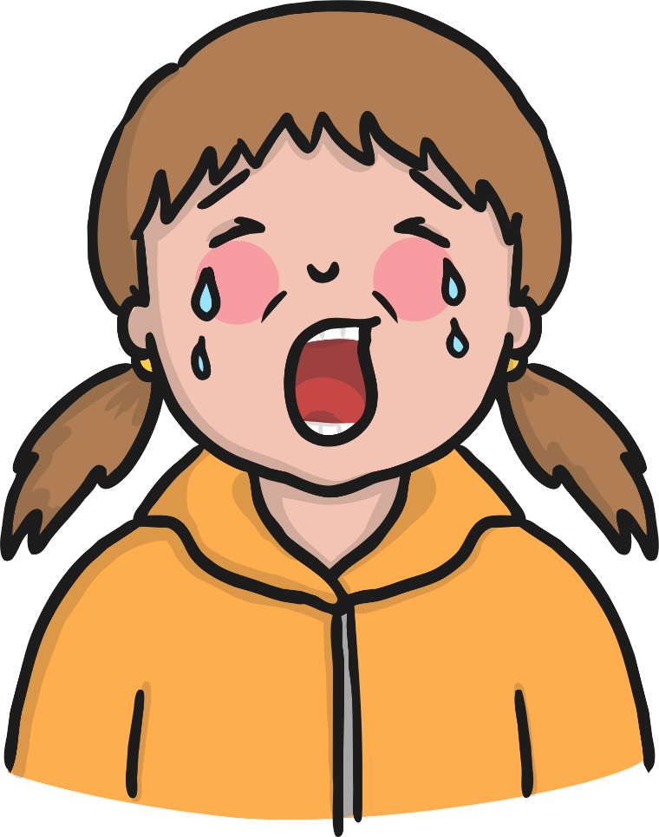
We even use them in everyday language!
How do we describe a very tall building?
A really sad film or story is often called a...
Oh look – here’s some alliteration! Other poetic devices can also be found in kennings.
sky-scraper
tear-jerker

Slide 9
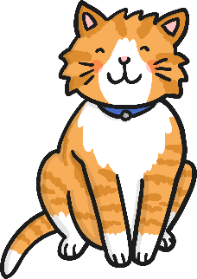
Let’s have a go!
How can we write a kenning?
First, we need to choose a theme. (It doesn’t have to be gory, like the Vikings!)
cat
Then, we brainstorm lots of words or phrases associated with that theme…
mice
nuzzle
drinks milk
scratch
stalk
sleeps a lot
fur
night
hunter
purr
hates dogs
rubs ankles

Slide 10
Let’s have a go!
How can we write a kenning?
To start creating your kenning, try and make a noun + noun phrase or a noun + verb phrase using your words.
nose
ear
mice
nuzzle
drinks milk
scratch
night
lick
stalk
sleeps a lot
fur
night
hunter
purr
hates dogs
rubs ankles

Slide 11
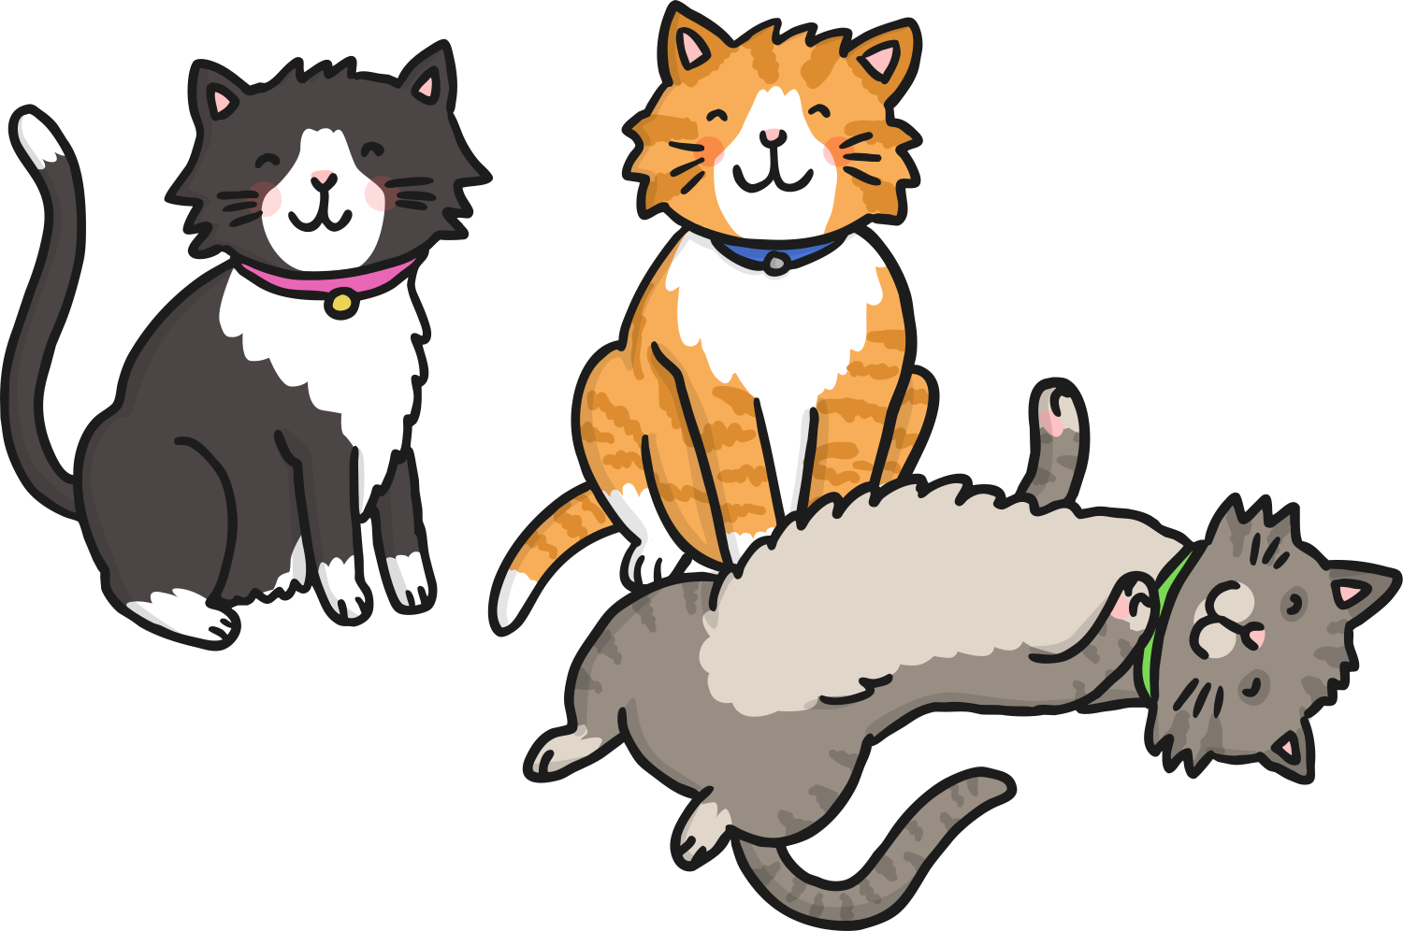
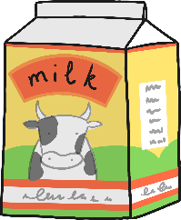
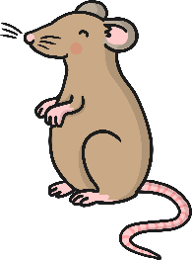
Let’s have a go!
How can we write a kenning?
Finally, put them together in your two-word phrases.
Don’t forget the hyphens!
mouse-hunter
milk-drinker
night-stalker
MEOW!
fur-licker
ankle-rubber
dog-hater
nose-nuzzler
ear-scratcher
loud-purrer

Slide 12
Let’s have a go!
You could write a kenning about all sorts of things. Here are a few ideas...
football
mums or dads
car
teachers
winter
pets
pizza

Slide 13
Plenary
What have we learned about Kennings?
Kennings are like riddles – they describe a thing but don’t tell you its name.
They usually have only two words- a noun plus a noun OR a noun plus a verb.
Poetic devices like alliteration can be used.
They’re great when you read them out loud so you can imagine the thing being describe.

Slide 14
The End

