Slide 1
Maths
Multiplication and Division
Year One
Maths | Year 3 | Multiplication and Division | Scaling Problems | Lesson 1 of 3: Animal Facts

Slide 2
Animal Facts

Slide 3
Aim
I can solve problems by scaling up.
Success Criteria
I can use known multiplication facts to scale up.
I can use the correct units in my answers.

Slide 4
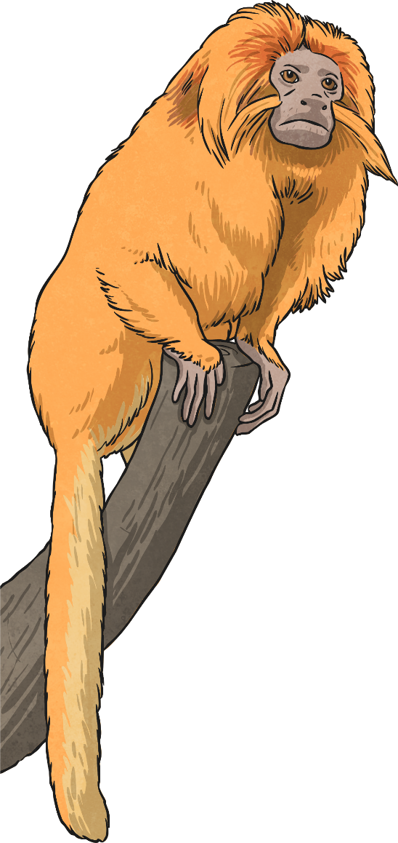
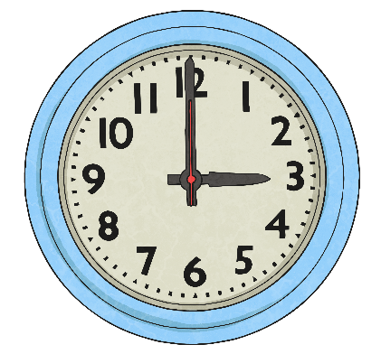
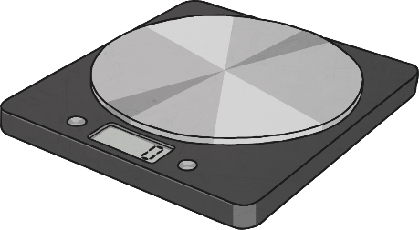
Measures
This is Tamara.
Tamara is a tamarin monkey from the Amazon forest.
We need to find out as much information as we can about Tamara, using measures.
What could we measure?

Slide 5
Measures
Height: 25cm
Length of tail: 40cm
Mass: 500g
Age: 5 years
Did you think of any more?

Slide 6
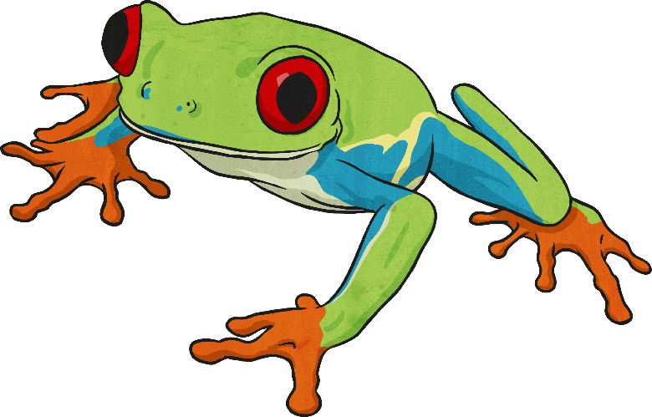
Felipe and Fabio
This is Felipe.
This is Fabio, he is Felipe’s son.
Fabio is much smaller than his dad, he is only half the size of Felipe.
Felipe is a red-eyed tree frog. He lives in the rainforest.
Felipe is twice as big as Fabio in every way.

Slide 7
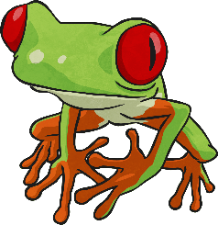
Felipe and Fabio
Fabio is 7cm long. Felipe is twice this length. How long is Felipe?
How could you work this out?
0
7cm
? cm

Slide 8
Felipe and Fabio
0
7cm
14cm
? cm
Fabio is 7cm long. Felipe is twice as long (or two times as long) as Fabio. Felipe is as long as two Fabios!
7cm + 7cm = 14cm, so Felipe must be 14cm long.
We can also work this out using multiplication: 2 × 7cm = 14cm

Slide 9
Felipe and Fabio
Fabio is 10cm tall. Felipe is twice this height. How tall is Felipe?
How could you work this out?
10cm
? cm
0

Slide 10
Felipe and Fabio
10cm
20cm
? cm
0
Fabio is 10 cm tall. Felipe is twice as tall (or two times as tall) as Fabio. He is as tall as two Fabios!
10cm + 10cm = 20cm, so Felipe is 20cm tall.
We could work also work this out using multiplication: 2 × 10cm = 20cm

Slide 11
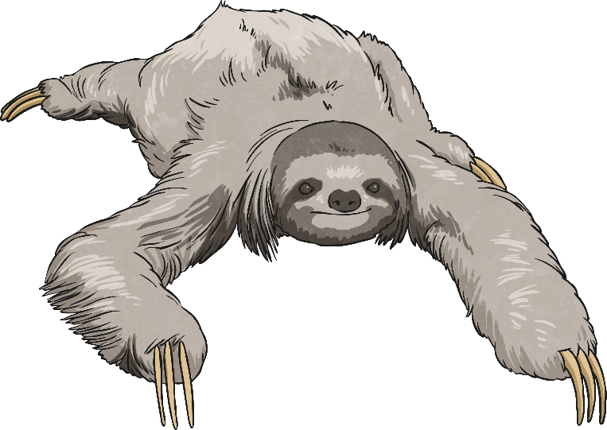
The Sloth Family
This is Santiago, the smallest member of the sloth family.
Santiago’s Facts
Height | 15cm
Body Length | 22cm
Mass | 2kg
Tail Length | 2cm

Slide 12
The Sloth Family
This is Santiago’s family.
Santiago
Sebastian
Mum
Dad
Sebastian is twice the size of Santiago.
Mum is three times as big as Santiago.
Dad is four times as big as Santiago.

Slide 13
The Sloth Family
Calculate the missing measurements using scaling.
 | Santiago | Sebastian (Twice as big) | Mum (Three times as big) | Dad (Four times as big)
Height | 12cm | 12cm × 2 = 24cm | 12cm × 3 = 36cm | 12cm × 4 = 48cm
Body Length | 20cm | 20cm × 2 = 40cm | 20cm × 3 = 60cm | 20cm × 4 = 80cm
Mass | 3kg | 3kg × 2 = 6kg | 3kg × 3 = 9kg | 3kg × 4 = 12kg
Tail Length | 2cm | 2cm × 2 = 4cm | 2cm × 3 = 6cm | 2cm × 4 = 8cm

Slide 14
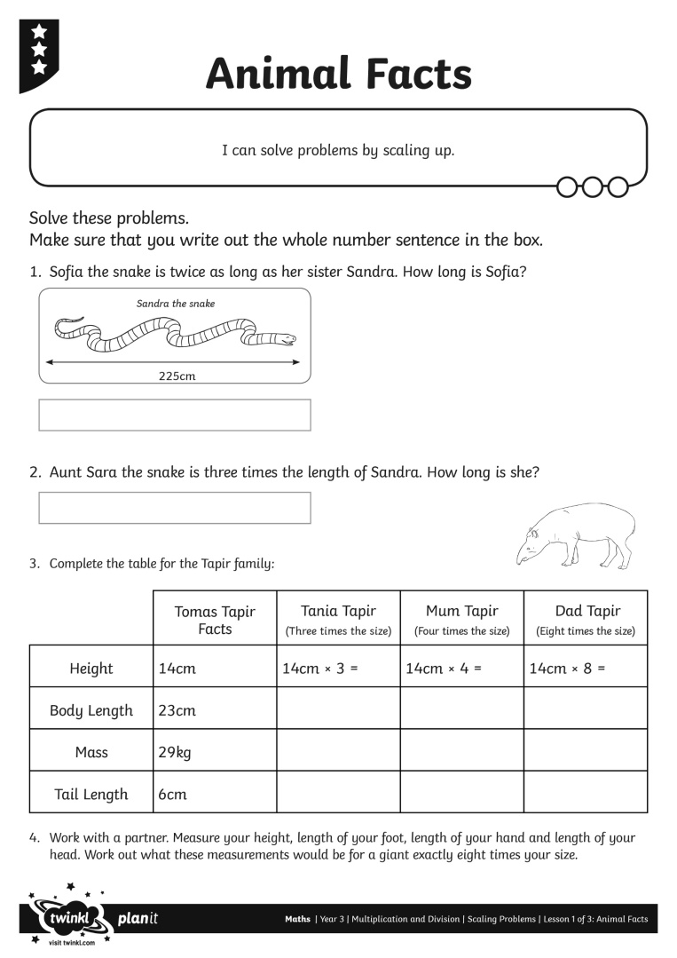
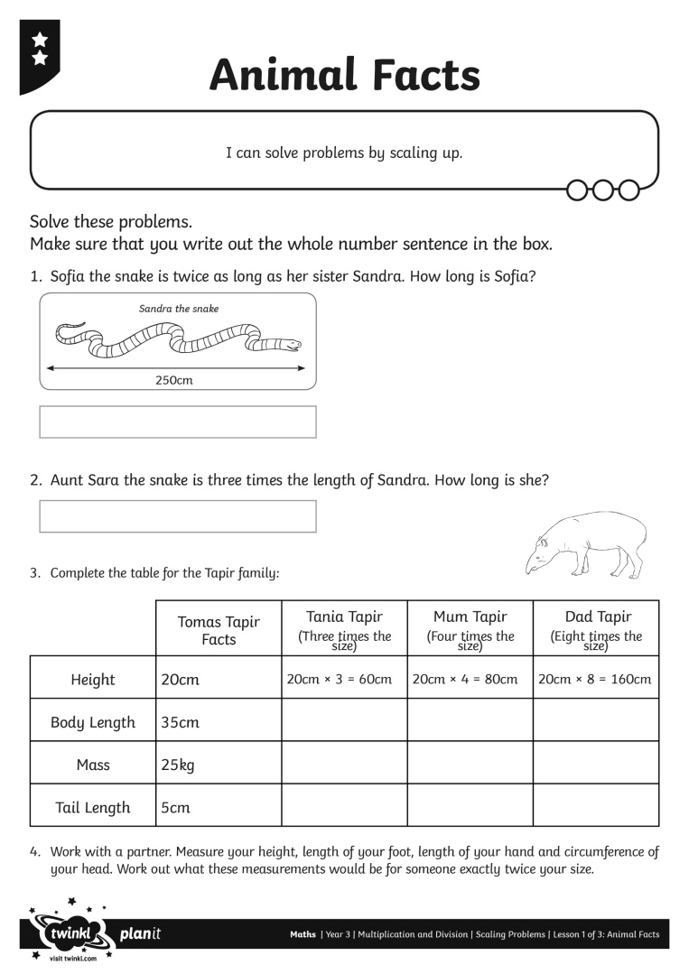
Animal Facts Activity

Slide 15
Aim
I can solve problems by scaling up.
Success Criteria
I can use known multiplication facts to scale up.
I can use the correct units in my answers.

