Slide 1
Spelling, Punctuation and Grammar
Compound Words
Year One
SPaG | Compound Words

Slide 2
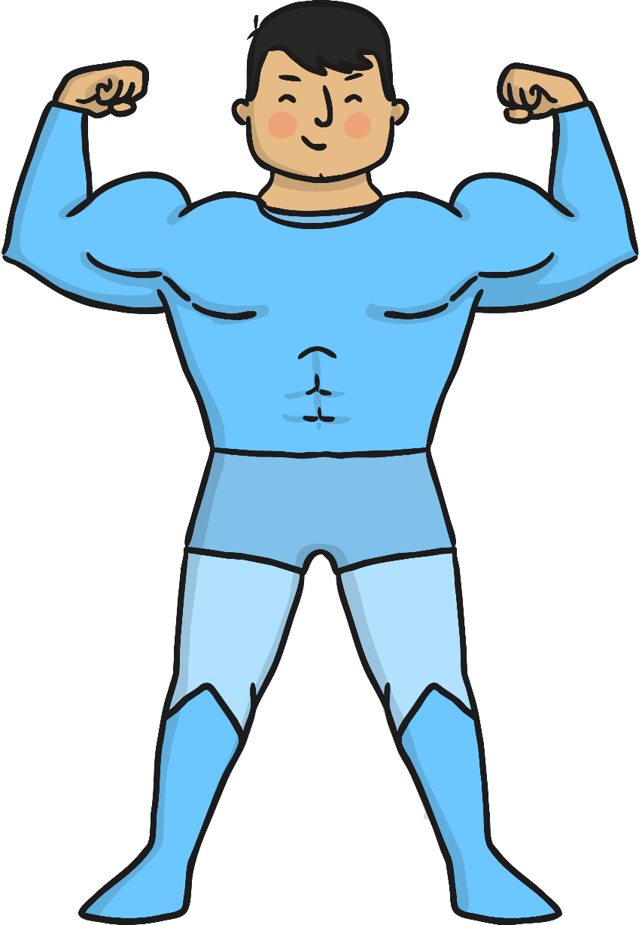
Compound Words

Slide 3
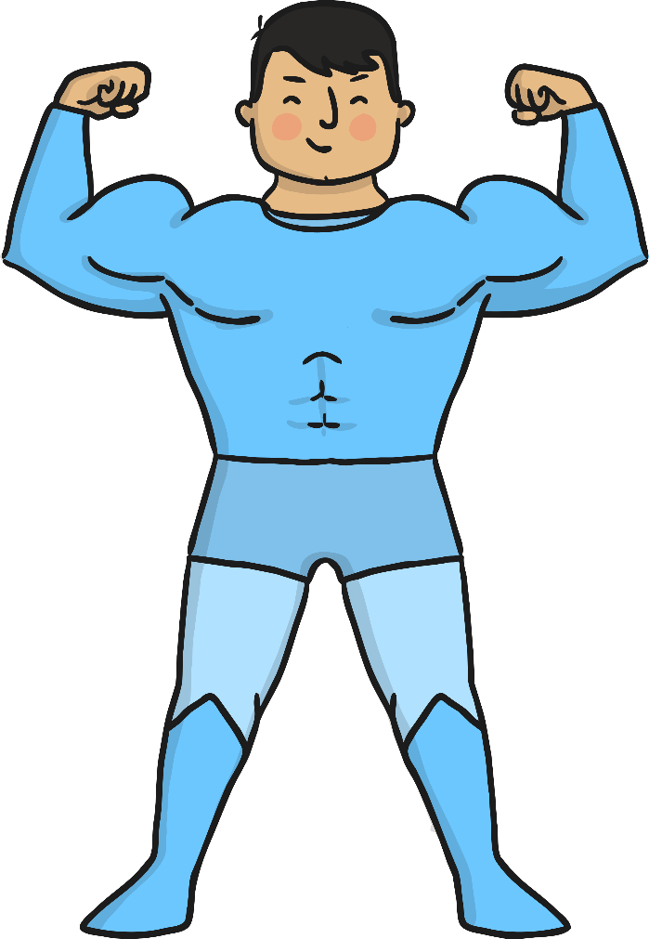
Meet Captain Compound. He is in charge of some very special words.

Slide 4
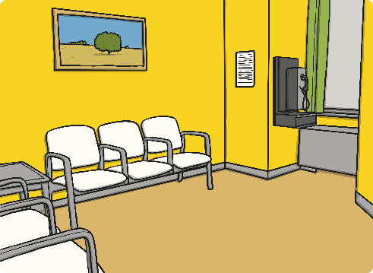
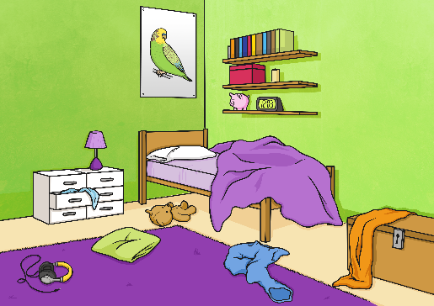
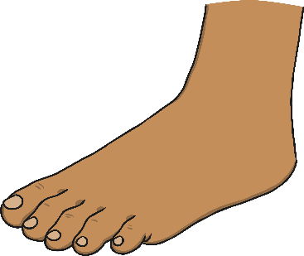
Look at these pictures. What can you see?
bed
room
bedroom
foot
ball
football
A compound word is made of two separate words. The two words are joined together to make a new word.

Slide 5
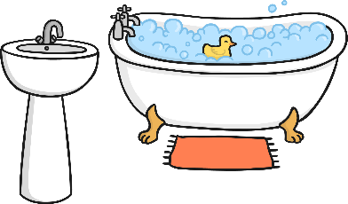
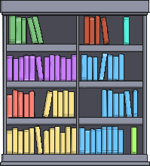
Can you read these compound words?
eyebrow
bathroom
raindrop
bookcase

Slide 6
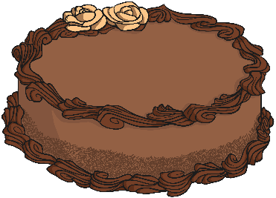
What do you think these compound words might be? Talk to your partner and write your answers on your whiteboard.
newspaper
pancake

Slide 7
Someone has chopped up the compound words! Can you help Captain Compound to put them back together again?
ear
air
mouth
bag
wash
shot

Slide 8
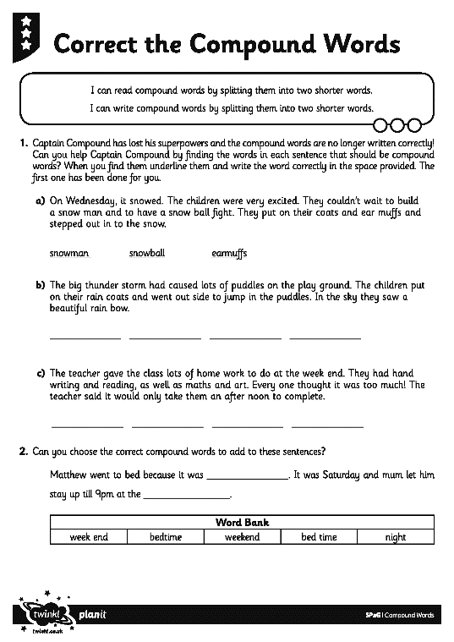
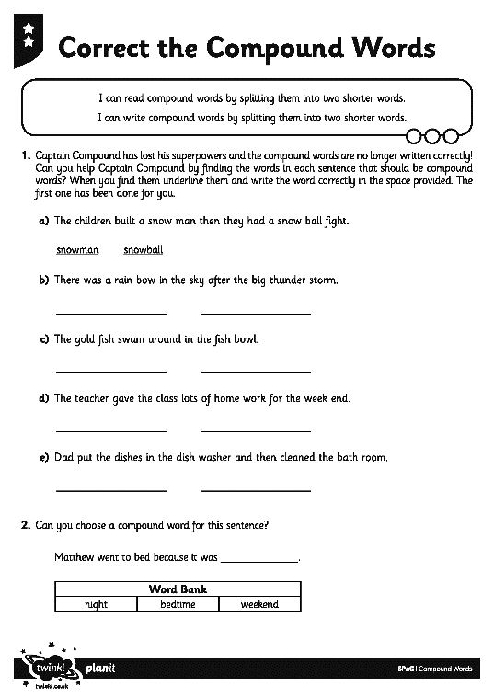
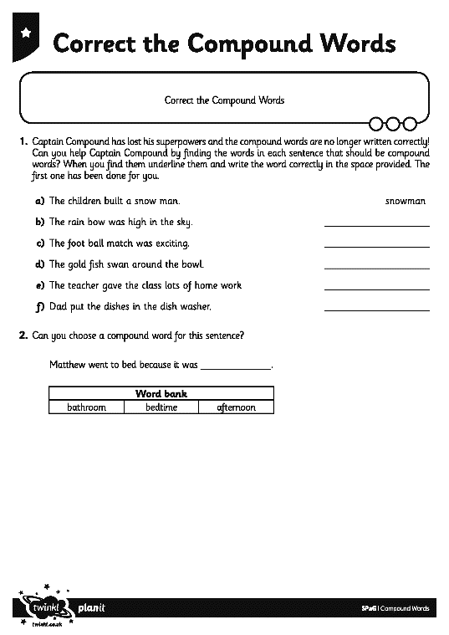
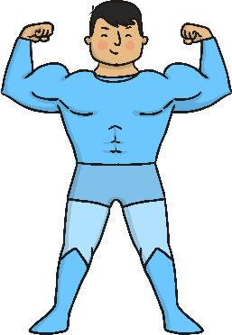
Captain Compound needs your help! Someone has taken his superpowers and he can no longer make sure that all the compound words are written correctly.
On the Correct the Compound Word Activity Sheet, can you find all of the incorrect compound words and correct them?

