Slide 1
Science
Living Things and Their Habitats
Year One
Science | Year 2 | Living Things and Their Habitats | Living, Dead or Never Alive | Lesson 1

Slide 3
Aim
I can compare the differences between things that are living, dead and have never been alive.
I can answer questions about things that are living, dead or have never been alive.
Success Criteria
I can explain some of the life processes.
I can explain how life processes can tell us if something is living, dead or has never been alive.
I can say if something is living, dead or has never been alive.
I can give reasons for my answers.

Slide 4
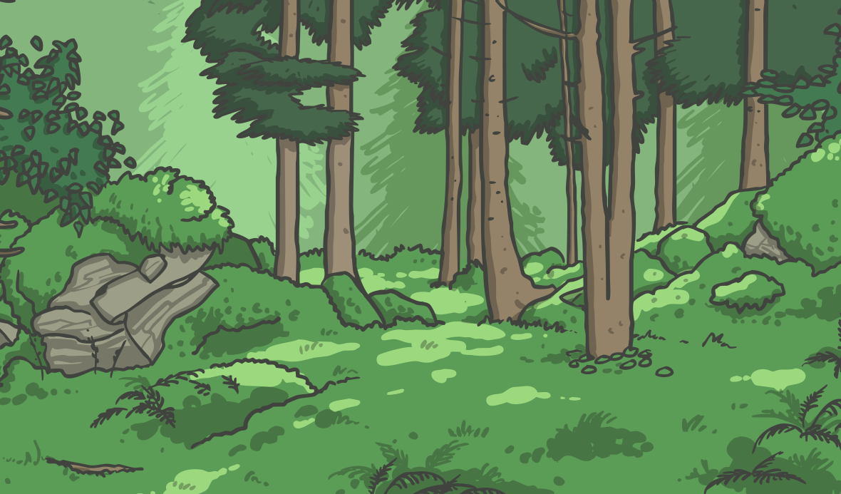
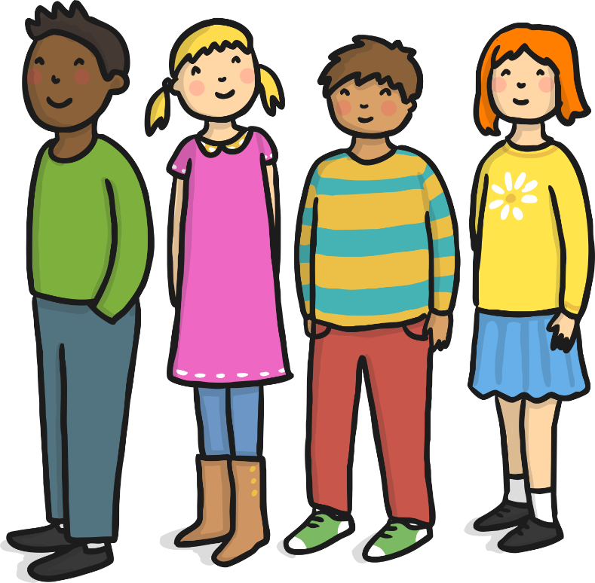
I’m Alive!
We are all alive!
What do we do that lets us know we are alive?

Slide 5
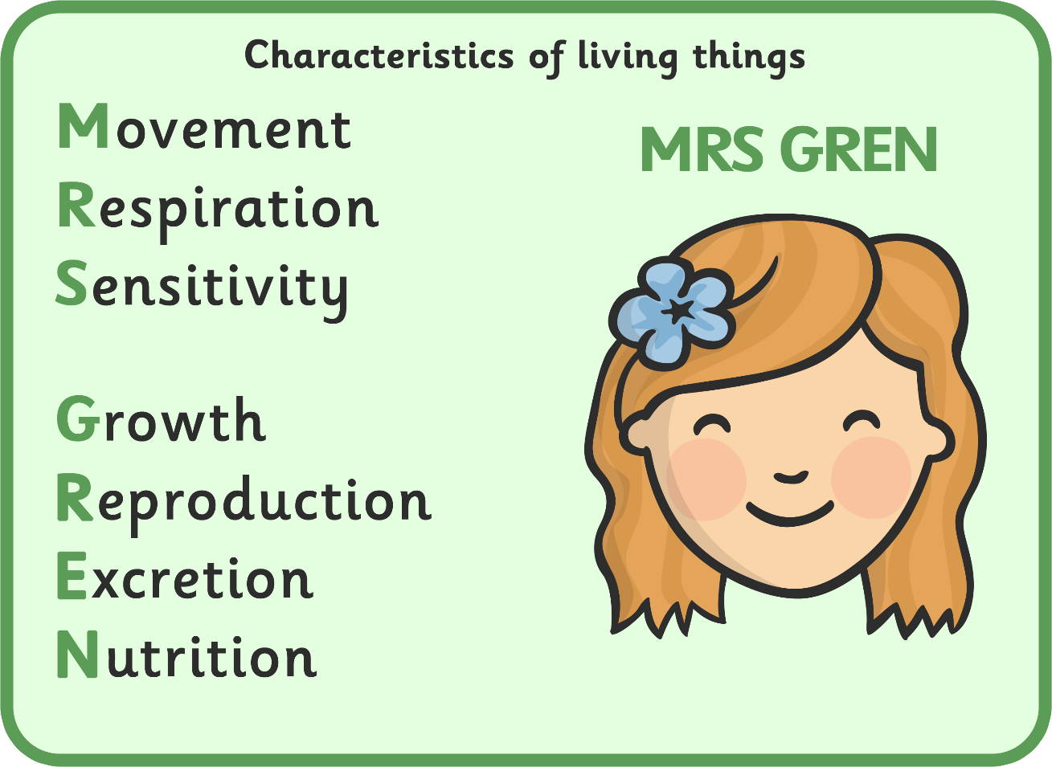
Life Processes

Slide 6
Life Processes

Slide 7
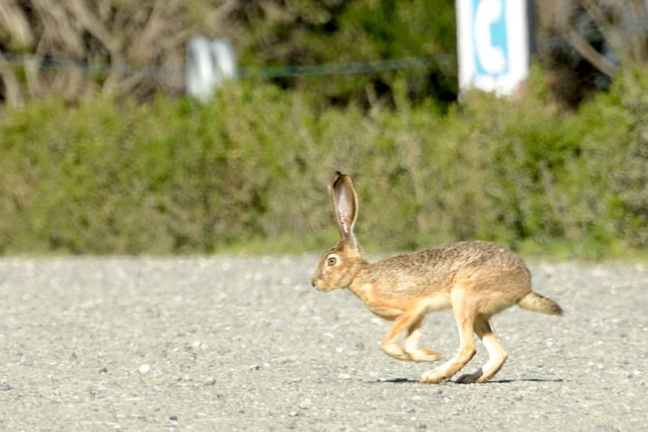
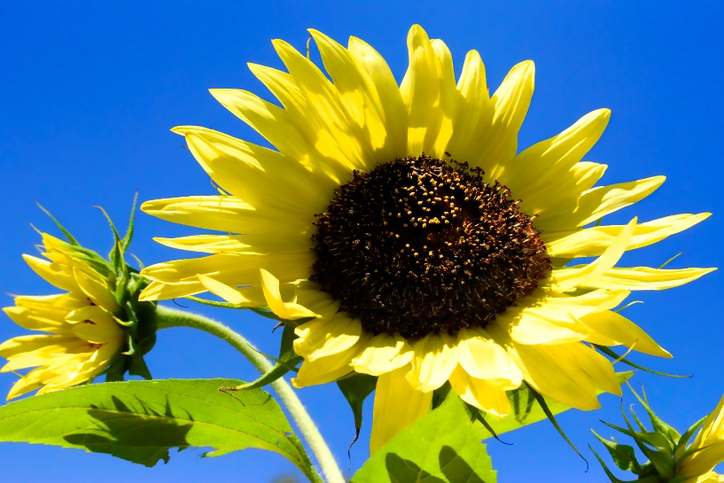
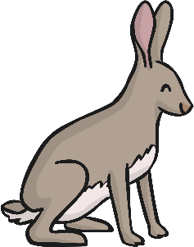
Life Processes: Movement
A sunflower moves to
turn its face towards the sun.
A hare runs to
escape from danger.
ATTRIBUTION - Photo courtesy of Don DeBold and Scott Hudson (@flickr.com) - granted under creative commons licence - attribution

Slide 8
Life Processes

Slide 9
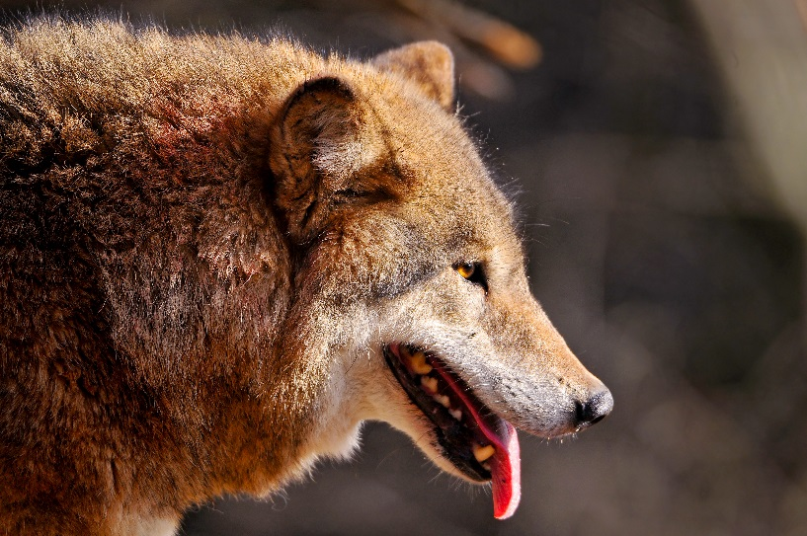
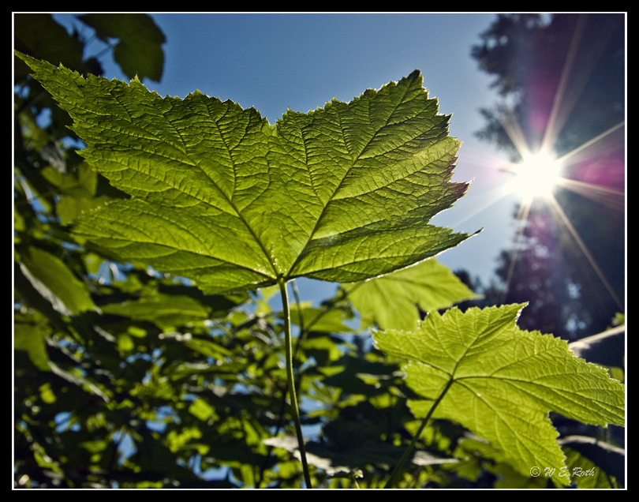
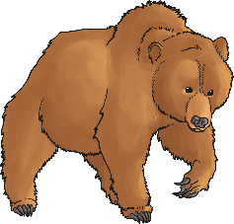
Life Processes: Respiration
Mammals breathe through their mouths and noses.
Plants take in and give out gases through their leaves.
ATTRIBUTION - Photo courtesy of Tambako the Jaguar and Waledro (@flickr.com) - granted under creative commons licence - attribution

Slide 10
Life Processes

Slide 11
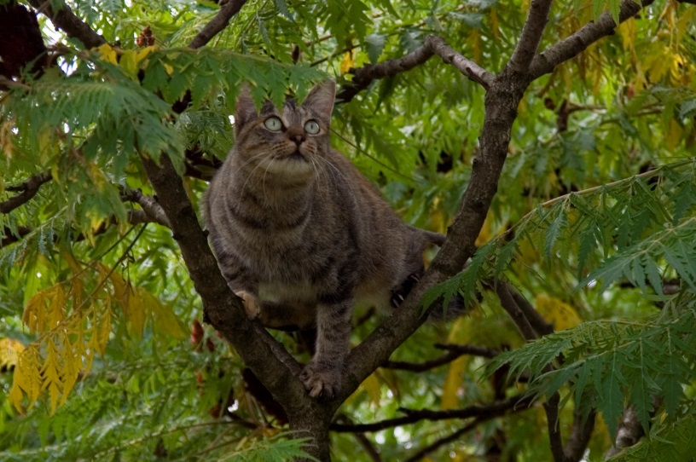
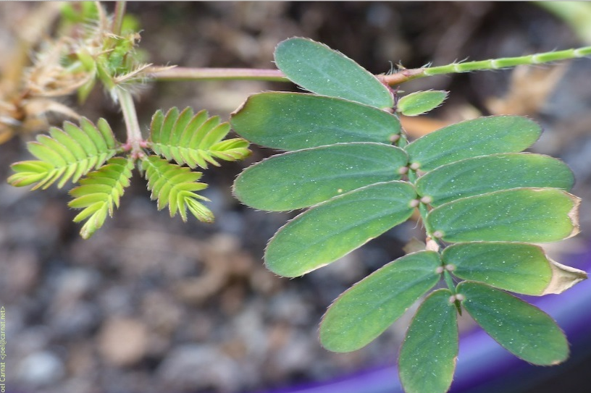
Life Processes: Sensitivity
Animals use their senses to see, hear, taste, touch and smell the world around them.
Plants can also detect changes in the environment. This mimosa plant curls up when you touch it!
ATTRIBUTION - Photo courtesy of Domenico Salvagnin and Carnat Joel (@flickr.com) - granted under creative commons licence - attribution

Slide 12
Life Processes

Slide 13
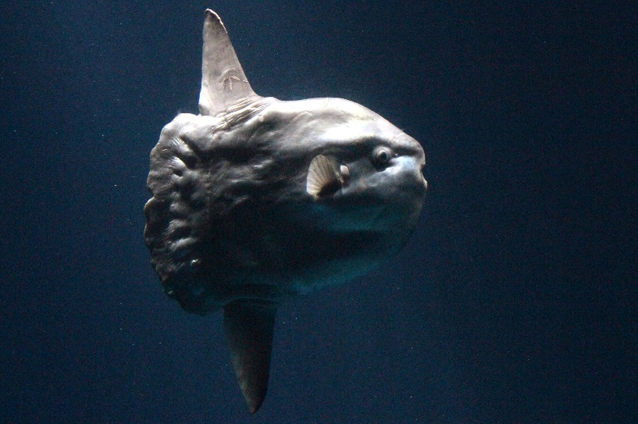
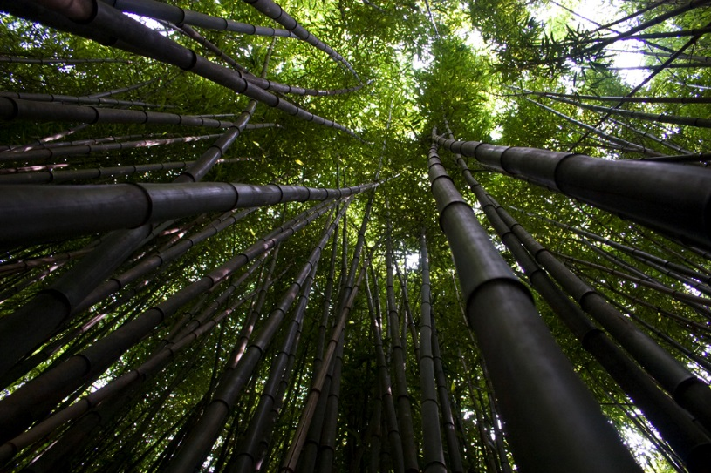
Life Processes: Growth
This ocean mola started life as an egg not much bigger than a full stop. It will grow to weigh about 1000 kg- this is the same size as a large bull!
Bamboo can grow up to 3cm every hour.
ATTRIBUTION - Photo courtesy of Sandip Bhattacharya and The Pug Father (@flickr.com) - granted under creative commons licence - attribution

Slide 14
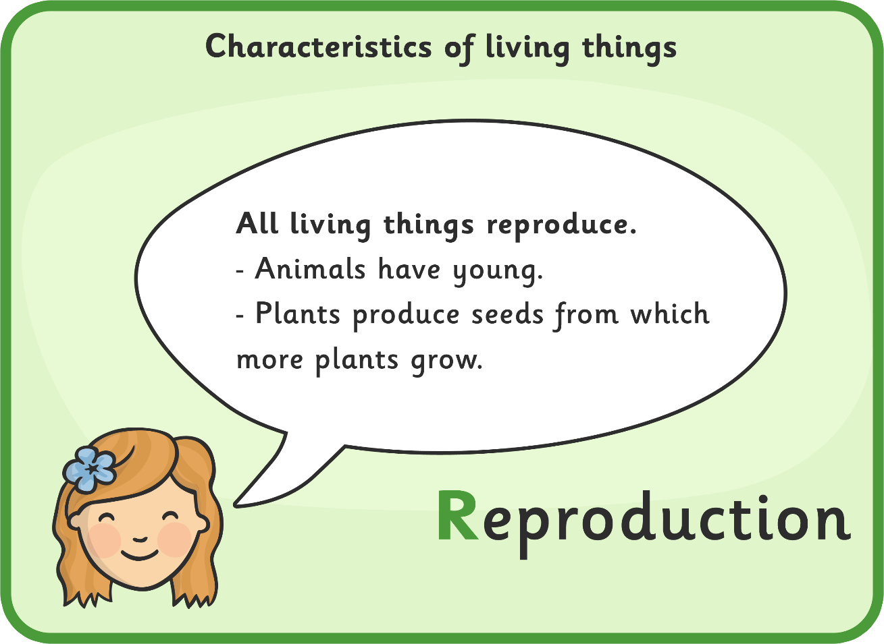
Life Processes

Slide 15
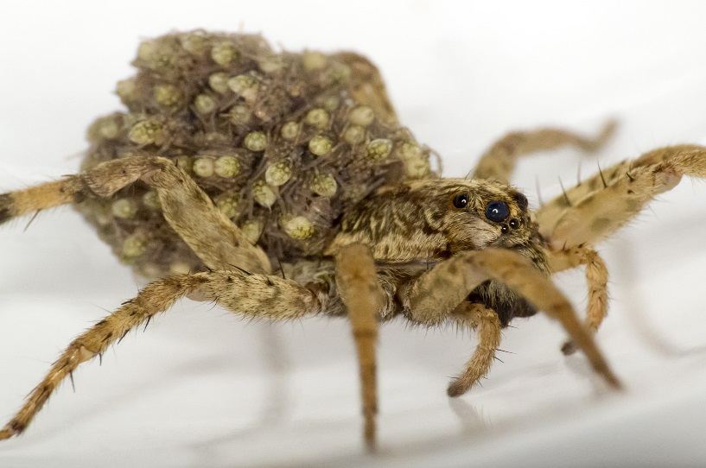
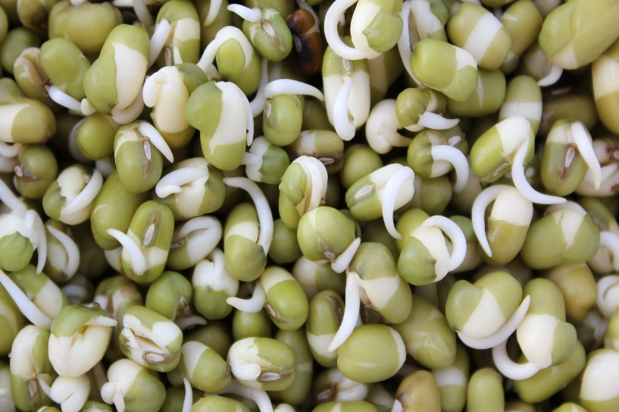
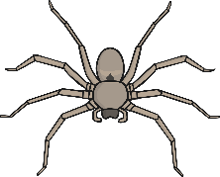
Life Processes: Reproduction
This wolf spider has her babies on her back.
Each seed contains a tiny miniature plant ready to grow.
ATTRIBUTION - Photo courtesy of Ralph Arvesen and U.S. Department of Agriculture (@flickr.com) - granted under creative commons licence - attribution

Slide 16
Life Processes

Slide 17
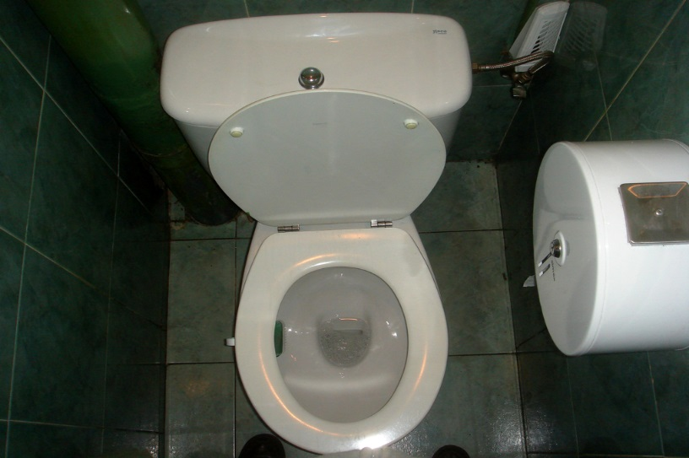
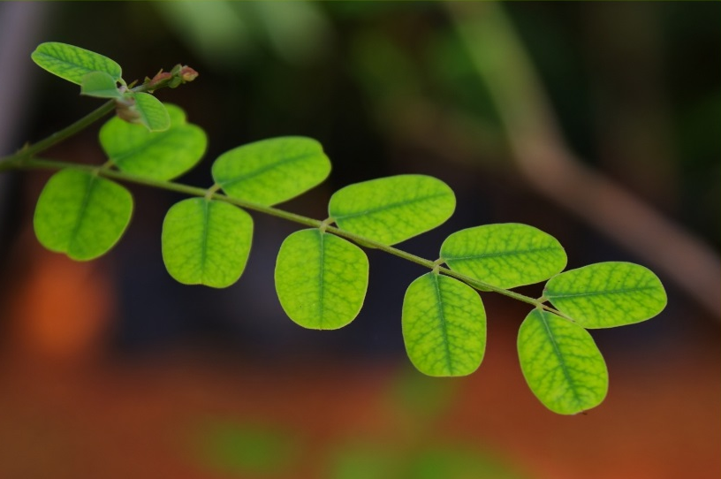
Life Processes: Excretion
How do you get rid of waste products from your body?
Left over gases and water leave plants through their leaves.
ATTRIBUTION - Photo courtesy of boxface and Pranav Yaddanapudl (@flickr.com) - granted under creative commons licence - attribution

Slide 18
Life Processes

Slide 19
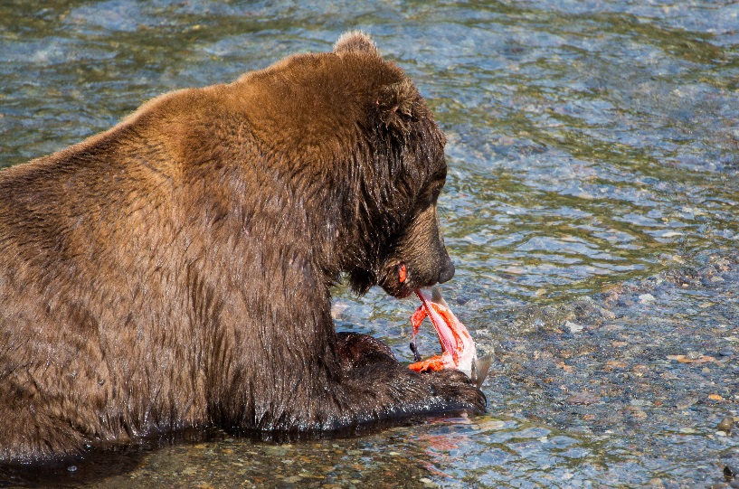
Life Processes: Nutrition
Some animals eat plants, and some eat other animals.
Bears eat both, like people!
Green plants make their own food using the energy from the sun.
ATTRIBUTION - Photo courtesy of Christoph Strassler and NielsWPhotography (@flickr.com) - granted under creative commons licence - attribution

Slide 20
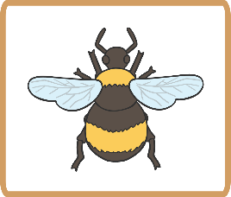
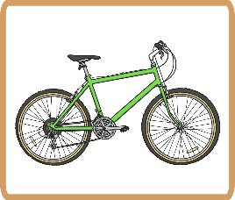
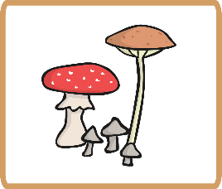
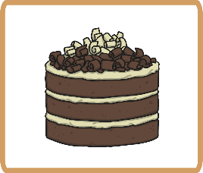
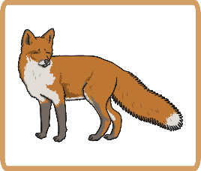
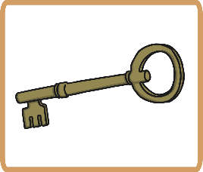
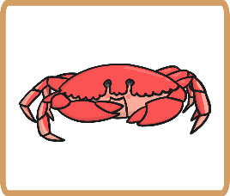
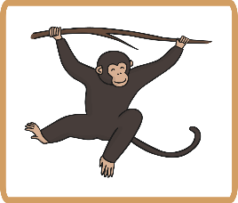
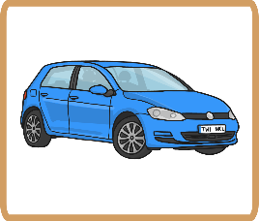
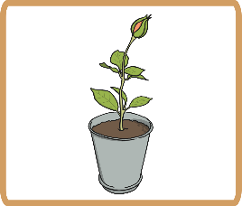
Living or Not?
Which of these are living?
Which are non-living?
How can you tell?

Slide 21
Living or Not?
Living
Non-living

Slide 22
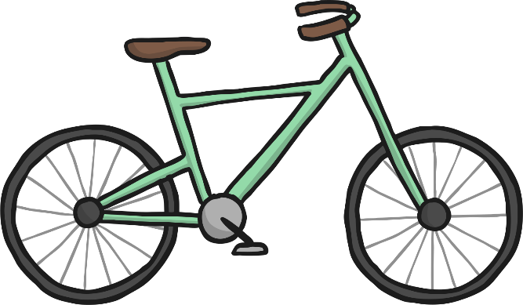
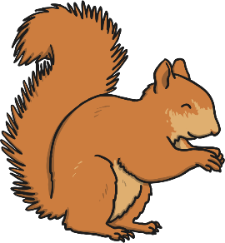
Living or Not?
Living things have life processes.
They need food, water and air to stay alive.
They can sense changes in the environment.
They can move, grow and reproduce.
Non-living things can be things that were once living or part of a living thing, or they can be things that have never been alive.
They do not need food, water or air.
They cannot reproduce.
v
v

Slide 23
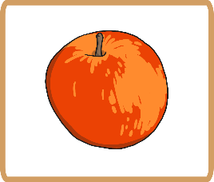
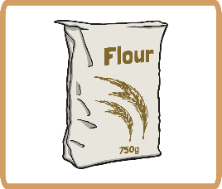
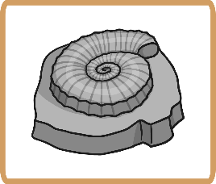
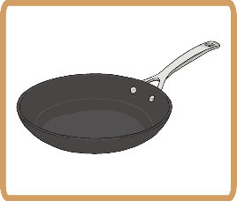
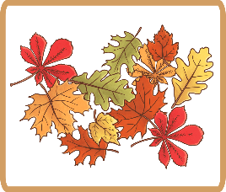
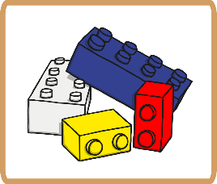
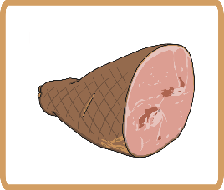
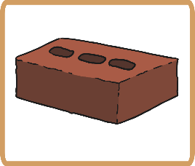
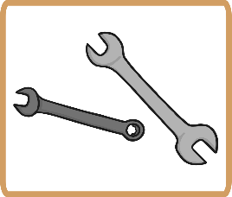
Dead or Never Alive?
Many non-living things have never been alive but some of them were once part of a living plant or an animal.
Which of these non living things are dead, and which were never alive?
It may help to think of what the thing is made from.

Slide 24
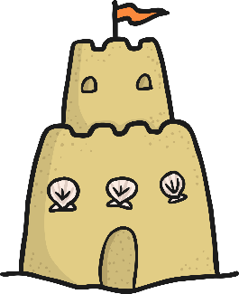
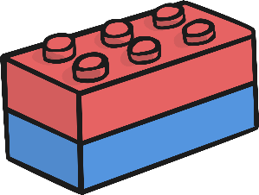
Dead or Never Alive?
Things made of materials like metal, rock, plastic, glass and sand have never been part of a living thing.
Never alive

Slide 25
Dead or Never Alive?
All of these things are non-living,
but they used to be part of a
living thing.
Dead
Which living thing were they part of?

Slide 26
How Can You Tell?
Is this teapot living, dead or has it never been alive?
How can you tell?

Slide 27
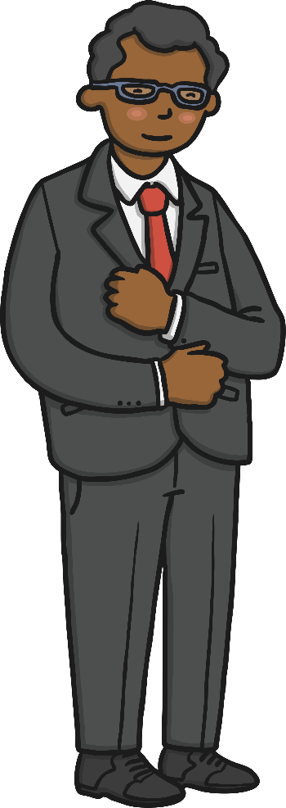
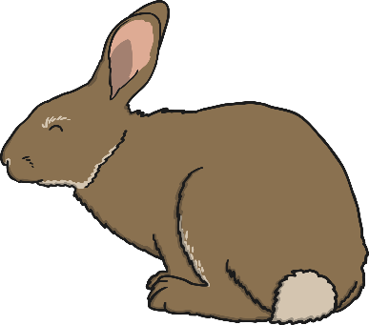
How Can You Tell?
Is this rabbit living, dead or has it never been alive?
How can you tell?

Slide 28
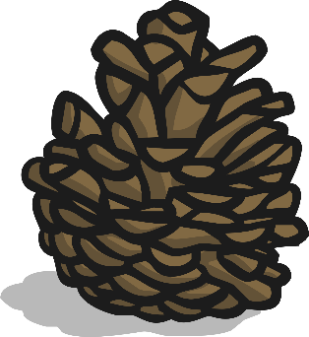
How Can You Tell?
Is this pinecone living, dead or has it never been alive?
How can you tell?

Slide 29
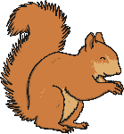
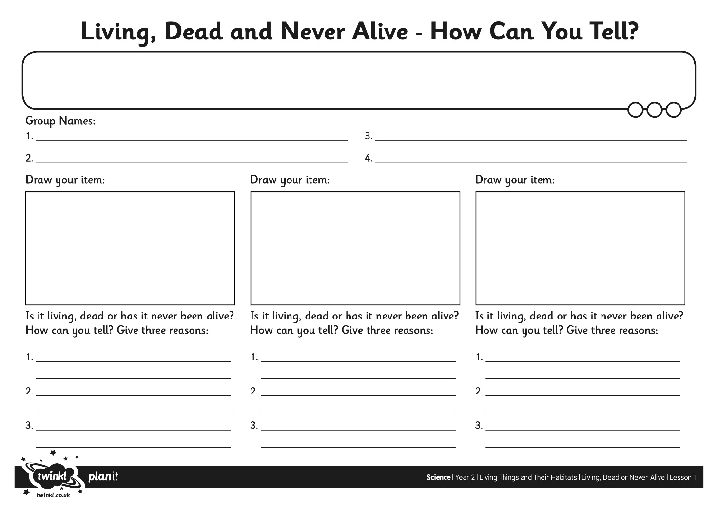
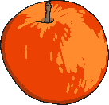
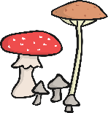
How Can You Tell?

