Slide 2
Aim
To show quarter past and quarter to times on a clock.
Success Criteria
I can read quarter past times on a clock.
I can read quarter to times on a clock.
I can make quarter past times on a clock.
I can make quarter to times on a clock.

Slide 3
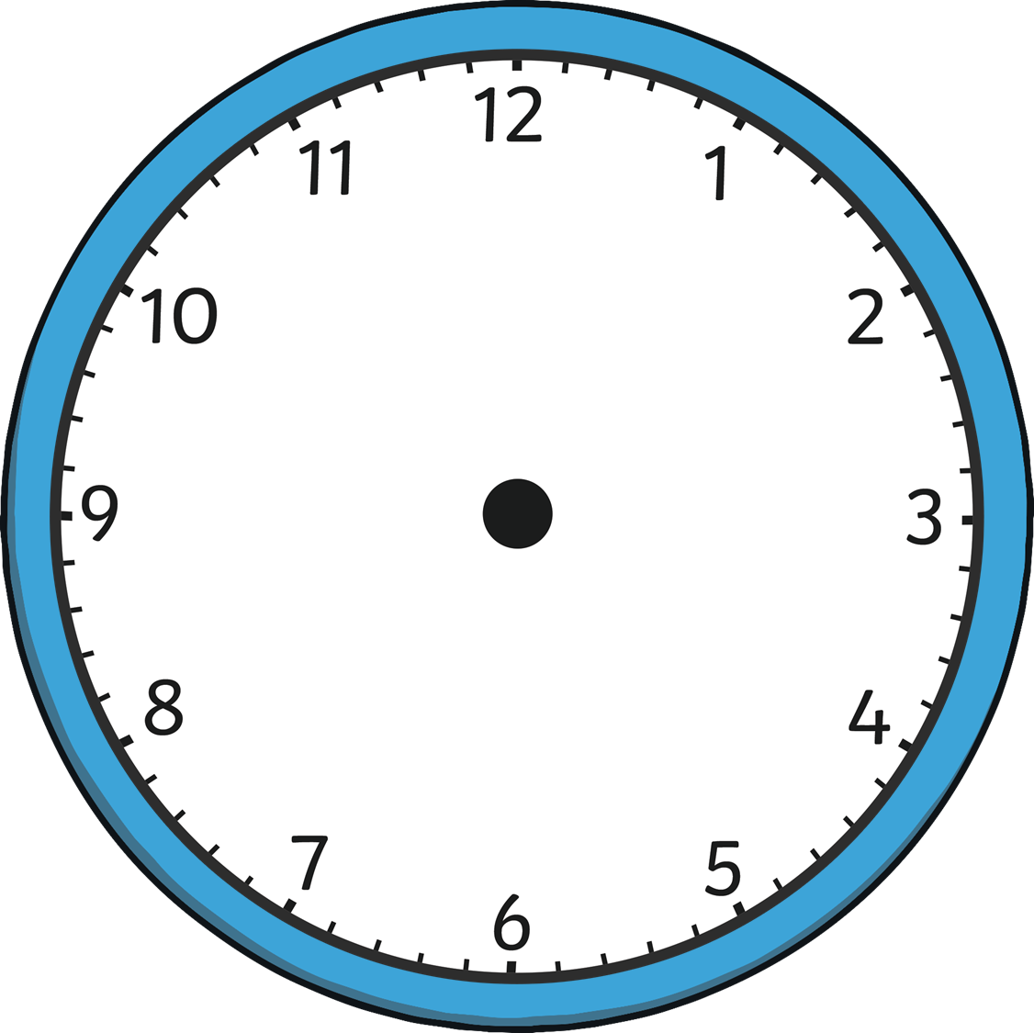
Out of Time
These driver’s clocks are all an hour too slow.
4 o’clock
?
Can you say what the correct times should be?

Slide 4
Out of Time
These driver’s clocks are all an hour too slow.
half past 9
?
Can you say what the correct times should be?

Slide 5
Out of Time
These driver’s clocks are all an hour too slow.
6 o’clock
?
Can you say what the correct times should be?

Slide 6
Out of Time
These driver’s clocks are all an hour too slow.
half past 3
?
Can you say what the correct times should be?

Slide 7
Out of Time
These driver’s clocks are all an hour too slow.
11 o’clock
?
Can you say what the correct times should be?

Slide 8
Out of Time
These driver’s clocks are all an hour too slow.
half past 7
?
Can you say what the correct times should be?

Slide 9
Out of Time
These driver’s clocks are all half an hour too fast.
half past 3
?
Can you say what the correct times should be?

Slide 10
Out of Time
These driver’s clocks are all half an hour too fast.
12 o’clock
?
Can you say what the correct times should be?

Slide 11
Out of Time
These driver’s clocks are all half an hour too fast.
half past 12
?
Can you say what the correct times should be?

Slide 12
Out of Time
These driver’s clocks are all half an hour too fast.
11 o’clock
?
Can you say what the correct times should be?

Slide 13
Telling the Time
We use clocks to help us to tell the time.
The small hand tells us what hour it is. We call this the hour hand.
The big hand tells us how many minutes past or to each hour it is. We call this the minute hand.
When the minute hand points straight up to the number 12, it is an o'clock time. This is when a new hour starts.
When the minute hand points down to the number 6, it is a half past time. This is halfway to the next hour.

Slide 14
Telling the Time
A clock face is a circle.
In one hour, the minute hand travels all the way around the circle and back to the beginning.

Slide 15
Telling the Time
A clock face is a circle.
half an hour
half an hour
In half an hour, the minute hand travels halfway around the circle.

Slide 16
Telling the Time
?
Where do you think the minute hand would travel to in quarter of an hour?
one quarter
one quarter
one quarter
one quarter
In quarter of an hour, the minute hand travels a quarter of the way around the circle.

Slide 17
Telling the Time
When the minute hand points to the number 3, it is a quarter past time.
When the minute hand points to the number 9, it is a quarter to time.

Slide 18
Telling the Time
o’clock
quarter to
quarter past
half past

Slide 19
Telling the Time
?
Can you tell these times? Which clocks have a quarter past time and which clocks have a quarter to time?
quarter past
quarter to
quarter past
quarter to
quarter past
quarter to
quarter past
quarter to

Slide 20
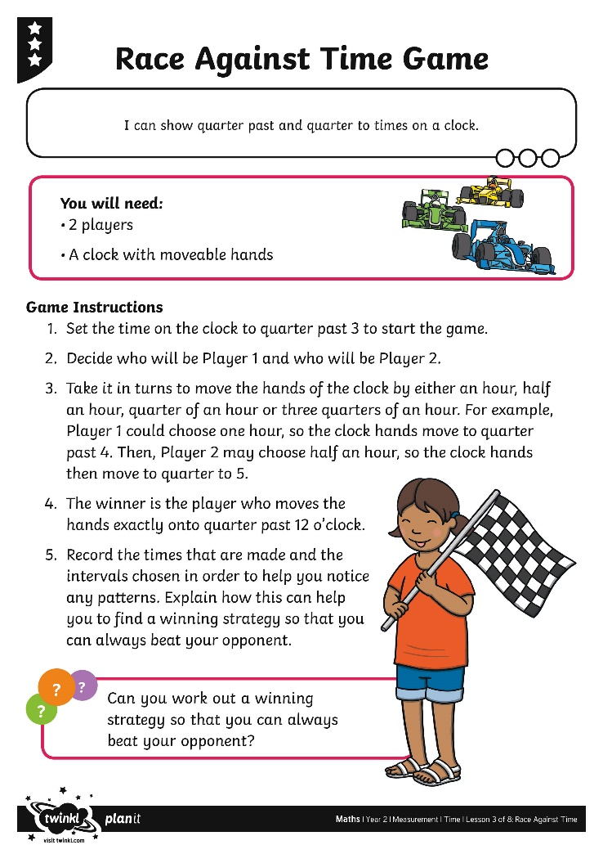
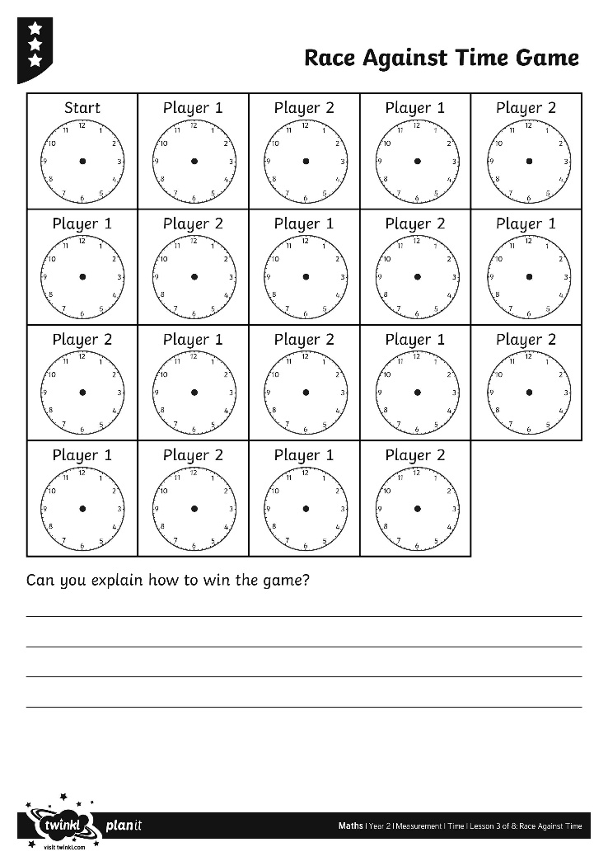
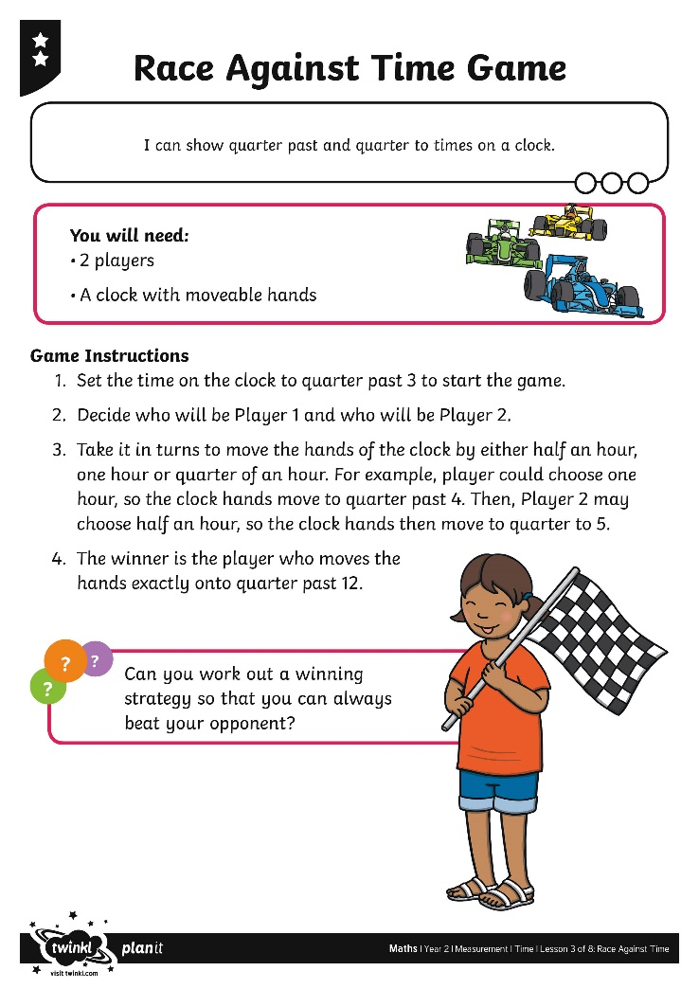
Race Against the Clock

Slide 21
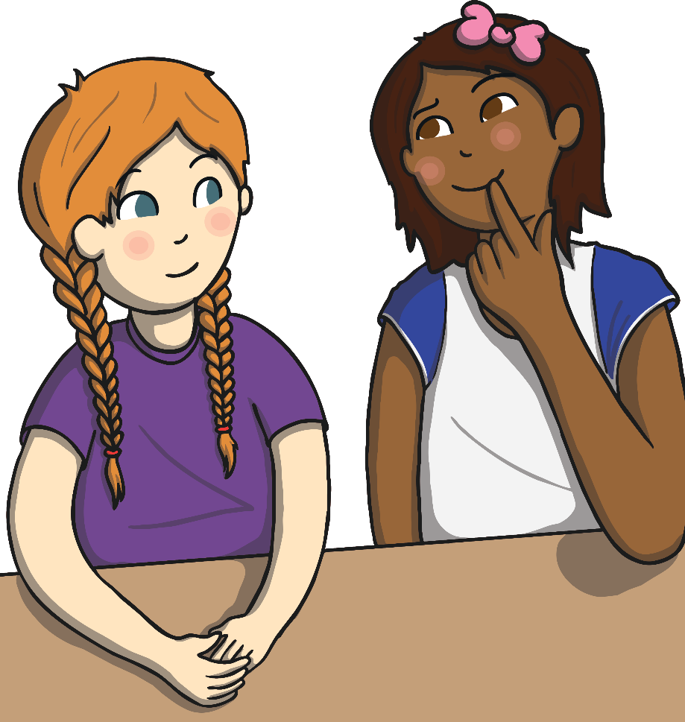
Diving into Mastery
Dive in by completing your own activity!

Slide 22
Times Up!
?
Can you beat the timer?
Read the time and see if you can show the time on your clock before the time runs out.

Slide 23
Times Up!
?
Can you beat the timer?
quarter past 3
10
9
8
7
6
5
4
3
2
1
Time’s up!

Slide 24
Times Up!
?
Can you beat the timer?
quarter past 6
10
9
8
7
6
5
4
3
2
1
Time’s up!

Slide 25
Times Up!
?
Can you beat the timer?
quarter to 10
10
9
8
7
6
5
4
3
2
1
Time’s up!

Slide 26
Times Up!
?
Can you beat the timer?
quarter past 1
10
9
8
7
6
5
4
3
2
1
Time’s up!

Slide 27
Times Up!
?
Can you beat the timer?
quarter to 8
10
9
8
7
6
5
4
3
2
1
Time’s up!

Slide 28
Times Up!
?
Can you beat the timer?
quarter to 12
10
9
8
7
6
5
4
3
2
1
Time’s up!

Slide 29
Aim
To show quarter past and quarter to times on a clock.
Success Criteria
I can read quarter past times on a clock.
I can read quarter to times on a clock.
I can make quarter past times on a clock.
I can make quarter to times on a clock.

