Slide 1
Maths
Measurement
Year One
Maths | Year 2 | Measurement | Telling the Time | Lesson 3 of 4: Rock around the Clock

Slide 3
Aim
To tell and show the time to five minutes.
Success Criteria
I can count clockwise in 5s to find ‘minutes past’.
I can count anticlockwise in 5s to find ‘minutes to’.
I can say how many minutes past or to the hour it is.
I can use the minute hand to show five minute intervals.

Slide 4
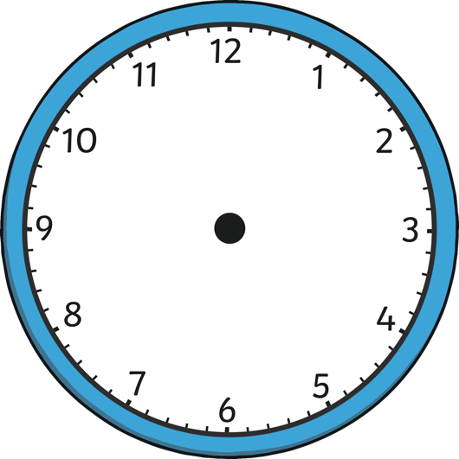
Hand Jive
Meet the dancing clock!
Click the clock to spin a time and say whether it would be an o’clock, half past, quarter past or quarter to time.
half past

Slide 5
Hand Jive
Meet the dancing clock!
Click the clock to spin a time and say whether it would be an o’clock, half past, quarter past or quarter to time.
quarter past

Slide 6
Hand Jive
Meet the dancing clock!
Click the clock to spin a time and say whether it would be an o’clock, half past, quarter past or quarter to time.
quarter to

Slide 7
Hand Jive
Meet the dancing clock!
Click the clock to spin a time and say whether it would be an o’clock, half past, quarter past or quarter to time.
o’clock

Slide 8
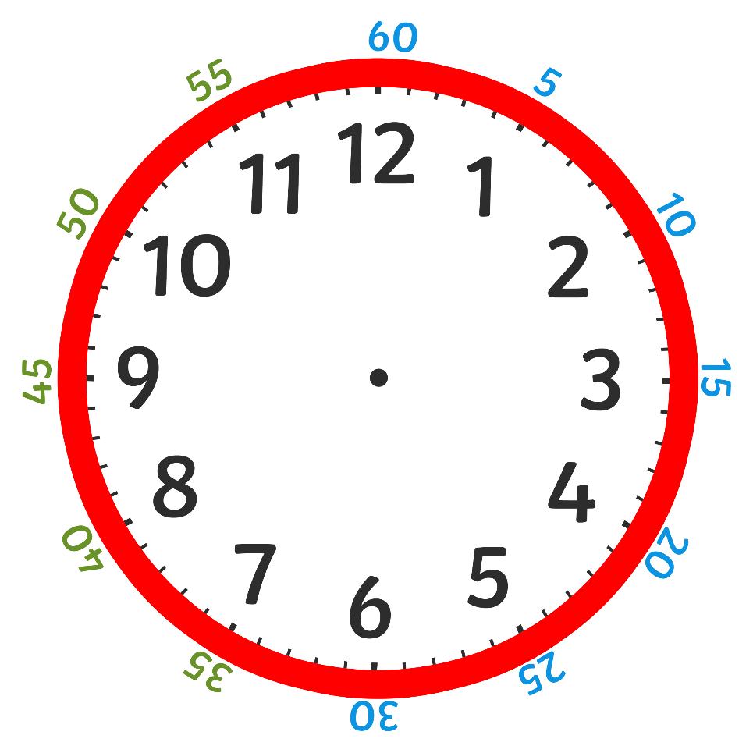
To and Past
This clock shows the hours in black on the inside and the minutes in
blue and green around the outside.

Slide 9
To and Past
?
Can you count the minutes in steps of 5?
?
Can you see a pattern between the hours on the inside and the
minutes on the outside?

Slide 10
To and Past
We read the time as minutes past or to the hour.
We can count clockwise around a clock to find how many minutes past the hour it is.

Slide 11
To and Past
?
How many minutes past the hour is the minute hand pointing to?
?
What time does the clock show?
five past 12

Slide 12
To and Past
?
How many minutes past the hour is the minute hand pointing to?
?
What time does the clock show?
twenty past 7

Slide 13
To and Past
?
How many minutes past the hour is the minute hand pointing to?
?
What time does the clock show?
twenty-five past 10

Slide 14
To and Past
?
How many minutes past the hour is the minute hand pointing to?
?
What time does the clock show?
What is this the same as?
quarter past 6
15 minutes past 6

Slide 15
To and Past
?
How many minutes past the hour is the minute hand pointing to?
?
What time does the clock show?
What is this the same as?
30 minutes past 4
half past 4

Slide 16
To and Past
After the minute hand passes half past, the time stops being ‘minutes past’ and becomes ‘minutes to’.
This is slightly trickier because the minutes on the outside of the clock are still counting past the hour.

Slide 17
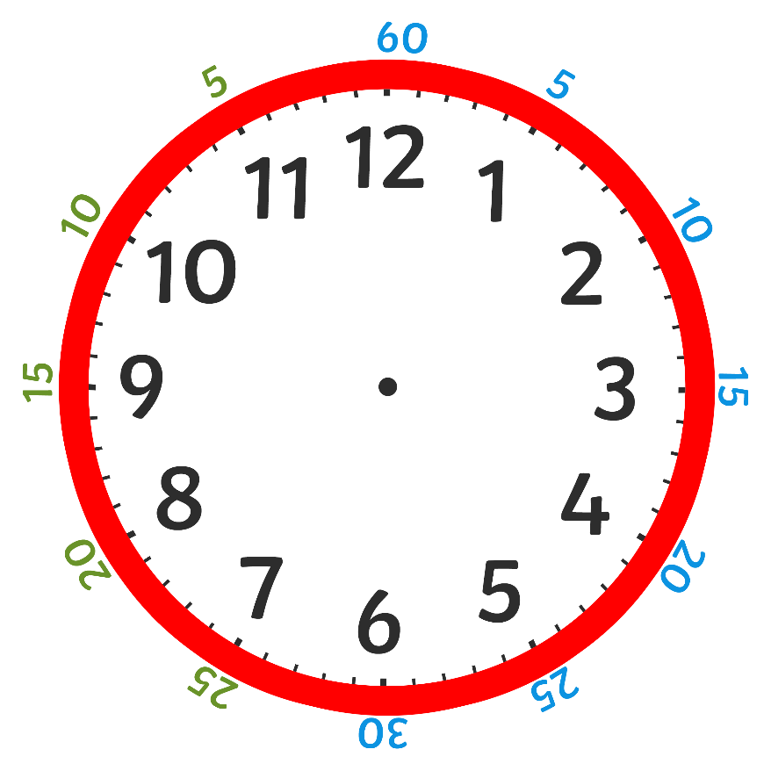
To and Past
When we find ‘minutes to’, we have to count back from the 12.
This is called ‘anticlockwise’.
Can you help count anticlockwise around the clock in 5s to half past?

Slide 18
To and Past
?
?
How many minutes is it to the hour?
What time is this clock showing us?
ten to 3

Slide 19
To and Past
?
?
How many minutes is it to the hour?
What time is this clock showing us?
twenty to 9

Slide 20
To and Past
?
?
How many minutes is it to the hour?
What time is this clock showing us?
five to 4

Slide 21
To and Past
?
?
How many minutes is it to the hour?
What time is this clock showing us?
What is this the same as?
quarter to 4
15 minutes to 4

Slide 22
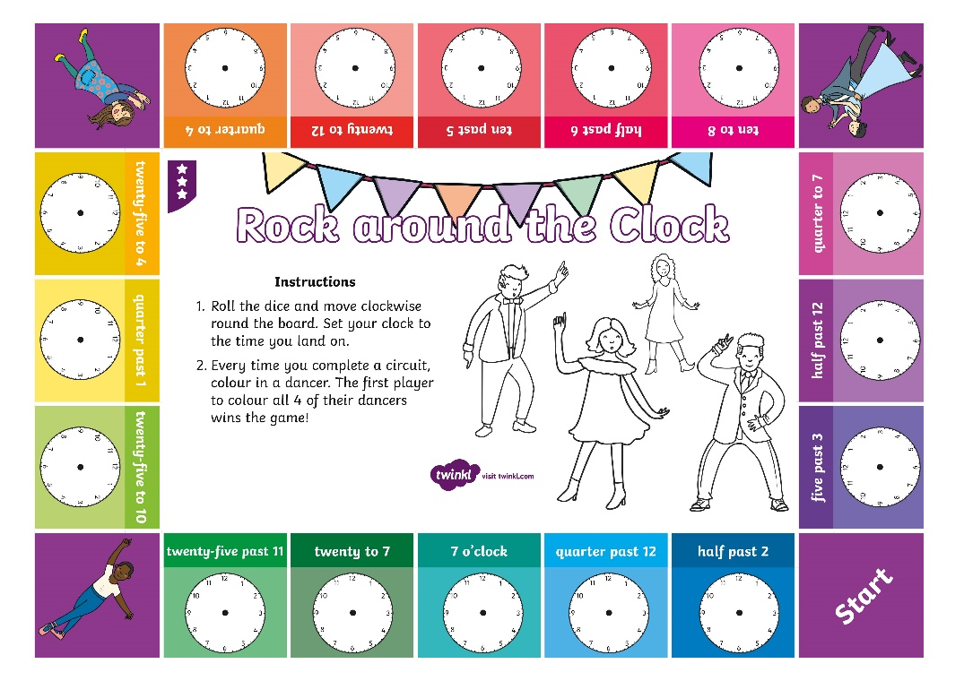
Rock around the Clock

