Slide 1
Maths
Multiplication and Division
Year One
Maths | Year 3 | Multiplication and Division | Scaling Problems | Lesson 2 of 3: Fruit Salad

Slide 2
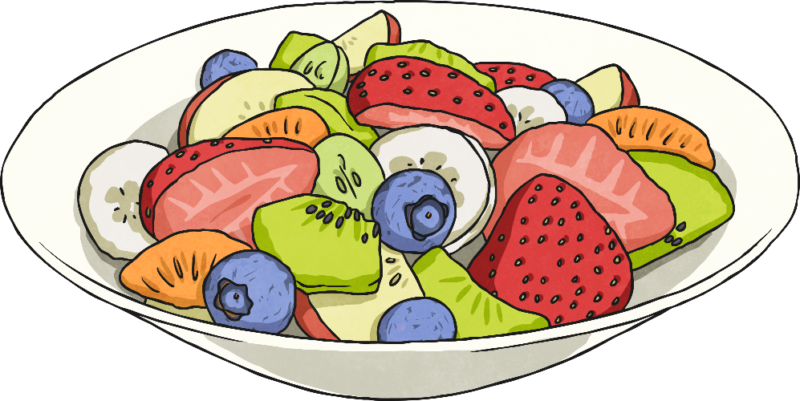
Fruit Salad

Slide 3
Aim
I can solve problems by scaling up and down.
Success Criteria
I can identify the number of portions in the recipe.
I can use known multiplication and division facts to scale up or down.
I can use the correct unit of measure in my answer.

Slide 4
Fruit Salad
This recipe makes 16 portions of delicious fruit salad.
Ingredients
8 bananas
2 large oranges
4 apples
24 grapes
16 blackberries
32 blueberries
8 strawberries
2 kiwi fruit
240ml lemonade
160ml fresh orange juice
Method
Carefully chop up all of the fruit into small chunks.
Mix the fruit in a large bowl.
Tip over the lemonade and fresh orange juice.
Serve with fresh cream or ice cream, or simply on its own.

Slide 5
Fruit Salad
Ingredients
8 bananas
2 large oranges
4 apples
24 grapes
16 blackberries
32 blueberries
8 strawberries
2 kiwi fruit
240ml lemonade
160ml fresh orange juice
The recipe makes enough fruit salad for 16 people but I only need enough for 8.
How could I adjust the recipe to get the right amount?
I need to
halve it
or divide every ingredient by 2.

Slide 6
Finding Halves
Can you finish adjusting the recipe?
16 Portions | 8 Portions (half as much, or divide by 2)
8 bananas | 4 bananas
2 large oranges
4 apples
24 grapes | 12 grapes
16 blackberries
32 blueberries
8 strawberries
2 kiwi fruit | 1 kiwi fruit
240ml lemonade
160ml fresh orange juice

Slide 7
Finding Halves
Can you finish adjusting the recipe for 4 portions and 2 portions?
16 Portions | 8 Portions (half as much) | 4 Portions (divide by ?) | 2 Portions (divide by ?)
8 bananas | 4 bananas
2 large oranges | 1 large orange
4 apples | 2 apples
24 grapes | 12 grapes
16 blackberries | 8 blackberries
32 blueberries | 16 blueberries
8 strawberries | 4 strawberries
2 kiwi fruit | 1 kiwi fruit
240ml lemonade | 120ml lemonade
160ml fresh orange juice | 80ml fresh orange juice

Slide 8
Answers
Can you finish adjusting the recipe for 4 portions and 2 portions?
16 Portions | 8 Portions (half as much) | 4 Portions (divide by 4) | 2 Portions (divide by 8)
8 bananas | 4 bananas | 2 bananas | 1 banana
2 large oranges | 1 large orange | ½ a large orange | ¼ of a large orange
4 apples | 2 apples | 1 apple | ½ an apple
24 grapes | 12 grapes | 6 grapes | 3 grapes
16 blackberries | 8 blackberries | 4 blackberries | 2 blackberries
32 blueberries | 16 blueberries | 8 blueberries | 4 blueberries
8 strawberries | 4 strawberries | 2 strawberries | 1 strawberry
2 kiwi fruit | 1 kiwi fruit | ½ a kiwi fruit | ¼ of a kiwi fruit
240ml lemonade | 120ml lemonade | 60ml lemonade | 30ml lemonade
160ml fresh orange juice | 80ml fresh orange juice | 40ml fresh orange juice | 20ml fresh orange juice

Slide 9
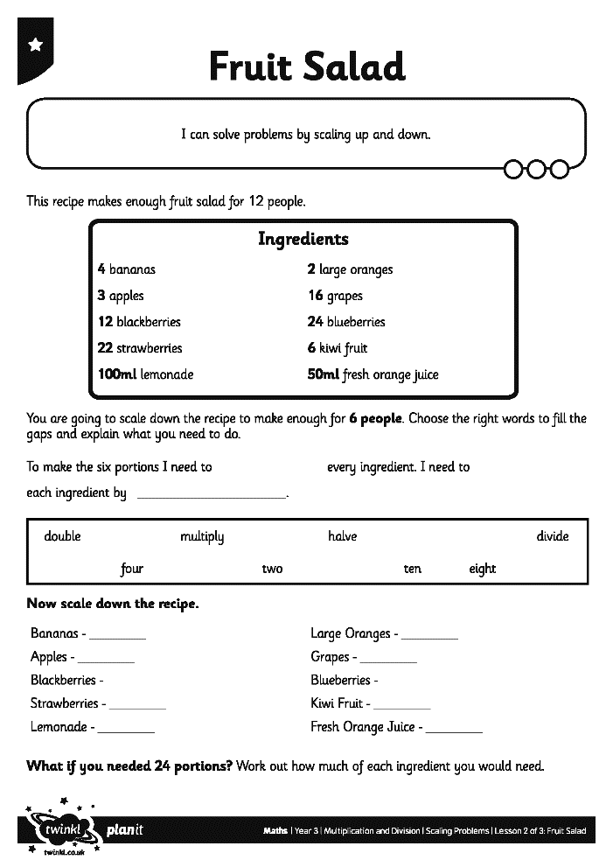
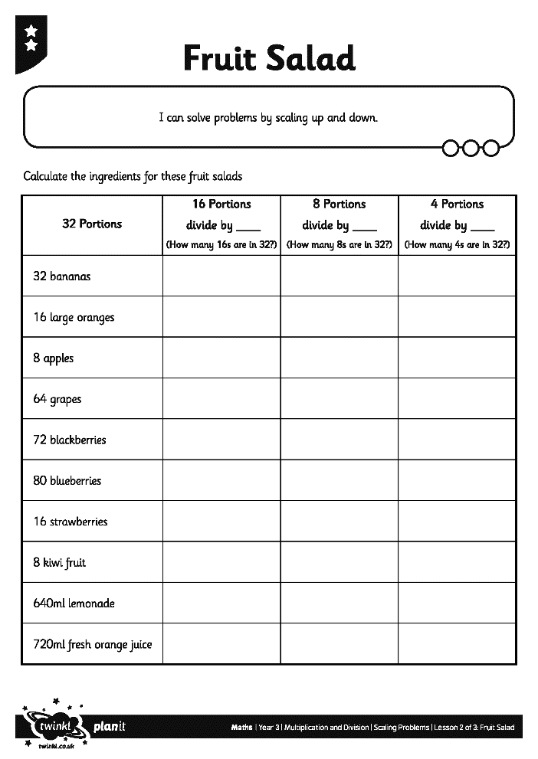
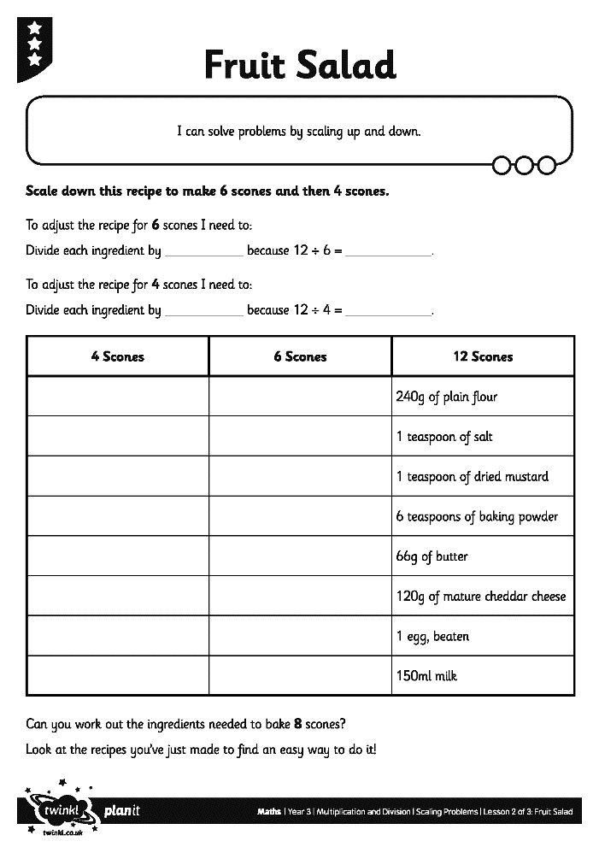
Recipe Activities

