Slide 1
Maths
Measurement
Year One
Maths | Year 2 | Measurement | Money | Lesson 2 of 2: Show Me the Money

Slide 3
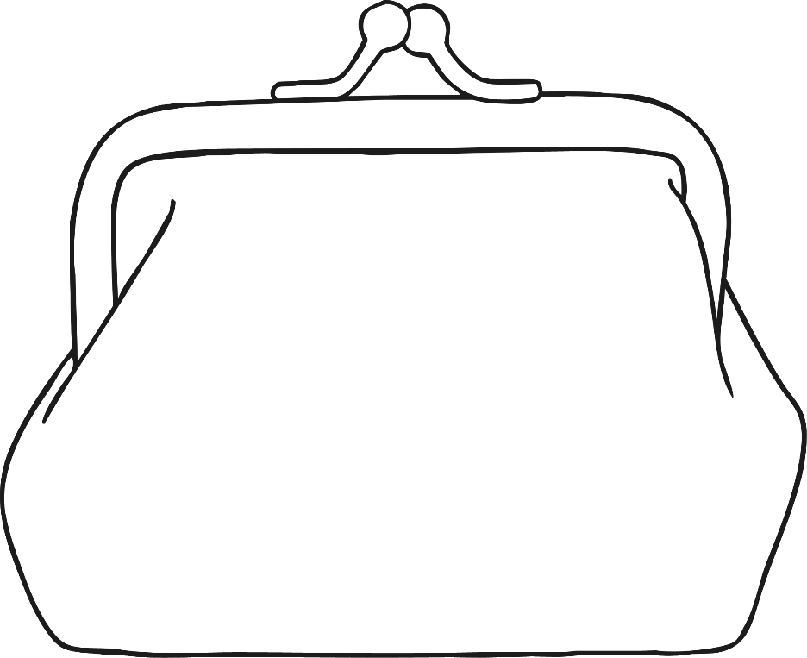
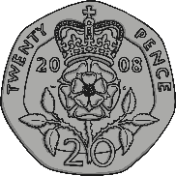
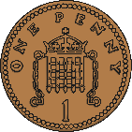
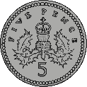
In My Purse
?
How much money is in my purse?
26p
Answer

Slide 4
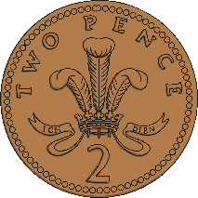
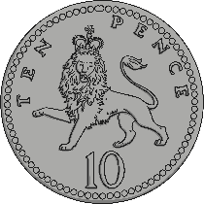
In My Purse
?
How much money is in my purse?
17p
Answer

Slide 5
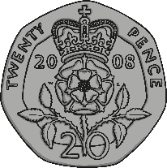
In My Purse
?
How much money is in my purse?
32p
Answer

Slide 6
In My Purse
?
How much money is in my purse?
55p
Answer

Slide 7
In My Purse
?
How much money is in my purse?
45p
Answer

Slide 8
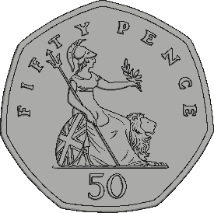
In My Purse
?
How much money is in my purse?
81p
Answer

Slide 9
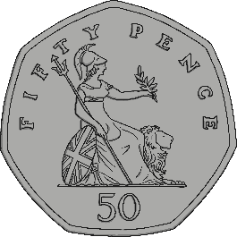
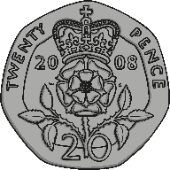
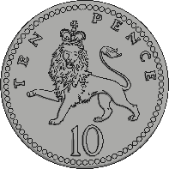
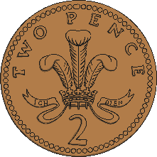
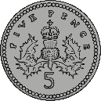
Totally Total
When adding amounts of money, it is usually easier to start with the largest amount first.
For example, if we were to find the total of these coins then it would make sense to arrange the coins in order of value first.
50p
+
20p
+
10p
+
5p
+
2p
+
2p

Slide 10
Totally Total
50p
+
20p
+
10p
+
5p
+
2p
+
2p
= 89p
+20p
+10p
+5p
+2p
+2p
50p
70p
80p
85p
87p
89p

Slide 11
Totally Total
When adding to a given total, it is also easier to chose your coins in order of value.
77p
For example, if you have to make 77p then it would make sense to choose the coins in order of value.
50p
+
20p
+
5p
+
2p
= 77p

Slide 12
Totally Total
+20p
+5p
+2p
50p
70p
75p
77p

Slide 13
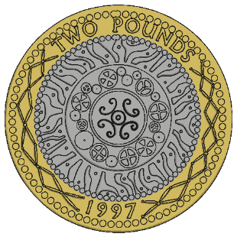
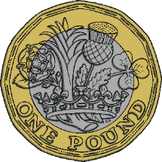
Totally Total
?
Which coins could you use to make the total?
57p
?
Did you find another way?

Slide 14
Totally Total
+5p
+2p
50p
55p
57p

Slide 15
Totally Total
?
Which coins could you use to make the total?
29p
?
Did you find another way?

Slide 16
Totally Total
+5p
+2p
+2p
20p
25p
27p
29p

Slide 17
Pay for It!
Martha has to pay for a pencil which costs 28p. Which money box contains the correct amount to pay for it?
Click to select the right box.

Slide 18
Pay for It!
Archie has to pay for a slice of cake which costs 77p. Which money box contains the correct amount to pay for it?
Click to select the right box.

Slide 19
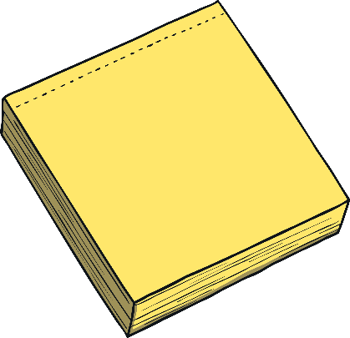
Pay for It!
Ali has to pay for a notepad which costs 82p. Which money box contains the correct amount to pay for it?
Click to select the right box.

