Slide 2
Aim
I can draw the position of a shape following a reflection.
Success Criteria
I know that when reflected, a shape keeps the same dimensions.
I can count how far each point is from the mirror line.

Slide 3
Is It a Reflection?
Is this reflection correct?
This reflection is correct!
Show Answer

Slide 4
Is It a Reflection?
Is this reflection correct?
This reflection is incorrect! Click here to see the correct reflection.
Show Answer

Slide 5
Is It a Reflection?
Is this reflection correct?
This reflection is correct!
Show Answer

Slide 6
Is It a Reflection?
Is this reflection correct?
This reflection is incorrect! Click here to see the correct reflection.
Show Answer

Slide 7
Is It a Reflection?
Is this reflection correct?
This reflection is correct!
Show Answer

Slide 8
Is It a Reflection?
Is this reflection correct?
This reflection is correct!
Show Answer

Slide 9
Is It a Reflection?
Is this reflection correct?
This reflection is incorrect! Click here to see the correct reflection.
Show Answer

Slide 10
Reflecting Shapes in a
Mirror Line
The reflected image is congruent to the original. This means that the measurements of the sides and angles have not changed.
Each point of the reflected shape is the same distance from the mirror line as the original shape.
When a shape is reflected in a mirror line, it is flipped over.
90°
90°

Slide 11
Drawing a Reflected Shape
When asked to draw the new position of a 2D shape after a reflection, we have to make sure that each corner of the reflected shape is the same distance from the mirror line.
1 square to the left of the mirror line
1 square to the right of the mirror line
First identify the distance of a corner from the mirror line on the original shape.
Then apply this to the opposite side of the mirror line.
Repeat this process with each corner.

Slide 12
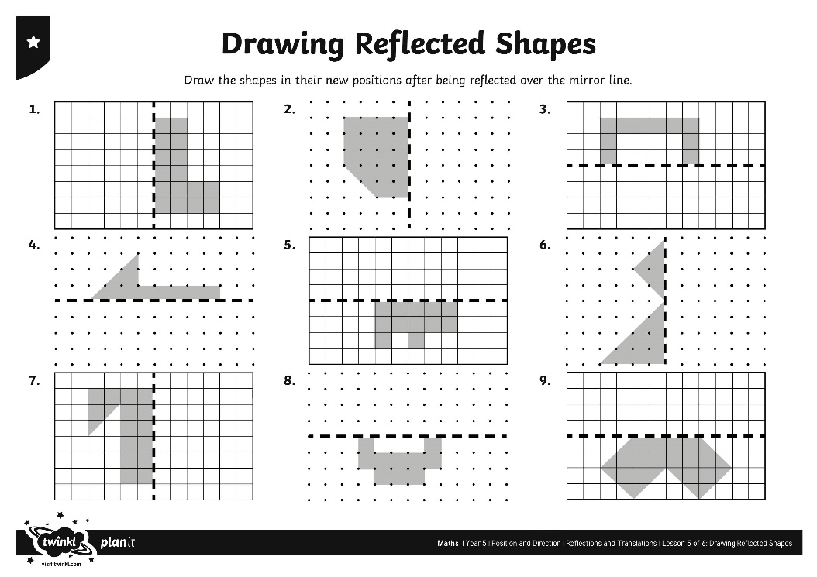
Drawing Reflected Shapes

