Slide 2
Diving into Mastery Guidance for Educators
Each activity sheet is split into three sections, diving, deeper and deepest, which are represented by the following icons:
These carefully designed activities take your children through a learning journey, initially ensuring they are fluent with the key concept being taught; then applying this to a range of reasoning and problem-solving activities.
These sheets might not necessarily be used in a linear way. Some children might begin at the ‘Deeper’ section and in fact, others may ‘dive straight in’ to the ‘Deepest’ section if they have already mastered the skill and are applying this to show their depth of understanding.
Diving
Deeper
Deepest

Slide 3
National Curriculum Objective
Identify horizontal and vertical lines and pairs of perpendicular and parallel lines.

Slide 4
Parallel and Perpendicular Lines
Diving
Parallel lines run alongside each other in pairs.
They would never meet if they carried on.
They are always the same distance apart.
They are shown, in maths, with these arrows.

Slide 5
Parallel and Perpendicular Lines
Diving
Perpendicular lines are pairs of lines that meet at a right angle.
They are usually marked by using the right-angle symbol at the point where they meet.

Slide 6
Parallel and Perpendicular Lines
Diving
Look at these shapes.
How many pairs of parallel lines can you see in each shape?
How many pairs of perpendicular lines can you see in each shape?

Slide 7
Parallel and Perpendicular Lines
Deeper
Which dots should I join up to make a pair of perpendicular lines?
Remember, we can label lines by naming them after the points they start and end at.
B
C
D
Lines AB and BD will be perpendicular to each other.
A
E

Slide 8
Parallel and Perpendicular Lines
Deeper
Which statements about this shape are false?
B
A
D
C
D
Line BD is parallel to line AC.
Line AB is perpendicular to BD.
Line AB is parallel to line CD.
Line AB is not perpendicular to any other lines.
.



Slide 9
Parallel and Perpendicular Lines
Deepest
We can prove that lines are parallel by continuing them and showing that they will not meet.
If I continue these lines, will they meet eventually?

Slide 10
Parallel and Perpendicular Lines
Deepest
Identify a pair of parallel lines and a pair of perpendicular lines in this picture:

Slide 11
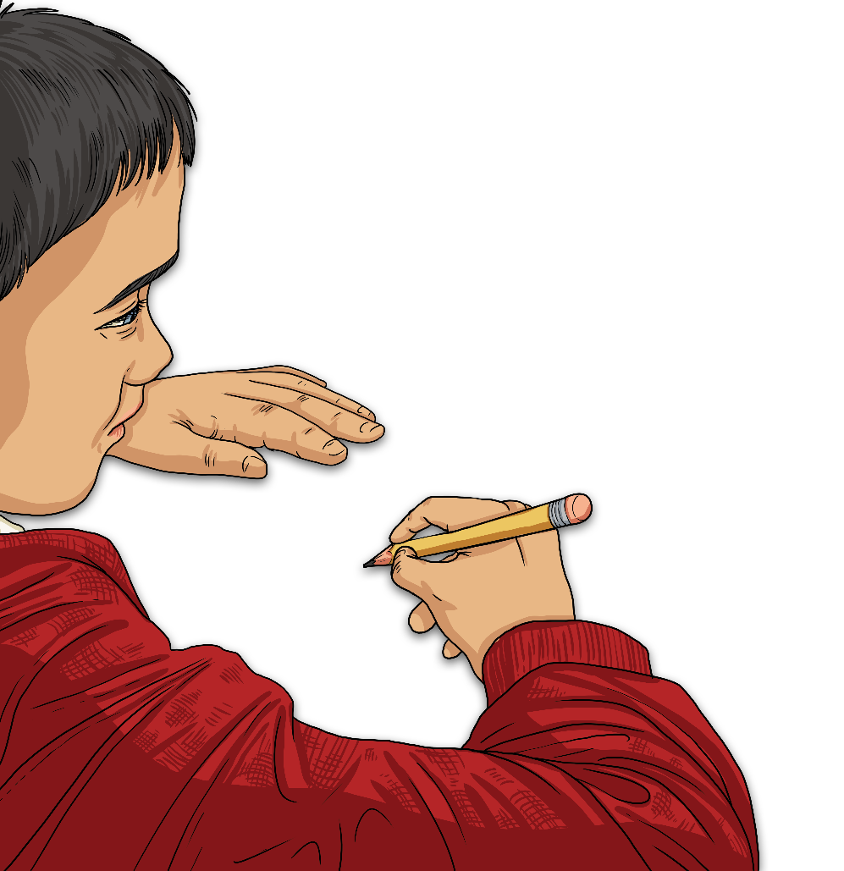
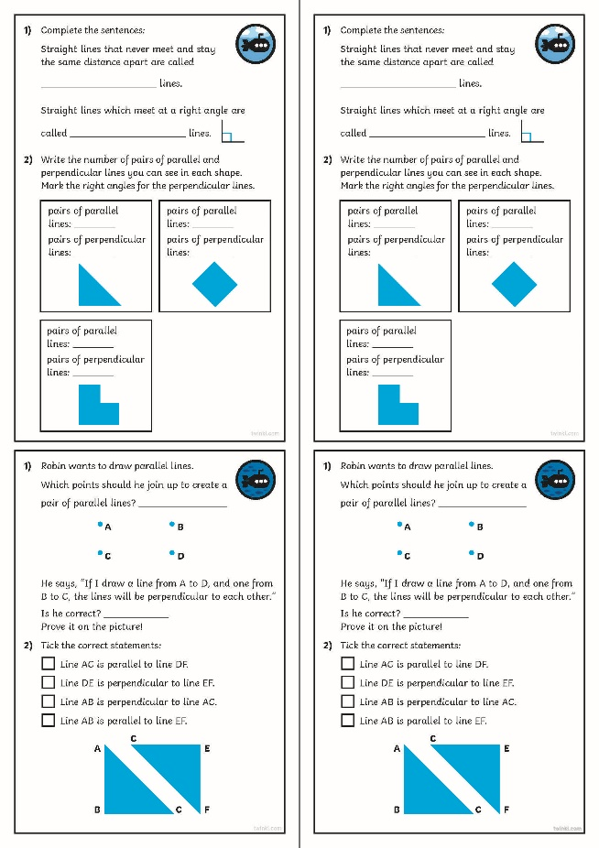
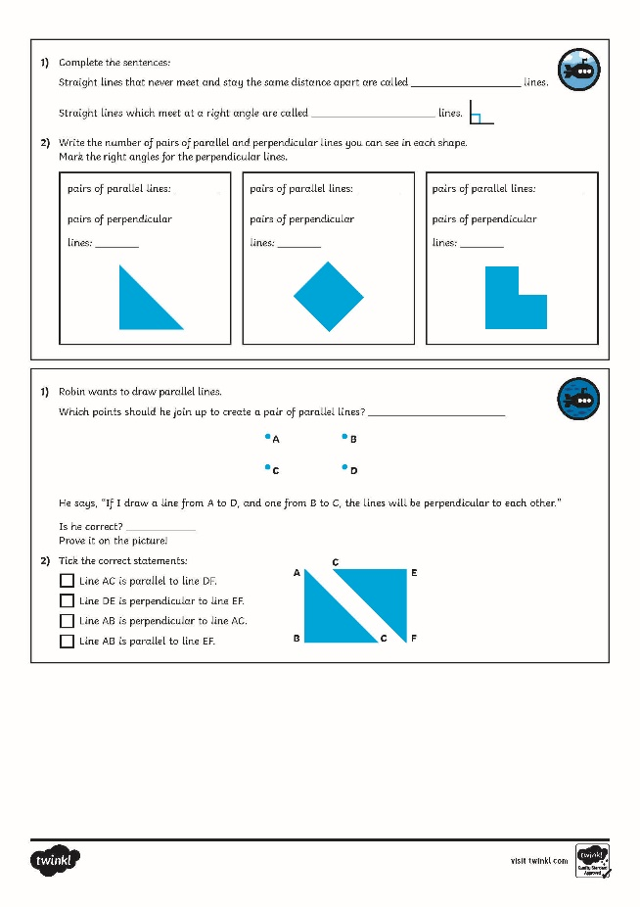
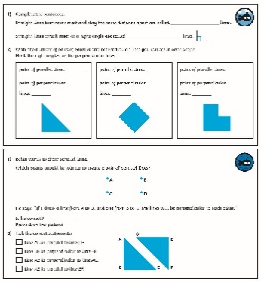
Parallel and Perpendicular Lines
Dive in by completing your own activity!

Slide 12
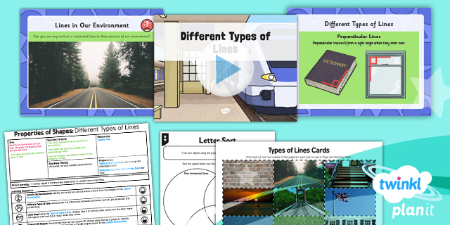
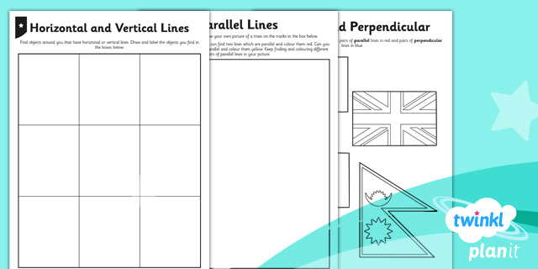
Need Planning to Complement this Resource?
National Curriculum Aim
Identify horizontal and vertical lines and pairs of perpendicular and parallel lines.
For more planning resources to support this aim, click here.
Twinkl PlanIt is our award-winning scheme of work with over 4000 resources.

