Slide 2



Diving into Mastery Guidance for Educators
Each activity sheet is split into three sections, diving, deeper and deepest, which are represented by the following icons:
These carefully designed activities take your children through a learning journey, initially ensuring they are fluent with the key concept being taught; then applying this to a range of reasoning and problem-solving activities.
These sheets might not necessarily be used in a linear way. Some children might begin at the ‘Deeper’ section and in fact, others may ‘dive straight in’ to the ‘Deepest’ section if they have already mastered the skill and are applying this to show their depth of understanding.
Diving
Deeper
Deepest

Slide 3
Aim
Solve simple measure and money problems involving fractions and decimals to two decimal places.

Slide 4
Make a Whole
Diving
What fraction of the hundred square is shaded and not shaded?
shaded = 32 hundredths
not shaded = 68 hundredths
shaded = =
32
100
0.32
not shaded = =
68
100
0.68
0.32
+
0.68
=
1 whole

Slide 5
Make a Whole
Diving
Complete this part-whole model.
1
Complete this
bar model.
0.4
0.6
1
 | 0.72
0.28

Slide 6

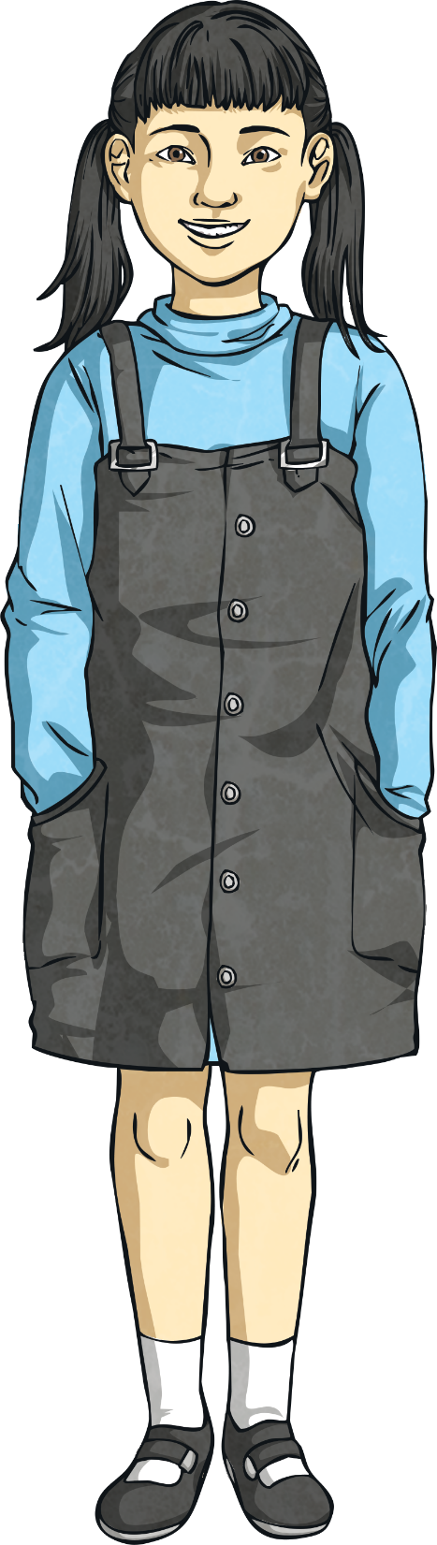
Make a Whole
Deeper
I need to add 0.53 to 0.57
to make a whole.
Is Khatija correct?
No
How can you change her statement
to make it correct?
I need to add 0.43 to 0.57 to make a whole.
or
I need to add 0.53 to 0.47 to make a whole.

Slide 7

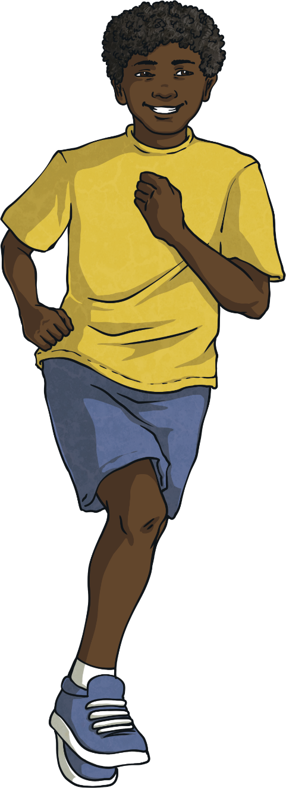
Make a Whole
Deepest
Sam has set a target of running 2km in a day.
Has he reached his target?
Here is what he has run so far:
10 a.m. | 0.36km
1 p.m. | 1.29km
2 p.m. | 0.24km
Has he reached his target?
If not, how much further does he need to run?t
Has he reached his target?
If not, how much further does he need to run?
No. He has run 0.36km + 1.29km + 0.24km = 1.89km.
He would need to run another 0.11km.

Slide 8
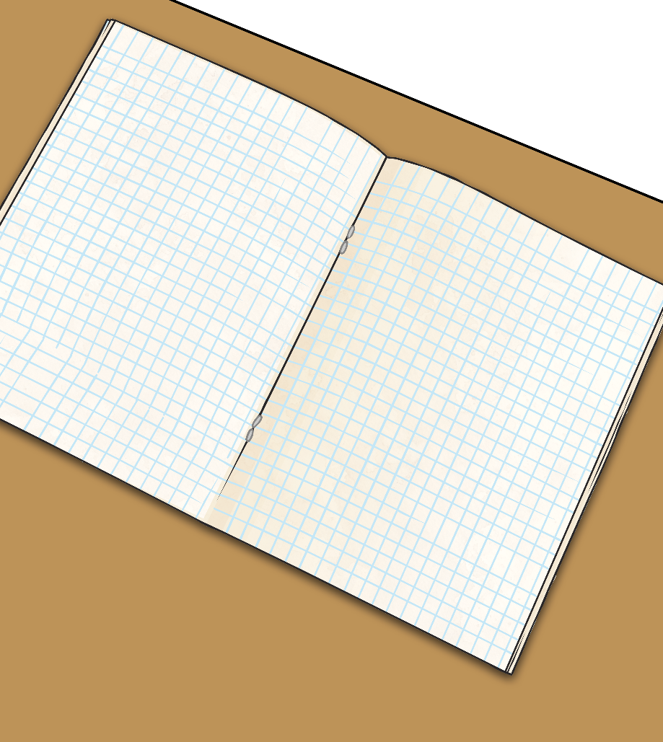
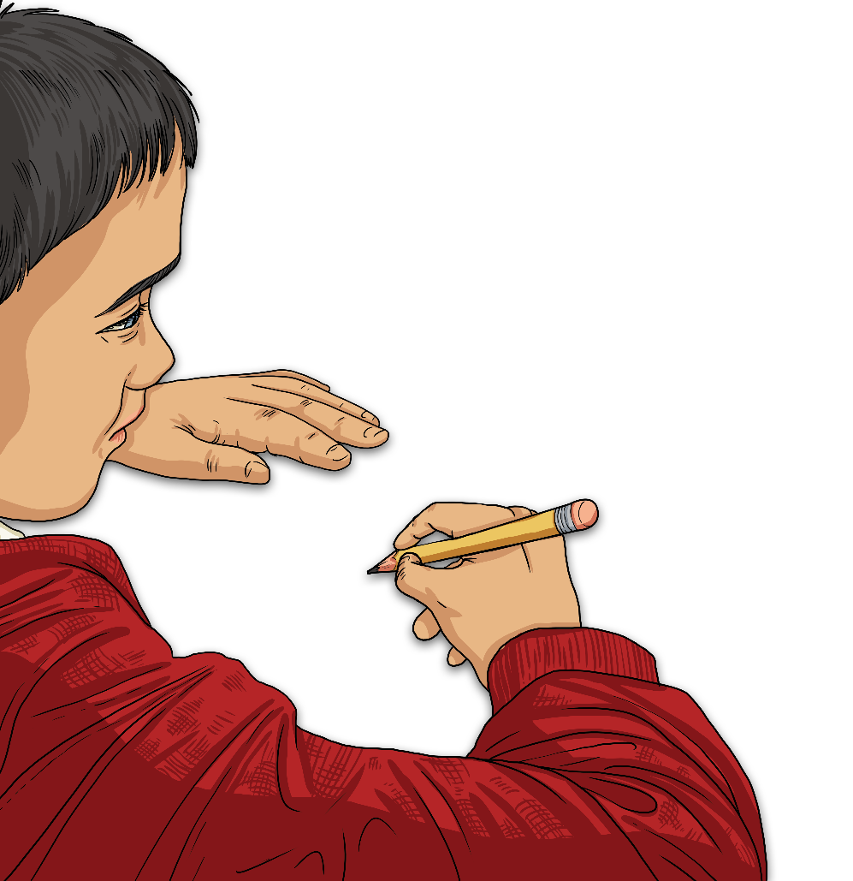
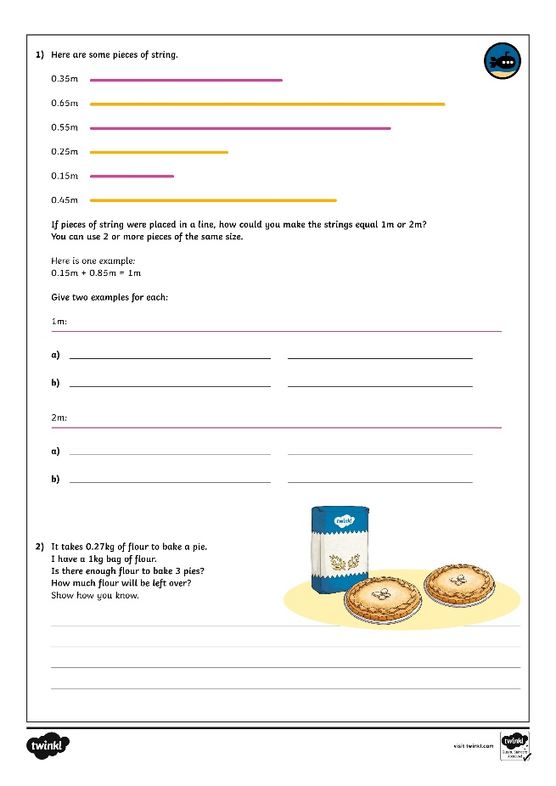
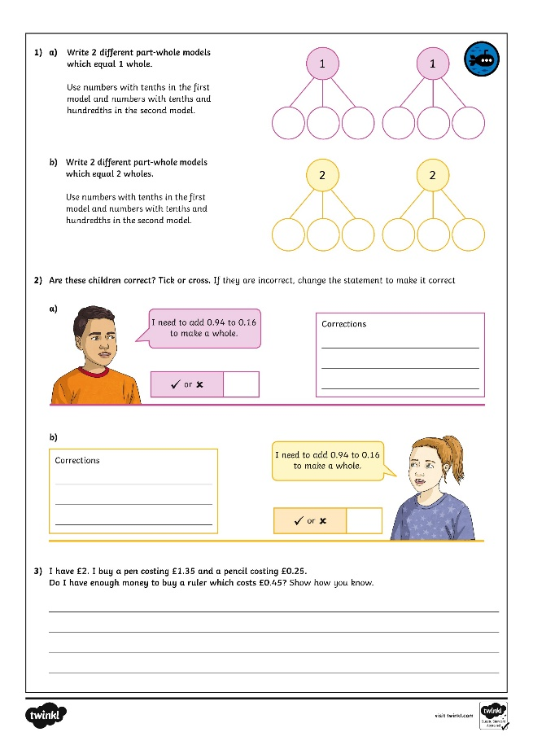
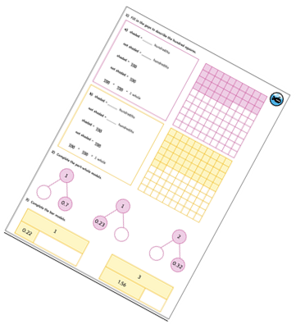
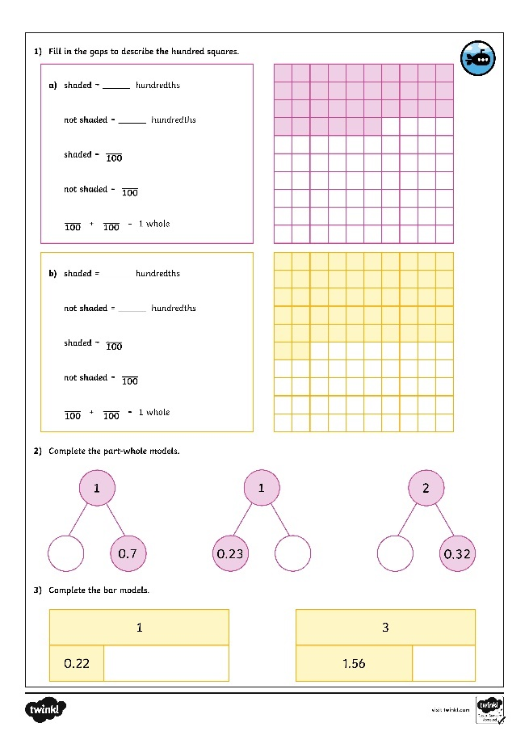
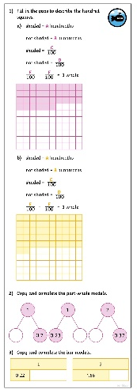
Insert White Rose Aim Here
Dive in by completing your own activity!

Slide 9
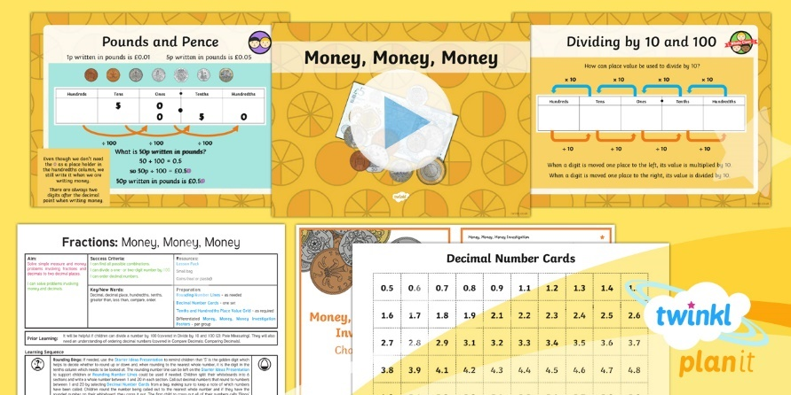
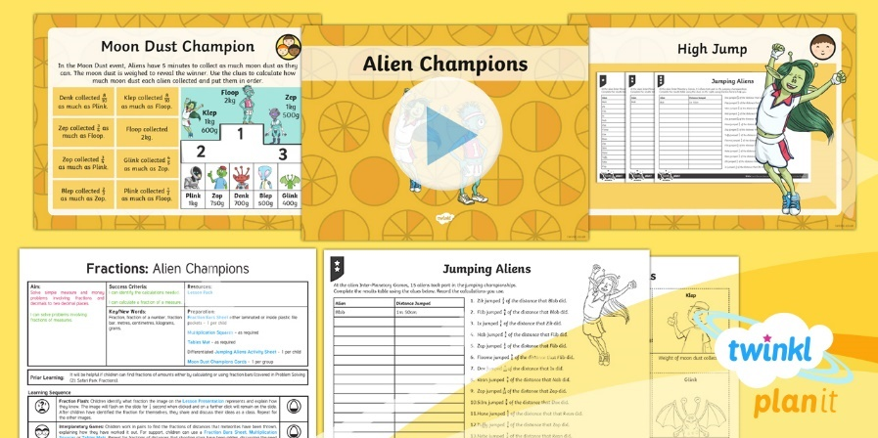

Need Planning to Complement this Resource?
National Curriculum Aim
Solve simple measure and money problems involving fractions and decimals to two decimal places.
For more planning resources to support this aim, click here.
Twinkl PlanIt is our award-winning scheme of work
with over 4000 resources.

