Slide 1
Representing Hundredths on a Place Value Grid

Slide 2
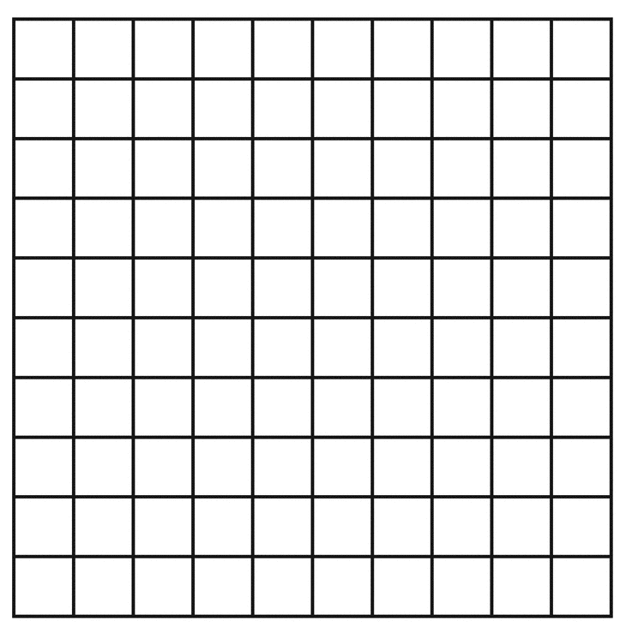
Remember – when something is divided into 100ths there
are 100 pieces in the whole. Just like a hundred square.
This hundred square has 1 square coloured in so that is
1
100
Can you remember how to write that as a decimal number?
That’s right! It’s 0.01 because there is one hundredth in the hundredths place.

Slide 3
This hundred square has 22 squares coloured in so that is
22
100
Can you remember how to write this as a decimal number?
That’s right. It’s 0.22 because 10 hundredths makes one tenth. So in this number we have 2 tenths in the tenths place and then the 2 hundredths go in the hundredths place.

Slide 4
What about if there’s a whole number coloured in too?
Here there is one whole coloured in
100
100
There are also 3 columns coloured in
30
3
or
100
10
Then there are 4 hundredths coloured in too
4
100
As a fraction that would be
1
34
100

Slide 5
If you wrote it in a place value grid, it would look like this:
1s | 10ths | 100ths
1
3
4
This is because there is 1 whole that can go in the 1s place.
There are 3 columns so those are 3 tenths to go in the tenths place
There are also 4 hundredths to go in the hundredths place. So the number is 1.34

Slide 6
Draw yourself a grid like this on your whiteboard/chalkboard/scrap paper:
Now in the grid, draw counters to represent the number 3.43…
1s | 10ths | 100ths

Slide 7
Now in the grid, draw counters to represent the number 5.64
1s | 10ths | 100ths

Slide 8
Now in the grid, draw counters to represent the number 0.06
1s | 10ths | 100ths

Slide 9
We could do it like this:
Here’s a part-whole model
Remember, the circle that the other 2 are
attached to has the total amount in it.
2.54
In this part whole model, we’re going to partition the number
2.54
0.54
2

Slide 10
You could also do it in other ways as long as the total is 2.54
2.54
2.54
2.54
1.50
1.04
1.75
0.79
2.50
0.04
2.54
This is an extra challenge though so don’t panic if this bit is puzzling you ☺
1.20
1.34

Slide 11
If you were OK with what was on the previous slide, try partitioning 4.24 in different ways…
I haven’t out any answers because there are loads of different possibilities.

