Slide 1
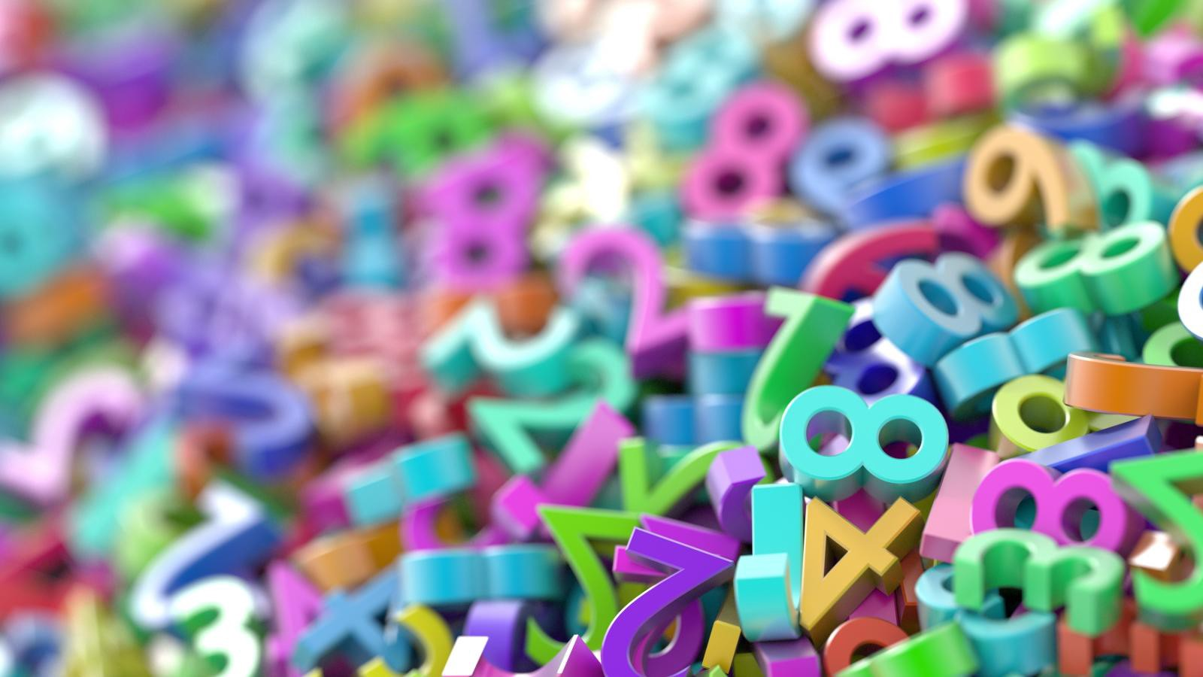
Rounding numbers to the nearest 10
(revision)

Slide 2
We have done rounding before but it is quite tricky so let’s do a bit of a recap. You’re going to need a whiteboard or a piece of scrap paper ☺

Slide 3
Rounding to the nearest 10
62
60
70
Which multiple of ten is 62 closest to?
You can see that it’s 60 from the number line, but what would you do if there wasn’t a number line?

Slide 4
Well, if I asked you to round 62 to the nearest ten, you need to follow these steps:
First, work out which two multiples of ten are on either side of the number 62. They are 60 and 70.
2. Next, you look at the 1s place and see whether the number is less than 5 or 5 or more.
3. If it is less than 5, you round DOWN to the multiple of 10 before (which is 60)
4. If it’s 5 or more, you round UP to the next multiple of 10 (which is 70)
Using these steps, what would 67 to the nearest 10 be?
That’s right, it would be 70 because 7 is more than 5 ☺

Slide 5
To help you remember, think of this rhyme:
If the ones are 1, 2, 3 or 4 leave the 10s just as before. If it’s 5,6,7,8 or 9 round up to the next 10 on the number line.
Have a go at these:
65 to the nearest 10
53 to the nearest 10
44 to the nearest 10
70
50
40
If you need to do some more work on this, type Twinkl Go Login into Google and enter this code : WJ4679
Then click on the hamster rounding game.

Slide 6
Now try these. This time the numbers have 3 or 4 digits but you still only need to worry about the tens and ones places (for now)
Round 134 to the nearest 10
Round 265 to the nearest 10
Round 1345 to the nearest 10
Round 4238 to the nearest 10
Round 3423 to the nearest 10
130
270
1350
If you’re not quite sure yet, type Twinkl Go into Google and enter this code: WJ4679
There is a game called Potion Maker that you can play ☺
4240
3420

Slide 7
Now, what happens if the number you are rounding is really close to a multiple of 100? Now you’re going to have to think about some extra details. Here’s an example, we’re going to round 497 to the nearest 10.
497
490
500
So, we need to work out the two multiples of ten on either side. These are 490 and 500.
The number in the ones place is 7. This is more than 5 so we need to round up to the next ten which is 500 ☺
This means the number in the hundreds place is changing as well as the number in the tens place.

Slide 8
What about if our number should be rounded down because the ones place is less than 5? Here’s an example. This time we’re looking at rounding 302 to the nearest 10.
302
300
310
So, we need to work out the two multiples of ten on either side. These are 300 and 310.
The number in the ones place is 2. This is less than 5 so we need to round down. This means the answer is 300.

Slide 9
Have a go at these:
Round 204 to the nearest 10.
Round 596 to the nearest 10.
Round 101 to the nearest 10.
Round 399 to the nearest 10.
200
600
100
400

