Slide 1
History
Anglo-Saxons and Scots
Year One
History | LKS2 | Anglo-Saxons and Scots | Artefacts and Culture | Lesson 4

Slide 3
Aim
I can analyse and describe Anglo-Saxon artefacts and explain what they can teach us about Anglo-Saxon culture.
Success Criteria
I can draw and annotate a picture of an Anglo-Saxon artefact.
I can answer questions to show I understand how sources of evidence can be analysed to help us understand more about Anglo-Saxon culture.

Slide 4
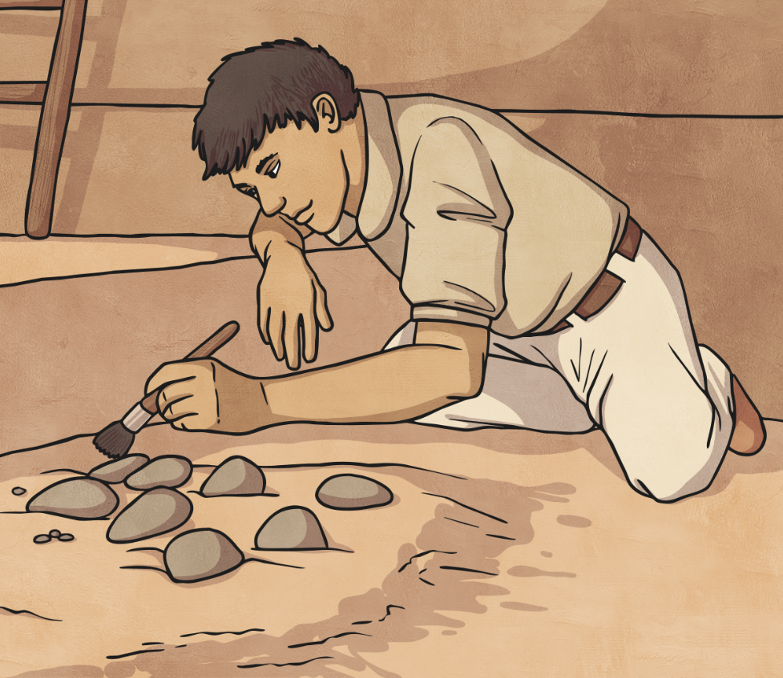
Digging up the Past
What do we mean by the term ‘digging up the past’?
Is it important to know what happened in times before we were even born?
What can ‘digging up the past’ teach us?
What is archaeology?
Who is a historian?
Talk to the other children in your group to discuss these questions.
Be ready to give feedback to the rest of the class.

Slide 5
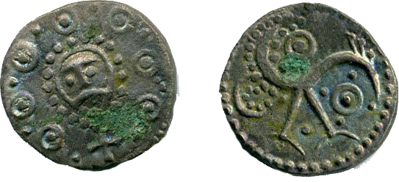
Anglo-Saxon Finds
Archaeologists and historians have an important role in helping us to understand what life was like in Anglo-Saxon Britain. This, in turn helps us to understand how the Anglo-Saxons shaped the world in which we live today.
Looking at artefacts and forming conclusions about life in Anglo-Saxon Britain is important because:
We can learn from the success and mistakes of the people.
We can develop and refine new forms of art and technology by examining how and why things were done in the Anglo-Saxon times.
It can help us to develop a sense of perspective and belonging as we understand our place in the chronology of British history.
We can examine the relationships and interactions between Anglo-Saxon groups and societies and compare and contrast them with how we live today.
Photo courtesy of Hampshire and Solent Museums (@flickr.com)-granted under creative commons licence-attribution

Slide 6
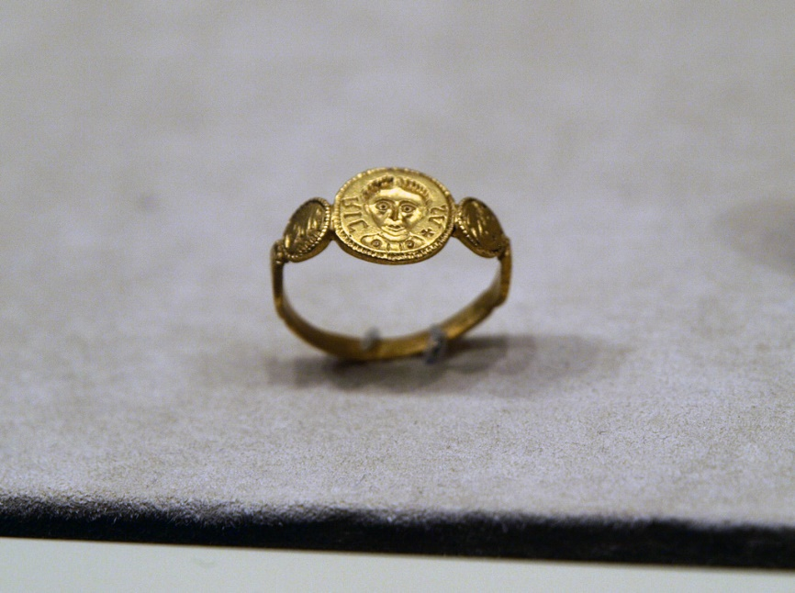
Being Historians
Today we are going to be historians, examining evidence from Anglo-Saxon Britain. We are going to ask and answer questions about the artefacts and evidence we see to work out what it can teach us about the life and culture of the Anglo-Saxon people.
For each source of evidence we will consider the following questions:
What do you think the object is?
Who do you think would have used it?
Where was the object found or came from originally?
What is it made of?
What can it teach us about Anglo-Saxon life?
Any other observations?
Photo courtesy of Mararie(@flickr.com)-granted under creative commons licence-attribution

Slide 7
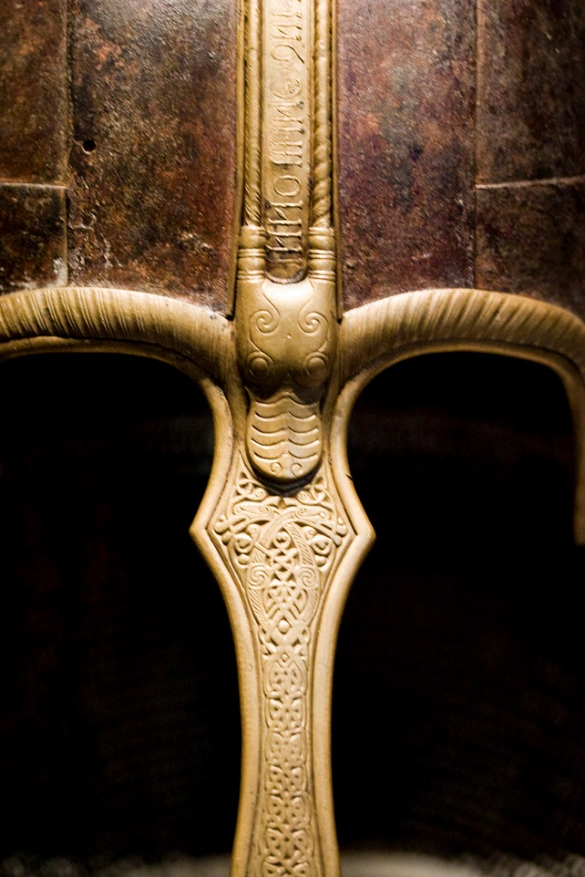
Artefact 1
Photo courtesy of vintagedept (@flickr.com) - granted under creative commons licence - attribution

Slide 8
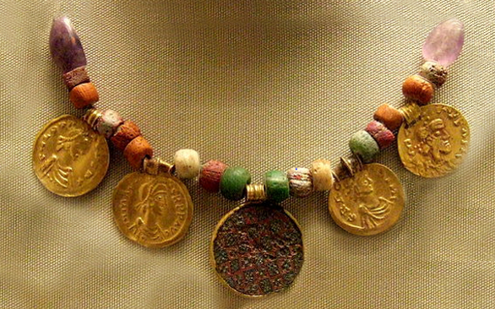
Artefact 2
Photo courtesy of Kotomi_ (@flickr.com) - granted under creative commons licence - attribution

Slide 9
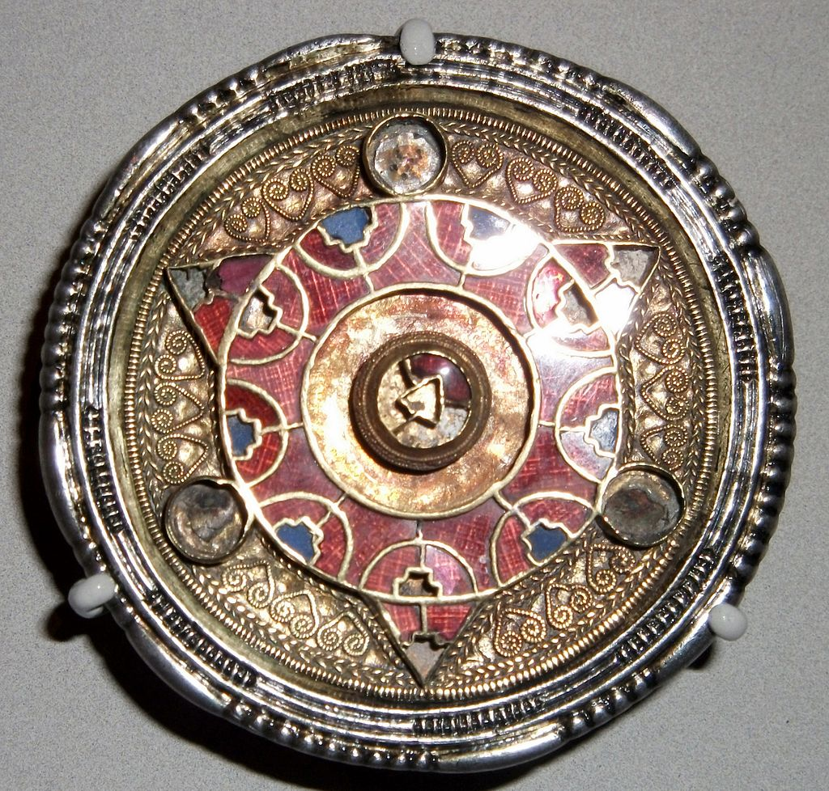
Artefact 3
By Johnbod (Own work) [CC BY-SA 3.0 (http://creativecommons.org/licenses/by-sa/3.0) or GFDL (http://www.gnu.org/copyleft/fdl.html)], via Wikimedia Commons

