Slide 1
Complete and Incomplete Circuits

Slide 2
Before we begin…
DO NOT try any experiments with electricity yourselves at home. Even batteries can be dangerous if they are not used correctly as they can overheat. NEVER leave batteries in the reach of young children or pets as they are extremely toxic if swallowed.
NEVER EVER play with mains electricity. It is HIGHLY DANGEROUS!!!!

Slide 3
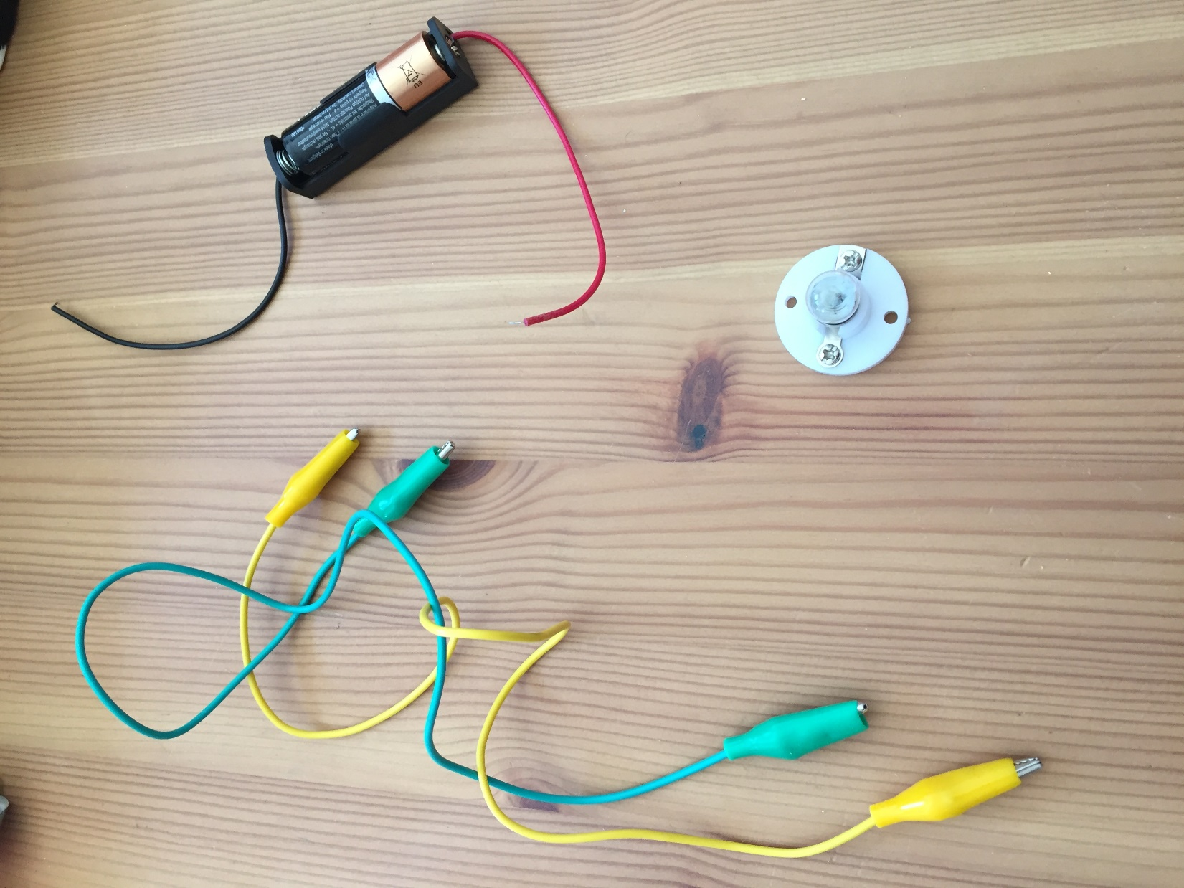
Electricity happens when teeny tiny particles called electrons can move along a totally unbroken pathway from a source of power like a battery or a plug. This pathway is called a circuit.
Today, I am going to make some circuits using these components:
Battery (also called a cell in science)
Bulb
Copper wire with a plastic coating

Slide 4
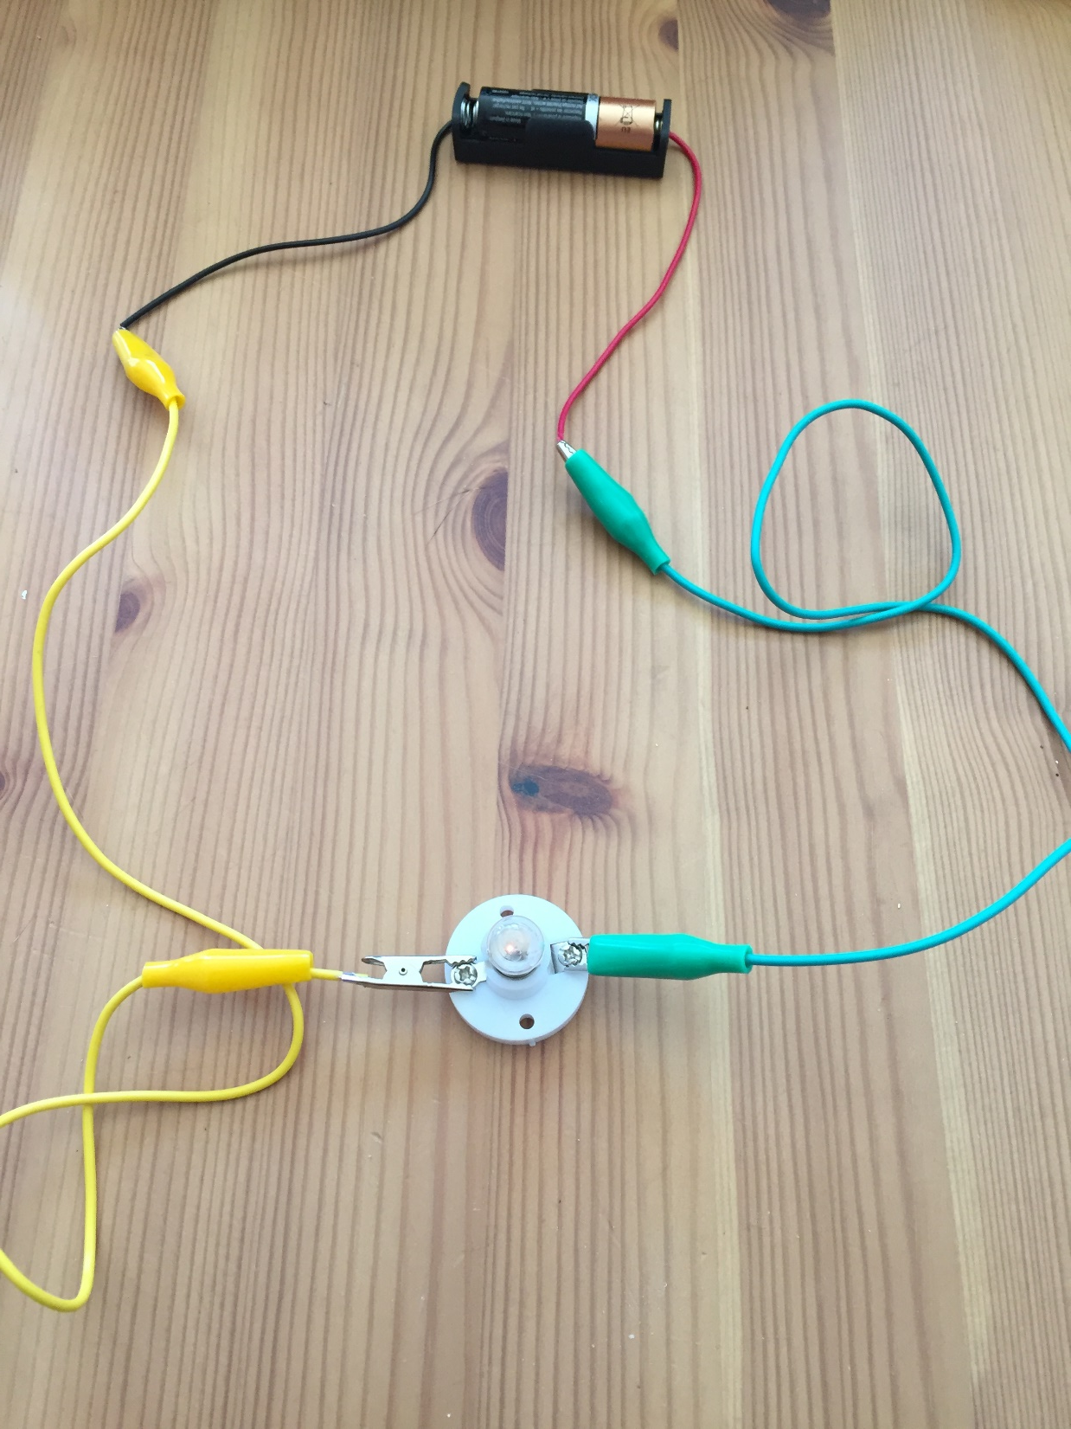
To make the bulb light up, I need to make a complete pathway from the negative end of the battery to the bulb and then back to the positive end of the battery. Here is an example of a complete circuit:
Hopefully, you can just about see that the bulb is lit. Sorry, the battery must have been running out.

Slide 5
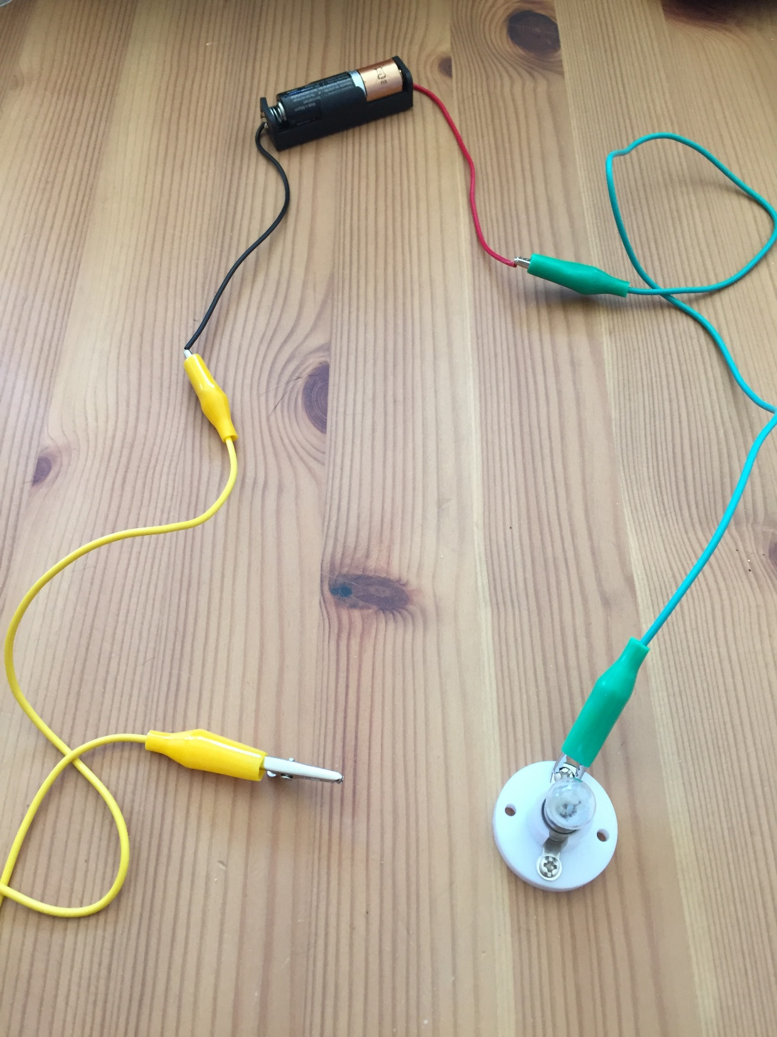
If the pathway is broken, the electrons cannot flow around the circuit so the bulb will not light up. Here is an example of an incomplete circuit:
There is now a gap in the circuit so the bulb is not lit up.

Slide 6
Before you go any further, have a go at the sheet on complete and incomplete circuits. Write whether you think the circuit will work or not.
I will go through the answers on the next few slides.

Slide 7
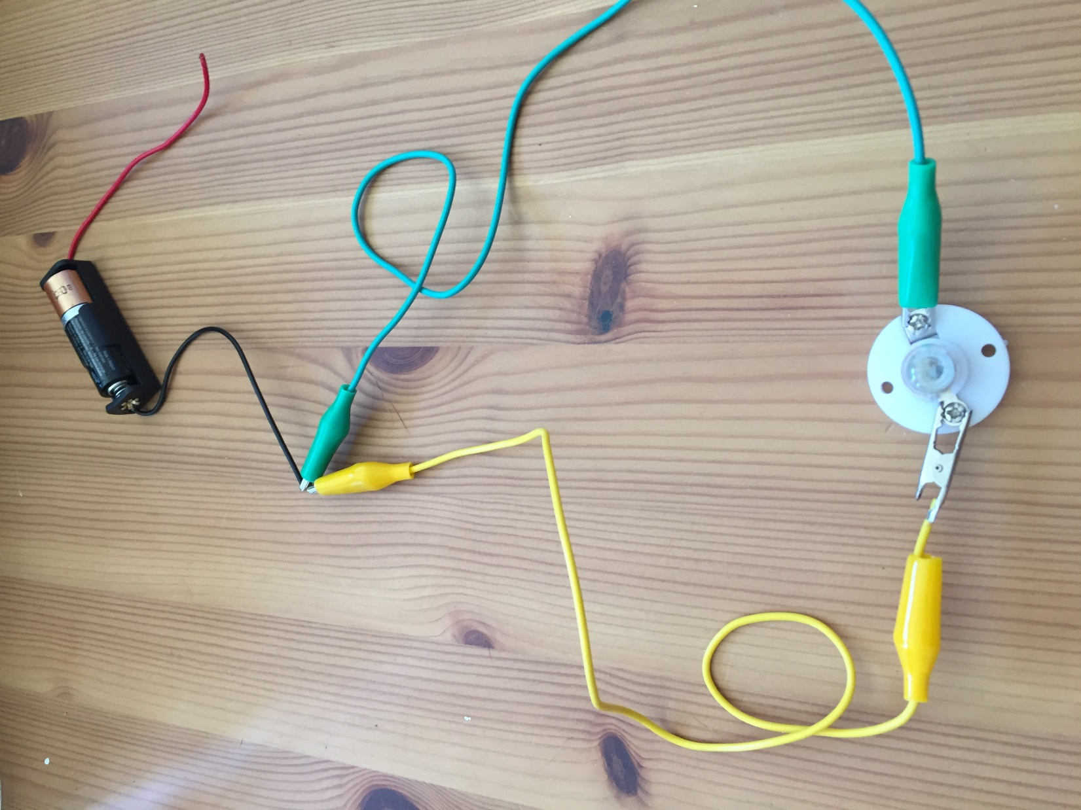
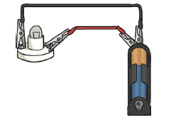
In this circuit, the wires are both attached to the same end of the battery. This means the electrons can’t flow from one end of the battery to the other. The circuit is INCOMPLETE. The bulb will not light up.

Slide 8
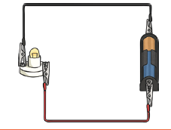
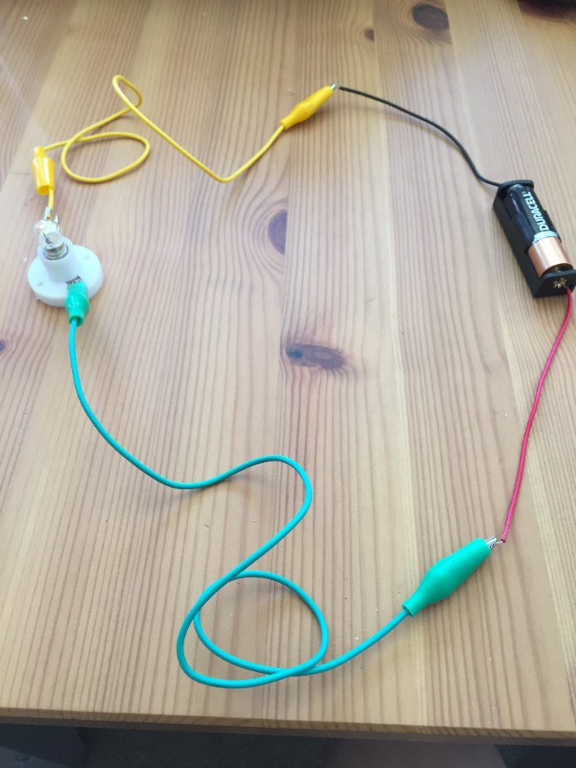
In this circuit, the electrons can flow all the way around. The bulb is lit and the circuit is COMPLETE.

Slide 9
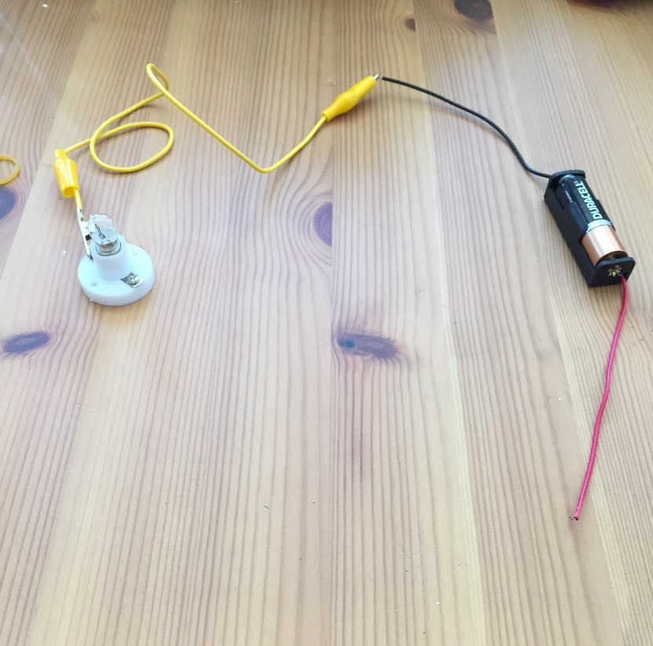
In this circuit, the wire is only connected to one end of the battery, the electrons can’t flow all the way back to the other end of the battery. The circuit is INCOMPLETE and the bulb is not lit.

Slide 10
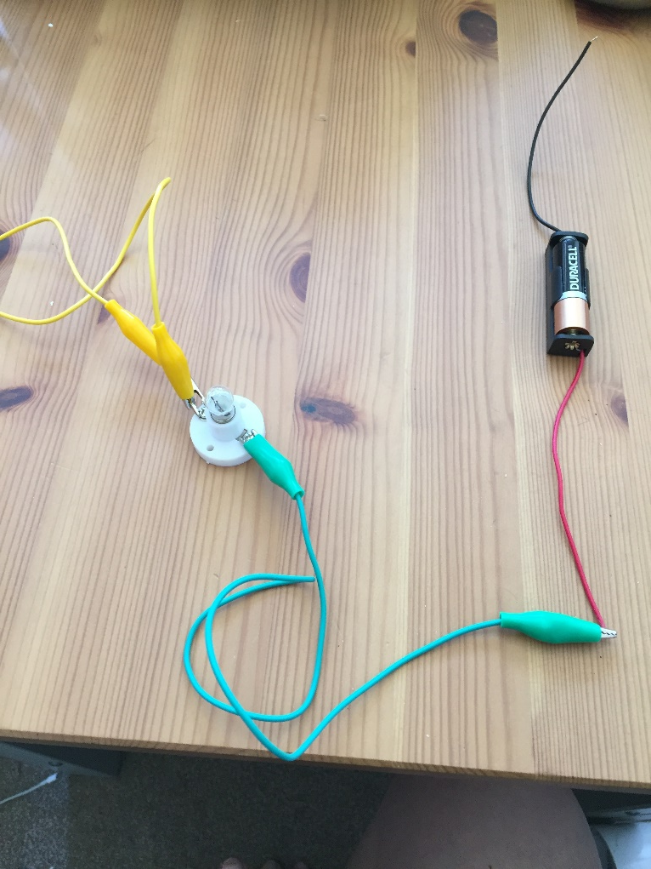
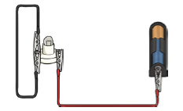
In this circuit, the electrons can’t flow all the way to the other end of the battery so the bulb is not lit. The circuit is INCOMPLETE.

Slide 11
The difference between complete and incomplete circuits is that in a complete circuit the electrons can flow all the way around in an unbroken circle. In an incomplete circuit there is a gap that stops them from flowing.

Slide 12
Using no more than 2 wires, a bulb and a battery each time, can you draw any other circuits that you think would be complete or incomplete?
Are there any ways of making a complete circuit that are different to the one that was on the sheet?
Send me your ideas for complete circuits on Tapestry and I’ll see if I can show you whether they work or not ☺

