Slide 1
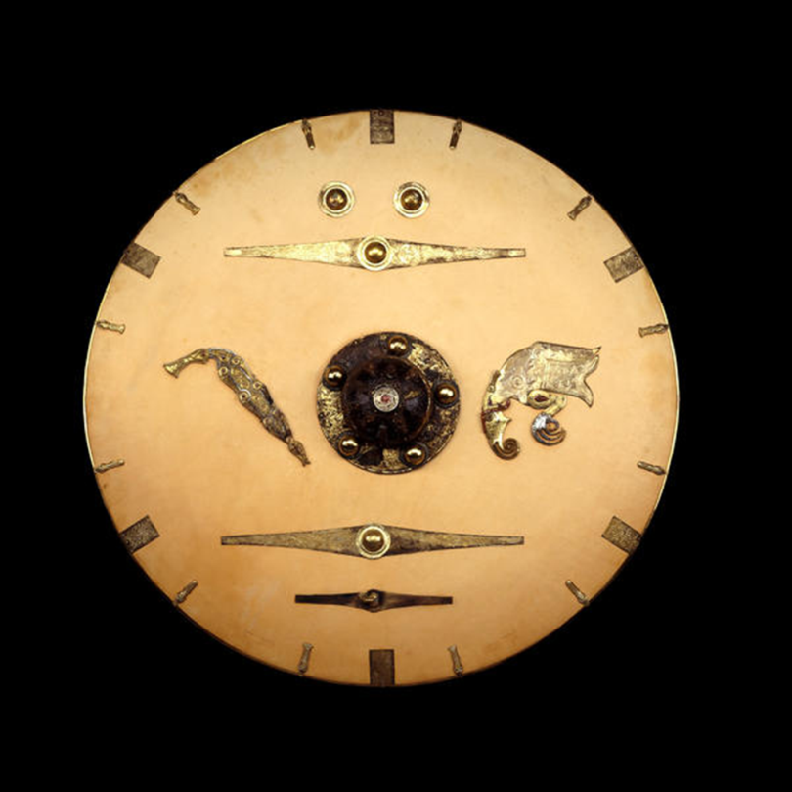
Sutton Hoo
Image bank for schools

Slide 2
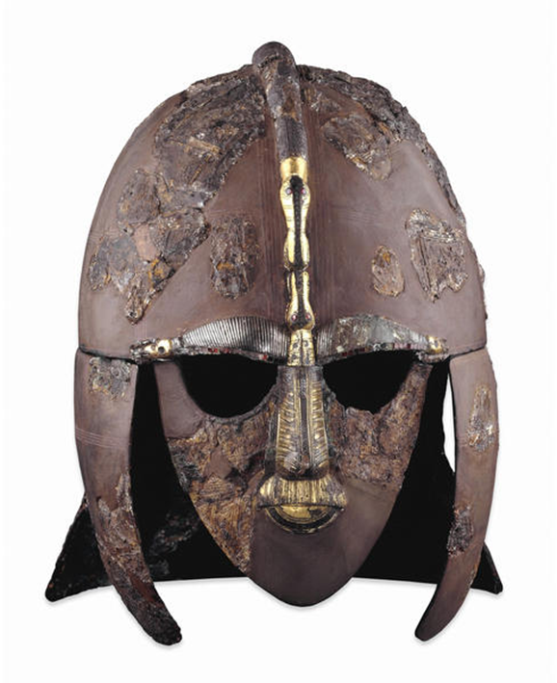
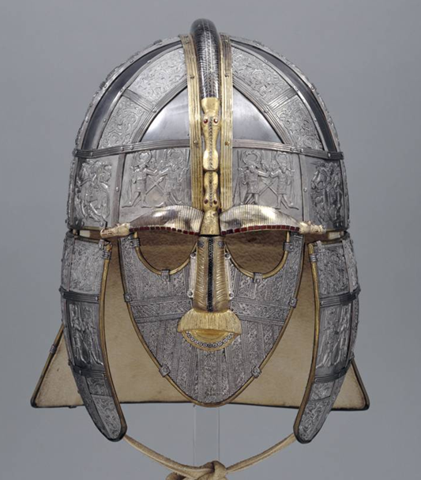
Notes:
The Sutton Hoo helmet, Anglo-Saxon, early 7th century AD, From Mound 1, Sutton Hoo, Suffolk, England
Museum numbers: 1939,1010.93
http://www.britishmuseum.org/explore/highlights/highlight_objects/pe_mla/h/helmet_from_sutton_hoo.aspx

Slide 3
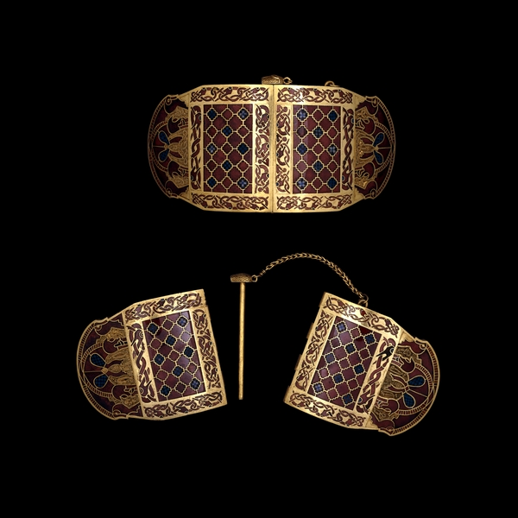
Notes:
Shoulder clasps from the Sutton Hoo ship burial, Anglo-Saxon, early 7th century AD, From Mound 1, Sutton Hoo, Suffolk, England
Museum number: 1939,1010.4–5
http://www.britishmuseum.org/explore/highlights/highlight_objects/pe_mla/s/sutton_hoo_shoulder_clasps.aspx

Slide 4
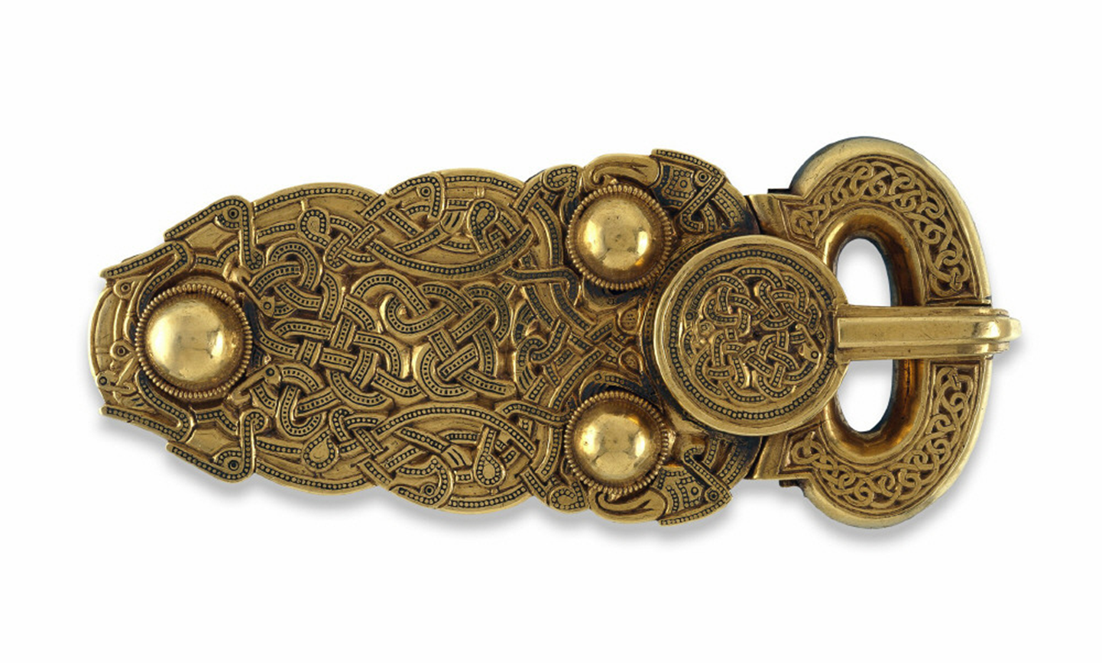
Notes:
Gold belt buckle from the Sutton Hoo ship burial, Anglo-Saxon, early 7th century AD, From Mound 1, Sutton Hoo, Suffolk, England
Museum number: 1939,1010.1
http://www.britishmuseum.org/explore/highlights/highlight_objects/pe_mla/g/sutton_hoo_gold_belt_buckle.aspx

Slide 5
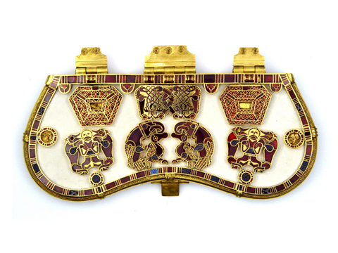
Notes:
Purse lid from the Sutton Hoo ship burial, Anglo-Saxon, early 7th century AD, From Mound 1, Sutton Hoo, Suffolk, England
Museum number: 1939,1010.2
http://www.britishmuseum.org/explore/highlights/highlight_objects/pe_mla/p/sutton_hoo_purse_lid.aspx

Slide 6
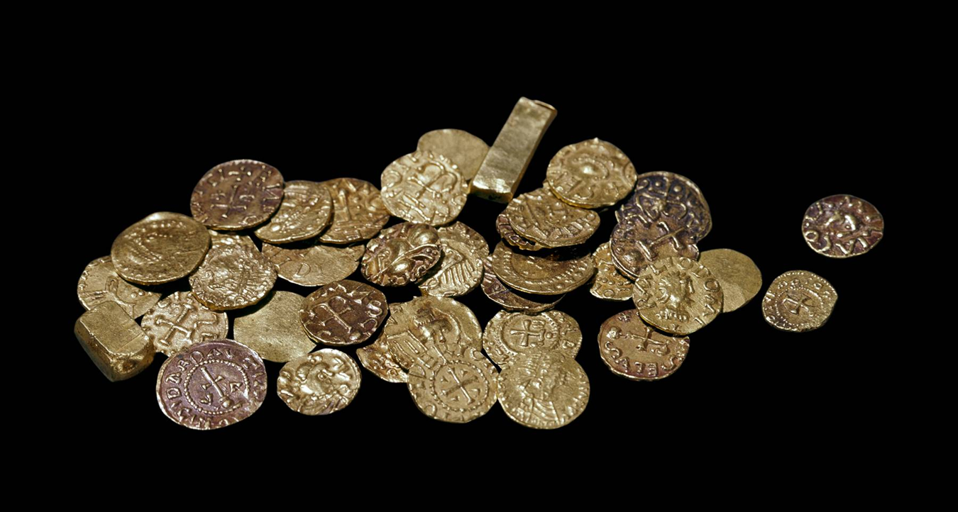
Notes:
Gold coins and ingots from the ship burial at Sutton Hoo, Frankish, early 7th century AD, From Mound 1, Sutton Hoo, Suffolk, England
Museum numbers: 1939,1003.1-42
http://www.britishmuseum.org/explore/highlights/highlight_objects/cm/g/sutton_hoo_coins_and_ingots.aspx

Slide 7
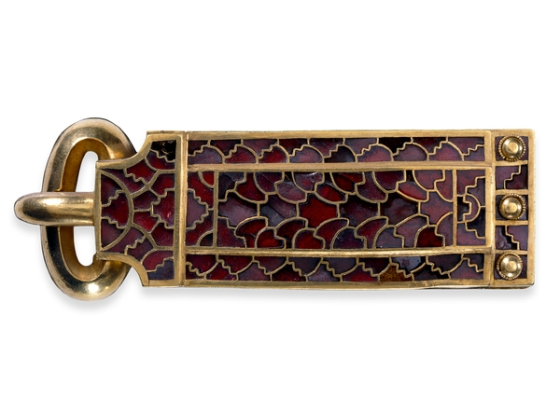
Notes:
Buckle from a sword belt, from the Sutton Hoo ship burial, Anglo-Saxon, early 7th century AD, From Mound 1, Sutton Hoo, Suffolk, England
Museum number: 1939,1010.11
http://www.britishmuseum.org/explore/highlights/highlight_objects/pe_mla/b/sutton_hoo_sword_belt_buckle.aspx

Slide 8
Notes:
Shield from the Sutton Hoo ship burial (part-reconstruction), Anglo-Saxon, early 7th century AD, From Mound 1, Sutton Hoo, Suffolk, England
Museum number: 1939,1010.94
http://www.britishmuseum.org/explore/highlights/highlight_objects/pe_mla/s/sutton_hoo_shield.aspx

Slide 9
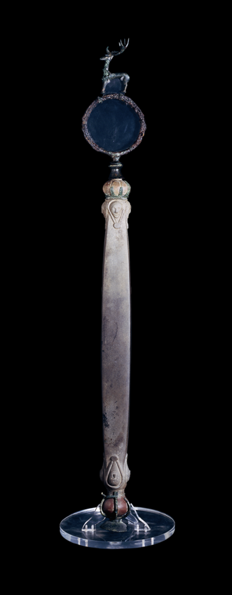
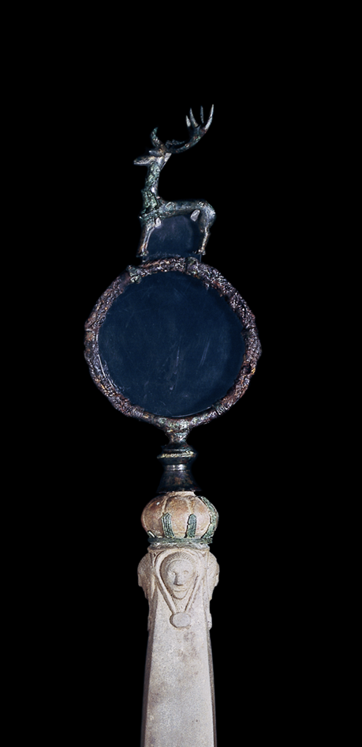
Notes:
Whetstone from the Sutton Hoo ship burial, Anglo-Saxon, early 7th century AD, From Mound 1, Sutton Hoo, Suffolk, England
Museum numbers:1939,1010.160 and 1939,1010.205
http://www.britishmuseum.org/explore/highlights/highlight_objects/pe_mla/s/sceptre_from_sutton_hoo.aspx

Slide 10
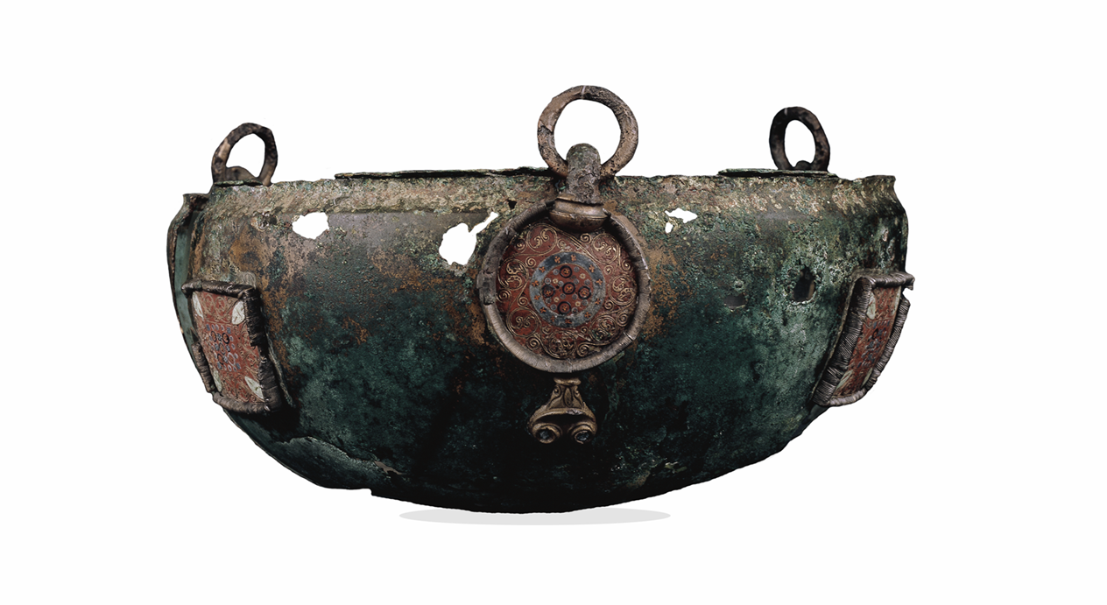
Notes:
Hanging bowl from the Sutton Hoo ship burial, Early medieval Celtic, late 6th–early 7th century AD, From Mound 1, Sutton Hoo, Suffolk, England
Museum number: 1939,1010.110
http://www.britishmuseum.org/explore/highlights/highlight_objects/pe_mla/h/sutton_hoo_hanging_bowl.aspx

Slide 11
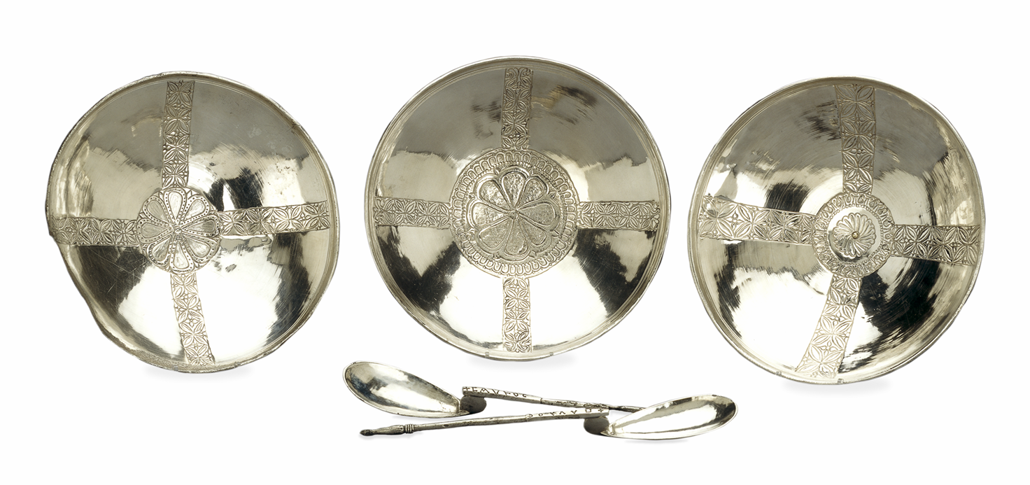
Notes:
Silver bowls and spoons from the ship burial at Sutton Hoo, Byzantine, early 7th century AD, From Mound 1, Sutton Hoo, Suffolk, England
Museum numbers: 1939,1010.79-81,88,89
http://www.britishmuseum.org/explore/highlights/highlight_objects/pe_mla/s/sutton_hoo_bowls_and_spoons.aspx

