Slide 1
Sweet Shop

Slide 2
Aim
I can decide which operation to use and explain why.
Success Criteria
I can decide whether a problem is one or two steps.
I can decide if I need to use addition and/or subtraction.

Slide 3
The Answer Is…
On the next slides, you will see a number.
Create the number using an addition or subtraction word problem.
If you want to, you can use both operations in one problem.
The most creative way of making the number will win a point.
Are you ready?

Slide 4
The Answer Is…
573 676

Slide 5
The Answer Is…
5644

Slide 6
The Answer Is…
86 303

Slide 7
The Answer Is…
29 938

Slide 8
Operations
How can we say this operation?
add
sum
addition
total
+
more
increase
combined
altogether
plus

Slide 9
Operations
How can we say this operation?
subtract
less than
take away
fewer than
-
decrease
minus
difference
how many remain
how many more

Slide 10
Operations
Which of these words are addition words?
Which of these words are subtraction words?
add
subtract
less than
take away
fewer than
more
minus
decrease
total
sum
plus
altogether
how many left
combined
increase
how many more
difference

Slide 11
Lollipops
A green lolly costs 39p and a red lolly 42p.
I want to buy 2 green lollies and 1 red lolly. What would the total be?
First we need to
read the question carefully.

Slide 12
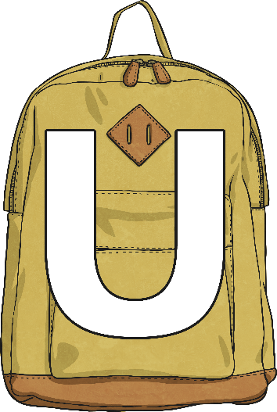
Lollipops
A green lolly costs 39p and a red lolly 42p.
I want to buy 2 green lollies and 1 red lolly. What would the total be?
Next, we need to
understand the question.
To help us, we could underline the key information.

Slide 13
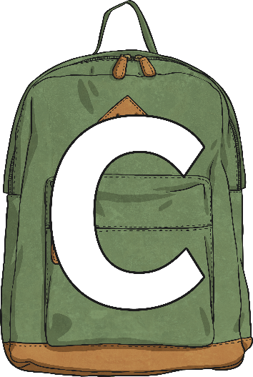
Lollipops
A green lolly costs 39p and a red lolly 42p.
I want to buy 2 green lollies and 1 red lolly. What would the total be?
After that, we need to
choose the correct method
to solve the problem.
We need to look carefully at the vocabulary used.

Slide 14
Lollipops
A green lolly costs 39p and a red lolly 42p.
I want to buy 2 green lollies and 1 red lolly. What would the total be?
This question asks me to find the total.
Therefore we need to use addition to solve this problem.
39 + 39 + 42

Slide 15
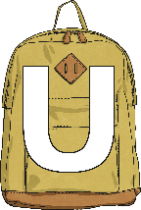
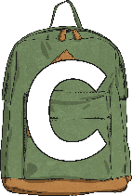
Lollipops
A red lolly costs 42p.
I want to buy a red lolly. I have £1.
How much change will I receive?
Read the question carefully.
Understand the question.
Choose the correct operation.

Slide 16
Lollipops
A red lolly costs 42p.
I want to buy a red lolly. I have £1.
How much change will I receive?
This question asks me to find how much is left over.
I need to use subtraction to solve this problem.
100p – 42p = 58p

Slide 17
Creamy Chocolate
On the next slide, you will see a problem.
Your task is to decide whether addition, subtraction or both operations are needed to solve the problem.
Use RUCSAC to help you.
Read the question carefully.
Understand the question.
Choose the correct operation.

Slide 18
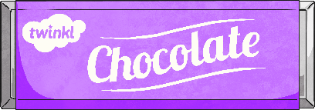
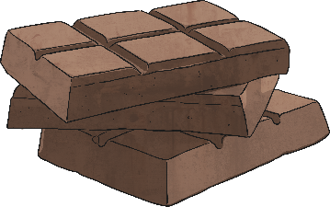
Creamy Chocolate
A chocolate bar weighs 200 grams.
50 grams of this is butter, 25 grams is cocoa, and the rest is sugar.
How many grams of sugar are there in the chocolate bar?
125g

Slide 19
Creamy Chocolate
A chocolate bar costs 76p.
If I paid with a £5 note, how much change will I receive?
£4.24

Slide 20
Creamy Chocolate
A chocolate bar costs 76p.
How much would it cost me for 3 bars of chocolate?
£2.28

Slide 21
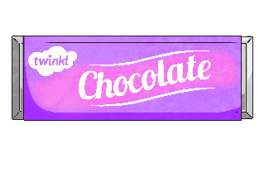
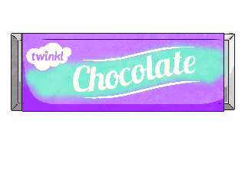
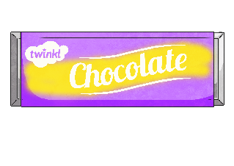
Creamy Chocolate
Strawberry Chocolate: 76p
Mint Chocolate: 54p
Caramel Chocolate: 73p
I have £10. If I buy 3 bars of mint chocolate and 1 bar of caramel chocolate, how much change would I have?
£7.65

Slide 22
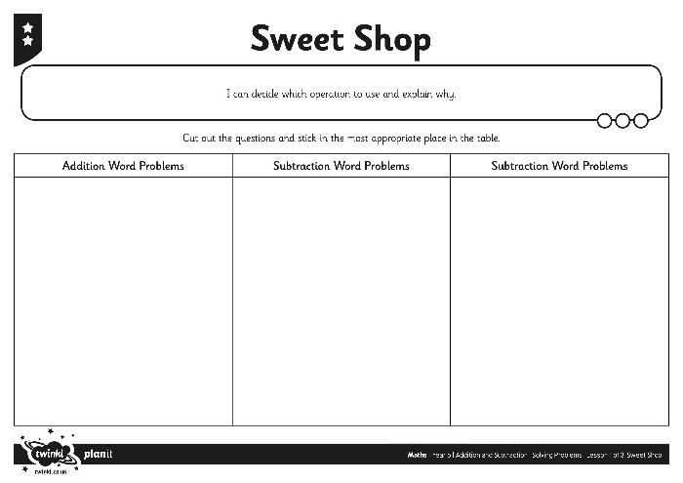
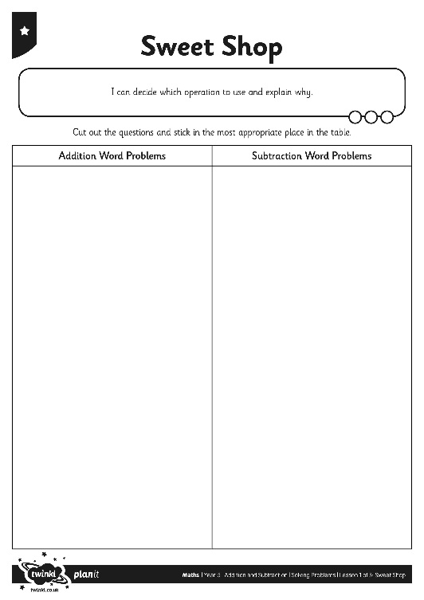
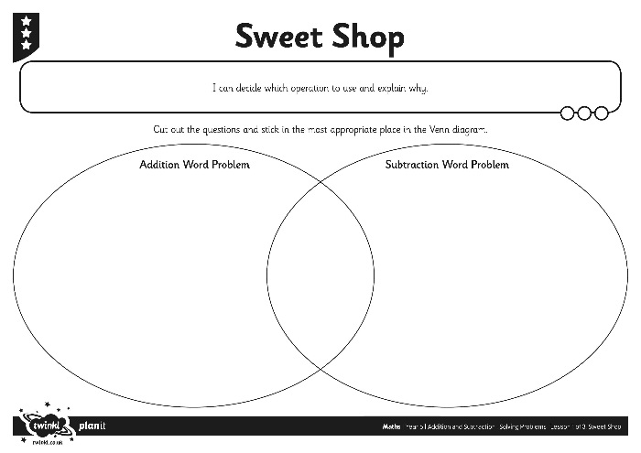
Sweet Shop
Your task is to sort the questions into the correct category.
Use RUC from RUCSAC to help you.

Slide 23
Venn Diagram
Place these questions into the correct category.
A jar holds 1395 sweets. If the shopkeeper sells 425 sweets, how many sweets are left in the jar?
A 1kg bag of sweets costs £15.98, and a jar of sweets costs £4.59 less. How much does the jar of sweets cost?
I have 500 pieces of fudge. 243 are vanilla, 38 are mint, and the rest are chocolate. How many pieces of chocolate fudge do I have?
Addition
Subtraction

Slide 24
Aim
I can decide which operation to use and explain why.
Success Criteria
I can decide whether a problem is one or two steps.
I can decide if I need to use addition and/or subtraction.

