Slide 1
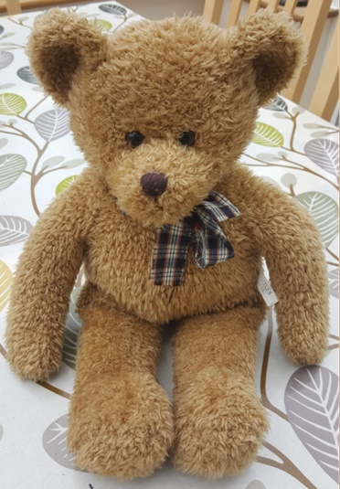
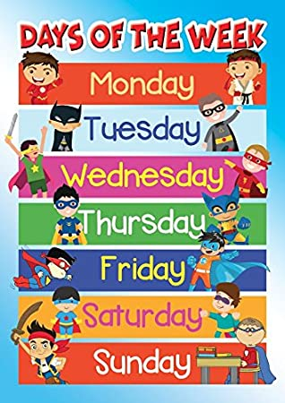
Ted’s Time Adventure: Monday
Hi my name is Ted. This week we are going to share an exciting learning adventure together. We will be learning about time.
Do you know your days of the week?
What day was it yesterday?
What day is it today?
https://www.bbc.co.uk/teach/supermovers/ks1-english-days-of-the-week/zd8njhv

Slide 2
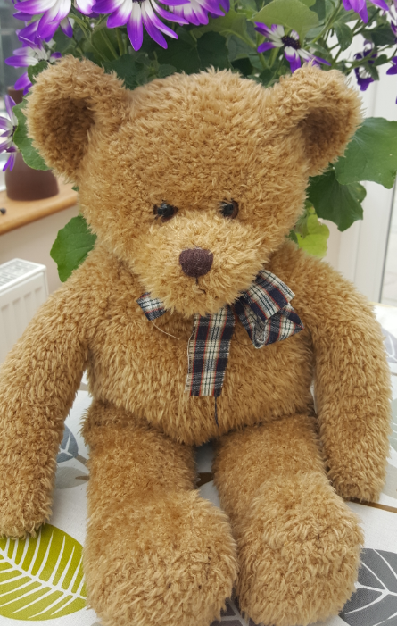
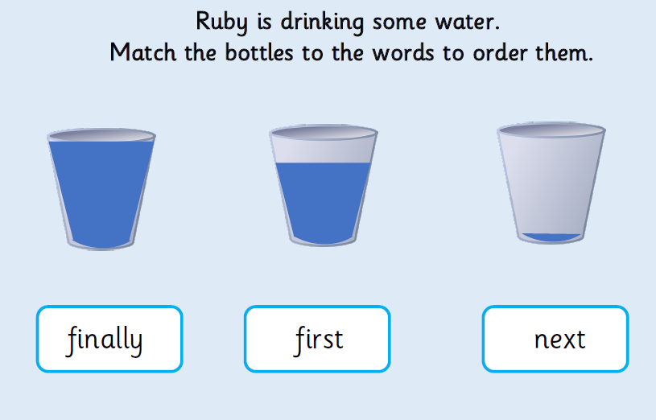
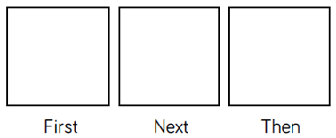
Ted’s Time Adventure: Tuesday
What day was it yesterday?
Today we are going to learn words to help us sequence events.
I have been so busy today! First, I went to the park. After lunch I went to the cinema. Before the cinema, I went to McDonalds for lunch.
What day will it be in two days?
Can you draw a picture and write the key words to order Ted’s day?

Slide 3
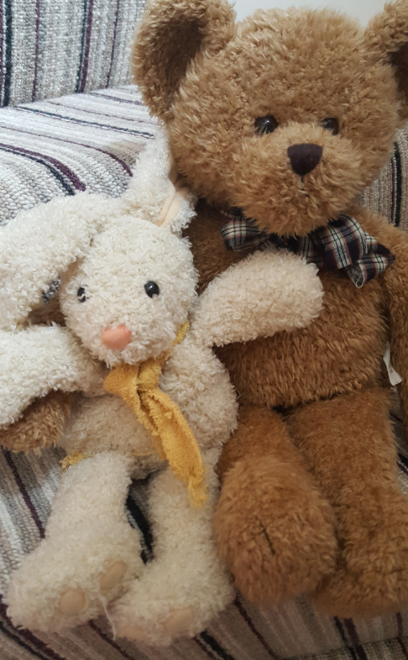
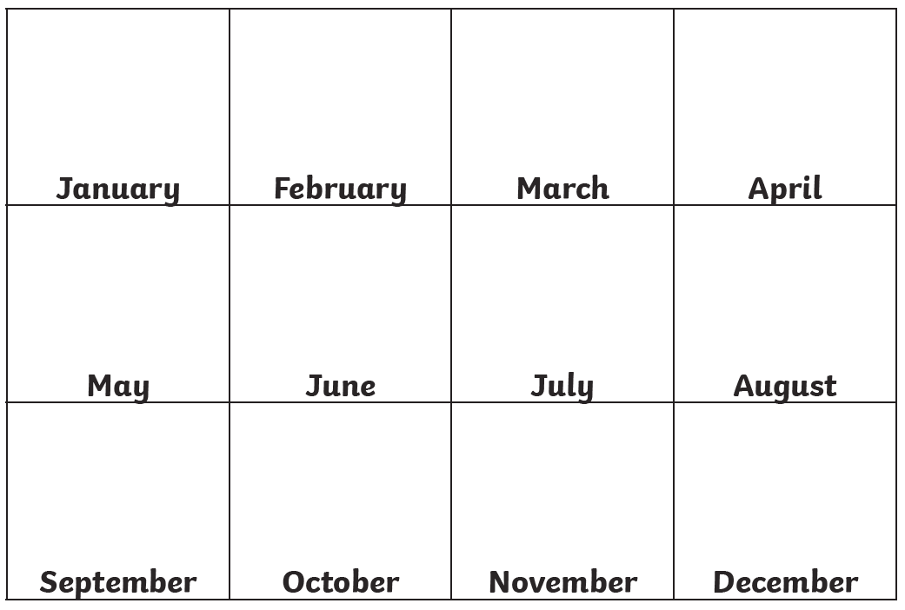
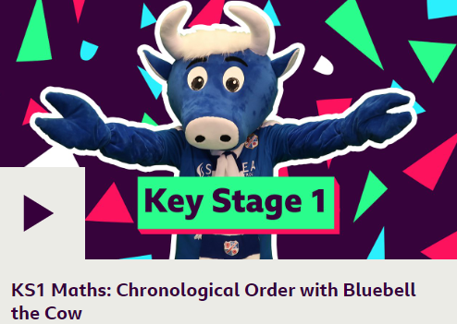
Ted’s Time Adventure: Wednesday
What day is it tomorrow?
Today we are going to learn about the months of the year. Do you already know them? Start with January…
How many days until the weekend?
My birthday is in 3 months time. Which month is my birthday in? My best friend is Boo Bunny. His birthday was last month. Which month was this?
Can you make your own calendar. Add your family’s birthdays and other days that are important to you.
Which month are we in now?
https://www.bbc.co.uk/teach/supermovers/ks1-maths-chronological-order-with-bluebell-the-cow/zbtkf4j

Slide 4
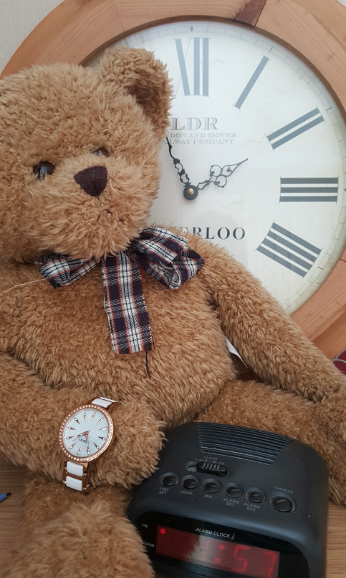
Ted’s Time Adventure: Thursday
Which day was it yesterday?
Today we are going to practise telling the time by solving problems.
How many days until next Wednesday?
I was one hour late getting up today. I got up at 8 o’clock. What time should I have got up? After breakfast I made Boo some special cookies. I put them in the oven at 10 o’clock and they took 1 hour and 30 minutes to bake. What time were they ready?
What month is next month?
Why don’t you bake some special cookies for your family. You could always make pretend ones for your special toys. How long will they take to bake? Look at the instructions to find out.
https://www.bbc.co.uk/teach/supermovers/ks1-maths-telling-the-time/zk4t8xs

Slide 5
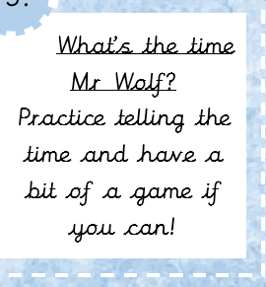
Ted’s Time Adventure: Friday
How many days until Tuesday?
Today can you practise telling the time to the hour? https://www.bing.com/videos/search?q=telling+the+time+to+the+hour+youtube&docid=608003464281458944&mid=E10AAF1BE9E863AE9006E10AAF1BE9E863AE9006&view=detail&FORM=VIRE
What day will it be in 3 days time?

