Slide 1
Triangles

Slide 2
Aim
I can compare and classify different types of triangles.
Success Criteria
I know the name and properties of different types of triangle.
I can compare triangles based on their properties.
I can classify triangles based on their properties.

Slide 3
2D Shape Quiz
Name this 2D shape.
equilateral triangle
parallelogram
scalene triangle

Slide 4
2D Shape Quiz
Name this 2D shape.
trapezium
triangle
heptagon

Slide 5
2D Shape Quiz
Name this 2D shape.
scalene triangle
isosceles triangle
equilateral triangle

Slide 6
2D Shape Quiz
Name this 2D shape.
parallelogram
rhombus
rectangle

Slide 7
2D Shape Quiz
Name this 2D shape.
rhombus
trapezium
decagon

Slide 8
2D Shape Quiz
Name this 2D shape.
rhombus
trapezium
hexagon

Slide 9
2D Shape Quiz
Name this 2D shape.
rhombus
trapezium
octagon

Slide 10
2D Shape Quiz
Name this 2D shape.
decagon
pentagon
hexagon

Slide 11
2D Shape Quiz
Name this 2D shape.
rectangle
rhombus
square

Slide 12
2D Shape Quiz
Name this 2D shape.
decagon
rhombus
hexagon

Slide 13
2D Shape Quiz
Name this 2D shape.
decagon
square
trapezium

Slide 14
Comparing Triangles
How are these triangles different?
How are they the same?

Slide 15
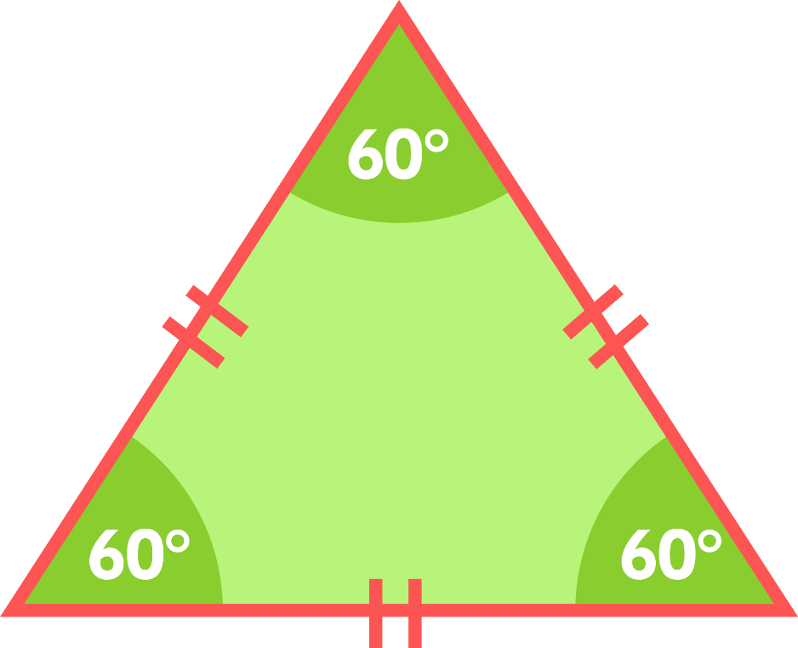
Tricky Triangles
This is an equilateral triangle.
It has 3 sides the same length and 3 equal angles.
3 equal sides
3 equal angles (60°)

Slide 16
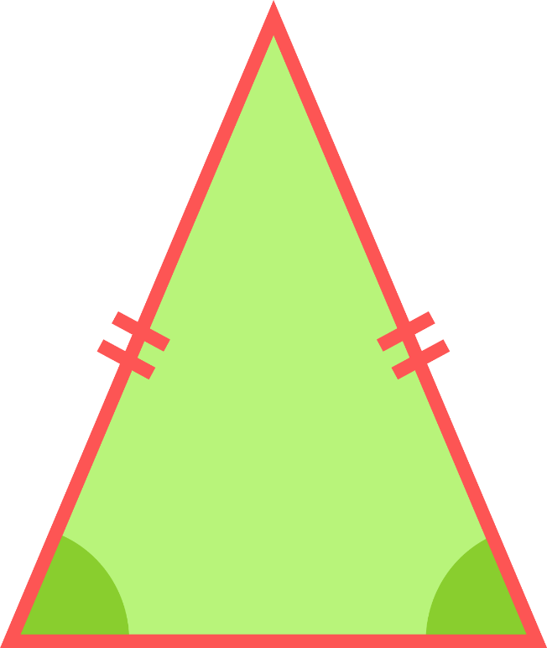
Tricky Triangles
This is an isosceles triangle.
It has 2 sides the same length and 2 equal angles.
2 equal sides
2 equal angles

Slide 17
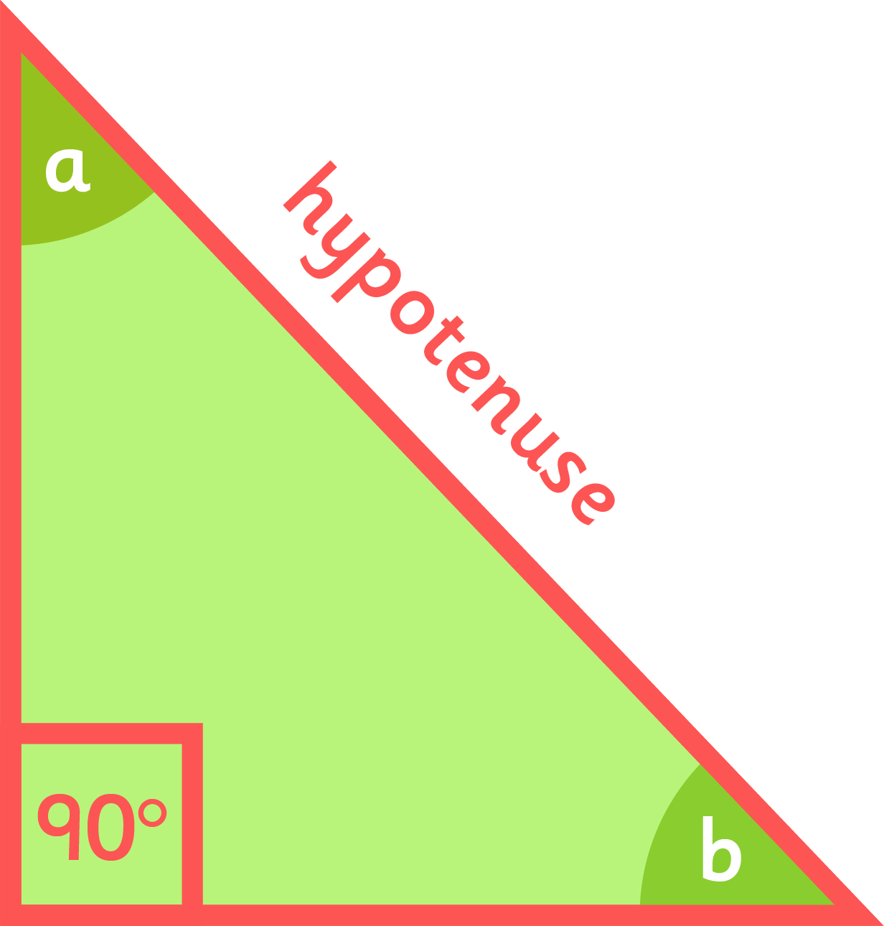
Tricky Triangles
This is a right-angled triangle.
One angle is always a right angle.
One angle is a right angle (90°)
Two other angles add up to 90°
The longest side is called the hypotenuse

Slide 18
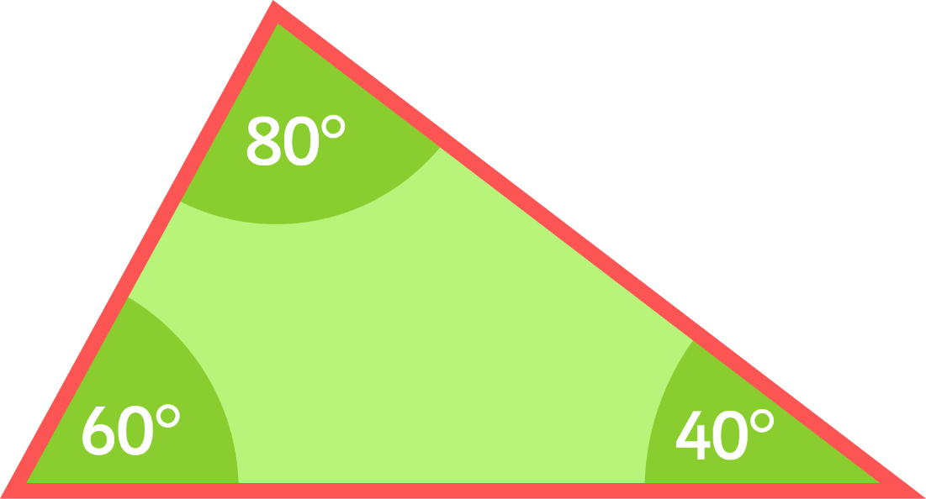
Tricky Triangles
This is a scalene triangle.
All 3 angles are different and all 3 sides are different lengths.
All sides are different
All angles are different

Slide 19
Triangle Go Fish
Aim of the game: be the first player to get 5 matching pairs of triangles.
Deal 5 cards to each player. The remaining cards go in a pile in the centre.
When it is your turn, ask the person to your left for a card.
If they have it, they have to give it to you.
If they do not have it, they say “Go Fish”, and you can take a card from the pile.
When you have a pair, place them on the table, saying the name and properties of the triangle.
The first player to collect five pairs wins.

