Slide 1
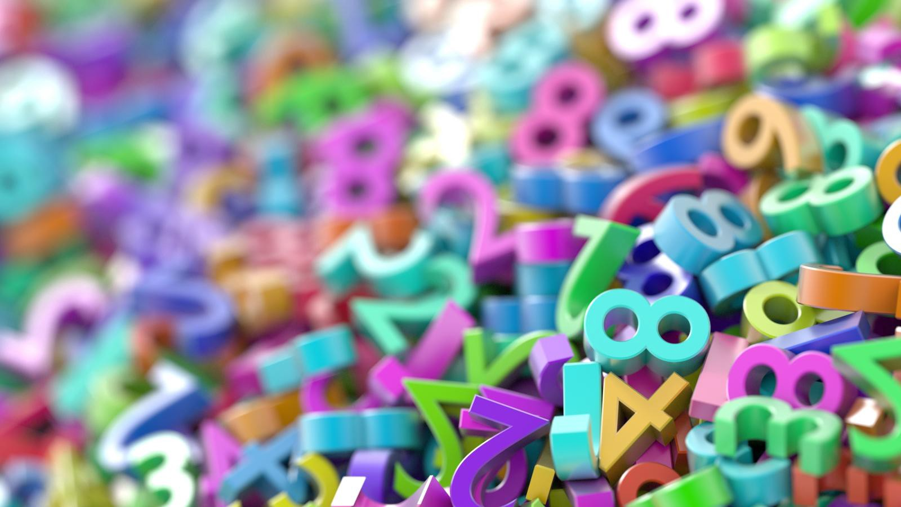
Writing Decimals

Slide 2
Get a whiteboard, chalkboard or a piece of scrap paper to write your answers

Slide 3
10s | 1s | 10ths | 100ths
What number is shown in this place value grid?
It’s 30 because there are 3 tens and no ones, tenths or hundredths.

Slide 4
10s | 1s | 10ths | 100ths
What number is shown in this place value grid?
It’s 41 because there are 4 tens, 1 one and no tenths or hundredths.

Slide 5
10s | 1s | 10ths | 100ths
What number is shown in this place value grid?
It’s 1.3 because there are no tens, 1 one, 3 tenths and no hundredths.

Slide 6
10s | 1s | 10ths | 100ths
What number is shown in this place value grid?
It’s 0.4 because there are no tens, no ones, 4 tenths and no hundredths.
You have to put in the 0 because the 1s column can’t be empty.

Slide 7
10s | 1s | 10ths | 100ths
What number is shown in this place value grid?
It’s 20.2 because there are 2 tens, no ones, 2 tenths and no hundredths.
You have to put in the 0 because the 1s column can’t be empty.

Slide 8
10s | 1s | 10ths | 100ths
What number is shown in this place value grid?
It’s 0.21 because there are 0 tens, no ones, 2 tenths and one hundredth.
You have to put in the 0 because the 1s column can’t be empty.

Slide 9
10s | 1s | 10ths | 100ths
What number is shown in this place value grid?
It’s 0.03 because there are 0 tens, no ones, no tenths and 3 hundredths
You have to put in the 0 because the 1s column can’t be empty and neither can the 10ths if you’ve got numbers after the decimal point.

Slide 10
10s | 1s | 10ths | 100ths
What number is shown in this place value grid?
It’s 20.02 because there are 2 tens, no ones, no tenths and 2 hundredths
You have to put in the 0 because the 1s column can’t be empty and neither can the 10ths if you’ve got numbers after the decimal point.

Slide 11
10s | 1s | 10ths | 100ths
What number is shown in this place value grid?
It’s 20.02 because there are 2 tens, no ones, no tenths and 2 hundredths
You have to put in the 0 because the 1s column can’t be empty and neither can the 10ths if you’ve got numbers after the decimal point.

Slide 12
Draw a grid like this on your whiteboard/chalkboard/piece of scrap paper:
10s
1s
10ths
100ths

Slide 13
10s | 1s | 10ths | 100ths
Represent the number 0.04 on your grid.

Slide 14
10s | 1s | 10ths | 100ths
Represent the number 3.05 on your grid.

Slide 15
10s | 1s | 10ths | 100ths
Represent the number 12.6 on your grid.

Slide 16
10s | 1s | 10ths | 100ths
Represent the number 40.6 on your grid.

