Slide 1
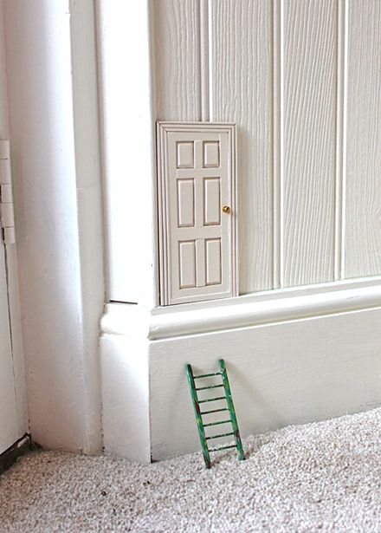
One day, you find this door at the corner of your room.

Slide 2
Think about these questions:
What does the door look like?
Can you see someone using the door?
Who is it? What do they look like?
When you look through the door, what can you see on the other side?
Your task is to write an opening to a story about this door. Try to describe the scenes in detail using exciting vocabulary. You are welcome to write the whole story if you like but I want you to spend some time focussing on creating an interesting opening where you see the door, approach it and look inside ☺
You are going to write it in the first person (I, me, my, mine).

