Slide 1
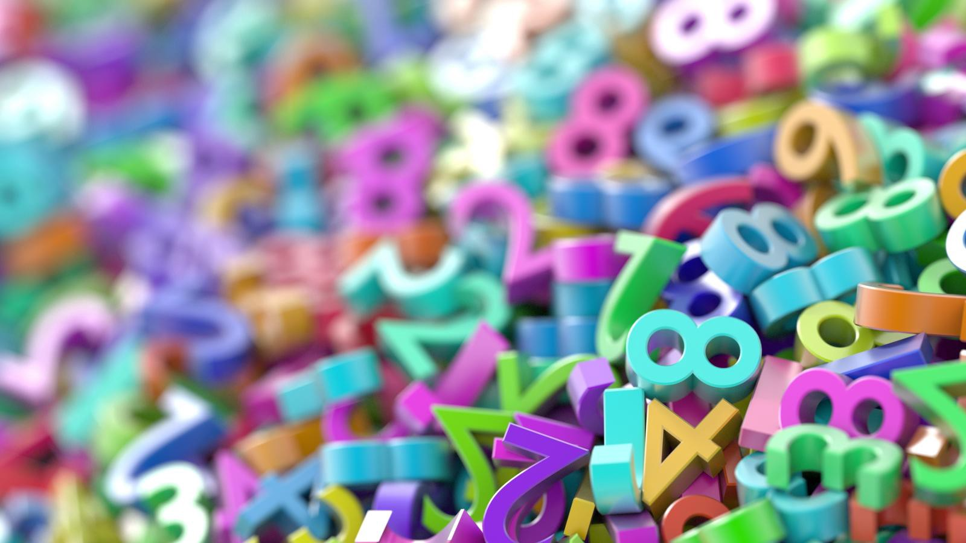
Comparing Decimals

Slide 2
Tens | Ones | Tenths | Hundredths
This number is 2.2
There are 2 ones in the ones place and 2 tenths in the tenths place.
2
2
Tens | Ones | Tenths | Hundredths
This number is 1.4
There is 1 one in the ones place and 4 tenths in the tenths place.
1
4

Slide 3
Tens | Ones | Tenths | Hundredths
These numbers are 2.4 and 2.5
The largest number is 2.5 because even though they have the same number in the ones place, 5 tenths is more than 4 tenths.
If you were going to write a comparison statement, it would look like this:
2.5 > 2.4
2
4
Tens | Ones | Tenths | Hundredths
2
5

Slide 4
Tens | Ones | Tenths | Hundredths
These numbers are 2.44 and 2.43
This time, they both have 2 ones and they both have 4 tenths so we need to have a look at the hundredths column to find out which is the biggest.
4 is bigger than 3 so if we wrote a comparision statement this time it would look like this:
2.44 > 2.43
2
4
4
Tens | Ones | Tenths | Hundredths
2
4
3

Slide 5
Can you complete these statements using < > or = (less than, greater than or equal to)
0.54
>
0.45
3.4
>
3.1
4.7
0.14
<
0.19
4.6
<
3.65
<
3.75
2.46
>
2.36

