Slide 2
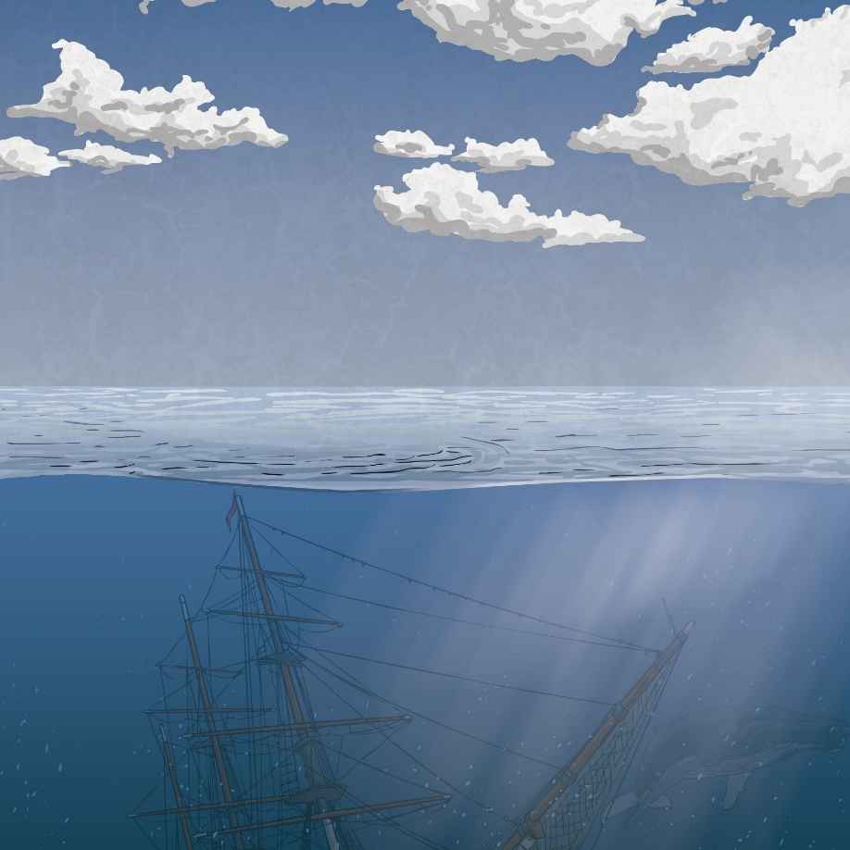
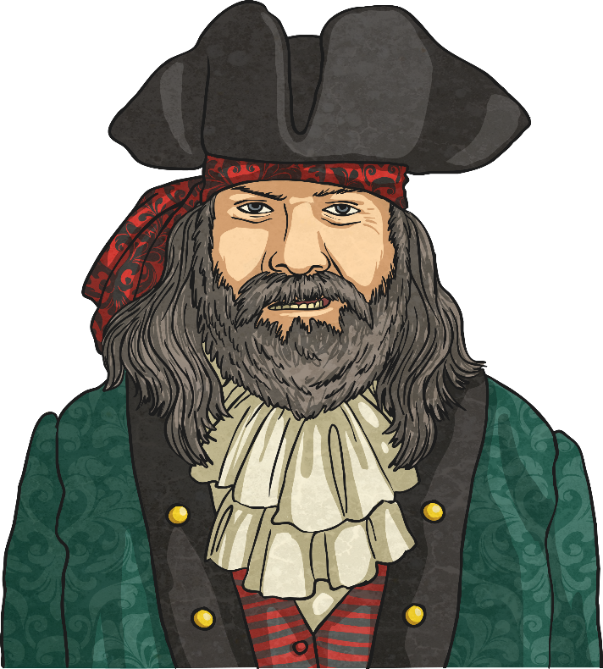
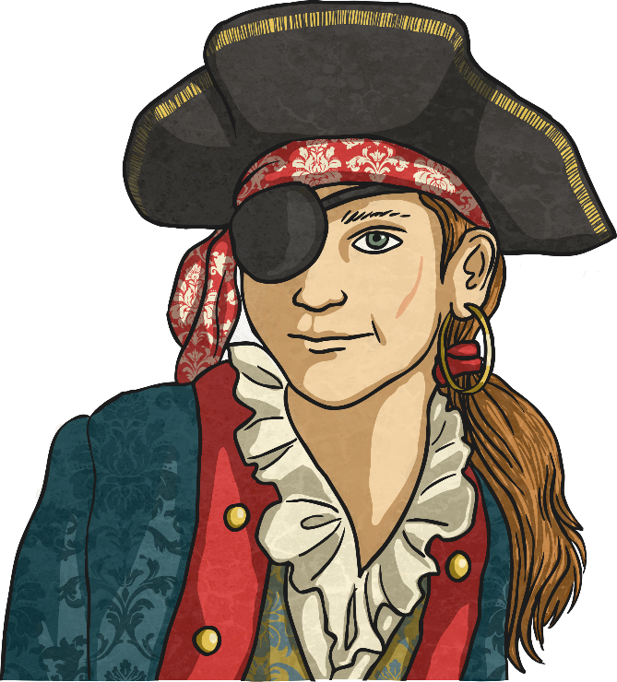
Who Are Pirates?
Pirates are people who steal things from ships while at sea.
This still happens but much less than it used to!
The period of time between 1650 and 1730 is commonly known as the Golden Age of Piracy as this was a time when piracy was common. During this time, there were many ships carrying valuable cargo around the Caribbean and Indian Ocean and everyone wanted a piece of it!
During the Golden Age of Piracy, there were also some specific types of pirate:

Slide 3
Who Are Pirates?
Buccaneers
Privateers
Corsairs
These were pirates specifically based around the Caribbean, mainly between 1650 and 1680.
A privateer was someone paid by the Government to commit piracy. Francis Drake was one of these.
Corsairs were pirates based around the Barbary Coast in North West Africa working in the Mediterranean..
Click to find out more about being a pirate…

Slide 4
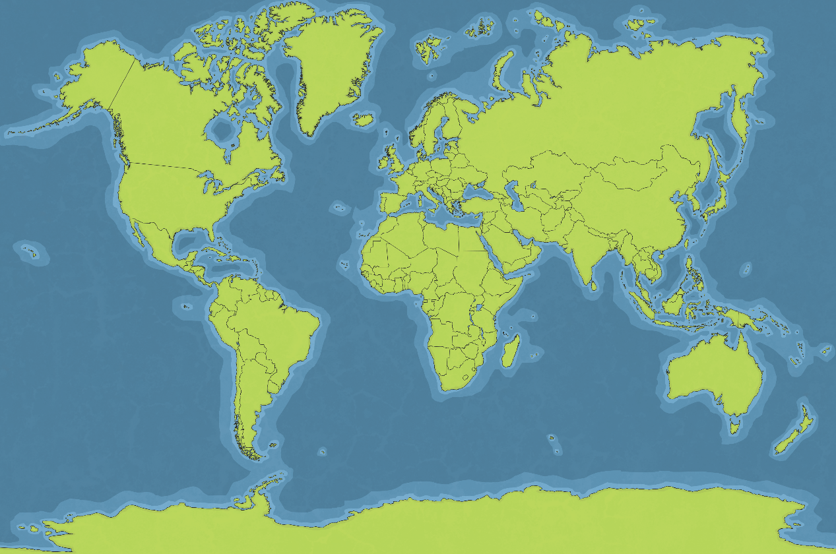
Who Are Pirates?
The map shows some of the key areas of piracy. They are all in places where valuable goods are on shipping routes. Click on the hotspot to find out more.
In the 1500s and 1600s, the Barbary Coast was popular with pirates and is even sung about in the song ‘High Barbaree’.
European pirates in Roman times even capture Julius Caesar. More piracy in the 1200s and 1300s.
The Caribbean, where buccaneers stole from Spanish ships, taking riches from South America back to Spain in the late 1600s.
The Indian Ocean and Red Sea had rich trade routes that attracted pirates around 1690. It is also a hotspot for modern day piracy.
Click to find out more about being a pirate…

Slide 5
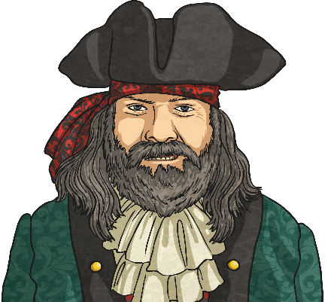
Pirate Job Advertisement
Job title: Pirate
Salary: Whatever you can plunder
Location: The high seas
Hours: Any time of day or night (eyepatch recommended for night-vision training)
Job description: Steal loot, gold or treasures (anything that is worth any money) from other ships on the high seas.
Key skills: Sailing and fighting
Desirable skills: Sing sea shanties, Cook, Perform surgery, Talk like a pirate.
Working with: A crew of other pirates under a male or female captain
We are also on the look out for Buccaneers to work specifically in
the Caribbean and also Privateers to be paid by the government.
Could you have been a pirate?

Slide 6
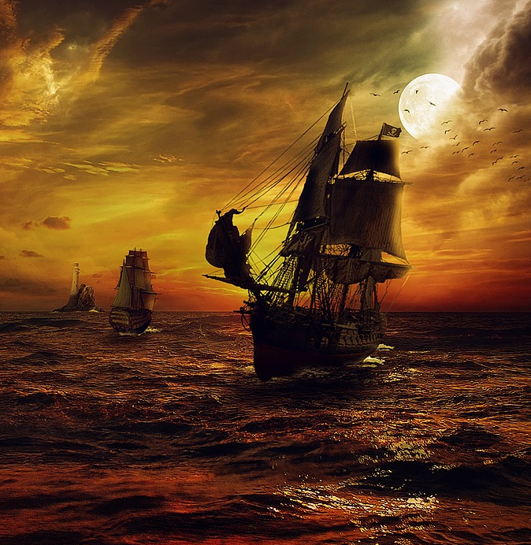
What You Need to Be a Pirate
Click on each to find out more…
A Pirate Ship
A Pirate Name
A Pirate Flag
I’ve got those things… what now?

Slide 7
Pirate Names
Some pirates had aliases (nicknames) that became well known and often made them sound more scary or courageous.
Do you know the real names of these pirates?
Click on the name to find out their real name.
Blackbeard
Anne Bonny
Edward Teach
(or Thatch)
Her real name was Anne Bonny!
Black Bart
Calico Jack
Captain Bartholomew Roberts
John Rakham
Mary Read
Long Ben or Benjamin Bridgeman
The Gentleman Pirate
Edward Lowe
Her real name was Mary Read!
Henry Every (or Avery)
Stede Bonnet
His real name was Edward Lowe!
What else do I need?

Slide 8
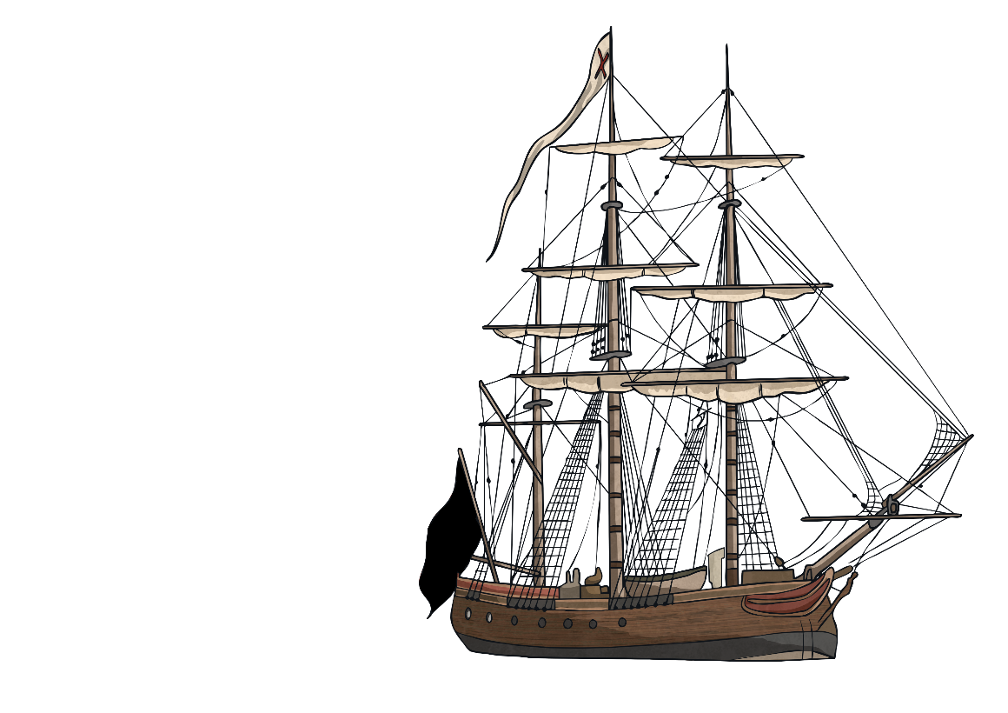
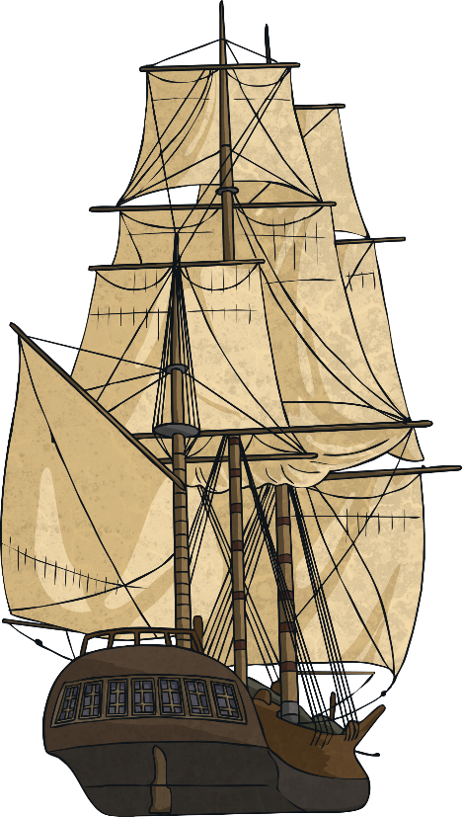
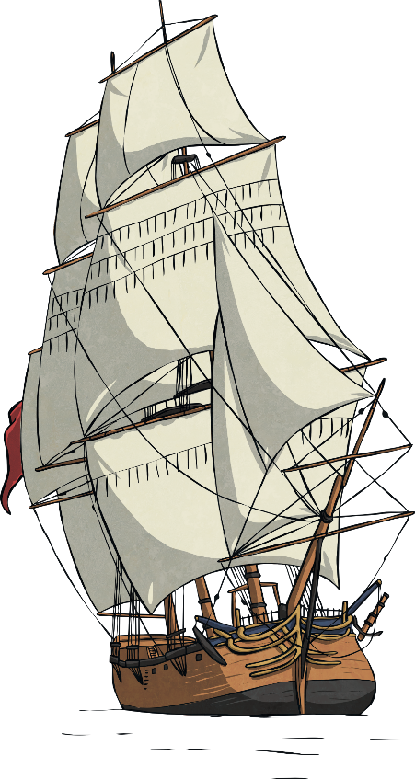
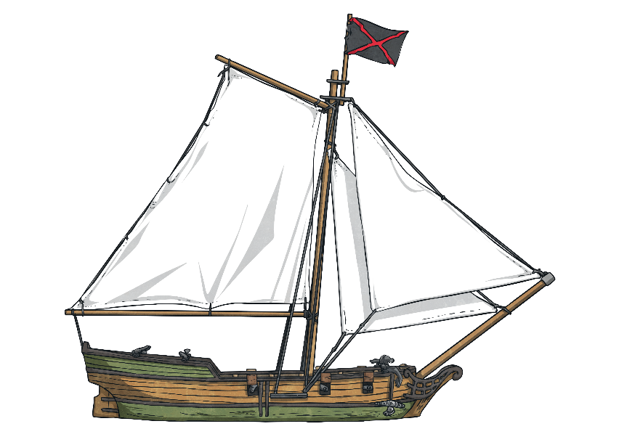
Pirate Ships
Pirate ships could come in many shapes and sizes but were basically ships that they had stolen during a battle or raid. Most captains started with a small ship but, with success, gained bigger ones.
Squarerigger
What people imagine as a pirate ship. A huge ship with three masts and square sails. Plenty of room in the body of the ship for cargo and loot. A Galleon is a type of squarerigger.
Brigantine
A ship with two masts and excellent steering capabilities. It has square sails on the front foremast and can reach speeds of 11 knots
(as fast as a schooner or sloop). It can hold
around 125 crew and 20 cannons.
Sloop
A small, but fast ship with one mast and a long bowsprit for speed. It is good for hiding and moving quickly to evade enemies. It is shallow so it can sail in shallow waters. It can hold around 75 pirates and 10 cannons.
Schooner
This ship has two masts but is still small
and fast like the sloop. It has a long
bowsprit for speed and is small and shallow
for hiding and getting into shallow waters.
It can hold around 75 pirates and 10
cannons.
What else do I need?

Slide 9
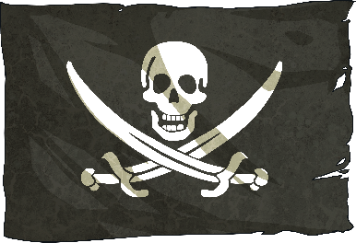
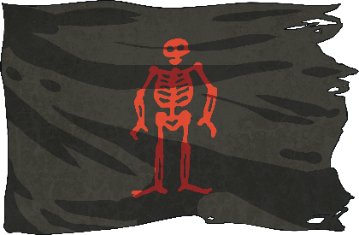
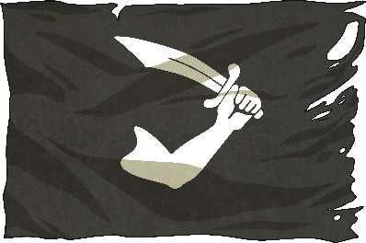
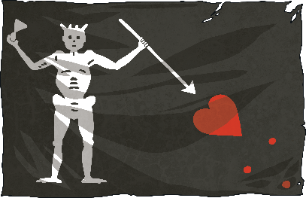
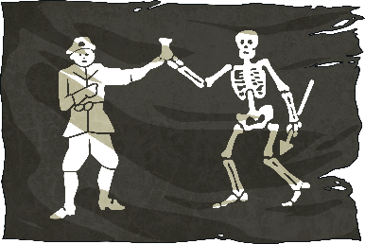
Pirate Flags
People often think that all pirates flew the Jolly Roger flag (also known as the skull and crossbones).
This was flown by some pirates, but many pirates had their own personal flag or even just flew a black flag. Do you know who these flags belong to?
Calico Jack
Edward Lowe
Black Bart
Blackbeard
Thomas Tew
What else do I need?

Slide 10
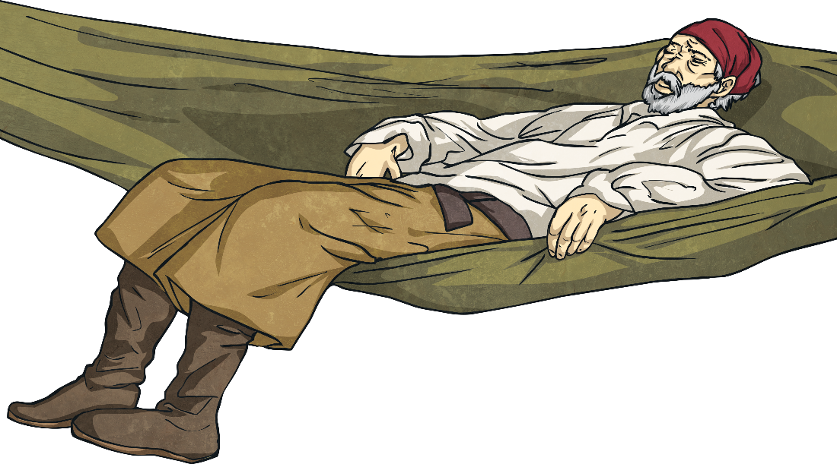
Pirate Crew
On board a pirate ship there are many jobs needed, not just to commit piracy but to actually keep the ship sailing and all the crew looked after.
There could sometimes be up to 300 crew members on a ship.
The captain is in charge of the ship but there are also other senior roles with official responsibilities as well as the sailing crew and powder monkeys.
Find out more about the roles on a ship…

Slide 11
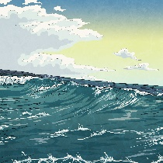
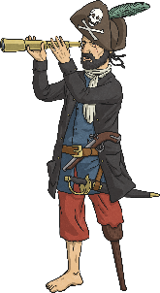
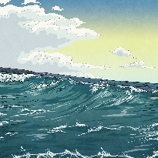
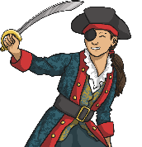
Senior Pirates
Click on the name to find out more…
Quartermaster
The Captain
First Mate
The quartermaster is in charge of all the supplies and water on the ship and a close deputy for the captain. They have the authority to punish people.
The captain is the main person in charge. They own the ship and have a crew below them. They lead their crew into battle and make strategic decisions. Voted for by the crew.
The first mate takes over the ship if the captain can’t lead. They are not always found on pirate ships. If there was no first mate, then the quartermaster would take over.
Who is next?

Slide 12
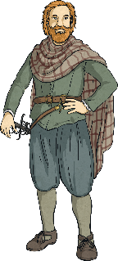
Pirates in Charge
Click on the name to find out more…
Navigator
Bosun
First Mate
The navigator, also known as a sailing master, is a very knowledgeable sailor who is able to read maps directing and navigating the ship. A sailing master is well educated and often made to go on pirate ships but paid well.
A bosun, also called the boatswain, is
just below the quartermaster and captain and often in charge of anchoring and supplies.
The master gunner is in charge of a team of gunners operating the cannons. It takes around five crew members to operate a cannon, including
aiming, firing, resetting, swabbing and loading.
Who is next?

Slide 13
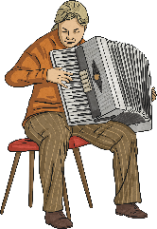
Pirates with Special Jobs
Click on the name to find out more…
Surgeon/Doctor
Cooper
Musician
Not usually a real or even a trained surgeon, the ship’s medic is good with tools. If no surgeon is available, they often use the ship’s carpenter.
The cooper is skilled with tools and in barrel making.
The musician keeps the crew entertained by singing and playing sea shanties and tunes for dancing. They are often stolen from a non-pirate ship.
Cook
The cook is not usually properly trained, just a normal pirate who prepares and cooks the food.
Who is next?

Slide 14
Junior and Lower Rank Pirates
Click on the name to find out more…
Powder Monkey
Swabbie
Gunner
The powder monkey assists the gunners.
It is a very dangerous job, often done by teenage boys who could then work up to being a gunner.
The swabbie is a crew member who swabs (mops) the decks.
The gunner is one of
the crew members, in a group of around five people, who fire the cannons.
Rigger
A rigger is a
crew member
who climbs the rigging.

