Slide 2
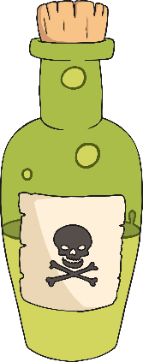
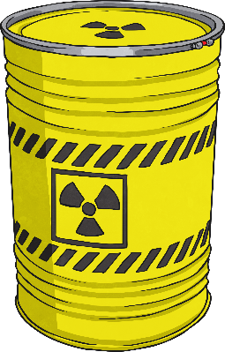
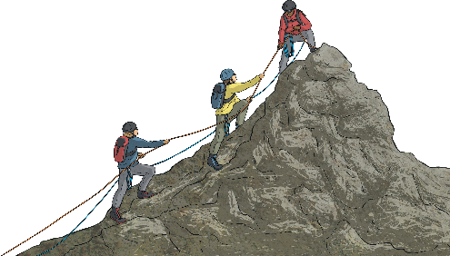
What do you notice about these words?
poisonous
mountainous
dangerous
This week we are looking at adding the suffix -ous to words...

Slide 3
These words all have a very obvious root word that is a noun. Then ous has been added making it into an adjective
Mountain is a noun (The mountain)
Mountainous is an adjective (Northern India is mountainous)

Slide 4
dangerous
poisonous
mountainous
joyous
synonymous
hazardous
riotous
perilous
momentous
scandalous
Which suffix do these words have in common?
How does that suffix affect how the word is spelt?
These words all contain the suffix –ous.
There is no change to the root word.

Slide 6
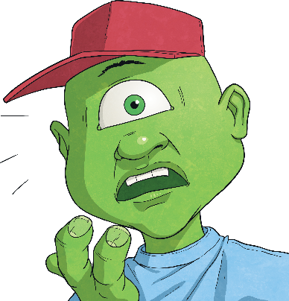
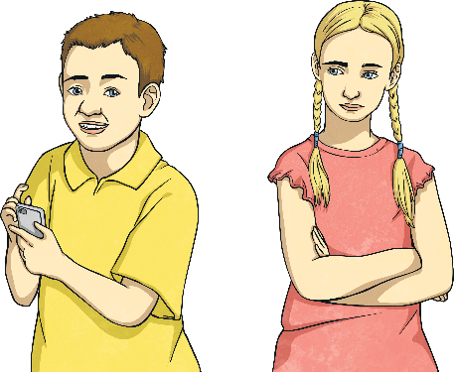
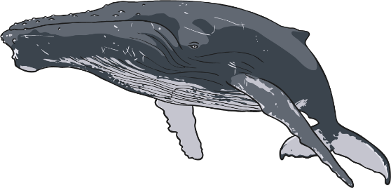
What do you notice about these words?
enormous
anxious
jealous
This week we are looking at adding the suffix – ous to words...

Slide 7
These words are all still adjectives but they don’t have a root word that you can easily find ☺

Slide 8
tremendous
enormous
jealous
serious
hideous
fabulous
curious
anxious
obvious
gorgeous
Which suffix do these words have in common?
How does that suffix affect how the word is spelt?
These words all contain the suffix – ous.
These words all have no definitive root word.

Slide 10
These words do have root words.
Some of the root words end in a y.
For example, victorious has victory as a root word and furious has fury.
For these, the rule is ‘change the y to an i and add ous’
The other root words end in our. Like in humorous the root word is humour and in odorous the root word is odour.
The rule for these is ‘Take out the u and add ous’

Slide 11
various
furious
glorious
victorious
mysterious
humorous
glamorous
vigorous
odorous
rigorous
Which suffix do these words have in common?
How does that suffix affect how the word is spelt?
These words all contain the suffix -ous
When the root word ends in ‘y’, it becomes ‘i’ before adding -ous.
When the root word ends in ‘our’, it becomes ‘or’ before adding -ous.

