Slide 1
For each of these advertising posters, have a look closely and decide what you think the answer to the following questions are (you don’t have to write them down, just think about it)
Then click and it will bring up what I think (which may be different to your thoughts and that’s OK!)
What is the advert selling?
Who is it aimed at? (men, women, adults, children etc)
How does it try to persuade you to buy the product?

Slide 2
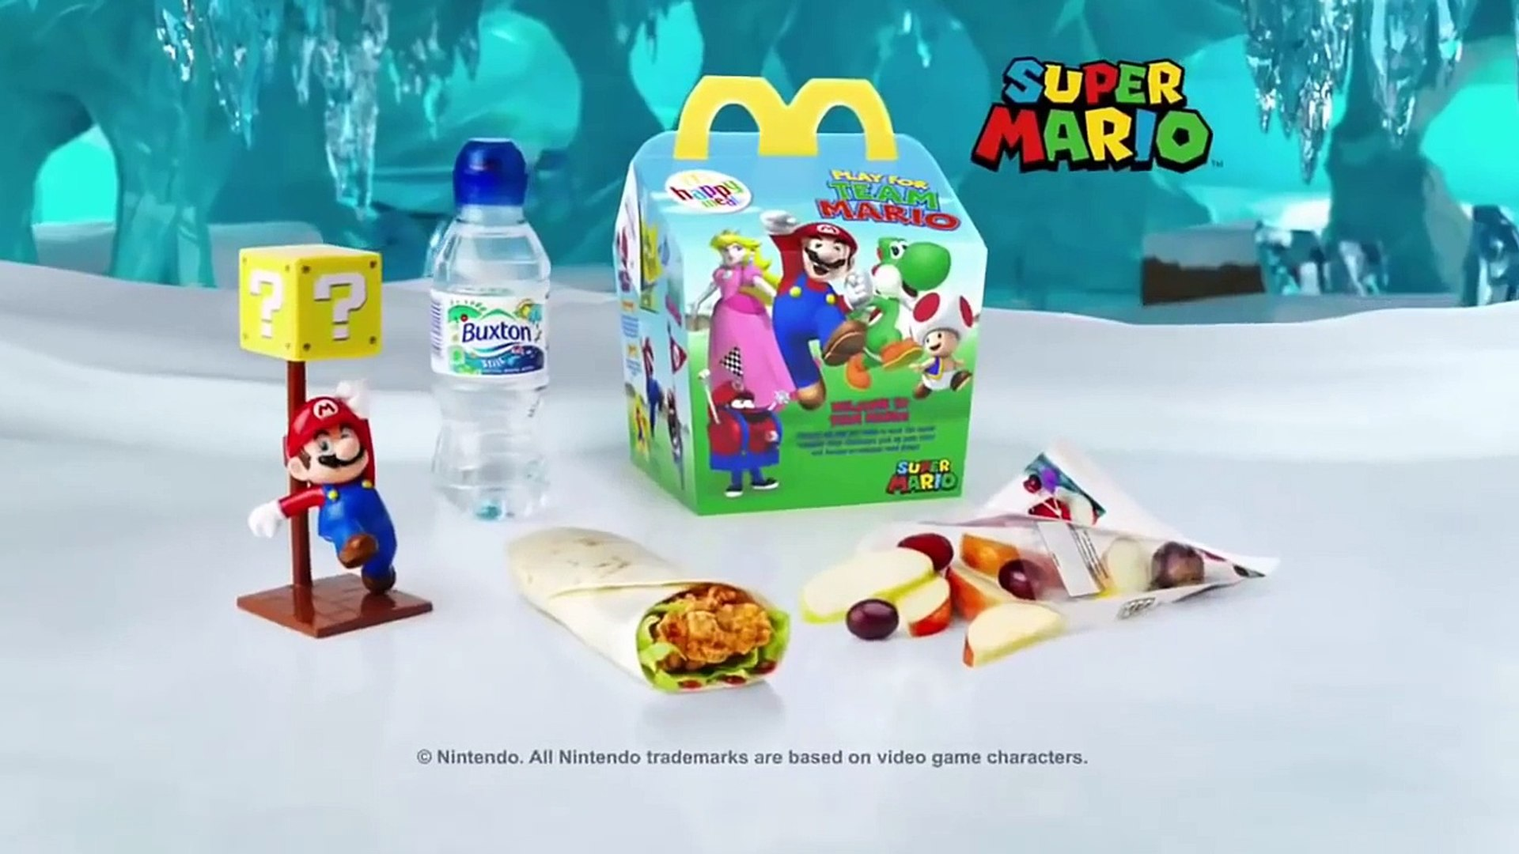
It’s selling a Happy Meal
It’s aimed at children. You can tell because it has Mario and bright colours. There’s also a picture of the toy you will get.
The advert is also aimed at adults (they will be buying the meal after all) They have shown a fruit bag and water instead of fries and coke to make the meal look healthy for the child to eat.

Slide 3
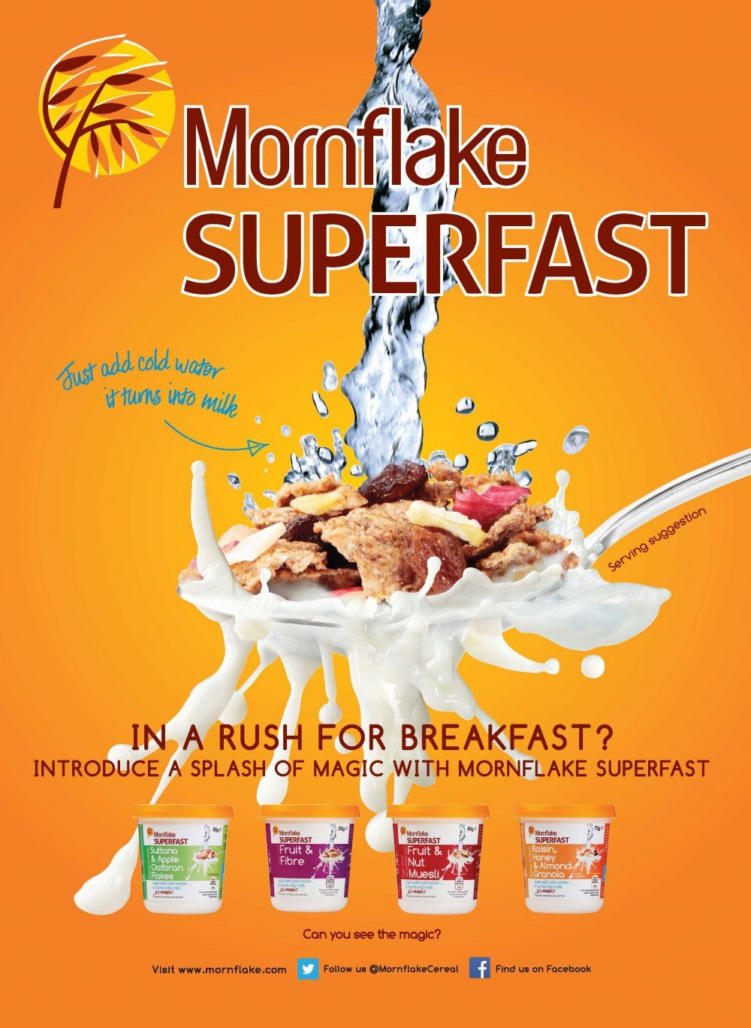
It’s selling a breakfast cereal.
They persuade you to buy it by showing a photo of the cereal so you can see what it looks like as well as by making the milk look really tasty.
They also show you the different flavours underneath.
It’s aimed at adults who are busy and don’t have time to eat breakfast at home.
Social media information so you can find out more

Slide 4
This is selling a conditioner
They list all the things in it that are good for your hair. All the things they list are natural even though there will definitely be some other chemicals in it. People tend to like natural things.
It is aimed at adult women who want to have shiny hair.
They persuade you by showing a photo of a woman with shiny hair.
They show a photo of almonds and walnuts to show just how natural it is.

Slide 5
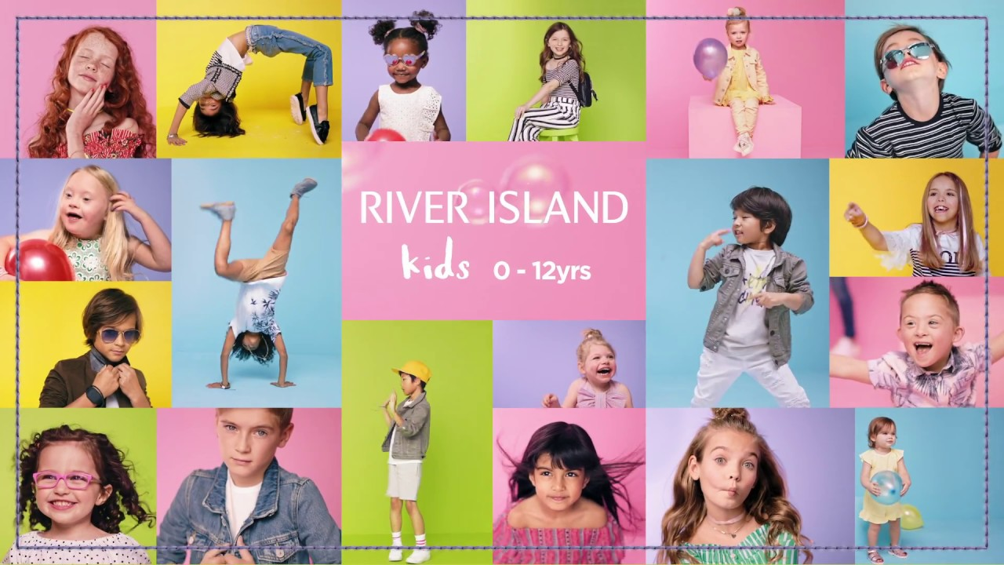
It’s aimed mainly at adults because they’re the ones who buy your clothes (and they choose them for younger children too)
It persuades by showing children having fun in their clothes. It also shows all kinds of different children so parents will think ‘Oh that’s like my child – I bet he’d like to wear that’ It’s also trying to show that the company is inclusive and suitable for everybody.
It could also be aimed at children from about your age because you might see the bright colours, the fun clothes and also that there are children on the poster just like you and then you might ask your parents to take you to River Island.

