Slide 1
History
Anglo-Saxons and Scots
Year One
History | LKS2 | Anglo-Saxons and Scots | Conversion to Christianity | Lesson 6

Slide 3
Aim
I can explain the work of some of the saints who were influenced in converting the Anglo-Saxons to Christianity and I know about some of the important Christian buildings that they founded.
Success Criteria
I can take notes and answer questions to show I understand the saints who helped to convert the Anglo-Saxons to Christianity.
I can produce my own historical guide about a famous Christian building.

Slide 4
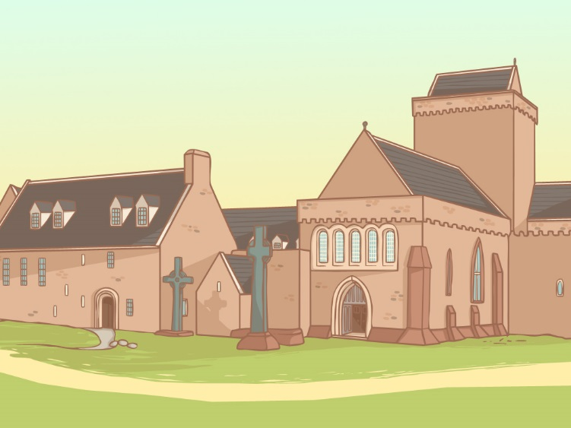
Anglo-Saxon Religion
The early Anglo-Saxons were Pagans but over the course of approximately one hundred years, they were converted to Christianity.
With your partner discuss the following questions:
What do you know about these two religions?
What are the similarities and differences?
Be ready to feedback your ideas to the rest of the class.

Slide 5
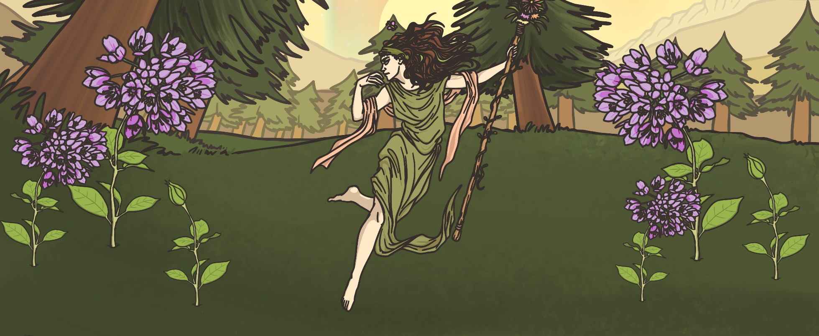
Changing Religions
When the Romans were in Britain many people had become Christians, but when the Anglo-Saxons invaded and settled, Christians only carried on in places where the Anglo-Saxons did not live.
The Anglo-Saxons brought their pagan religion with them to Britain and Christianity ceased to be the main religion.

Slide 6
Christian Mission
In 597AD, Pope Gregory the Great from Rome sent a Roman monk called Augustine (early 6th century – 604AD) to Britain to tell the Anglo-Saxons all about Christianity, and persuade them to become Christians.
Augustine arrived in Kent and set about his work. King Ethelbert, who was the king of Kent at the time, allowed him to preach to the people to teach them all about Christianity.
Augustine converted King Ethelbert of Kent to Christianity soon after his arrival. Ethelbert was baptised and became the first Anglo-Saxon Christian king.
On Christmas day 597AD, Augustine baptised 10,000 of the kings’ subjects. The mission was proving to be a great success!
Augustine was made a saint after his death in recognition of his work.

Slide 7
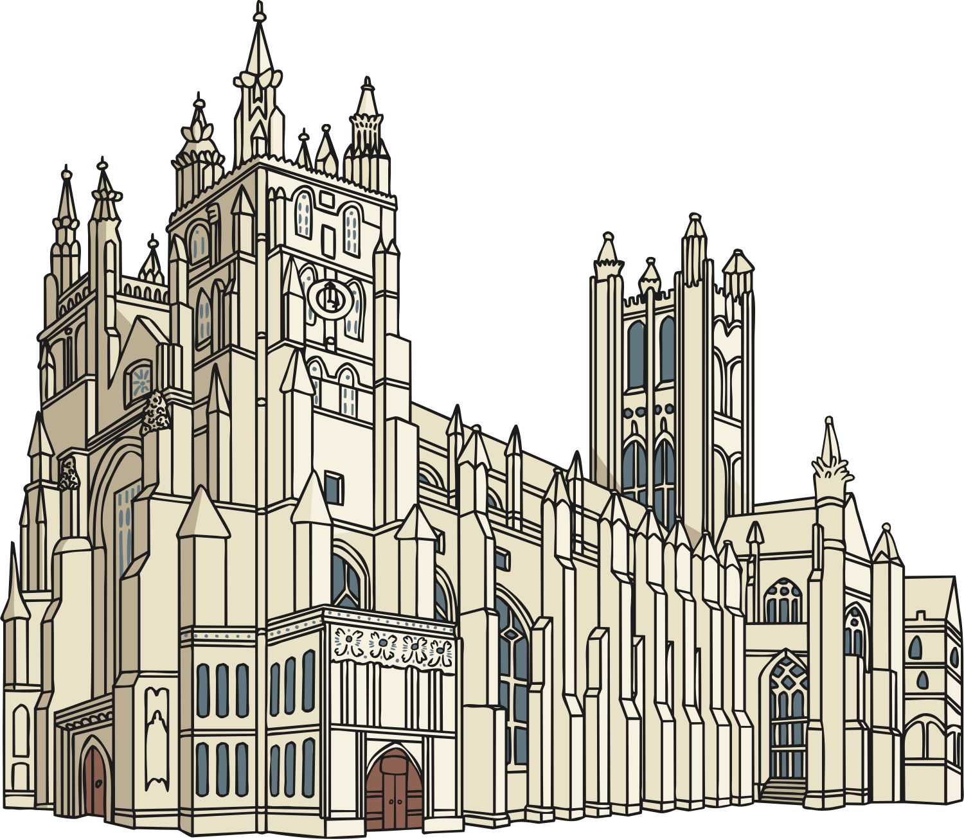
Canterbury Cathedral
Augustine founded Canterbury Cathedral and became the first Archbishop of Canterbury. The cathedral had to be rebuilt in 1070AD following a major fire. It is thought that Augustine’s original building is located under the nave of the cathedral.
Today the Archbishop of Canterbury is also the head of the Church of England and Canterbury Cathedral is one of the most important and famous Christian buildings in the world.

Slide 8
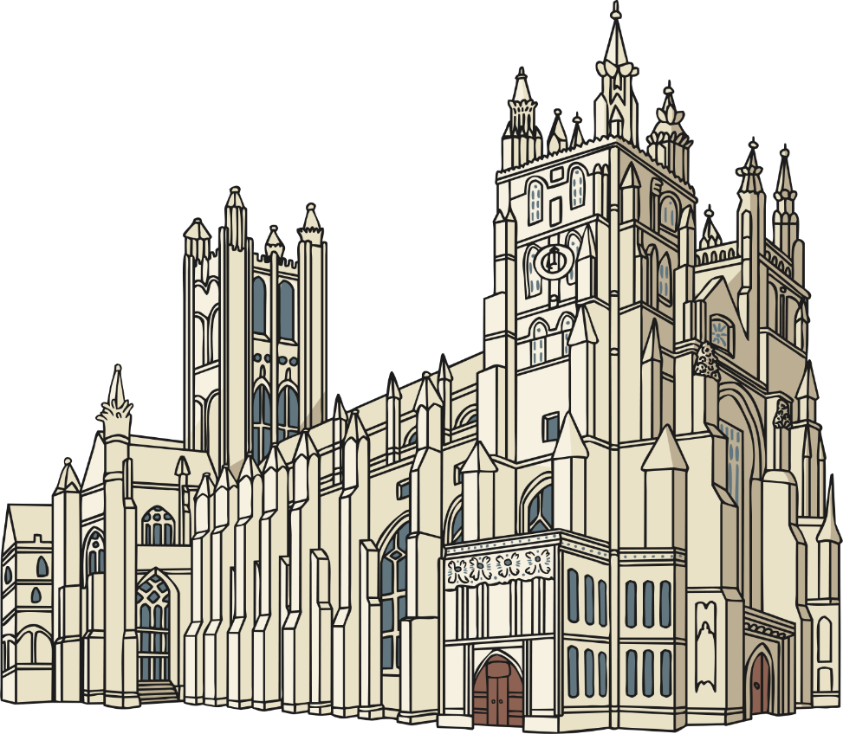
Spreading the Word
The kingdom of Kent was the first Anglo-Saxon kingdom to convert to Christianity, but over the next hundred years the rest of Britain gradually converted to Christianity too. Other missionaries spread the word about Christianity around the country and more and more people were converted to the religion.

Slide 9
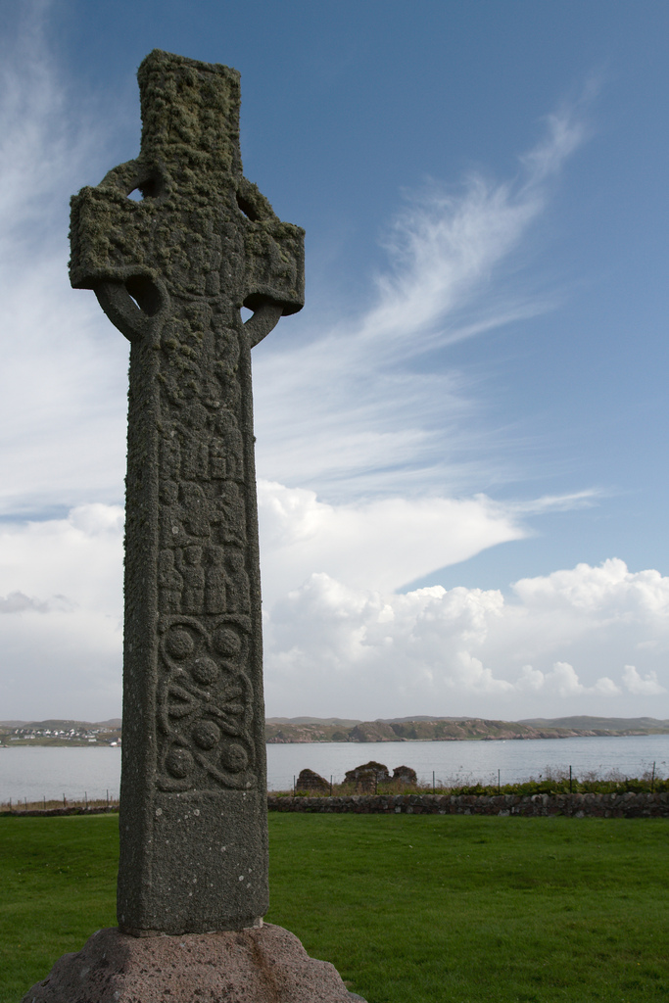
Celtic Christianity
Before St. Augustine even arrived in Britain there were places where Christianity was growing and thriving.
By the early 6th century, many Irish people were already practising the Celtic form of Christianity and there were lots of monasteries in Ireland teaching the religion.
Missionaries from Ireland were sent to Scotland and England to preach Christianity and encourage people to follow the religion.

Slide 10
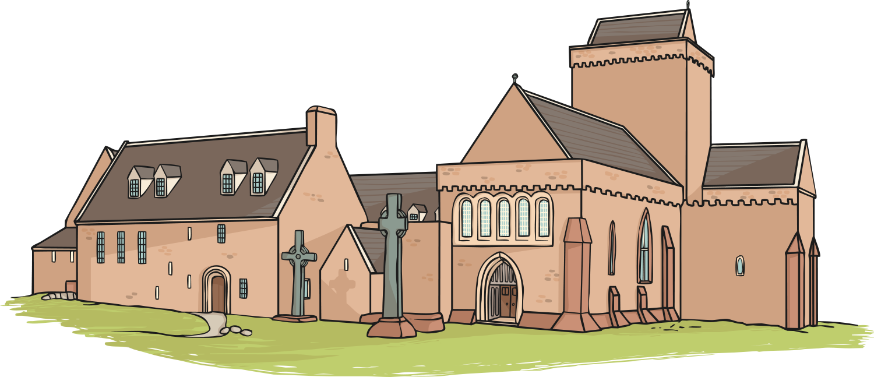
St. Columba and Iona
A famous Irish abbot (head monk from a monastery) called Columba (521AD – 597AD) was particularly successful in introducing Christianity to Scotland.
In 563AD, Columba left Ireland and founded a very important and influential abbey on the Island of Iona, just off the west coast of Scotland. Then, around 565AD, he converted the Northern Pictish King, King Bridei to Christianity.
The remains of Columba’s abbey are still visible on Iona today and Columba’s missionary work earned him the title of saint after his death in 597AD.

Slide 11
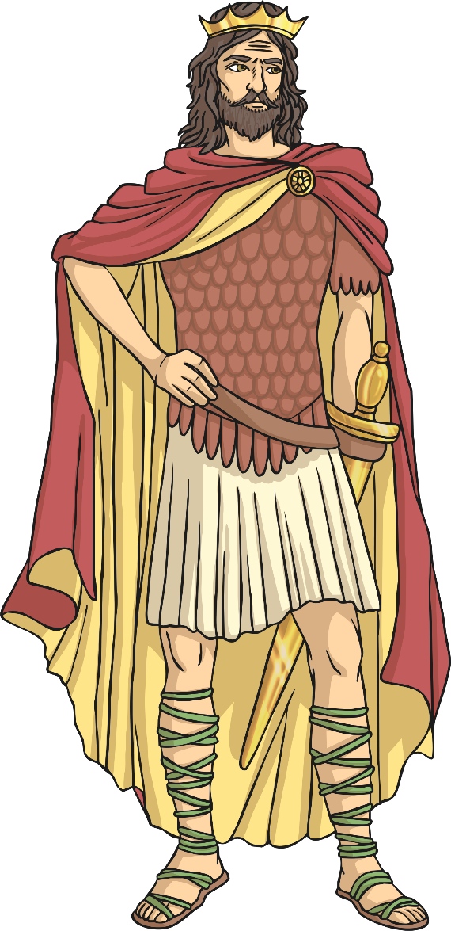
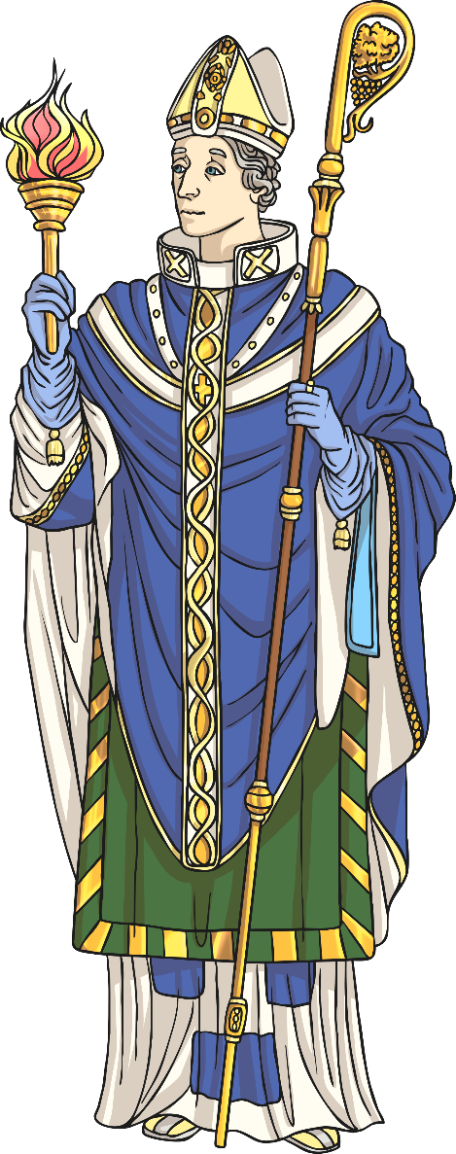
Oswald and Aiden
Oswald (born 604AD) was the King of Northumbria from 634AD until he was killed in battle in 642AD. Oswald did a lot to promote the spread of Christianity and he is regarded as a saintly king in the writings of the historian Bede.
In 635AD Oswald asked the monks at Iona to help him teach the people of Northumbria about Christianity.
A monk called Aiden (590AD – 651AD) was sent from Iona to Northumbria to help with the mission. Oswald made Aiden a bishop and gave him the island of Lindisfarne where he founded a monastery.
Oswald and Aiden are both revered as saints.

Slide 12
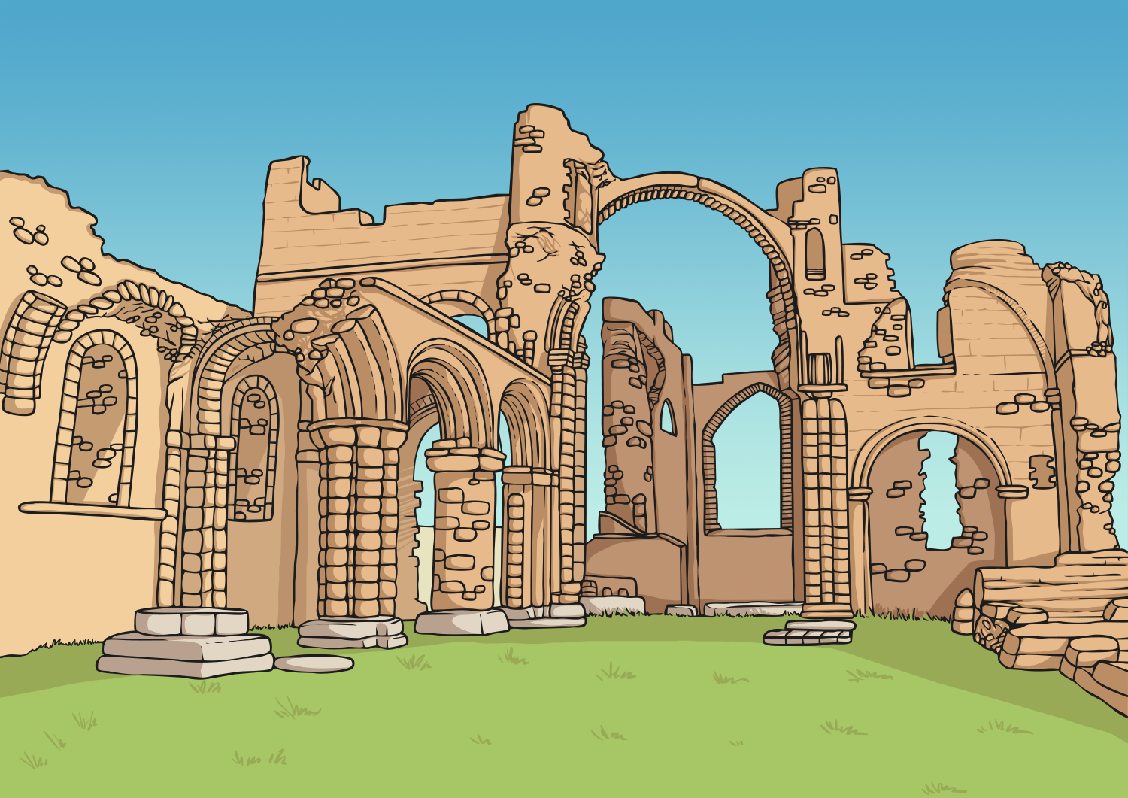
Lindisfarne Priory
Aiden established his priory on the island of Lindisfarne, which is also known as The Holy Island of Lindisfarne or just Holy Island.
Lindisfarne Priory became a very influential place. Using the priory as a base, the monks from Lindisfarne were successfully able to promote the spread of Christianity across the North of England.
Aiden worked hard to teach the people of Northumbria all about Christianity and he was known for his gentle, understanding approach with all the people he talked to.

Slide 13
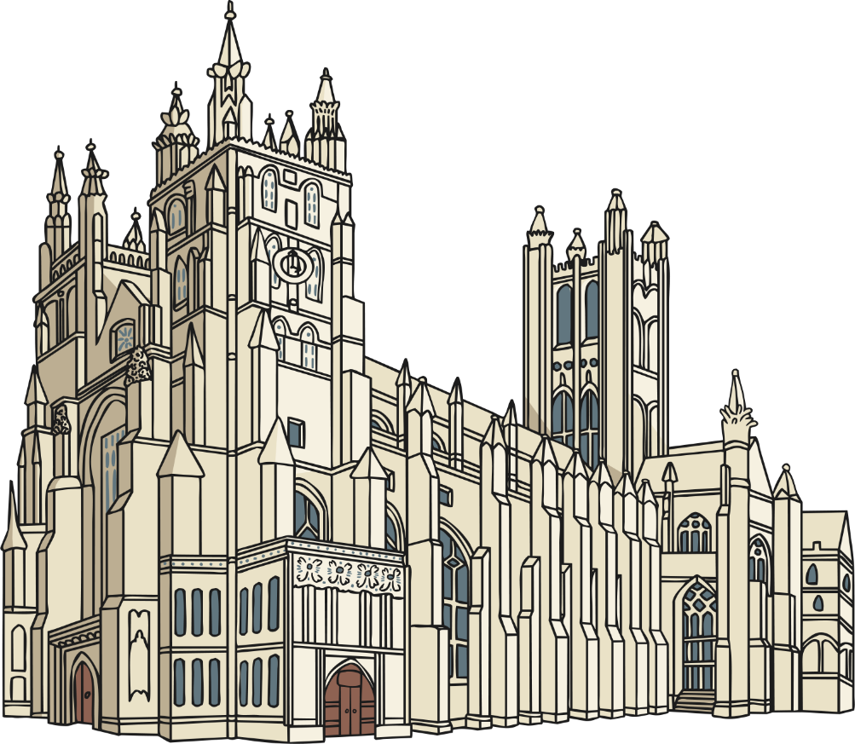
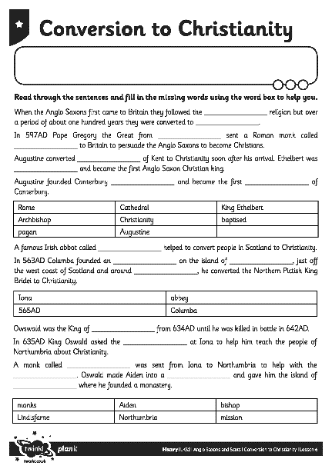
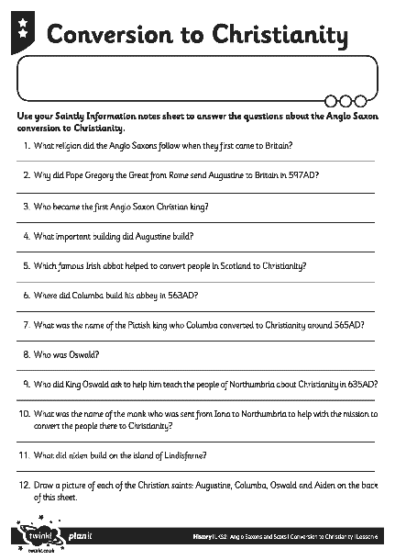
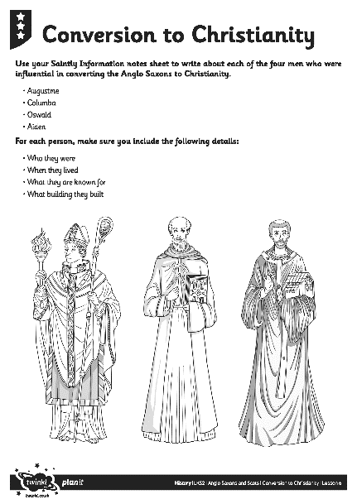
Anglo-Saxon Conversion to Christianity
Your challenge is to complete the Anglo-Saxon Conversion to Christianity Sheet to show you understand about the work of the men who were important in spreading Christianity to Britain.

Slide 14
Historical Guide
Work with a partner to research and produce a guide about one of the following places:
Canterbury Cathedral
Iona Abbey
Lindisfarne Priory
Include details about the history of the building, explaining why it was built and who lived or worked there and why it is significant in the history of Christianity. You can then go on to explain about the building as it is today and what visitors can expect to see when they visit.
Include pictures or drawings in your guide and ensure your information is presented neatly and carefully.
Be ready to present your guide to the rest of the class.

Slide 15
Aim
I can explain the work of some of the saints who were influenced in converting the Anglo-Saxons to Christianity and I know about some of the important Christian buildings that they founded.
Success Criteria
I can take notes and answer questions to show I understand the saints who helped to convert the Anglo-Saxons to Christianity.
I can produce my own historical guide about a famous Christian building.

