Slide 1
Science Morning Activities
Electricity Year 4

Slide 2
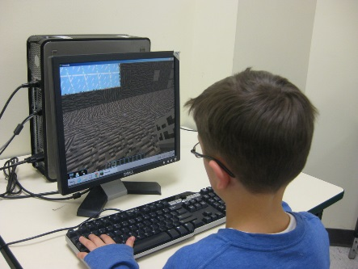
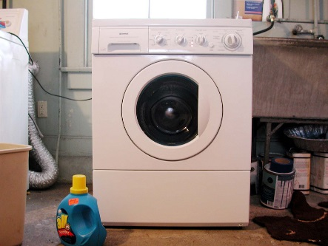
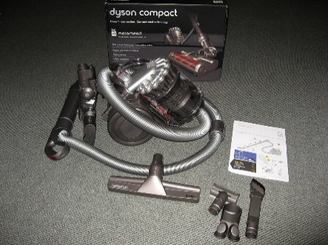
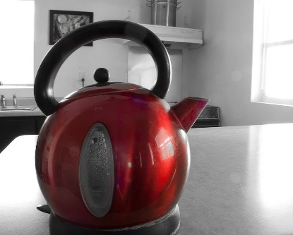
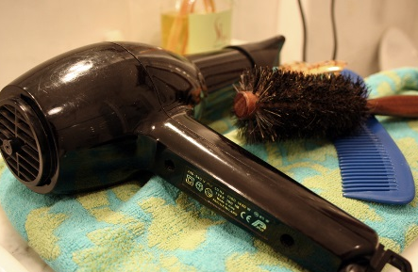
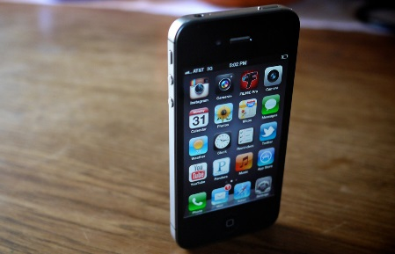
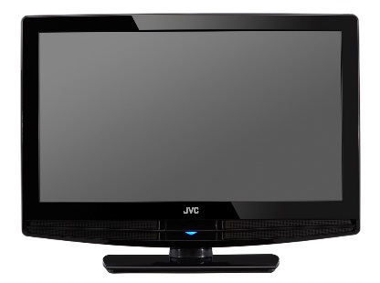
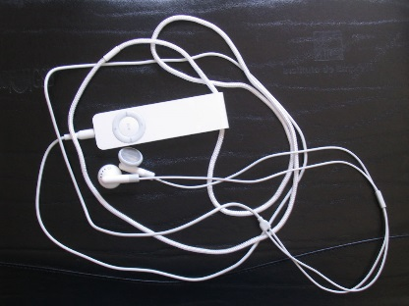
Important Inventions
Look at the different home equipment here. None of these appliances can work without electricity to power or charge them.
Rank the items in order of the most important to the least important in your home.
computer
kettle
washing machine
hoover
mobile phone
television
hairdryer
MP3 player
Challenge: How did you choose the two most important items?
Photo courtesy of Lestyn Lloyd @flickr.com) - granted under creative commons licence - attribution
Photo courtesy of kjarrett, Editor B, Michael.aulia, Steve A Johnson, sunshinecity, MattsMacintosh, JVC America and edans (@flickr.com) granted under creative commons licence attribution

Slide 3
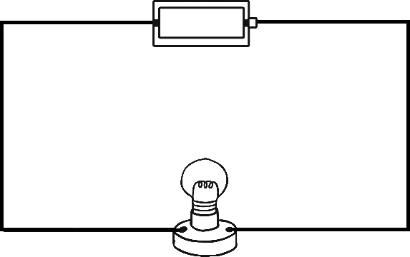
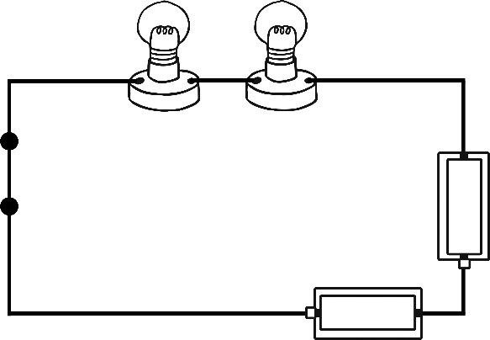
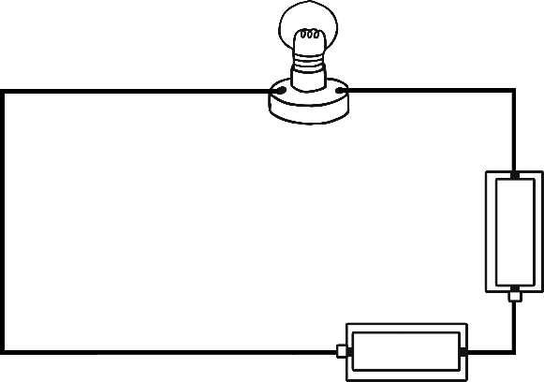
Complete Circuits
Can you draw some more complete circuits using these components?
Cell, bulb, motor
2 cells, bulb
A piece of aluminium foil, a cell, a bulb
cell
1
bulb
bulb
closed switch
bulb
2
cell
Challenge:
Circuit 1 is very similar to circuit 3.
Circuit 3 has 2 cells instead of 1.
What impact will the extra cell have?
Write a sentence that describes what happens when more cells are added to a circuit.
bulb
cell
3
cell
cell
Photo courtesy of Lestyn Lloyd @flickr.com) - granted under creative commons licence - attribution
Photo courtesy of kjarrett, Editor B, Michael.aulia, Steve A Johnson, sunshinecity, MattsMacintosh, JVC America and edans (@flickr.com) granted under creative commons licence attribution

Slide 4
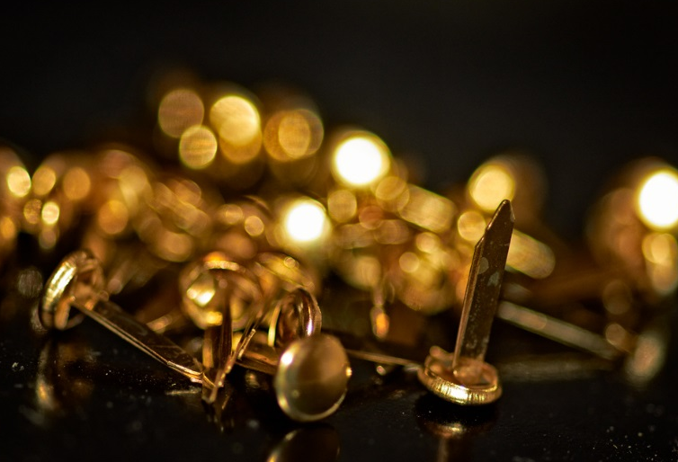
The Experiment
A group of children are given a selection of equipment. They must make a complete circuit to light the bulb.
This is the equipment they were given:
Draw a complete circuit using all of this equipment. Use the split pins and paper clip to make a switch.
Draw the circuit again showing the switch in the ‘off’ position.
wires
a bulb
a paperclip
2 split pins
a cell
split pins
Challenge:
The paper clip is replaced with a plastic hair clip. What happens?
Photo courtesy of Darren Wilkin (@flickr.com) granted under creative commons licence attribution

Slide 5
It is impossible to live without electricity.
Agree or disagree?
Consider how people used to live a few hundred years ago.
Think about your favourite ways to have fun.
Think about important jobs around the home that do or do not need electricity.
Starter: Which electrical items did you use this morning? Make a list.

