Slide 1
Have a look at the posters in this PowerPoint
Think about the following questions whilst you’re looking. When you think you have thought of everything, click to see what I thought.
Who is this poster aimed at?
What are the features of the Poster that would make you want to go and see the film?
3. Do you think it would be an effective advert? (would it actually make you want to see the film?)

Slide 2
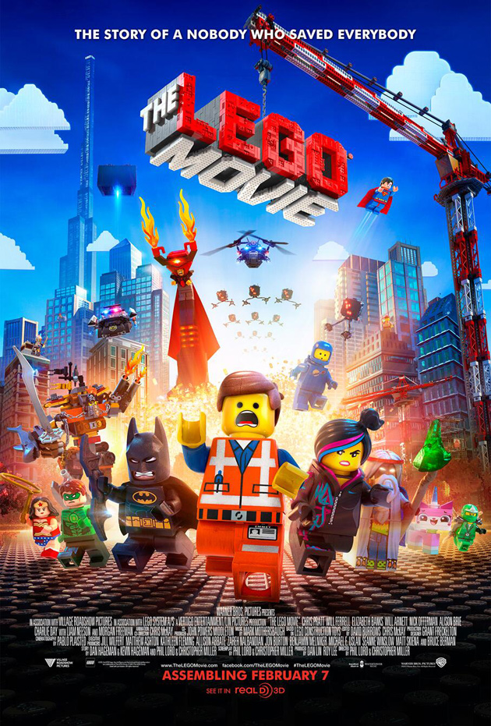
The baddies look kind of funny so you can tell it’s going to be a comedy film rather than scary.
But the people running away look scared so it will still be action-packed.
It’s clearly about Lego so it will appeal to anyone who likes Lego.
You can’t really see it but down here it tells you some of the actors in the film so if you like a certain actor that might make you want to see the film. (Also, really famous actors usually only choose to be in films they think are going to be good).
It’s going to be in 3D which appeals to lots of people.

Slide 3
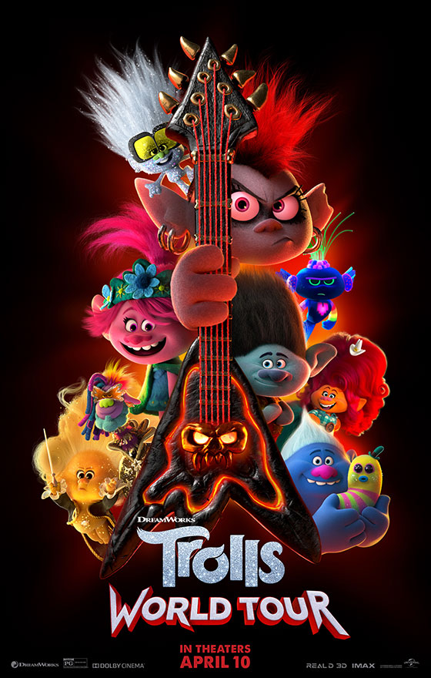
The baddie has a guitar and it’s called World Tour so the film is probably going to have lots of songs in it. Lots of people like musical films.
This is a sequel so if you liked the first Trolls film, you can see that some of your favourite characters are back which might make you want to see it.
It tells you the studio that made it (Dreamworks) They make a lot of films so if you like them, you’ll probably like this too.
It gives you the date it will be out so you can remember it.
This film is in 3D too and you can see it on IMAX.

Slide 4
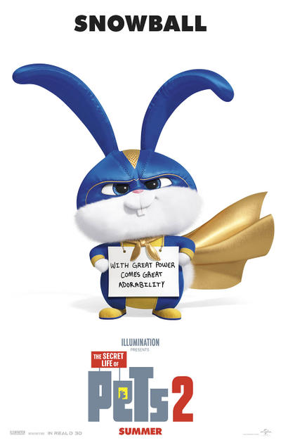
It’s a sequel so you can see that Snowball is back in it if you liked him in the first film.
It’s a rabbit in a superhero costume so you can tell the film will be funny
He’s got a funny saying on the sign he’s wearing.
It’s got the name of the studio again (Illumination) they make the Despicable Me films so if you like them, you’ll like this.
It tells you when it’s going to be out again.

