Slide 2
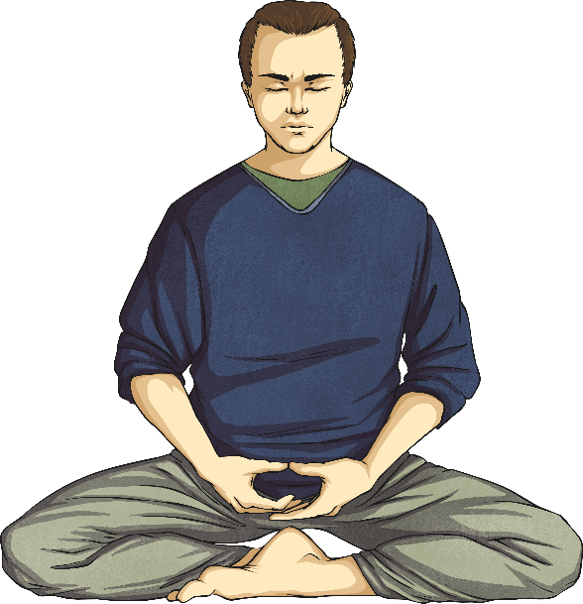
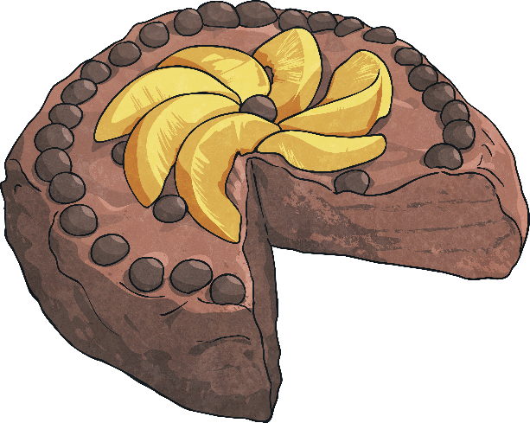
What Is a Homophone?
A homophone is a word that sounds the same as another word, but its spelling or meaning is different.
piece
peace
I just want one piece of cake.
I just want some peace and quiet.

Slide 3
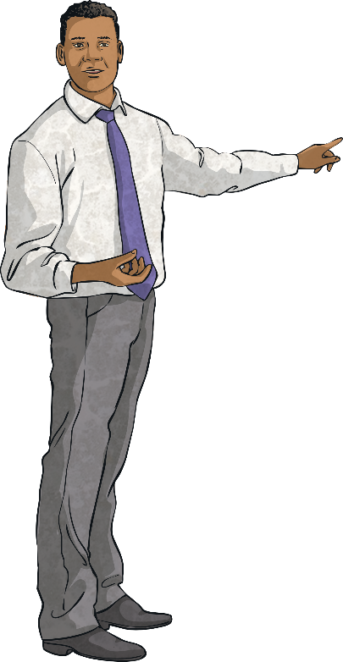
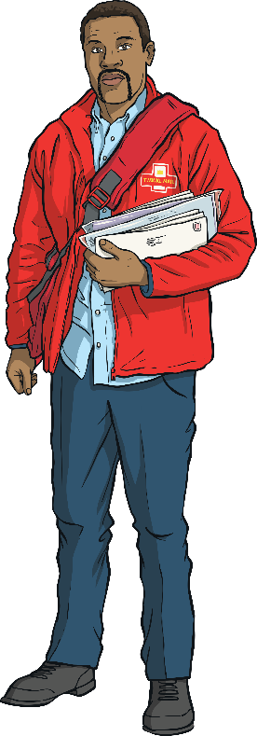
What Is a Homophone?
Here is another example:
male
mail
We have a new male teacher.
The postman delivered the mail.

Slide 4
Pears or Pairs?
Use your memory skills to uncover these pairs of homophones. Do you know the difference in their meanings?
peace
heel
here
mist
fare
main
?
?
?
?
?
?
heal
mane
piece
hear
fair
missed
?
?
?
?
?
?
peace
heel
here
mist
fare
main

Slide 5
Homophones Quick Quiz
Take a quiz to see if you are an expert!
Which homophone is the correct word to complete this sentence?
coming to my party?
whose
Who’s
You’re correct. Well done!

Slide 6
Homophones Quick Quiz
Take a quiz to see if you are an expert!
Which homophone is the correct word to complete this sentence?
I’m still waiting for the to be delivered.
mail
male
You’re correct. Well done!

Slide 7
Homophones Quick Quiz
Take a quiz to see if you are an expert!
Which homophone is the correct word to complete this sentence?
Tie a in the rope.
not
knot
You’re correct. Well done!

Slide 8
Homophones Quick Quiz
Take a quiz to see if you are an expert!
Which homophone is the correct word to complete this sentence?
It isn’t if you get another turn.
fare
fair
You’re correct. Well done!

Slide 9
Homophones Quick Quiz
Take a quiz to see if you are an expert!
Which homophone is the correct word to complete this sentence?
“All I want is a bit of and quiet!” screamed Mum.
piece
peace
You’re correct. Well done!

