Slide 2
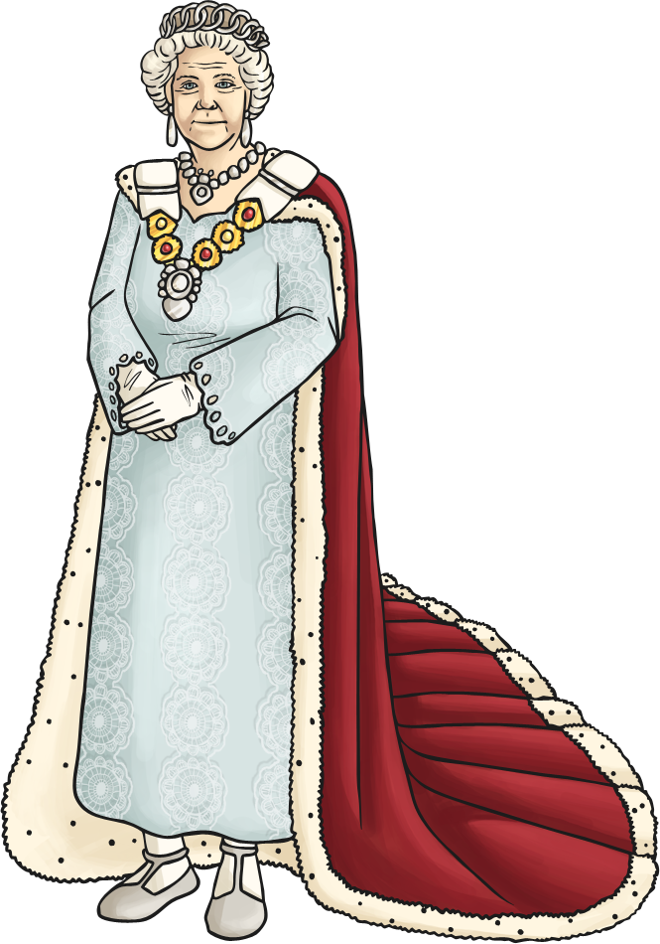
What is a determiner?
Determiners are words that come before a noun.
They introduce the noun and can give the reader important information about it.
the
my
Determiners
Queen
a

Slide 3
Specific Determiners
These refer to a specific noun. Use specific determiners when the reader knows exactly what noun you are referring to.
definite article
possessive determiners
the
this
her
his
those
those
that
our
my
which
these
their
interrogative determiner
demonstrative determiners
your

Slide 4
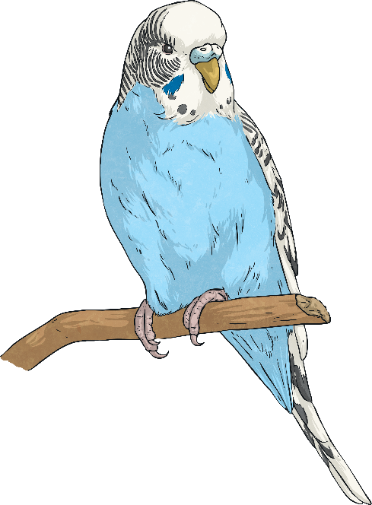

Specific Determiners in Action
Use specific determiners when the reader knows exactly what noun you are referring to.
Your pet budgie is smiling at me.
Which film did you go and see?

Slide 5
General Determiners
These refer to general nouns or nouns that the reader does not know. General determiners can also tell the reader how many nouns you are talking about, these are called quantifiers.
quantifiers
a
any
few
other
some
five
any
an
another
what
more
many
indefinite article
less

Slide 6
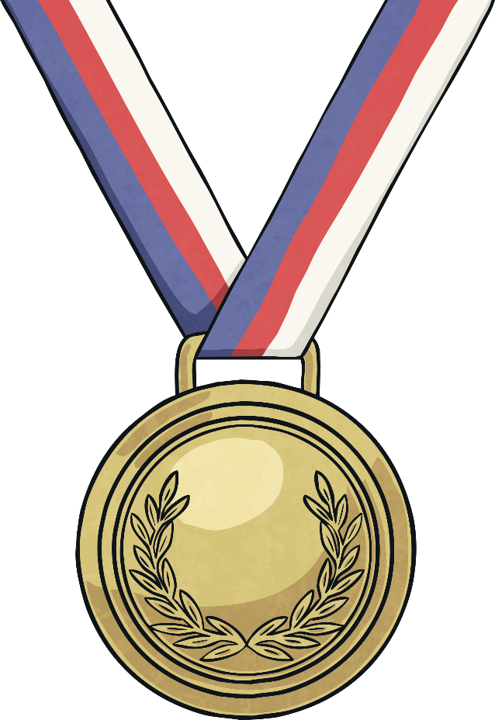

Challenge
Complete this sentence using a specific determiner:
Olympic medal was really hard to obtain.
Complete this sentence using a general determiner:
ice cream costs two pounds.

Slide 7
Determiners and Adjectives
Adjectives (describing words) can be used after determiners to describe the noun further.
That cute kitten is so tiny.
Determiner
Noun
What adjectives could you use to complete these sentences?
Adjective
Many talented children go to the after-school club.
Many talented children go to the after-school club.
The last house belongs to my friend.
The last house belongs to my friend.

Slide 8
Determiners and Pronouns
A pronoun replaces a noun. This avoids repeating the noun over and over again. Some pronouns are also determiners because they give extra information about a noun.
The boy took off his coat because he was too hot.
Some pronouns are close but not exactly the same as determiners.
This is my sandwich.
That sandwich is mine.
Determiner
Pronoun
That is your car.
That car is yours.

Slide 9
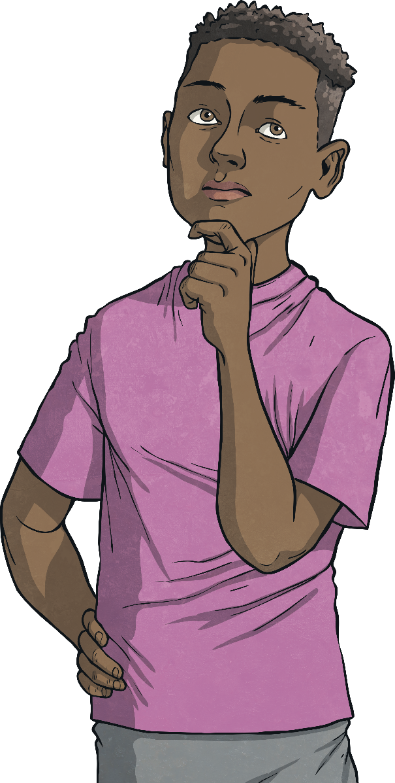
Challenge
Can you identify the determiners in these sentences?
The hoop rolled down the road.
Whose socks are these?
The river is just beyond those trees.
Five seagulls landed on the beach.
Any computers must be turned off.

Slide 10

Challenge
Can you identify the determiners in these sentences?
The hoop rolled down the road.
Whose socks are these?
The river is just beyond those trees.
Five seagulls landed on the beach.
Any computers must be turned off.

